Slide 1
Accounting Principles
Thirteenth Edition
Weygandt Kimmel Kieso
Chapter 8
Fraud, Internal Control,
and Cash

Slide 2
Chapter Outline
Learning Objectives
LO 1 Define fraud and the principles of internal control.
LO 2 Apply internal control principles to cash.
LO 3 Identify the control features of a bank account.
LO 4 Explain the reporting of cash.

Slide 3
Fraud
Dishonest act by an employee that results in personal benefit to the employee at a cost to the employer.
Opportunity
Three factors that contribute to fraudulent activity.
ILLUSTRATION 8.1
Fraud triangle
Financial Pressure
Rationalization
LO 1

Slide 4
The Sarbanes-Oxley Act
Applies to publicly traded U.S. corporations
Required to maintain a system of internal control
Corporate executives and boards of directors must ensure that these controls are reliable and effective
Independent outside auditors must attest to the adequacy of the internal control system
SOX created the Public Company Accounting Oversight Board (PCAOB)
LO 1

Slide 5
Internal Control
Purposes of internal control:
Safeguard assets.
Enhance the reliability of accounting records.
Increase efficiency of operations.
Ensure compliance with laws and regulations.
LO 1

Slide 6
Internal Control
Five Primary Components:
A control environment
Risk assessment
Control activities
Information and communication
Monitoring
LO 1

Slide 7
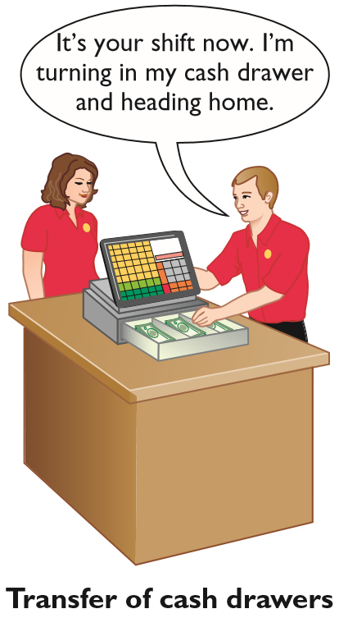
Principles of Internal Control Activities
Establishment of Responsibility
Control is most effective when only one person is responsible for a given task
Establishing responsibility often requires limiting access only to authorized personnel, and then identifying those personnel
LO 1

Slide 8
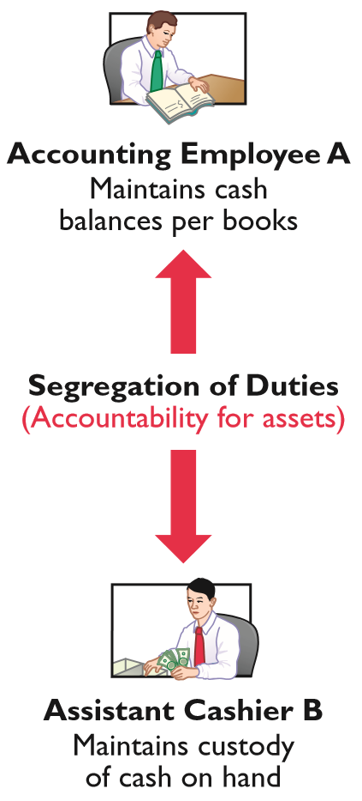
Principles of Internal Control Activities
Segregation of Duties
Different individuals should be responsible for related activities
Responsibility for record-keeping for an asset should be separate from physical custody of that asset
LO 1

Slide 9
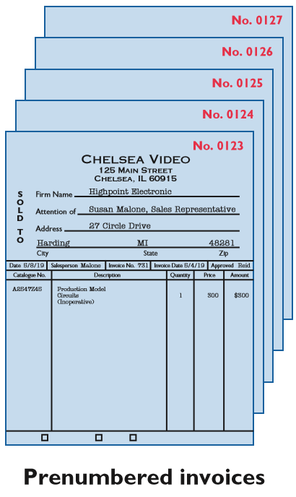
Principles of Internal Control Activities
Documentation Procedures
Companies should use prenumbered documents, and all documents should be accounted for
Employees should promptly forward source documents for accounting entries to the accounting department
LO 1

Slide 10
Principles of Internal Control Activities
Physical Controls
Safes, vaults, and safety deposit boxes
Locked warehouses and storage cabinets
Computer facilities with passkey access or fingerprint or eyeball scans
Alarms to prevent break-ins
Television monitors and garment sensors
Time clocks for recording time worked
LO 1

Slide 11
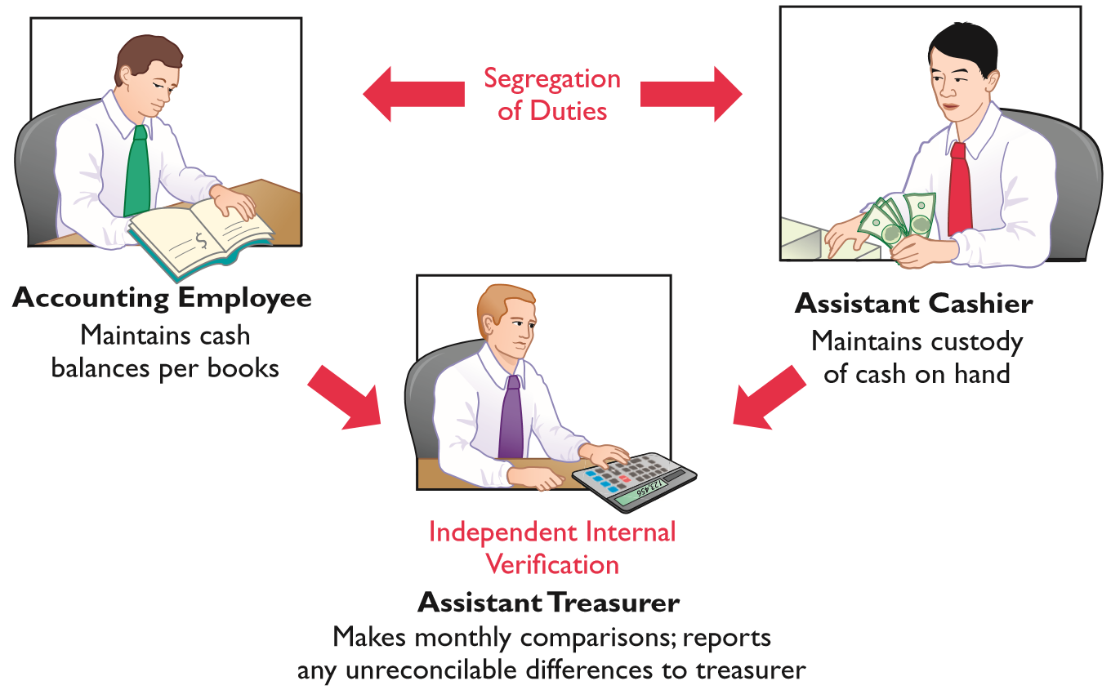
Principles of Internal Control Activities
Independent Internal Verification
Records periodically verified by an employee
who is independent
Discrepancies
reported to
management
ILLUSTRATION 8.3
Comparison of segregation of duties principle with independent internal
verification principle
LO 1

Slide 12
Total take: $275,000
The Missing Control
Independent internal verification. Bobbi Jean’s boss should have verified her expense reports. When asked what he thought her expenses for a year were, the boss said about $10,000. At $115,000 per year, her actual expenses were more than 10 times what would have been expected. However, because he was “too busy” to verify her expense reports or to review the budget, he never noticed.
LO 1

Slide 13
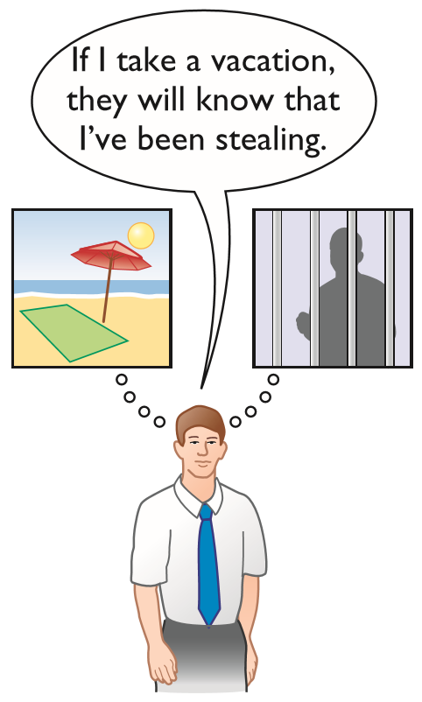
Principles of Internal Control Activities
Human Resource Controls
Bond employees who
handle cash
Rotate employees’ duties
and require vacations
Conduct background checks
LO 1

Slide 14
Limitations of Internal Control
Costs should not exceed benefit
Human element
Size of the business
Helpful Hint
Controls may vary with the risk level of the activity. For example, management may consider cash to be high risk and maintaining inventories in the stockroom as low risk. Thus, management would have stricter controls for cash.
LO 1

Slide 15
DO IT! 1 Control Activities
Identify which control activity is violated and explain how the situation creates an opportunity for a fraud.
The person with primary responsibility for reconciling the bank account and making all bank deposits is also the company’s accountant.
Solution
Violates the control activity of segregation of duties
Recordkeeping should be separate from physical custody
Employee could embezzle cash and make journal entries to hide the theft
LO 1

Slide 16
DO IT! 1 Control Activities
Identify which control activity is and explain how the situation creates an opportunity for a fraud.
Wellstone Company’s treasurer received an award for distinguished service because he had not taken a vacation in 30 years.
Solution
Violates the control activity of human resource controls
Key employees must take vacations
Treasurer, who manages the company’s cash, might embezzle cash and use his position to conceal the theft
LO 1

Slide 17
DO IT! 1 Control Activities
Identify which control activity is violated and explain how the situation creates an opportunity for a fraud.
A local restaurant does not buy prenumbered order slips.
Solution
Violates the control activity of documentation procedures
If prenumbered documents are not used, then it is virtually impossible to account for the documents
An employee could write up a dinner sale, receive cash from the customer, and then throw away the order slip and keep the cash.
LO 1

Slide 18
Cash Controls
Cash Receipts Controls
Establishment of Responsibility:
Only designated personnel are authorized to handle cash receipts
Segregation of Duties: Different individuals
Receive cash
Record cash receipts
Hold cash
LO 2

Slide 19
Cash Controls
Cash Receipts Controls
Documentation Procedures: Use
Remittance advice (mail receipts)
Cash register tapes or computer records
Deposit slips
Physical Controls
Store cash in safes and bank vaults
Limit access to storage areas
Use cash registers or point-of-sale terminals
LO 2

Slide 20
Cash Controls
Cash Receipts Controls
Independent Internal Verification
Supervisors count cash receipts daily
Assistant treasurer compares total receipts to bank deposits daily
Human Resource Controls
Bond personnel who handle cash
Require employees to take vacations
Conduct background checks
LO 2

Slide 21
Over-the-Counter Receipts
ILLUSTRATION 8.5
Control of over-the-counter receipts
Cash Receipts Controls
Clerk Enters sales, counts cash |  | Supervisor Removes locked cash register tape
Sends cash and count to cashier |  | Sends cash register tape to accounting dept.
Cashier Counts cash, prepares deposit slips | Sends deposit slip copy to accounting dept. | Accounting Department Agrees register tape to deposit slip and records journal entry
Delivers cash and deposit slip to bank |  | Bank
LO 2

Slide 22
Cash Receipts Controls
Mail Receipts
Mail receipts should be opened by two clerks, a list prepared, each check endorsed “For Deposit Only”
Each clerk signs the list to establish responsibility
Original copy of list, along with checks, is sent to cashier’s department
Copy of list is sent to accounting department for recording. Clerks also keep a copy.
LO 2

Slide 23
Cash Receipts Controls
Permitting only designated personnel to handle cash receipts is an application of the principle of:
segregation of duties
establishment of responsibility
independent internal verification
human resource controls
LO 2

Slide 24
Cash Disbursement Controls
Generally, internal control over cash disbursements is more effective when companies pay by check or electronic funds transfer (EFT) rather than by cash.
One exception is payments for incidental amounts that are paid out of petty cash.
LO 2

Slide 25
Cash Controls
Cash Disbursements Controls
Establishment of Responsibility
Only designated personnel are authorized to sign checks (treasurer) and approve vendors
Segregation of Duties
Different individuals approve and make payments
Check-signers do not record disbursements
LO 2

Slide 26
Cash Controls
Cash Disbursements Controls
Documentation Procedures
Use prenumbered checks and account for sequence
Each check must have an approved invoice
Require employees to use corporate credit cards for reimbursable expenses
Stamp invoices “paid”
LO 2

Slide 27
Cash Controls
Cash Disbursements Controls
Physical Controls
Store blank checks in safes, with limited access
Print check amounts by machine in indelible ink
Independent Internal Verification
Compare checks to invoices
Reconcile bank statement monthly
LO 2

Slide 28
Cash Controls
Cash Disbursements Controls
Human Resource Controls:
Bond personnel who handle cash
Require employees to take vacations
Conduct background checks
LO 2

Slide 29
Cash Disbursements Controls
The use of prenumbered checks in disbursing cash is an application of the principle of:
establishment of responsibility
segregation of duties
physical controls
documentation procedures
LO 2

Slide 30
Cash Disbursement Controls
Voucher System Controls
A network of approvals by authorized individuals, acting independently, to ensure all disbursements by check are proper
A voucher is an authorization form prepared for each expenditure in a voucher system
LO 2

Slide 31
Petty Cash Fund
Petty Cash Fund - Used to pay small amounts.
Involves:
establishing the fund
making payments from the fund
replenishing the fund
LO 2

Slide 32
Petty Cash Fund
Establishing the Petty Cash Fund
Illustration: If Laird Company decides to establish a $100 fund on March 1, the general journal entry is:
Mar. 1 Petty Cash 100
Cash 100
LO 2

Slide 33
Petty Cash Fund
Replenishing the Petty Cash Fund
Illustration: On March 15 Laird’s petty cash custodian requests a check for $87. The fund contains $13 cash and petty cash receipts for postage $44, freight-out $38, and miscellaneous expenses $5. The journal entry is:
Mar. 15 Postage Expense 44
Freight-Out 38
Miscellaneous Expense 5
Cash 87
LO 2

Slide 34
Petty Cash Fund
Replenishing the Petty Cash Fund
Illustration: Assume in the preceding example that the custodian had only $12 in cash in the fund plus the receipts as listed. The request for reimbursement would therefore be for $88, and Laird would make the following entry.
Mar. 15 Postage Expense 44
Freight-Out 38
Miscellaneous Expense 5
Cash Over and Short 1
Cash 88
LO 2

Slide 35
DO IT! 2b Petty Cash Fund
Bateer Company established a $50 petty cash fund on July 1. On July 30, the fund had $12 cash remaining and petty cash receipts for postage $14, office supplies $10, and delivery expense $15. Prepare journal entries on July 1 and on July 30.
July 1 Petty Cash 50
Cash 50
July 30 Postage Expense 14
Supplies 10
Delivery Expense 15
Cash Over and Short 1
Cash 38
LO 2

Slide 36
Control Features of a Bank Account
The use of a bank contributes significantly to good internal control over cash.
Minimizes the amount of currency on hand
Creates a double record of bank transactions
Bank reconciliation
LO 3

Slide 37
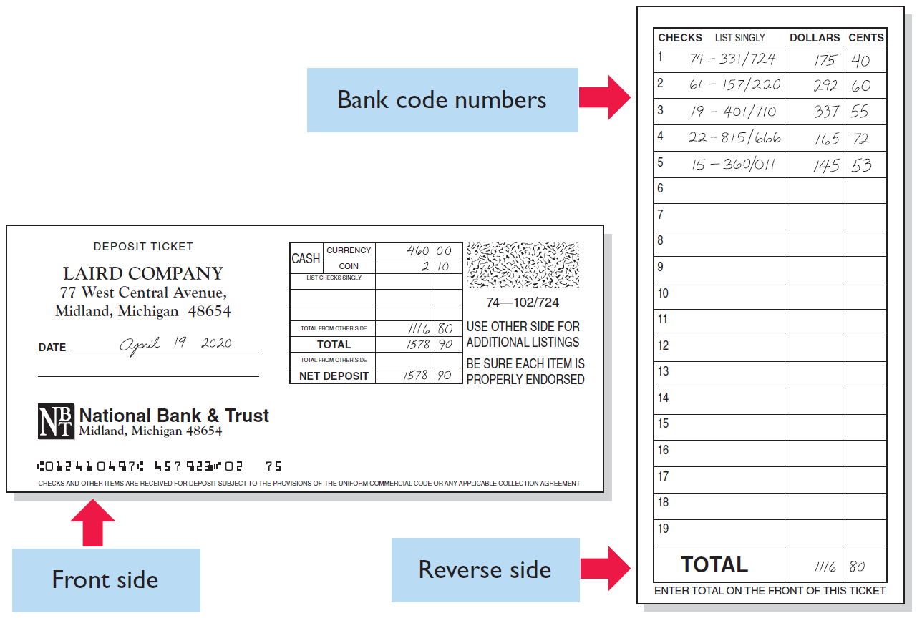
Making Bank Deposits
Authorized employee should make deposit.
LO 3
ILLUSTRATION 8.8

Slide 38
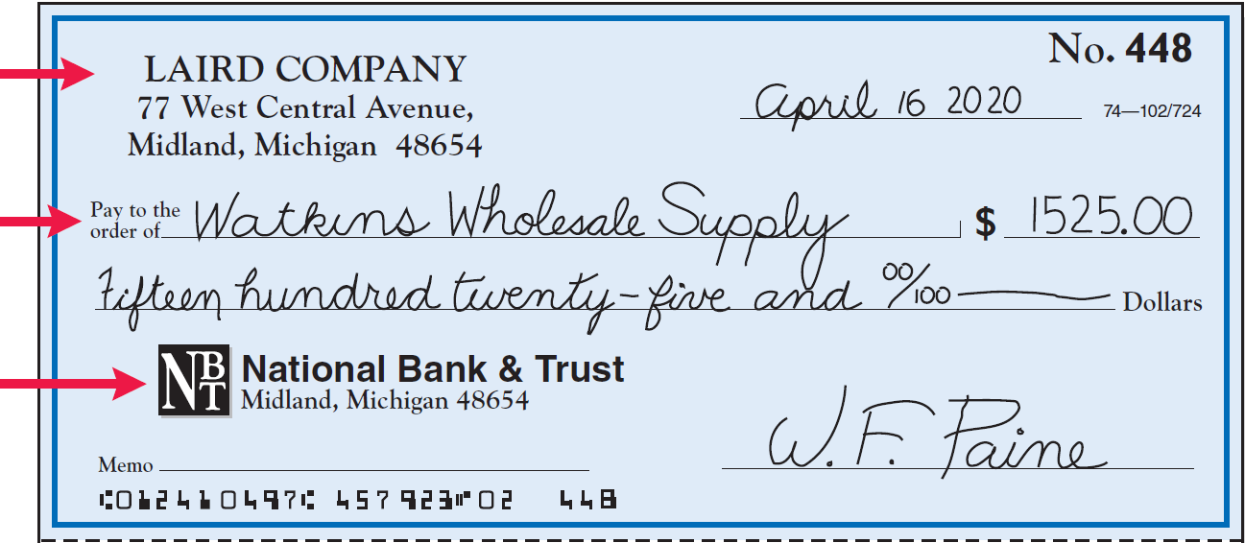
Writing Checks
Written order signed by depositor directing bank to pay a specified sum of money to a designated recipient.
Maker
Payee
Payer
ILLUSTRATION 8.9
Check with remittance advice
LO 3

Slide 39
Electronic Funds Transfer (EFT) System
Disbursement systems that use wire, telephone, or computers to transfer cash from one location to another
Use is quite common
EFT transactions normally result in better internal control since no cash or checks are handled by company employees
LO 3

Slide 40
Bank Statements
Prepared from bank’s perspective
Every deposit bank receives is an increase in bank’s liabilities (an account payable to the depositor)
Lists in numerical sequence all paid checks along with date check was paid and its amount
Bank includes with bank statement memoranda explaining other debits and credits it made to depositor’s account
A check that is not paid by a bank because of insufficient funds in a bank account is called an NSF check (not sufficient funds)
LO 3

Slide 41
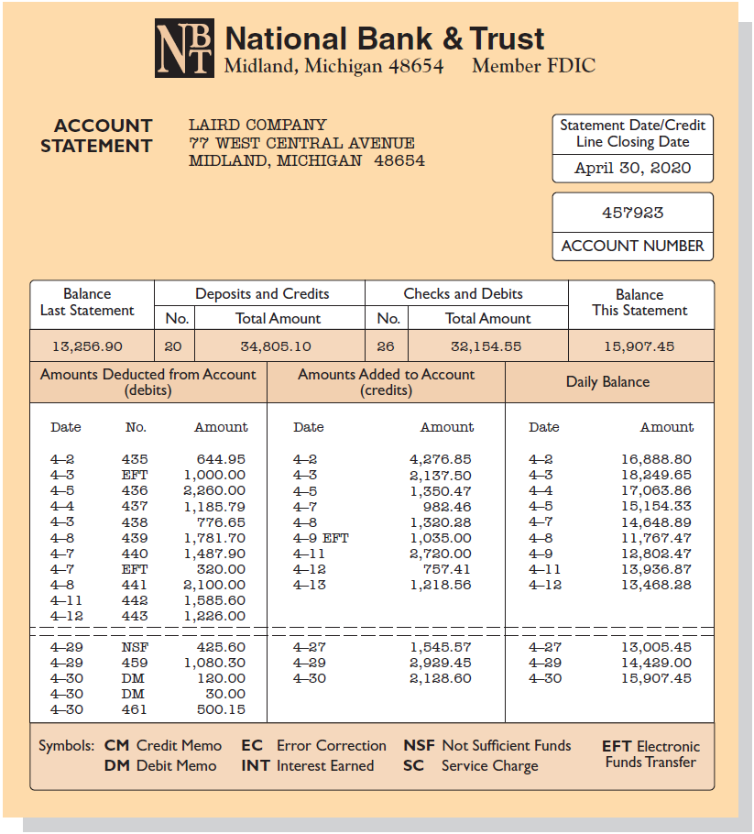
Bank Statements
ILLUSTRATION 8.10
Bank statement
LO 3

Slide 42
Cash Disbursements Controls
The control features of a bank account do not include:
having bank auditors verify the correctness of the bank balance per books
minimizing the amount of cash that must be kept on hand
providing a double record of all bank transactions
safeguarding cash by using a bank as a depository
LO 3

Slide 43
Reconciling the Bank Account
Reconcile balance per books and balance per bank to their “correct” or “true” balance.
Reconciling Items:
Deposits in transit
Outstanding checks
Bank memorandum
Errors
Time Lags
LO 3

Slide 44
Reconciling the Bank Account
Reconciliation Procedure
Cash Balance Per Bank |  |  | Cash Balance Per Books
+ | Deposits in transit |  | + | EFT collections and other deposits
- | Outstanding checks
+/- | Bank errors |  | - | NSF (bounced) checks
 |  |  | - | Service charges and other Payments
 |  |  | +/- | Company errors
Corrected Balance |  |  | Corrected Balance
LO 3

Slide 45
Bank Reconciliation Illustrated
Illustration 8.10 presented the bank statement for Laird Company which the company accessed online. It shows a balance per bank of $15,907.45 on April 30, 2020. On this date the balance of cash per books is $11,709.45. From the foregoing steps, Laird determines the following reconciling items for the bank.
Step 1. Deposits in transit (+): April 30 deposit
(received by bank on May 1). $2,201.40
Step 2. Outstanding checks (−): No. 453, $3,000.00;
No. 457, $1,401.30; No. 460, $1,502.70. 5,904.00
Step 3. Bank errors (+/−): None.
Reconciling items per books are as follows:
LO 3

Slide 46
Reconciling items per books are as follows:
Step 1. Other deposits (+): Unrecorded electronic
receipt from customer on account on April 9
determined from the bank statement. $1,035.00
Step 2. Other payments (−): The electronic payments
on April 3 and 7 were previously recorded by the
company when they were initiated. Unrecorded charges
determined from the bank statement are as follows:
Returned NSF check on April 29 425.60
Debit and credit card fees on April 30 120.00
Bank service charges on April 30 30.00
Step 3. Company errors (+): Check No. 443 was correctly
written by Laird for $1,226 and was correctly paid by the
bank on April 12. However, it was recorded as $1,262 on
Laird’s books. 36.00
LO 3

Slide 47
Bank Reconciliation April 30, 2020
Cash balance per bank statement |  |  |  | $15,907.45
Add: | Deposits in transit |  |  | 2,201.40
Less: | Outstanding checks
 | No. 453 | $3,000.00
 | No. 457 | 1,401.30
 | No. 460 | 1,502.70 |  | 5,904.00
Adjusted cash balance per bank |  |  |  | $12,204.85
Cash balance per books |  |  |  | $11,709.45
Add: | Electronic funds transfer received | 1,035.00
 | Error in recording check No. 443 | 36.00 |  | 1,071.00
Less: | NSF check | 425.60
 | Debit and credit card fees | 120.00
 | Bank service charge | 30.00 |  | 575.60
Adjusted cash balance per books |  |  |  | $12,204.85
LO 3

Slide 48
Entries for Bank Reconciliation
Collection of Electronic Funds Transfer: A payment of an account by a customer is recorded in the same way, whether the cash is received through the mail or electronically. The entry is as follows.
Apr. 30 Cash 1,035.00
Accounts Receivable 1,035.00
LO 3

Slide 49
Entries for Bank Reconciliation
Book Error: The cash disbursements journal shows that check no. 443 was a payment on account to Andrea Company, a supplier. The correcting entry is:
Apr. 30 Cash 36.00
Accounts Payable 36.00
NSF Check: As indicated earlier, an NSF check becomes an account receivable to the depositor. The entry is:
Apr. 30 Accounts Receivable 425.60
Cash 425.60
LO 3

Slide 50
Entries for Bank Reconciliation
Bank Charge Expense: Fees for processing debit and credit card transactions ($120) and the bank service charges ($30) have been combined in a single entry as follows:
Apr. 30 Bank Charge Expense 150.00
Cash 150.00
Cash
Apr. 30 | Balance | 11,709.45 | Apr. 30 | 425.60
30 |  | 1,035.00 | 30 | 150.00
30 |  | 36.00
Apr. 30 | Balance | 12,204.85
ILLUSTRATION 8.13
Adjusted balance in cash account
LO 3

Slide 51
Reconciling the Bank Account
The reconciling item in a bank reconciliation that will result in an adjusting entry by the depositor is:
outstanding checks
a bank error
deposit in transit
bank service charges
LO 3

Slide 52
DO IT! 3 Bank Reconciliation
Sally Kist owns Linen Kist Fabrics. Sally asks you to explain how she should treat the following reconciling items when reconciling the company’s bank account: (1) a debit memorandum for an NSF check, (2) a credit memorandum for an electronic funds transfer from one of the company’s customers received by the bank, (3) outstanding checks, and (4) a deposit in transit.
Sally should treat the reconciling items as follows.
Deduct from balance per books
Add to balance per books
Deduct from balance per bank
Add to balance per bank
LO 3

Slide 53
Reporting Cash
Cash Equivalents
Cash equivalents are short-term, highly liquid investments that are both:
Readily convertible to known amounts of cash, and
So near their maturity that their market value is relatively insensitive to changes in interest rates
Restricted Cash
Cash that is not available for general use but rather is restricted for a special purpose.
LO 4

Slide 54
Reporting Cash
ILLUSTRATION 8.14
Balance sheet presentation of cash
Delta Air Lines, Inc. Balance Sheet (partial, in millions)
Assets
Current assets
Cash and cash equivalents | $2,844
Short-term investments | 959
Restricted cash | 122
LO 4

Slide 55
Reporting Cash
Which of the following statements correctly describes the reporting of cash?
Cash cannot be combined with cash equivalents.
Restricted cash funds may be combined with cash.
Cash is listed first in the current assets section.
Restricted cash funds cannot be reported as a current asset.
LO 4

Slide 56
DO IT! 4 Reporting Cash
Indicate whether each of the following statements is true or false.
Cash and cash equivalents are comprised of coins, currency (paper money), money orders, and NSF checks.
Restricted cash is classified as either a current asset or noncurrent asset, depending on the circumstances.
A company may have a negative balance in its bank account. In this case, it should off set this negative balance against cash and cash equivalents on the balance sheet.
Because cash and cash equivalents often includes short-term investments, accounts receivable should be reported as the first item on the balance sheet.
1. False 2. True 3. False 4. False
LO 4

