Slide 1
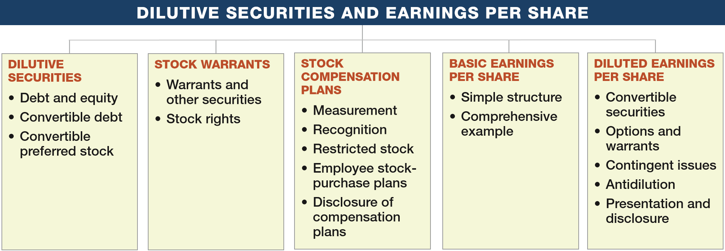
PREVIEW OF CHAPTER 16
Intermediate Accounting
16th Edition
Kieso ● Weygandt ● Warfield

Slide 2
LEARNING OBJECTIVES
16
Dilutive Securities and Earnings per Share
After studying this chapter, you should be able to:
Describe the accounting for the issuance, conversion, and retirement of convertible securities.
Contrast the accounting for stock warrants and for stock warrants issued with other securities.
Describe the accounting and reporting for stock compensation plans.
Compute basic earnings per share.
Compute diluted earnings per share.
LO 1

Slide 3
DILUTIVE SECURITIES
Debt and Equity
Should companies report these financial instruments as a liability or equity?
Stock Options
Convertible Securities
Preferred Stock
LO 1

Slide 4
DILUTIVE SECURITIES
Accounting for Convertible Debt
Convertible bonds can be changed into other corporate securities during some specified period of time after issuance.
Benefit of a Bond (guaranteed interest and principal)
+
Privilege of Exchanging it for Stock
(at the holder’s option)
LO 1

Slide 5
Accounting for Convertible Debt
Two main reasons corporations issue convertibles:
To raise equity capital without giving up more ownership control than necessary.
Obtain debt financing at cheaper rates.
The accounting for convertible debt involves reporting issues at the time of (1) issuance, (2) conversion, and (3) retirement.
LO 1

Slide 6
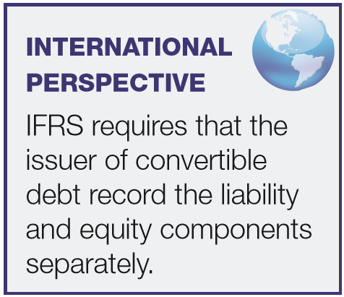
Accounting for Convertible Debt
At Time of Issuance
Recording convertible bonds follows the method used to record straight debt issues, with any discount or premium amortized over the term of the debt.
LO 1

Slide 7
Accounting for Convertible Debt
Illustration: Miller Corporation issued $4,000,000 par value, 7% convertible bonds at 99 for cash. If the bonds had not included the conversion feature, they would have sold for 95. Record the entry at date of issuance.
Issue Price =
($4,000,000 x 99% = $3,960,000)
Cash 3,960,000
Discount on Bonds Payable 40,000
Bonds Payable 4,000,000
LO 1

Slide 8
Accounting for Convertible Debt
At Time of Conversion
Companies use the book value method when converting bonds.
When the debtholder converts the debt to equity, the issuing company recognizes no gain or loss upon conversion.
LO 1

Slide 9
Accounting for Convertible Debt
Illustration: Moore Corporation has outstanding 2,000, $1,000 bonds, each convertible into 50 shares of $10 par value common stock. The bonds are converted on December 31, 2017, when the unamortized discount is $30,000 and the market price of the stock is $21 per share. Prepare the entry to record the conversion of the bonds.
Bonds Payable 2,000,000
Discount on Bonds Payable 30,000
Common Stock (2,000 x 50 x $10) 1,000,000
Paid-in Capital in Excess of Par—Common 970,000
LO 1

Slide 10
Accounting for Convertible Debt
Induced Conversion
Issuer wishes to encourage prompt conversion.
Issuer offers additional consideration, called a “sweetener.”
Sweetener is an expense of the current period.
LO 1

Slide 11
Accounting for Convertible Debt
Illustration: Moore Corporation has outstanding 2,000, $1,000 bonds, each convertible into 50 shares of $10 par value common stock. Assume Moore wanted to reduce its annual interest cost and agreed to pay the bondholders $70,000 to convert.
Bonds Payable 2,000,000
Discount on Bonds Payable 30,000
Common Stock (2,000 x 50 x $10) 1,000,000
Paid-in Capital in Excess of Par—Common 970,000
Same
Debt Conversion Expense 70,000
Cash 70,000
LO 1

Slide 12
Accounting for Convertible Debt
Retirement of Convertible Debt
Recognized same as retiring debt that is not convertible.
Difference between the cash acquisition price and carrying amount should be reported as gain or loss in the income statement.
LO 1

Slide 13
DILUTIVE SECURITIES
Convertible Preferred Stock
Convertible preferred stock includes an option for the holder to convert preferred shares into a fixed number of common shares.
  Classified as part of stockholders’ equity, unless mandatory redemption exists.
  No theoretical justification for recognizing a gain or loss when exercised.
LO 1

Slide 14
Convertible Preferred Stock
Illustration: Gall Inc. issued 2,000 shares of $10 par value common stock upon conversion of 1,000 shares of $50 par value preferred stock. The preferred stock was originally issued at $60 per share. The common stock is trading at $26 per share at the time of conversion. Prepare the entry to record the conversion.
Preferred Stock 50,000
Paid-in Capital in Excess of Par—Preferred 10,000
Common Stock (2,000 x $10) 20,000
Paid-in Capital in Excess of Par—Common 40,000
LO 1

Slide 15
LEARNING OBJECTIVES
16
Dilutive Securities and Earnings per Share
After studying this chapter, you should be able to:
Describe the accounting for the issuance, conversion, and retirement of convertible securities.
Contrast the accounting for stock warrants and for stock warrants issued with other securities.
Describe the accounting and reporting for stock compensation plans.
Compute basic earnings per share.
Compute diluted earnings per share.
LO 4

Slide 16

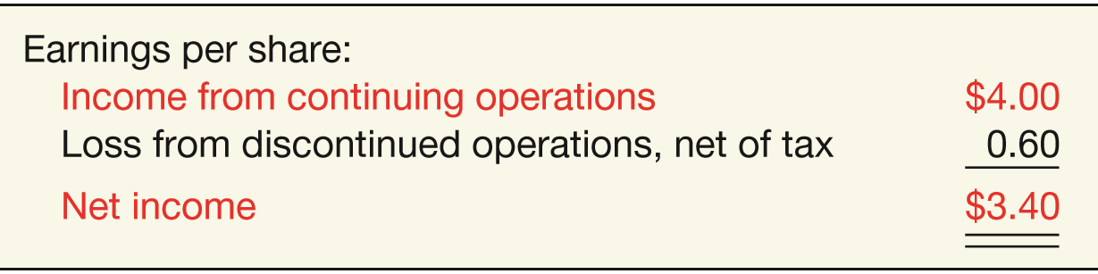
BASIC EARNINGS PER SHARE
Earnings per share indicates the income earned by each share of common stock.
  Companies report earnings per share only for common stock.
  When the income statement contains intermediate components, such as discontinued operations, companies should disclose earnings per share for each component.
ILLUSTRATION 16-7
Income Statement Presentation of EPS
ILLUSTRATION 16-8
Income Statement Presentation of EPS Components
LO 4

Slide 17
BASIC EARNINGS PER SHARE
Earnings per Share—Simple Capital Structure
Simple Structure--Common stock; no potentially dilutive securities.
Complex Structure--Includes securities that could dilute earnings per common share.
“Dilutive” means the ability to influence the EPS in a downward direction.
LO 4

Slide 18

BASIC EARNINGS PER SHARE
Preferred Stock Dividends
Subtracts the current-year preferred stock dividend from net income to arrive at income available to common stockholders.
ILLUSTRATION 16-9
Formula for Computing Earnings per Share
Preferred dividends are subtracted on cumulative preferred stock, whether declared or not.
LO 4

Slide 19
BASIC EARNINGS PER SHARE
Weighted-Average Number of Shares Outstanding
Companies must weight the shares by the fraction of the period they are outstanding.
When stock dividends or share splits occur, companies need to restate the shares outstanding before the share dividend or split.
LO 4

Slide 20
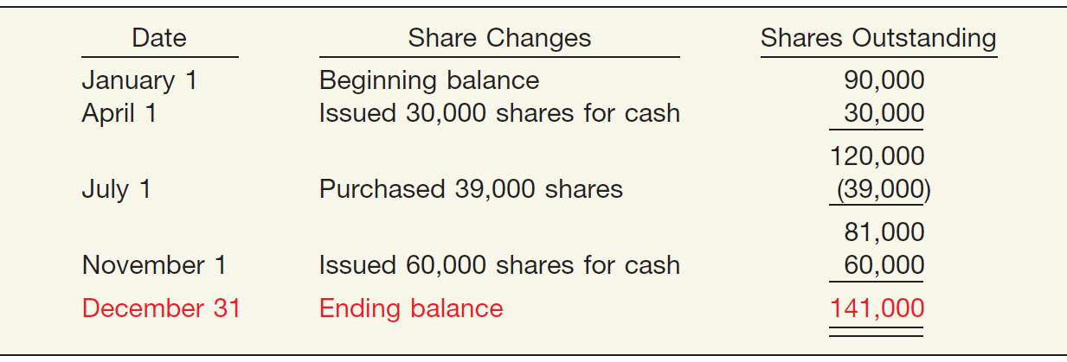
Weighted-Average Shares Outstanding
Illustration: Zachsmith Inc. has the following changes in its common stock during the period.
Compute the weighted-average number of shares outstanding for Zachsmith Inc.
ILLUSTRATION 16-10
Shares Outstanding, Ending Balance
LO 4

Slide 21
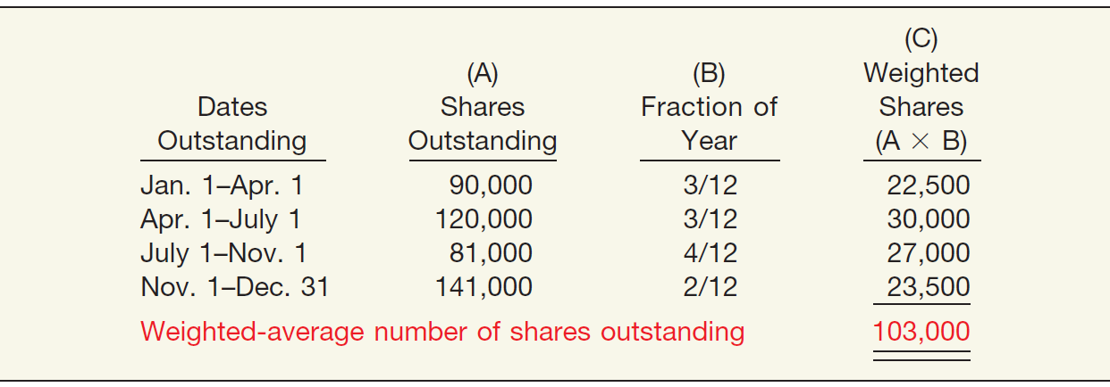
Weighted-Average Shares Outstanding
ILLUSTRATION 16-10
ILLUSTRATION 16-11
Weighted-Average Number of Shares Outstanding
LO 4

Slide 22
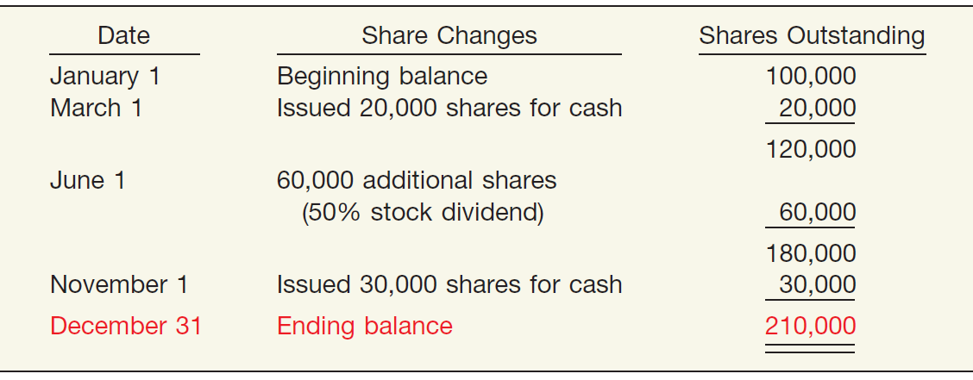
Weighted-Average Shares Outstanding
Illustration: Bergman Company has the following changes in its common stock during the period.
Compute the weighted-average number of shares outstanding for Bergman Company.
ILLUSTRATION 16-12
Shares Outstanding, Ending Balance— Bergman Company
LO 4

Slide 23
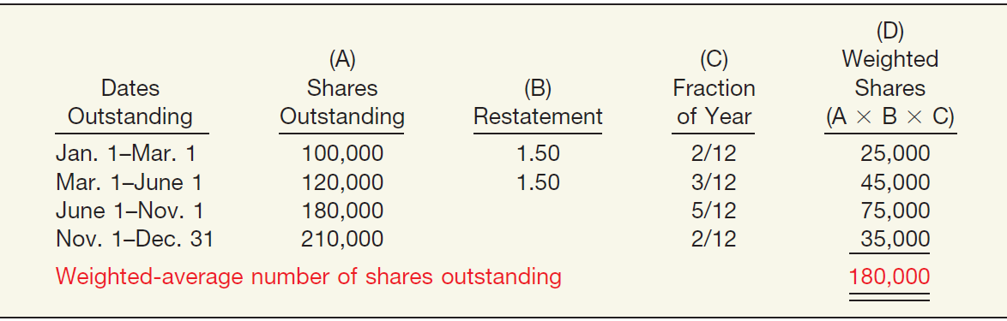
Weighted-Average Shares Outstanding
ILLUSTRATION 16-12
ILLUSTRATION 16-13
Weighted-Average Number of Shares Outstanding— Stock Issue and Stock Dividend
LO 4

Slide 24
LEARNING OBJECTIVES
16
Dilutive Securities and Earnings per Share
After studying this chapter, you should be able to:
Describe the accounting for the issuance, conversion, and retirement of convertible securities.
Contrast the accounting for stock warrants and for stock warrants issued with other securities.
Describe the accounting and reporting for stock compensation plans.
Compute basic earnings per share.
Compute diluted earnings per share.
LO 5

Slide 25
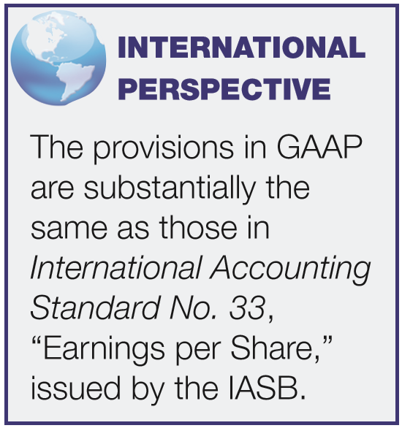
DILUTED EARNINGS PER SHARE
Complex Capital Structure exists when a business has
  convertible securities,
  options, warrants, or other rights
that upon conversion or exercise could dilute earnings per share.
Company generally reports both basic and diluted earnings per share.
LO 5

Slide 26
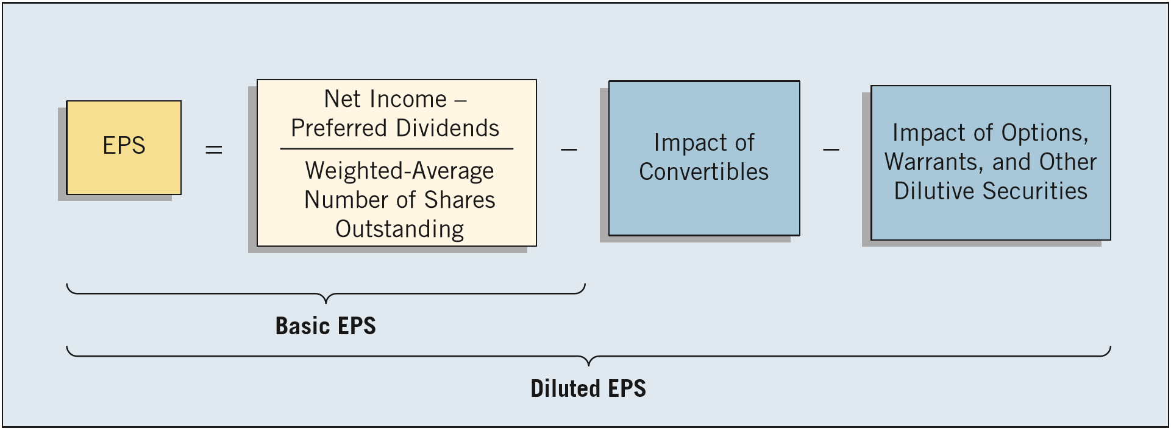
DILUTED EARNINGS PER SHARE
Diluted EPS includes the effect of all potential dilutive common shares that were outstanding during the period.
Companies will not report diluted EPS if the securities in their capital structure are antidilutive.
ILLUSTRATION 16-18
Relationship between Basic and Diluted EPS
LO 5

Slide 27
DILUTED EARNINGS PER SHARE
Diluted EPS — Convertible Securities
Measure the dilutive effects of potential conversion on EPS using the if-converted method.
This method for a convertible bond assumes:
the conversion at the beginning of the period (or at the time of issuance of the security, if issued during the period), and
the elimination of related interest, net of tax.
LO 5

Slide 28
Example — If-Converted Method
Illustration: Mayfield Corporation has net income of $210,000 for the year and a weighted-average number of common shares outstanding during the period of 100,000 shares. The company has two convertible debenture bond issues outstanding. One is a 6 percent issue sold at 100 (total $1,000,000) in a prior year and convertible into 20,000 common shares. Interest expense on the 6 percent convertibles is $60,000. The other is a 10 percent issue sold at 100 (total $1,000,000) on April 1 of the current year and convertible into 32,000 common shares. Interest expense on the 10 percent convertible bond is $75,000. The tax rate is 40 percent.
LO 5

Slide 29
Example — If-Converted Method
Calculate basic earnings per share.
Net income = $210,000
=
$2.10
Weighted-average shares = 100,000
LO 5

Slide 30
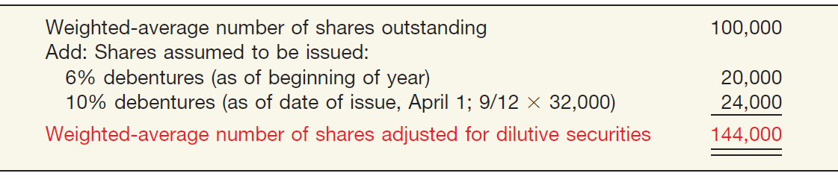
Example — If-Converted Method
Mayfield calculates the weighted-average number of shares outstanding, as follows.
ILLUSTRATION 16-20
Computation of Weighted-Average Number of Shares
Calculate diluted earnings per share.
LO 5

Slide 31
Example — If-Converted Method
When calculating Diluted EPS, begin with basic EPS.
Basic EPS
6% Debentures
10% Debentures
+
$210,000
$60,000 x (1 - .40)
+
$100,000 x (1 - .40) x 9/12
=
+
100,000
20,000
+
24,000
Basic EPS = $2.10
Effect on EPS = $1.80
Effect on EPS = $1.875
Diluted EPS = $2.02
LO 5

Slide 32
Example — If-Converted Method
Other Factors
The conversion rate on a dilutive security may change during the period in which the security is outstanding. In this situation, the company uses the most dilutive conversion rate available.
For Convertible Preferred Stock the company does not subtract preferred dividends from net income in computing the numerator. Why not?
Because for purposes of computing EPS, it assumes conversion of the convertible preferreds to outstanding common shares.
LO 5

Slide 33
Example — If-Converted Method
Illustration: In 2016, Chirac Enterprises issued, at par, 60, $1,000, 8% bonds, each convertible into 100 shares of common stock. Chirac had revenues of $17,500 and expenses other than interest and taxes of $8,400 for 2017. (Assume that the tax rate is 40%.) Throughout 2017, 2,000 shares of common stock were outstanding; none of the bonds was converted or redeemed.
Instructions
  (a) Compute diluted earnings per share for 2017.
  (b) Assume same facts as those for Part (a), except the 60 bonds were issued on September 1, 2017 (rather than in 2016), and none have been converted or redeemed.
LO 5

Slide 34
Example — If-Converted Method
(a) Compute diluted earnings per share for 2017.
Calculation of Net Income
Revenues $17,500
Expenses 8,400
Bond interest expense (60 x $1,000 x 8%) 4,800
Income before taxes 4,300
Income tax expense (40%) 1,740
Net income $ 2,580
LO 5

Slide 35
Example — If-Converted Method
(a) Compute diluted earnings per share for 2017.
When calculating Diluted EPS, begin with basic EPS.
Basic EPS
Net income = $2,580
=
$1.29
Weighted average shares = 2,000
LO 5

Slide 36
Example — If-Converted Method
(a) Compute diluted earnings per share for 2017.
When calculating Diluted EPS, begin with basic EPS.
Diluted EPS
+
$2,580
$4,800 (1 - .40)
$5,460
=
=
$.68
+
2,000
6,000
8,000
Basic EPS = $1.29
Effect on EPS = $.48
LO 5

Slide 37
Example — If-Converted Method
(b) Assume bonds were issued on Sept. 1, 2017 .
Calculation of Net Income
LO 5

Slide 38
Example — If-Converted Method
(b) Assume bonds were issued on Sept. 1, 2017 .
When calculating Diluted EPS, begin with basic EPS.
Diluted EPS
$4,500
+
$1,600 (1 - .40)
$5,460
=
=
$1.37
2,000
+
6,000 x 4/12 yr.
4,000
Basic EPS = $2.25
Effect on EPS = $.48
LO 5

Slide 39
Example — If-Converted Method
Illustration: Prior to 2017, Barkley Company issued 40,000 shares of 6% convertible, cumulative preferred stock, $100 par value. Each share is convertible into 5 shares of common stock. Net income for 2017 was $1,200,000. There were 600,000 common shares outstanding during 2017. There were no changes during 2017 in the number of common or preferred shares outstanding.
Instructions
  (a) Compute diluted earnings per share for 2017.
LO 5

Slide 40
Example — If-Converted Method
(a) Compute diluted earnings per share for 2017.
When calculating Diluted EPS, begin with basic EPS.
Basic EPS
Net income $1,200,000 – Pfd. Div. $240,000 *
=
$1.60
Weighted average shares = 600,000
* 40,000 shares x $100 par x 6% = $240,000 dividend
LO 5

Slide 41
Example — If-Converted Method
(a) Compute diluted earnings per share for 2017.
When calculating Diluted EPS, begin with basic EPS.
Diluted EPS
+
$1,200,000 – $240,000
$240,000
$1,200,000
=
=
600,000
+
200,000*
800,000
$1.50
Effect on EPS = $1.20
Basic EPS = $1.60
*(40,000 x 5)
LO 5

Slide 42
Example — If-Converted Method
(a) Compute diluted earnings per share for 2017 assuming each share of preferred is convertible into 3 shares of common stock.
Diluted EPS
+
$1,200,000 – $240,000
$240,000
$1,200,000
=
=
600,000
+
120,000*
720,000
$1.67
Effect on EPS = $2.00
Basic EPS = $1.60
*(40,000 x 3)
LO 5

Slide 43
Example — If-Converted Method
(a) Compute diluted earnings per share for 2017 assuming each share of preferred is convertible into 3 shares of common stock.
Diluted EPS
Basic = Diluted EPS
+
$1,200,000 – $240,000
$240,000
$1,200,000
=
=
600,000
+
120,000*
720,000
Antidilutive
$1.67
Effect on EPS = $2.00
Basic EPS = $1.60
*(40,000 x 3)
LO 5

Slide 44
DILUTED EARNINGS PER SHARE
Diluted EPS – Options and Warrants
Measure the dilutive effects of potential conversion using the treasury-stock method.
This method assumes:
the exercise the options or warrants at the beginning of the year (or date of issue if later), and
that the company uses those proceeds to purchase common stock for the treasury.
LO 5

Slide 45
Example — Treasury-Stock Method
Illustration: Zambrano Company’s net income for 2017 is $40,000. The only potentially dilutive securities outstanding were 1,000 options issued during 2016, each exercisable for one share at $8. None has been exercised, and 10,000 shares of common were outstanding during 2017. The average market price of the stock during 2017 was $20.
Instructions
  (a) Compute diluted earnings per share.
  (b) Assume the 1,000 options were issued on October 1, 2017 (rather than in 2016). The average market price during the last 3 months of 2017 was $20.
LO 5

Slide 46
Example — Treasury-Stock Method
(a) Compute diluted earnings per share for 2017.
Treasury-Stock Method
Proceeds if shares issued (1,000 x $8) $8,000
Purchase price for treasury shares $20
Shares assumed purchased 400
Shares assumed issued 1,000
Incremental share increase 600
÷
LO 5

Slide 47
Example — Treasury-Stock Method
(a) Compute diluted earnings per share for 2017.
When calculating Diluted EPS, begin with basic EPS.
Diluted EPS
$40,000
+
$40,000
=
=
$3.77
10,000
+
600
10,600
Basic EPS = $4.00
Options
LO 5

Slide 48
Example — Treasury-Stock Method
(b) Compute diluted earnings per share assuming the 1,000 options were issued on October 1, 2017.
Treasury-Stock Method
÷
x
LO 5

Slide 49
Example — Treasury-Stock Method
(b) Compute diluted earnings per share assuming the 1,000 options were issued on October 1, 2017.
Diluted EPS
$40,000
$40,000
=
=
$3.94
10,000
+
150
10,150
Basic EPS = $4.00
Options
LO 5

Slide 50
DILUTED EARNINGS PER SHARE
Contingent Issue Agreement
Contingent shares are issued as a result of the
passage of time condition or
upon attainment of a certain earnings or market price level.
Antidilution Revisited
Ignore antidilutive securities in all calculations and in computing diluted earnings per share.
LO 5

Slide 51
DILUTED EARNINGS PER SHARE
EPS Presentation and Disclosure
A company should show per share amounts for:
  Income from continuing operations,
  Income before extraordinary items, and
  Net income.
Per share amounts for a discontinued operation or an extraordinary item should be presented on the face of the income statement or in the notes.
LO 5

Slide 52
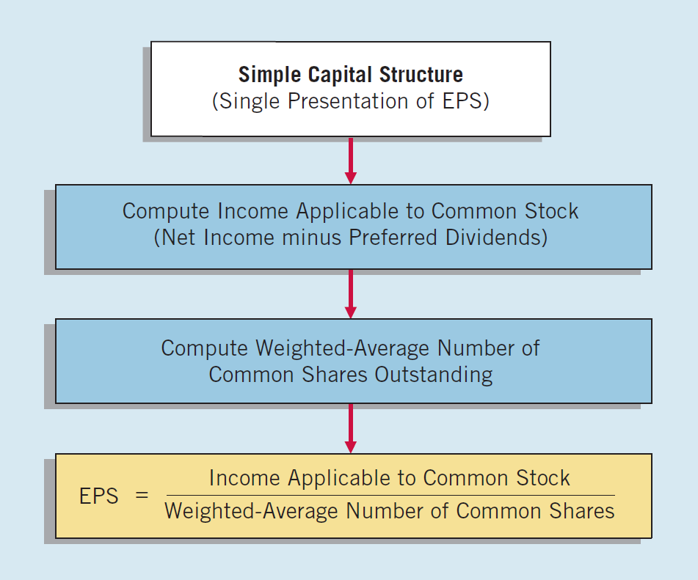
Summary of EPS Computation
ILLUSTRATION 16-28
Calculating EPS, Simple Capital Structure
LO 5

Slide 53
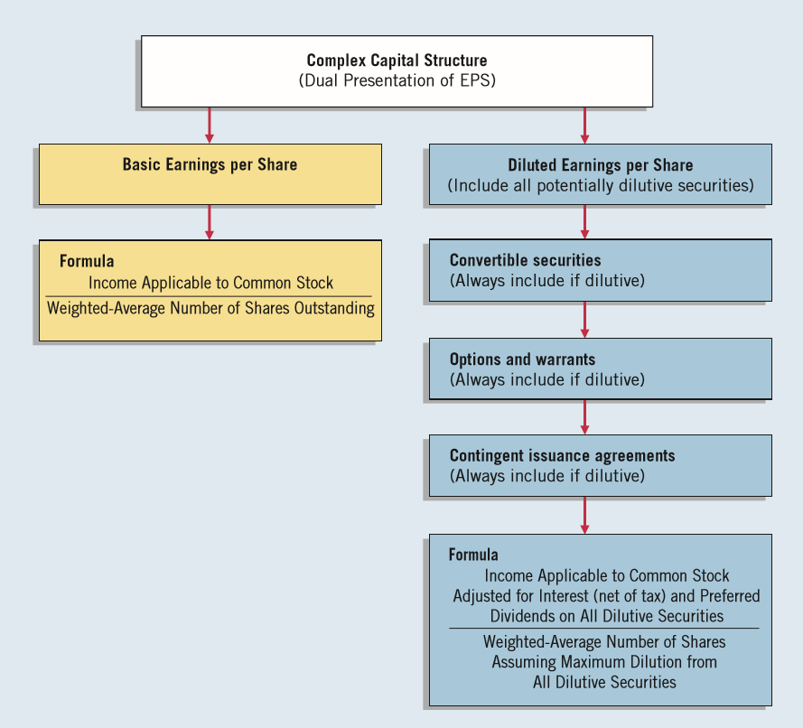
Earnings per Share
ILLUSTRATION 16-29
Calculating EPS, Complex Capital Structure
LO 5

Slide 54
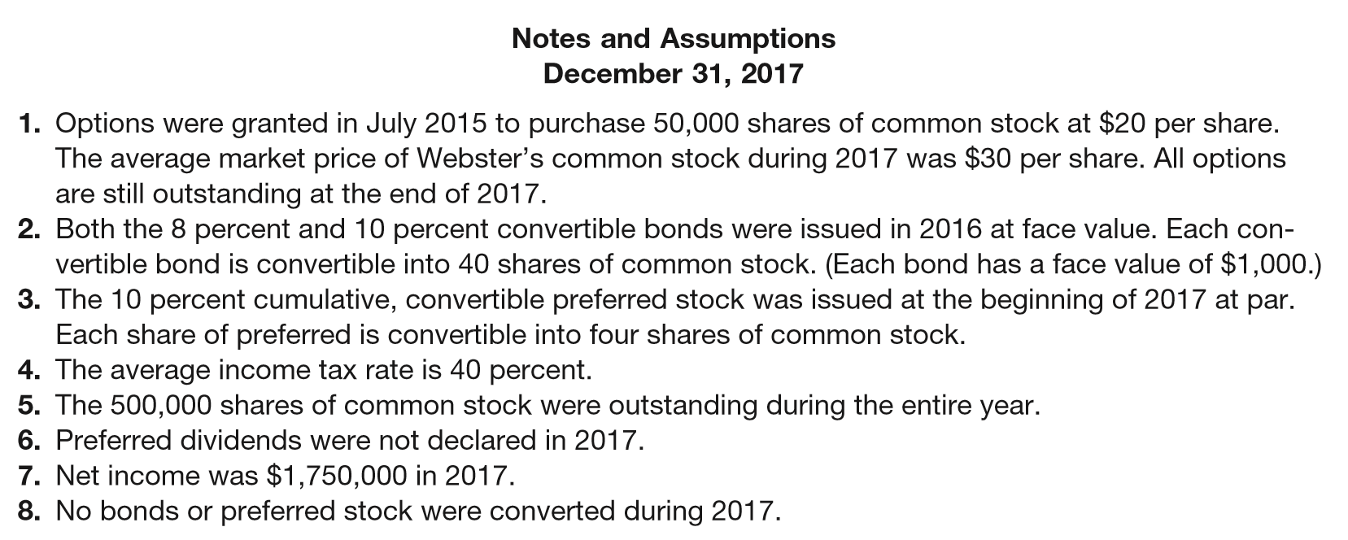
APPENDIX 16B
COMPREHENSIVE EARNINGS PER SHARE EXAMPLE
Illustration 16-B1
ILLUSTRATION 16B-1
Balance Sheet for Comprehensive Illustration
LO 7

Slide 55
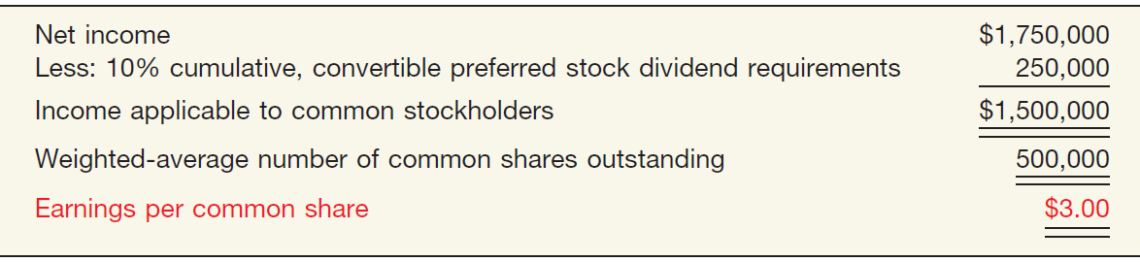
APPENDIX 16B
COMPREHENSIVE EARNINGS PER SHARE EXAMPLE
Computation of Earnings per Share—Simple Capital Structure
ILLUSTRATION 16B-2
Computation of Earnings per Share—Simple Capital Structure
LO 7

Slide 56
APPENDIX 16B
COMPREHENSIVE EARNINGS PER SHARE EXAMPLE
DILUTED EARNINGS PER SHARE
Steps for computing diluted earnings per share:
  Determine, for each dilutive security, the per share effect assuming exercise/conversion.
  Rank the results from step 1 from smallest to largest earnings effect per share.
  Beginning with the earnings per share based upon the weighted-average of common stock outstanding, recalculate earnings per share by adding the smallest per share effects from step 2. Continue this process so long as each recalculated earnings per share is smaller than the previous amount.
LO 7

Slide 57
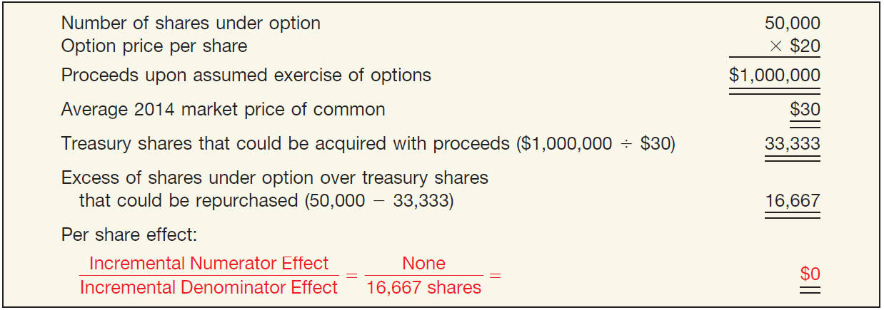
APPENDIX 16B
COMPREHENSIVE EARNINGS PER SHARE EXAMPLE
The first step is to determine a per share effect for each potentially dilutive security.
Per Share Effect of Options (Treasury-Share Method), Diluted Earnings per Share
ILLUSTRATION 16B-3
LO 7

Slide 58
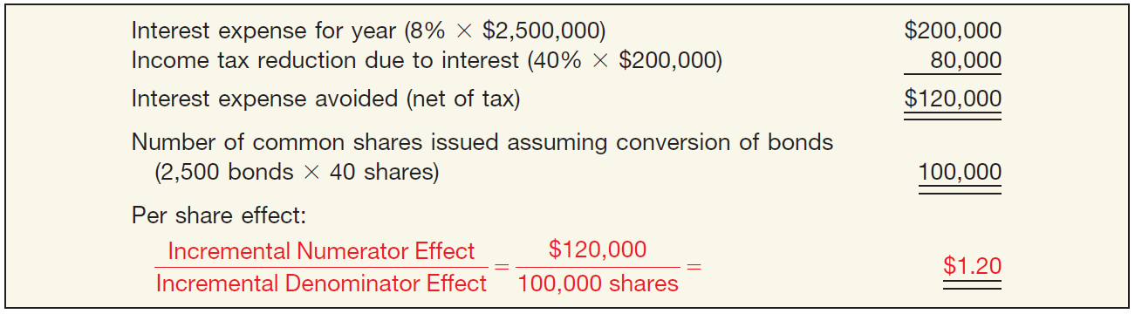
APPENDIX 16B
COMPREHENSIVE EARNINGS PER SHARE EXAMPLE
The first step is to determine a per share effect for each potentially dilutive security.
Per Share Effect of 8% Bonds (If-Converted Method), Diluted Earnings per Share
ILLUSTRATION 16B-4
LO 7

Slide 59
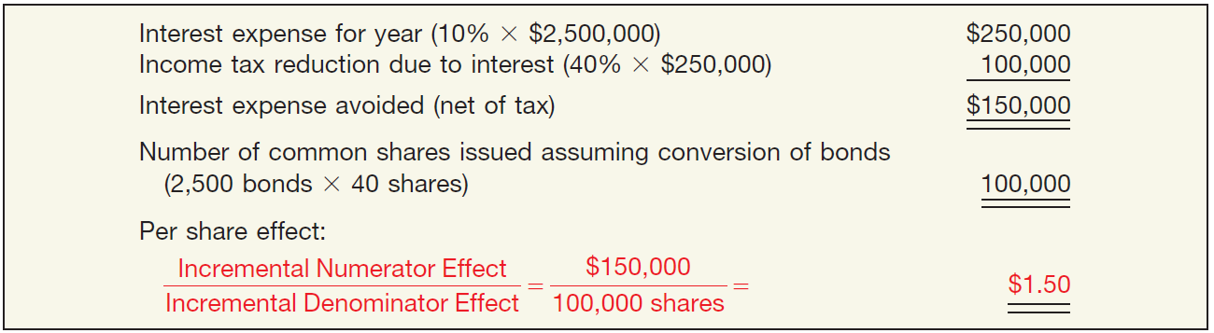
APPENDIX 16B
COMPREHENSIVE EARNINGS PER SHARE EXAMPLE
The first step is to determine a per share effect for each potentially dilutive security.
Per Share Effect of 10% Bonds (If-Converted Method), Diluted Earnings per Share
ILLUSTRATION 16B-5
LO 7

Slide 60
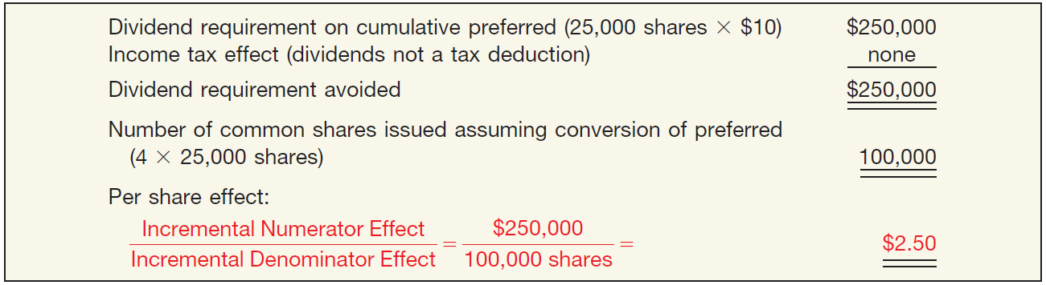
APPENDIX 16B
COMPREHENSIVE EARNINGS PER SHARE EXAMPLE
The first step is to determine a per share effect for each potentially dilutive security.
Per Share Effect of 10% Convertible preferred stocks (If-Converted Method), Diluted Earnings per Share
ILLUSTRATION 16B-6
LO 7

Slide 61
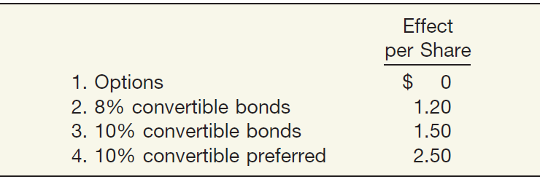
APPENDIX 16B
COMPREHENSIVE EARNINGS PER SHARE EXAMPLE
The first step is to determine a per share effect for each potentially dilutive security.
Ranking of per Share Effects (Smallest to Largest), Diluted Earnings per Share
ILLUSTRATION 16B-7
LO 7

Slide 62
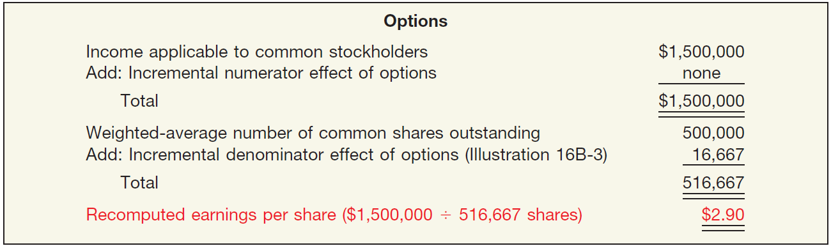
APPENDIX 16B
COMPREHENSIVE EARNINGS PER SHARE EXAMPLE
The next step is to determine earnings per share giving effect to the ranking.
Recomputation of EPS Using Incremental Effect of Options
The effect of the options is dilutive.
ILLUSTRATION 16B-8
LO 7

Slide 63
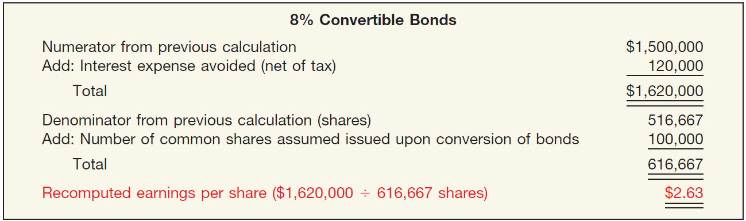
APPENDIX 16B
COMPREHENSIVE EARNINGS PER SHARE EXAMPLE
The next step is to determine earnings per share giving effect to the ranking.
Recomputation of EPS Using Incremental Effect of 8% Convertible Bonds
ILLUSTRATION 16-B9
The effect of the 8% convertible bonds is dilutive.
LO 7

Slide 64

APPENDIX 16B
COMPREHENSIVE EARNINGS PER SHARE EXAMPLE
The next step is to determine earnings per share giving effect to the ranking.
Recomputation of EPS Using Incremental Effect of 10% Convertible Bonds
ILLUSTRATION 16-B10
The effect of the 10% convertible bonds is dilutive.
LO 7

Slide 65
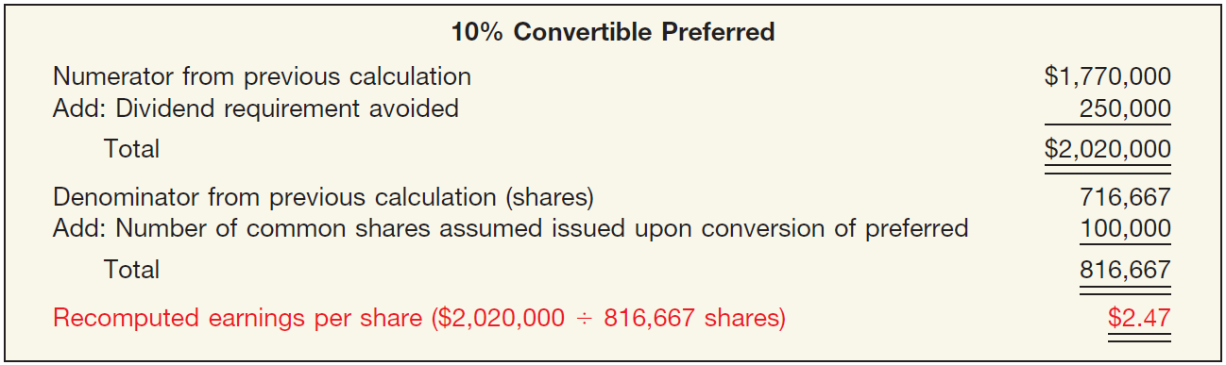
APPENDIX 16B
COMPREHENSIVE EARNINGS PER SHARE EXAMPLE
The next step is to determine earnings per share giving effect to the ranking
Recomputation of EPS Using Incremental Effect of 10% Convertible preferred
ILLUSTRATION 16-B11
The effect of the 10% convertible preferred stocks is NOT dilutive.
LO 7

Slide 66
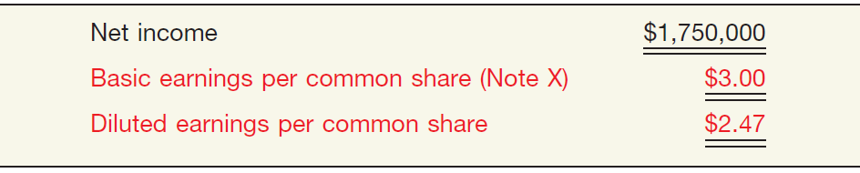
APPENDIX 16B
COMPREHENSIVE EARNINGS PER SHARE EXAMPLE
Finally, Webster Corporation’s disclosure of earnings per
share on its income statement.
ILLUSTRATION 16-B12
LO 7

Slide 67
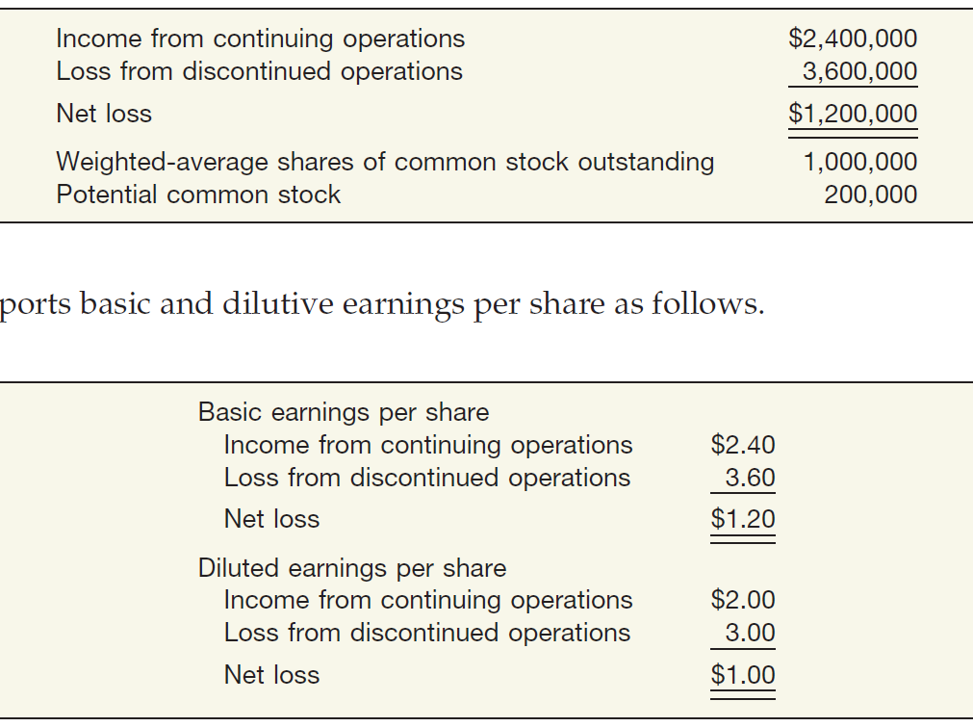
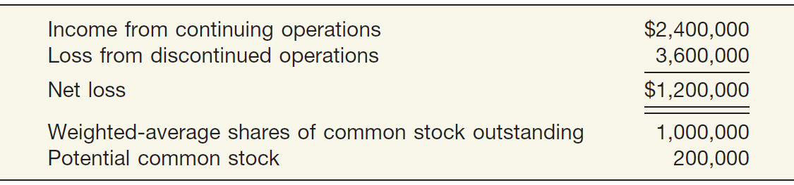
APPENDIX 16B
COMPREHENSIVE EARNINGS PER SHARE EXAMPLE
Assume that Barton Company provides the following information.
ILLUSTRATION 16-B13
ILLUSTRATION 16-B14
Basic and Diluted EPS
LO 7

