Slide 1
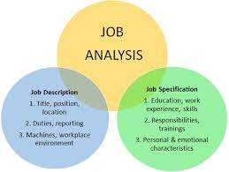
Human resource management (HRM) Job Analysis and the Talent Management Process
2nd year
complied and edited by :
Dr .Maha misbah
English program
Date :22/3/2020

Slide 2
4
Job Analysis and the
Talent Management Process

Slide 3
Learning Objectives
4-1. Define talent management and explain why it is important.
4-2. Discuss the process of job analysis, including why it is important.
4-3. Explain how to use at least three methods of collecting job analysis information, including interviews, questionnaires, and observation.

Slide 4
4-4. Explain how you would write a job description.
4-5. Explain how to write a job specification.
4-6. List some human traits and behaviors you would want an employee to bring to a job if employee engagement is important to doing the job well.

Slide 5
4-7. Explain competency-based job analysis, including what it means and how it’s done in practice.

Slide 6
I.
Define talent management and explain why it is important.

Slide 7
Talent management: The holistic, integrated and goal-oriented process of planning, recruiting, selecting, developing, managing, and compensating employees.

Slide 8
Talent management refers to the skills of attracting highly skilled workers, of integrating new workers, and developing and retaining current workers to meet current and future business objectives.

Slide 9
* When a manager takes a talent management perspective, he or she:
1) Understands that the talent management tasks (such as recruiting, training, and paying employees) are parts of a single interrelated talent management process.
EX: Having employees with the right skills depends as much on recruiting, training, and compensation as it does on applicant testing.

Slide 10
2) Makes sure talent management decisions such as staffing, training, and pay are goal-directed.
* Managers should always be asking, What recruiting, testing, or other actions should I take to produce the employee competencies we need to achieve our strategic goals?

Slide 11
3) Consistently uses the same profile of competencies, traits, knowledge, and experience for formulating recruitment plans for a job as for making selection, training, appraisal, and payment decisions for it.
EX: Ask selection interview questions to determine if the candidate has the knowledge and skills to do the job, and then train and appraise the employee based on whether he or she shows mastery of that knowledge and skills.

Slide 12
4) Actively segments and proactively manages employees. Taking a talent management approach requires that employers proactively manage their employees recruitment, selection, development, and rewards.
EX: IBM segmented its employees into three main groups (executive and technical employees, managers, and rank and file).

Slide 13
5) Integrates/coordinates all the talent management functions.
* Finally, an effective talent management process integrates the underlying talent management activities such as recruiting, developing, and compensating employees.
EX: Performance appraisals should generate the required employee training.

Slide 14
* One simple way to achieve such integration is for HR managers to meet as a team to visualize and discuss how to coordinate activities like testing, appraising, and training. (EX: They make sure the firm is using the same skills profile to recruit, as to select, train, and appraise for a particular job).
* Another way to coordinate these activities is by using information technology.

Slide 15
The Talent Management Process
1) Decide what positions to fill, through job analysis, personnel planning, and forecasting.
2) Build a pool of job candidates, by recruiting internal or external candidates.
3) Have candidates complete application forms and perhaps undergo initial screening (examination) Interviews.
4) Use selection tools like tests, interviews, background checks, and physical exams to identify viable candidates.

Slide 16
The Talent Management Process
5) Decide to whom to make an offer.
6) Orient, train, and develop employees to provide them with the competencies they need to do their jobs.
7) Appraise employees to assess how they re doing.
8) Reward and compensate employees to maintain their motivation.

Slide 17
Improving Performance Through HRIS:
Talent Management Software
* HRIS software is a type of software that allows organizations to handle many human resources functions electronically. “HRIS” stands for Human Resources Information System and that’s exactly what the software is at its core, a platform that collects and stores information related to the employees or “human resources” within an organization.

Slide 18
Improving Performance Through HRIS:
Talent Management Software
* In addition to passively collecting and storing information, HRIS software has evolved to assist with many HR activities such as time and attendance tracking, succession planning, and recruiting. This can improve efficiency and save labor hours, among other advantages.
HRIS is a valuable tool that is being utilized by many of the top ranking companies across every industry to improve operations starting at the heart of the organization.

Slide 19
Is Talent Management Related to an HRIS?
Talent management has prompted a new industry of software including HRIS, HRIS Systems, Performance Appraisal Software, and Training Software. In other words, technology can help implement a talent management solution that is ideal for a company’s specific employees. The question, though, is how can talent management and any accompanying software benefit your employees?

Slide 20
According to Maslow’s hierarchy of needs, employees will continue to strive for “self actualization.” By providing resources that support your employees, you are encouraging them to realize their full potential, to attain “self actualization.” This helps your business grow and reach its full potential. Furthermore, organizations with motivated employees typically create a following among the local work force pool, pulling in new employees that are just as motivated and loyal as the existing team. Thus, by focusing resources on individual talent and encouraging employees to reach their full potential, the current work force creates economic growth and spurs future success.

Slide 21
Talent management is essential for any business. For example, managing talent can help identify and then find solutions for “lost” or “misused” talent. By employing HCM, new business opportunities can be identified as well as business challenges (whether those be challenges of competition, government regulations, or economic downturns), which can then be immediately addressed. Considering the many benefits of managing your talent appropriately, it is imperative that every business take advantage of HCM. But how?

Slide 22
To get started with talent management, you could bring in consultants or experts that will review your existing processes. They evaluate the areas that are critical to your company and identify the areas that are the weakest and need to be improved. While this is useful, you MUST also have technology to help identify, track, and manage talent. Today, most solutions are cloud-based, integrating major HRMS Solutions with corporate solutions, including accounting. While an HRIS system can help with organizing employees and their “talent,” a best of breed talent management system also needs to be included in order to accomplish your goals. These solutions allow HR to:

Slide 23
Review real-time salary information and compare this information across industries for competitiveness • Access cascading goals and provide for complete corporate goal view, ensuring total integration of company goals • Review, at a glance, A/B/C members for promotion or other project opportunities • Measure existing talent against future needs
In the end, your employees are your talent and, thus, your future. Treat them well, give them opportunities to grow, and ultimately your company will grow too!

Slide 24
Improving Performance Through HRIS:
Talent Management Software
* Because talent management is holistic and interdependent, many employers use talent management software systems to coordinate their talent-related activities.
EX: Talent Management Suite: includes recruiting, employee performance management, a learning management system, and compensation management support. It “ensures that all levels of the organization are aligned—all working for the same goals.”

Slide 25
II.
Discuss the process of job analysis, including why it is important.

Slide 26
What Is Job Analysis?
* Talent management begins with understanding what jobs need to be filled, and the human traits and competencies employees need.

Slide 27
Job Analysis: The procedure through which you determine the duties of the positions and the characteristics of the people to hire for them.
Or: The procedure for determining the duties and skill requirements of a job and the kind of person who should be hired for it.

Slide 28
* Job analysis produces information for writing job descriptions (A list of what the job entails) and job (or “person”) specifications (what kind of people to hire for the job).

Slide 29
Job descriptions: A list of a job’s duties, responsibilities, reporting relationships, working conditions, and supervisory responsibilities one product of a job analysis.

Slide 30
Job specifications: A list of a job’s human requirements, that is, the requisite education, skills, personality, and so on another product of a job analysis.

Slide 31
The Basics of Job Analysis
* The supervisor or human resources specialist normally collects one or more of the following types of information via the job analysis:
1) Work activities: Information about the job’s actual work activities, such as cleaning, selling, teaching, or painting. This list may also include how, why, and when the worker performs each activity.

Slide 32
2) Human behaviors: Information about human behaviors the job requires, like sensing, communicating, lifting weights, or walking long distances.
3) Machines, tools, equipment, and work aids: Information regarding tools used, materials processed, knowledge dealt with or applied (such as finance or law), and services rendered (such as counseling or repairing).

Slide 33
4) Performance standards: Information about the job’s performance standards (in terms of quantity or quality levels for each job duty, for instance).

Slide 34
5) Job context: Information about such matters as physical working conditions, work schedule, incentives, and, for instance, the number of people with whom the employee would normally interact.
6) Human requirements: Information such as knowledge or skills (education, training, work experience) and required personal attributes (aptitudes, personality, interests).

Slide 35
Uses of Job Analysis Information
* Job analysis is important because it supports just about all human resource management activities.

Slide 36
* Job analysis is important in helping employers execute their overall strategic plans.

Slide 37
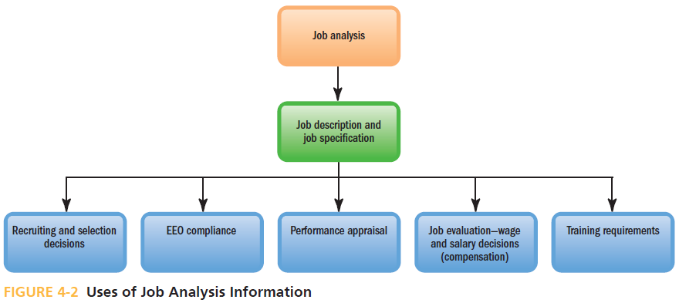

Slide 38
Recruitment and Selection:
Information about what duties the job entails and what human characteristics are required to perform these activities helps managers decide what sort of people to recruit and hire.

Slide 39
2) EEO Compliance: Job analysis is crucial for validating all major human resources practices.
EX: To comply with the Americans with Disabilities Act, employers should know each job’s essential job functions—which in turn requires a job analysis.

Slide 40
3) Performance Appraisal:
Compares each employee’s actual performance with his or her duties and performance standards.
* Managers use job analysis to learn what these duties and standards are.

Slide 41
4) Compensation:
Compensation (such as salary and bonus) usually depends on the job’s required skill and education level, safety hazards, degree of responsibility, and so on—all factors you assess through job analysis.

Slide 42
5) Training:
The job description lists the job’s specific duties and requisite skills—thus pinpointing what training the job requires.

Slide 43
Conducting a Job Analysis
1) (How will information be used?):
* Decide how you will use the information. This will determine the data you collect.

Slide 44
* Some data collection techniques like interviewing the employee are good for writing job descriptions.
* Other techniques, like the position analysis questionnaire, PAQ that evaluates job skill level and basic characteristics of applicants for a set match of employment opportunity.

Slide 45
*
* These techniques, like the position analysis questionnaire, provide numerical ratings for each job; these can be used to compare jobs for compensation purposes.

Slide 46
2) Background information:
* Review relevant background information such as organization chars, process charts, and job descriptions.

Slide 47
Organization chart: A chart that shows the organization-wide distribution of work, with titles of each position and interconnecting lines that show who reports to and communicates with whom.

Slide 48
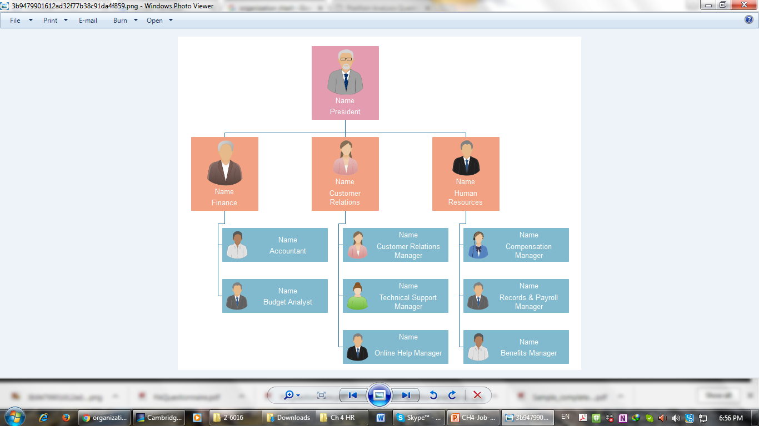

Slide 49
Process chart:
A more detailed picture of a workflow chart that shows the flow of inputs to and outputs from a particular job.

Slide 50
EX: A Process Chart for Analyzing a Jobs Workflow

Slide 51
Workflow analysis: A detailed study of the flow of work from job to job in a work process.

