Slide 1
Damietta Faculty of Education Department of English Second Year Criticism 1st lecture- March 2020
Dr. Engy Salah

Slide 2
Literary Criticism in The Middle Ages (MA): Allegorical Representation
Dante
Ibn Rushd

Slide 3
I- Dante Alighieri (1265-1321)
He is best known for his epic poem Divina Commedia (The Divine Comedy)
In his book Il Convivio, he wrote about allegory, and stated that it has four senses:
Literal
Allegorical
Moral
Anagogical
The twofold structure of allegory- duality

Slide 4
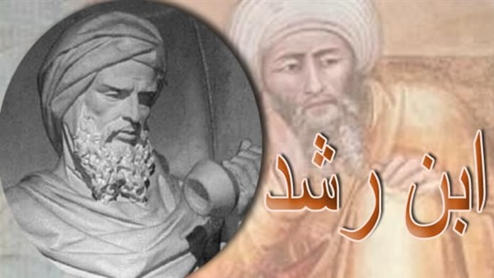
II- Ibn Rushd
Ibn Rushd
Ibn Rushd & Aristotle
Realism: Ibn Rushd vs. Aristotle

Slide 5
Ibn Rushd [Averroes]:
Ibn Rushd [Averroes] (1126—1198)
Abu al-Walid Muhammad ibn Ahmad ibn Rushd, better known in the Latin West as Averroes, lived during a unique period in Western intellectual history, in which interest in philosophy and theology was waning in the Muslim world and just beginning to flourish in Latin Christendom.

Slide 6
Ibn Rushd & Aristotle
His influential commentaries and unique interpretations on Aristotle revived Western scholarly interest in ancient Greek mythology, whose works for the most part had been neglected since the sixth century.
He critically examined the alleged tension between philosophy and religion in the Decisive Treatise, and he challenged the anti-philosophical sentiments within the Sunni tradition sparked by al-Ghazzali.
This critique ignited a similar re-examination within the Christian tradition, influencing a line of scholars who would come to be identified as the “Averroists.”

Slide 7
Ibn Rushd & Aristotle
Poetry ids defined broadly as the art of praise or blame, based on representations of moral choice.
The purpose of poetry is to produce a salutary effect upon its audience, through both excellence of imitative technique and performative elements such as melody, gesture, and intonation.
Poetry is viewed as a branch of logic, or logical discourse, which is compared and contrasted with rhetorical discourse.

Slide 8
Ibn Rushd & Aristotle
Regarding poetic imitation, Ibn Rushd places great emphasis on realism.
Whereas Aristotle talks of the poet representing what is probable, Ibn Rushd insists that the poet only engages in true representations, speaking “only of things that exist or may exist”

Slide 9
Go further:
https://www.youtube.com/watch?v=ITQgzi5r41M

Slide 10
Questions:
Dante’s contribution to allegorical representation lies in ….
What is meant by the twofold structure of allegory for Dante?
Ibn Rushd’ contribution to literary criticism lie sin the fact that he….
How does Ibn Rushd’s concept of realism differ from that of Aristotle?

Slide 11
Thank you … See you soon Inshaa Allah… missed you
Dr. Engy Salah

