Slide 1
Damietta Faculty of Education Department of English Second Year Criticism 3rd lecture- March 2020
Dr. Engy Salah

Slide 2
Contents:
Sir Philip Sidney
An Apology for Poetry
Main points

Slide 3
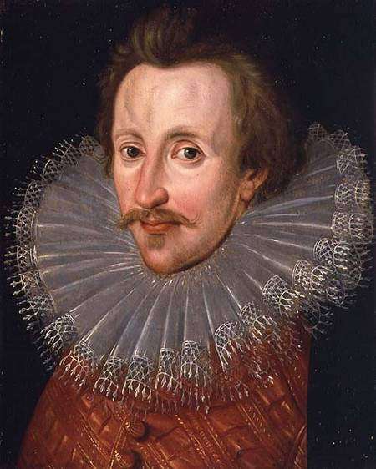
Sir Philip Sidney:
Sir Philip Sidney was born on November 30, 1554, at Penshurst, Kent. He was the eldest son of Sir Henry Sidney, Lord Deputy of Ireland, and nephew of Robert Dudley, Earl of Leicester. He was named after his godfather, King Philip II of Spain.
Sidney attended the court of Elizabeth I, and was considered "the flower of chivalry." He was also a patron of the arts, actively encouraging such authors as Edward Dyer, Greville, and most importantly, the young poet Edmund Spenser, who dedicated The Shepheardes Calender to him. In 1580, he incurred the Queen Elizabeth's displeasure by opposing her projected marriage to the Duke of Anjou, Roman Catholic heir to the French throne, and was dismissed from court for a time.
At some uncertain date, he composed a major piece of critical prose that was published after his death under the two titles, The Defence of Poesy and An Apology for Poetry. Sidney's Astrophil and Stella ("Starlover and Star") was begun probably around 1576, during his courtship with Penelope Devereux. Astrophil and Stella, which includes 108 sonnets and 11 songs, is the first in the long line of Elizabethan sonnet cycles. Most of the sonnets are influenced by Petrarchan conventions — the abject lover laments the coldness of his beloved lady towards him, even though he is so true of love and her neglect causes him so much anguish.

Slide 4
An Apology for Poetry/ Defense of Poesy :
Philip Sidney in his "Apology for Poetry" reacts against the attacks made on poetry by the puritan, Stephen Gosson. To, Sidney, poetry is an art of imitation for specific purpose, it is imitated to teach and delight. According to him, poetry is simply a superior means of communication and its value depends on what is communicated.
So, even history when it is described in a lively and passionate expression becomes poetic. He prefers imaginative literature that teaches better than history and philosophy. Literature has the power to reproduce an ideal golden world not just the brazen world.
Stephen Gossen, in his School of Abuse, charged poetry with
1. Poetry is the waste of time.
2. Poetry is mother of lies.
3. It is nurse of abuse.
4. Plato had rightly banished the poets from his ideal world.

Slide 5
An APOLOGY for poetry and the renaissance:
Sidney’s 'Apology for Poetry' is a work of genius, a rare and valuable critical document. Among the manifold achievements of Sidney as a critic one of the most important is the introduction of Aristotelianism into England.
Defense of Poesy, "is a veritable epitome of the literary criticism of the Italian Renaissance; and so thoroughly is it imbued with this spirit, that no other work, Italian, French, or English, can be said to give so complete and so noble a conception of the temper and the principles of Renaissance criticism.“
"The sources of Sidney's 'Defence' were classical, but the spirit was not very sternly classical. Sidney sends up the joyous fireworks of the ltalian Renaissance. His colors are enthusiastic, neo-Platonic, the dual purple and gold. The motion is soaring. He is essentially a theorist of the exuberant imagination.“
Sidney's Defence of Poetry is the earliest attempt to deal with the poetic art, practically and not theoretically. His judgments are based on contemporary literature and show ample of good sense and sound scholarship. It is not merely empty, abstract theorising: apart from the unities, and his dislike of tragi-comedy, his judgments are not governed, to any great extent, by rules and theories. His ultimate test is of a practical kind, i.e. the power of poetry to move to virtuous action. "The first sign of literary appreciation is to feel; and not the least of Sidney's achievement as a critic was the early recognition of that fact"—(Atkins). He has thus contributed to the appreciation of literature in the concrete. His treatise is the key to an understanding of Elizabethan poetry and poetic theory.'

Slide 6
Main Ideas:
Poetry is the origin of knowledge.
Poetry and classical culture.
Poetry and nature.
Defending poetry within a theological context.
Defending poetry against the four charges of Gosson.

Slide 7
Questions:
Compete:
Gosson’s attack on poetry rested on four charges: ….,…,…and ….
Sidney’s ….. was a response to Gossaon’s …….
According to Sidney, the difference between a historian and a moral philosopher is …..
The poet excels both because….
The poet is the least liar because…..
Sidney made use of medieval theology to defend his point in the sense that…..
Nature is all domineering on all fields of knowledge except…… because……

Slide 8
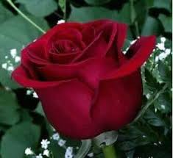
Thank YOU… stay safe
Dr. Engy Salah

