Slide 1
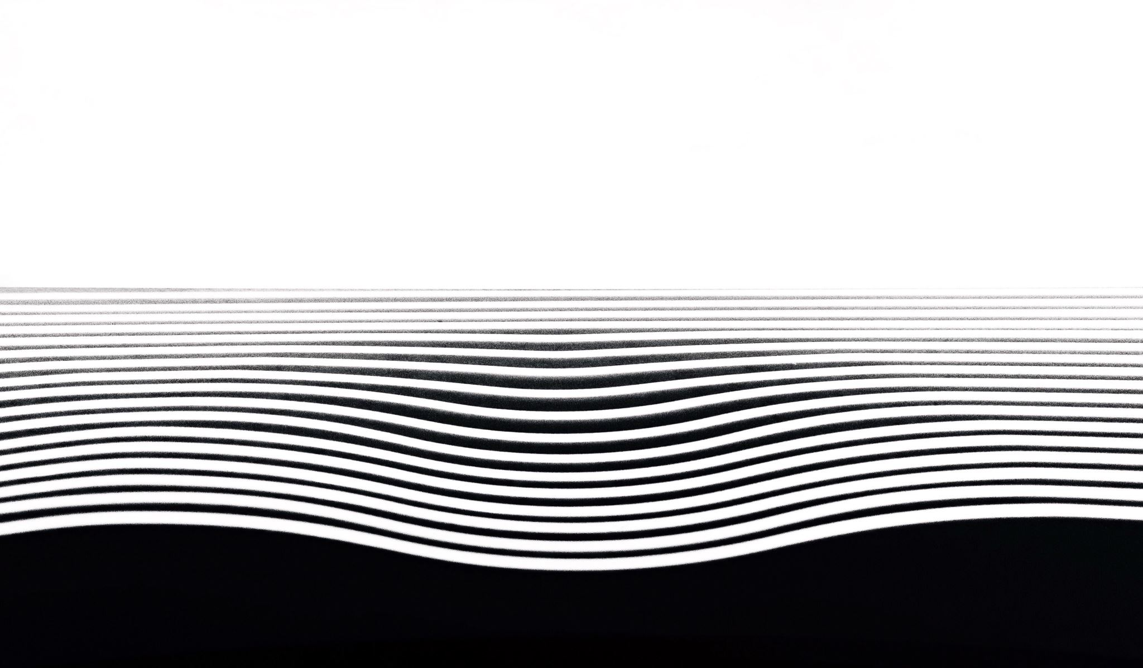
Damietta Faculty of Education Department of English Second Year Criticism 4th lecture- March 2020
Dr. Engy Salah

Slide 2
Contents:

Slide 3
First Argument:
Sidney’s initial argument is that poetry was the first form in which knowledge was expressed, the “first lightgiver to ignorance,” as bodied forth by figures such as Musaeus, Homer, and Hesiod, Livius, Ennius, Dante, Boccaccio, and Petrarch (216–217). And the first Greek philosophers Thales, Empedocles, Parmenides, and Pythagoras, he points out, expressed their vision in verse. Even Plato used poetic devices such as dialogue and description of setting and circumstance to adorn his philosophy (217). Again, historians such as Herodotus have borrowed the “fashion” and the “weight” of poetry. Sidney concludes here that “neither philosopher nor historiographer, could at the first have entered into the gates of popular judgments, if they had not taken a great passport of poetry” (218). Sidney’s point is that an essential prerequisite of knowledge is pleasure in learning; and it is poetry that has made each of these varieties of knowledge – scientific, moral, philosophical, political – accessible by expressing them in pleasurable forms (218).

Slide 4
Second Argument: Argument from tradition
Sidney’s second argument might be called the “argument from tradition” since it appeals to the ancient Roman and Greek conceptions of poetry and “stands upon their authorities” (219). The Roman term for the poet was vates, meaning “diviner, foreseer, or prophet, . . . so heavenly a title did that excellent people bestow upon this heart ravishing knowledge” (219). Sidney argues that this definition of the poet was quite “reasonable,”.
The ancient Greek definition of poetry is even more important for Sidney, providing access into his own view of the connection between poetry and nature. Sidney reminds the reader that the Greek origin of the English word “poet” was the word poiein, meaning “to make” (220).

Slide 5
Third Argument: Poet and Nature – Subject Matter
Every art, says Sidney, has “the works of Nature” for its “principal object”: the astronomer, for example, observes the stars as ordered in nature, and the geometrician and arithmetician examine quantities as ordered in nature; the natural philosopher examines physical nature, and the moral philosopher considers the natural virtues and vices; the grammarian, rhetorician, and logician expound respectively the rules of speech, persuasion, and reasoning as based on nature.
The poet, however, is free of any such subjection or dependence on nature: “only the poet, disdaining to be tied to any such subjection, lifted up with the vigor of his own invention, doth grow in effect into another Nature, in making things either better than Nature bringeth forth, or, quite anew forms such as never were in Nature”
Rather than being constrained within the “narrow” compass of nature, the poet ranges freely “only within the zodiac of his own wit” (221). As such, the poet’s “making” or production is superior to nature: “Nature never set forth the earth in so rich tapestry, as divers poets have done . . . Her world is brazen, the poets only deliver a golden” (221).
It is clear that if, for Sidney, poetry is higher than nature, his conception of poetry as imitation does not imply a slavish copying of nature. He states that poetry “is an art of imitation, for so Aristotle termeth it in his word mimesis, that is to say, a representing, counterfeiting, or figuring forth: to speak metaphorically, a speaking picture: with this end, to teach and delight” (223).

Slide 6
Fourth Argument: Poet and nature- Imitation
In this definition, Sidney adapts elements from Aristotle and Horace to offer his own somewhat broader view of imitation.
He suggests that there have been three kinds of poetic imitation:
The first consists of poetry that “did imitate the inconceivable excellencies of God,” as in the various poetical portions of the Old Testament.
The second kind of imitation is effected by poetry that deals with subjects whose scope is philosophical, historical, or scientific, such as the works … Lucan (223). This kind, Sidney observes, is determined by its field of study, being “wrapped within the fold of the proposed subject,” rather than relying on the poet’s “own invention” (224).
It is the final kind of imitation proposed by Sidney that lifts it free of the constraints imposed by Aristotle. This third kind, urges Sidney, is produced by “right poets . . . who having no law but wit, bestow that in colors upon you which is fittest for the eye to see.” These are the poets who “most properly do imitate to teach and delight, and to imitate, borrow nothing of what is, hath been, or shall be: but range only . . . into the divine consideration of what may be, and should be” (224).

Slide 7
Fourth Argument: Follow ‘Poet and Nature’
Hence the poet is free of dependence on nature in at least two ways: firstly, he is not restricted to any given subject matter, any given sphere of nature. Secondly, his “imitation” does not actually reproduce anything in nature, since his concern is not with actuality but with portrayals of probability and of idealized situations.
The ultimate aim of this kind of poetry is moral: the poet imitates, says Sidney, in order “both to delight and teach.” The object of both teaching and delighting is goodness: by delighting, the poet moves people to welcome goodness; and by teaching, he enables them to “know that goodness whereunto they are moved.” And this, says Sidney, is “the noblest scope to which ever any learning was directed” (224). Given these aims of poetry, it is not surprising that Sidney relegates “rhyming and versing” to the status of ornaments: it is not these which produce a poet but, rather, the “feigning notable images of virtues, vices, . . . with . . . delightful teaching” (225).

Slide 8
Fifth Argument: Poetry in a theological context
Sidney is careful to situate this human creativity in a theological context. Though man is a “maker” or poet, his ability derives from his “heavenly Maker . . . who having made man to his own likeness, set him beyond and over all the works of that second nature, which in nothing he showeth so much as in poetry: when with the force of a divine breath, he bringeth things forth far surpassing her doings” (222).
Sidney goes on to refer to original sin, as a result of which “our erected wit, maketh us know what perfection is, and yet our infected will, keepeth us from reaching unto it” (222).
Significant here is the intrinsic connection Sidney attempts to establish between man’s ability to “make” poetry and his status in relation to God. That man is made in the image of God is most profoundly expressed in man’s replication, on a lower level, of God’s function as a creator.
It also implies that man is elevated above the world of physical nature (which Sidney calls “second nature”). This God-like activity in man which exalts him above the rest of nature is expressed above all in poetry; it is poetry, too, in its exercise of “wit,” that allows us to glimpse perfection, even as our will, “infected” by original sin, prevents us from achieving it. This ultimately theological aim of poetry is elaborated later in Sidney’s text.

Slide 9
Sixth Argument: Poetry vs. other disciplines
However, Sidney sees all learning, and not just poetry, as directed to this final end or purpose: “to lead and draw us to as high a perfection, as our degenerate souls made worse by their clayey lodgings, can be capable of ” (225). All the spheres of learning, he states, endeavor “by knowledge to lift up the mind from the dungeon of the body, to the enjoying of his own divine essence” (226). While each of the sciences have “a private end in themselves,” they are nonetheless all directed “to the highest end.” And the “ending end of all earthly learning” is “virtuous action” (226).
Indeed, Sidney’s invocation of the ultimate aim of learning itself has an ulterior purpose: to establish poetry as the discipline most suited to this purpose.
The poet’s chief competitors in this regard, thinks Sidney, will be the moral philosopher and the historian. The former will claim that his path to virtue is the most direct since he will teach what virtue and vice are, how passion must be mastered, and how the domain of virtue extends into family and society (227). The historian, on the other hand, will claim that moral philosophers merely teach virtue “by certain abstract considerations,” whereas his own discipline, history, will offer concrete examples of virtue based on the “experience of many ages” (227). Sidney cites a third possible contender for this office of teaching virtue, the lawyer. But he rapidly dismisses the lawyer’s claim, since the lawyer “doth not endeavor to make men good, but that their evil hurt not others.” The lawyer merely imposes upon people to follow the outward form of virtue without changing their inward disposition (228).

Slide 10
Follow: the Sixth Argument-
Sidney summarizes the dispute between the moral philosopher and the historian by saying respectively that “the one giveth the precept, and the other the example” (228).
Since both disciplines are thus one-sided, they are both deficient:
the philosopher sets down the “bare rule” in difficult terms that are “abstract and general”;
the historian, conversely, lacks the force of generalization and is “tied, not to what should be, but to what is, to the particular truth of things” (229). Indeed, since the historian is “captived to the truth of a foolish world,” the lessons he is bound to impart will often be negative, showing in some cases how the wicked thrive and prosper (234).
It is the “peerless poet,” according to Sidney, who performs both functions:
“he coupleth the general notion with the particular example.”
The poet paints a “perfect picture” of the philosopher’s abstract insight, providing an image of what in philosophy is merely a “wordish description” (229).
It is poetry which can strike the soul and the inward sentiments by means of “a true lively knowledge.”
The philosopher’s declarations remain dark “if they be not illuminated or figured forth by the speaking picture of poesy” (230).
It is poetry which brings to life all the virtues, vices, and passions, and hence the “feigned images” of poetry have “more force in teaching” than the “regular instruction” of philosophy (231).

Slide 11
Follow the Sixth Argument-
And, whereas the philosopher teaches “obscurely” such that only learned people can understand him, the “poet is the food for the tenderest stomachs, the poet is indeed the right popular philosopher,” as shown by Aesop’s fables, which use accessible allegories (231).
The power of poetry to move or influence people, says Sidney, “is of a higher degree than teaching . . . it is well nigh the cause and the effect of teaching” (236). For people to be taught, they must first be filled with desire to learn: citing Aristotle’s dictum that the fruit of learning must not be merely gnosis (knowing) but praxis (doing), Sidney holds that poetry inspires people to perform what philosophy merely teaches in the abstract (236).
Since the historian is tied to reality, he is not at liberty to present the ideal pattern of people or events, whereas the poet can “frame his example to that which is most reasonable” (233). Moreover, whatever the historian can relate in terms of true events, the poet can make by his own imitation, “beautifying it both for further teaching, and more delighting, . . . having all . . . under the authority of his pen” (234). The emphasis here is on the poet’s freedom, which allows him to choose his material, to frame it in an ideal pattern, so that he can present virtue “in her best colors,” setting out his words “in delightful proportion” (234, 237). For all of these reasons, proclaims Sidney, we must set “the laurel crown upon the poet as victorious, not only of the historian, but over the philosopher” (235).

Slide 12
Sidney vs. Gosson
The first is that there are other kinds of knowledge more fruitful than poetry.
Sidney states that the greatest gifts bestowed upon human beings are oratio and ratio, speech and reason. It is poetry which most polishes the gift of speech, and it “far exceedeth prose” on two accounts: it engenders delight because of its meticulous ordering of words, and therefore it is memorable. Since knowledge depends on memory, poetry has an affinity with knowledge (246–247). Moreover, since poetry “teacheth and moveth to virtue,” there can be no “more fruitful knowledge” than this (248).
The second charge is that poetry “is the mother of lies” (247).
Sidney’s famous retort is that “the poet . . . nothing affirms, and therefore never lieth” (248). Unlike the historian, the poet does not claim to be telling the truth; he is not relating “what is, or is not, but what should or should not be.” He is writing “not affirmatively, but allegorically, and figuratively” (249).
The next objection to poetry is that it “abuseth men’s wit, training it to wanton sinfulness, and lustful love” (250).
The fault here, says Sidney, is with particular poets who have abused their art, not with the art itself. It is not that “poetry abuseth man’s wit, but that, man’s wit abuseth poetry” (250). Even the word of God, says Sidney, when abused, can breed heresy and blasphemy (251).
The final, and perhaps most serious, charge that Sidney confronts is that Plato banished poets from his ideal republic, some claiming that, as a philosopher, Plato was “a natural enemy of poets” (253).
Sidney suggests that Plato opposed the abuse of poetry rather than the art itself: he charged the poets of his day with promulgating false opinions of the gods which might corrupt the youth (255). The dangers of such false belief have now been removed by Christianity. Sidney also cites Plato’s dialogue Ion as giving a “divine commendation to poetry,” viewing poetry as inspired by “a divine force, far above man’s wit” (255–256).

Slide 13
General Hints
Sidney’s Apology for Poetry is in the mid-point between the Medieval and Renaissance ages.
What is interesting here is that Sidney’s invocation of a theological framework of learning is characteristically medieval; what is distinctly more modern and characteristic of the Renaissance is his alteration of the medieval hierarchy of disciplines, to place poetry at the apex.
Sidney’s tone is repeatedly triumphalist and persistent in attempting to overturn the conventional hierarchy of knowledge: “of all sciences . . . is our poet the monarch” (236). The irony here is that Sidney uses a theological justification for poetry to dethrone theology and philosophy from their preeminent status. Another reading of his procedure might be to say that, by imbuing poetry itself with a theological function, he furnishes the terms whereby theology might be displaced by poetry. It is poetry which most effectively disposes man to overcome his own lower nature, thereby offering access into the divine: “as virtue is the most excellent resting place for all worldly learning . . . so poetry, being the most familiar to teach it, and most princely to move towards it . . . is the most excellent workman” (239). And yet, for poetry to assume the “monarchy” of learning undermines the very theological framework to which this claim appeals: it is unmistakably a step in the direction of secular humanism.

Slide 14
General Hints:
The function of poetry for Sidney, as manifested in these comments, is threefold:
to teach people the substance of virtue;
to move people to virtuous action;
to impress upon people the transitory and worthless nature of worldly affairs.
The poet is historian and moral philosopher, but above all, preacher and theologian.
In Sidney’s text, poetry is elevated to that sacred status: in its very nature it is opposed to worldliness and “earth creeping” concerns; it is the newly appointed heaven of human invention and endeavor.

Slide 15
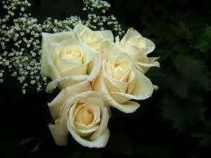
Thank You… Stay Safe
Dr. Engy Salah

