Slide 1
Damietta Faculty of Arts/Education Department of Geography/Social Studies First Year (Special) English 4th lecture- March 2020
Dr. Engy Salah

Slide 2
Reading Comprehension Unit 14
Look at the picture and try to describe it.
Who are the main characters of the story?
Does Miss Miller have a car?
Miss Miller has 10 new neighbors. (T/F)

Slide 3
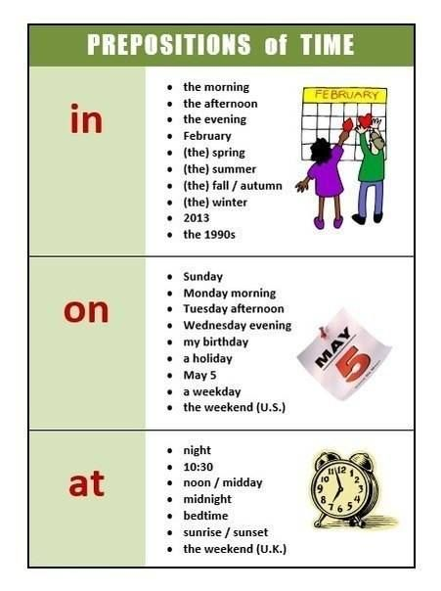
Unit 14- Language Functions
Empty x full
Town vs. city
One of the houses (was not were)….
In (morning/evening/afternoon) –
at (night/noon/dawn)- at (two o’clock)
Kind=nice x type
Kind x mean/evil
Can I come with you/ please do
Handsome vs beautiful

Slide 4
Unit 14- questions
How did Miss Miller go to the market?
Why did Miss Miller visit Mary Adam’s house?
Did Mary need food?
Were there any empty seats in the bus?
Put a title to the passage.
Summarize the passage in one complex sentence.
Write what you can imagine about what happened next?

Slide 5
Unit 11
Look at the picture and try to describe it.
Who are the main characters of the story?
Does Mrs. Walker have many children?
Al students in Harry’s school have bicycles. (T/F)

Slide 6
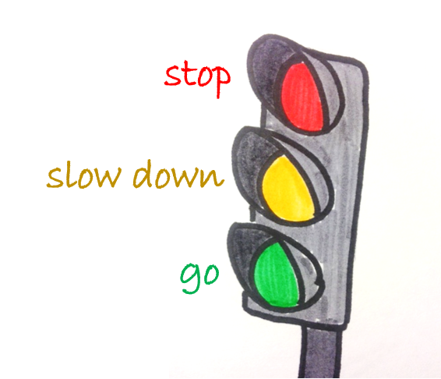
Language Functions/vocabulary
Traffic Lights: stop-slow down-go
His (he owns it) vs. (he’s (he+is)
His friend is my brother
He’s my brother
He is a four-year old boy vs. this boy is four years old.

Slide 7
Language Functions/Vocabulary
Colors in English

Slide 8
Language Functions/ pronouns

Slide 9
Questions
What will come next in the story?
Put a title
Summarize the passage in one compound-complex sentence
Can Harry drive a bicycle?
Is it difficult for Mrs. Walker to bring Harry from school? Why?
If you were Harry’s parents, what would you do?

Slide 10
Functional English: At the Airport
Key Phrases/ Vocabulary:
Passenger/ passenger service agent/ passport official/ detination/terminal/aisle/ baggage/upgrade/

Slide 11
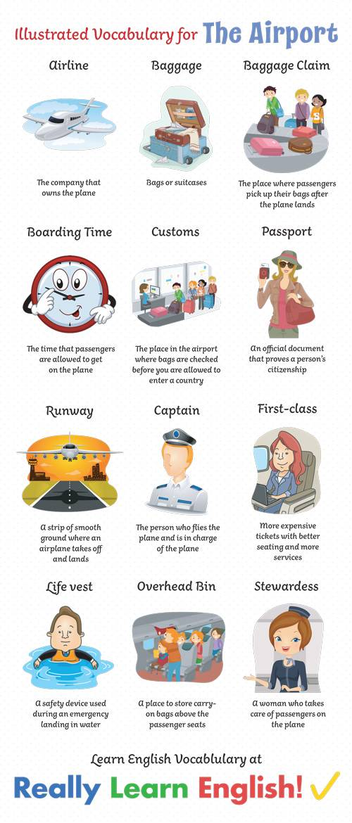
Vocabulary-Airport

Slide 12
Phrases at the airport

Slide 13
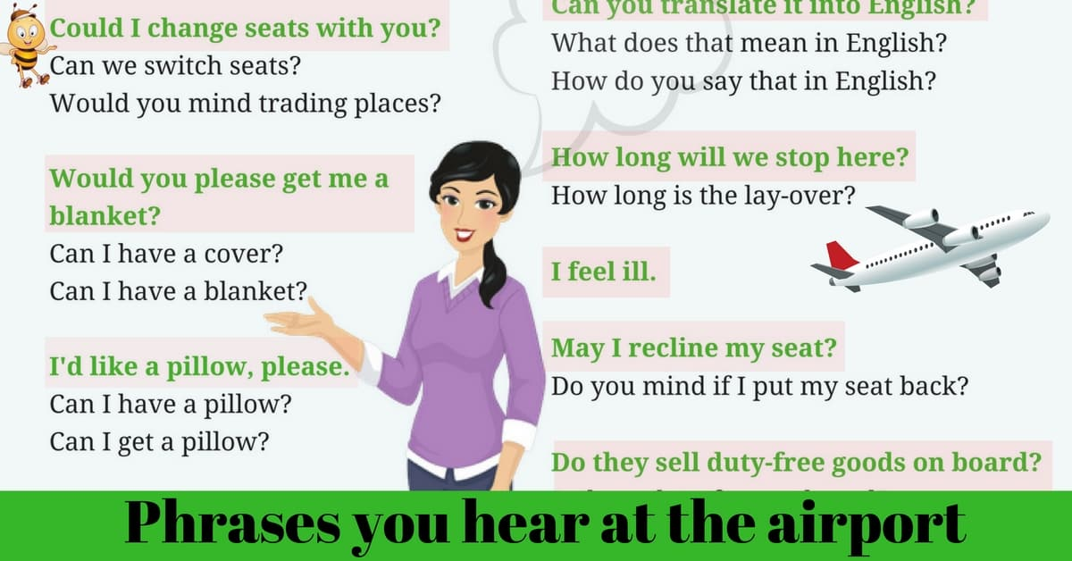
Phrases- Airport

Slide 14
Thank You … hope you all the best Stay Safe
Dr. Engy Salah

