Slide 1
Chpapter 5:
TRUSSES, FRAMES,
AND MACHINES

Slide 2
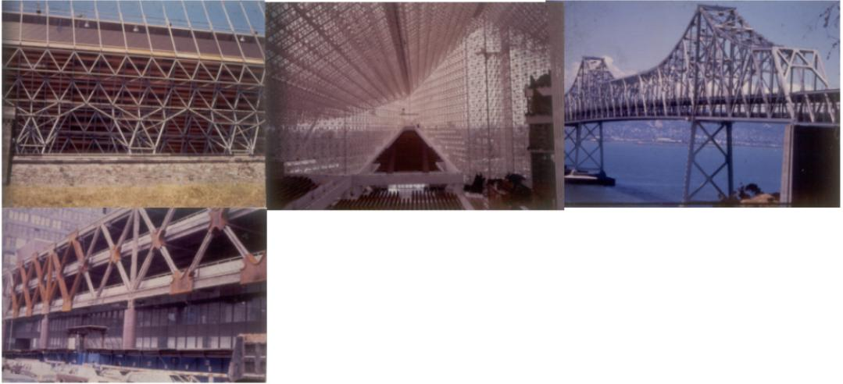
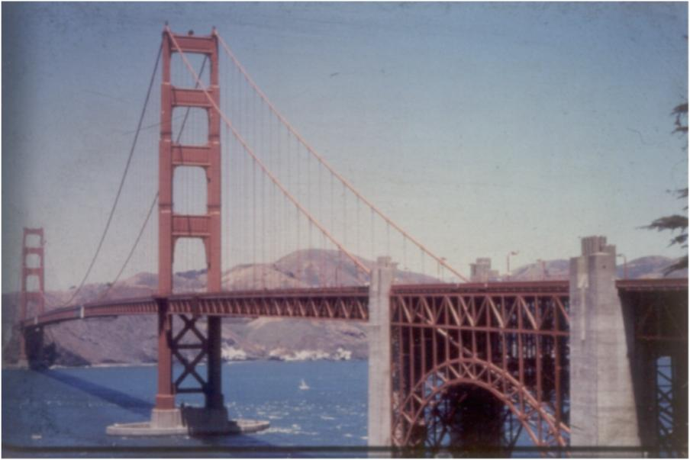
TRUSSES

Slide 3
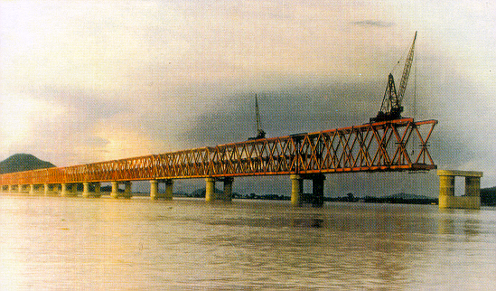
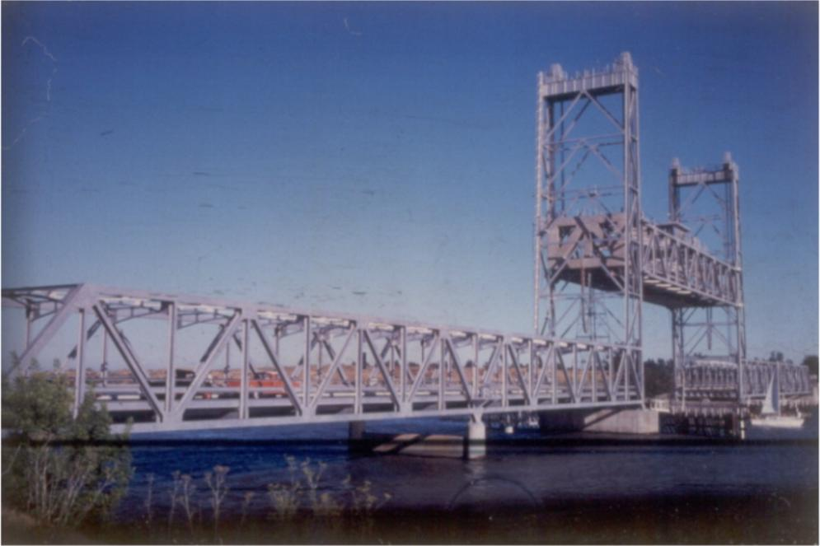
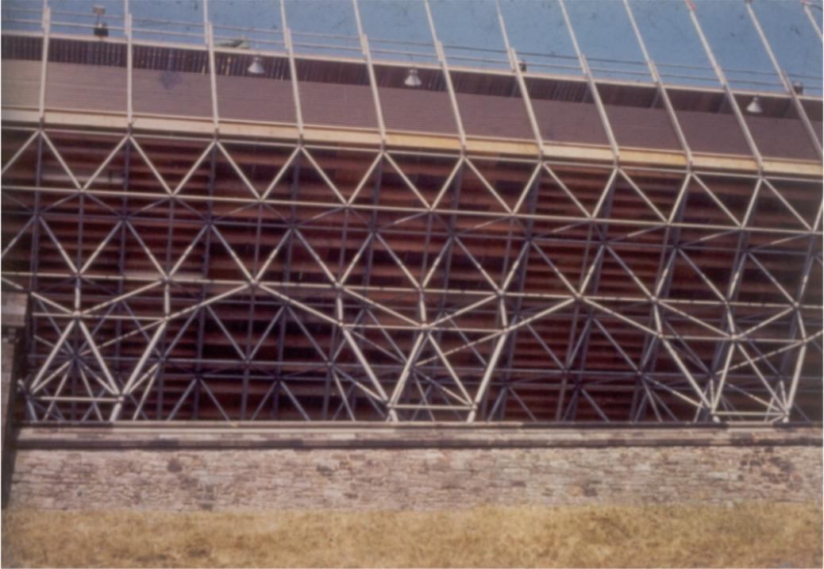
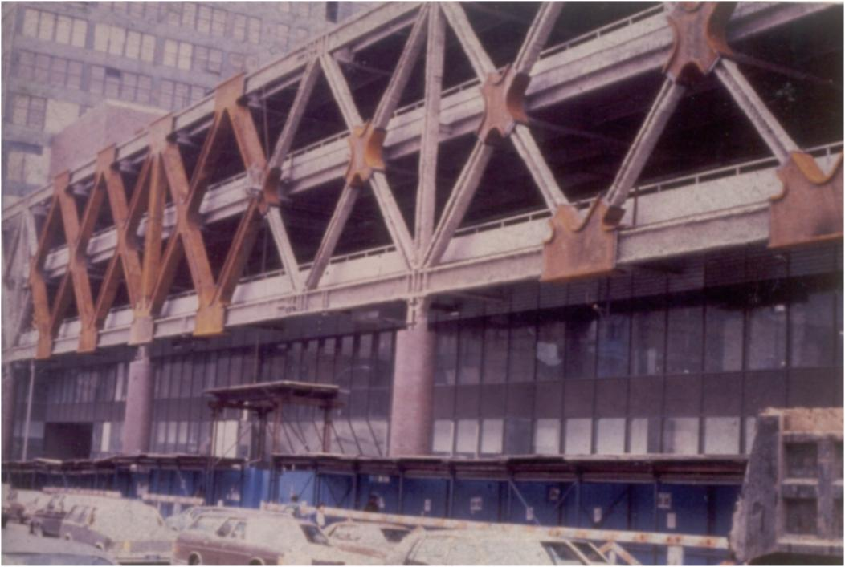

Slide 4
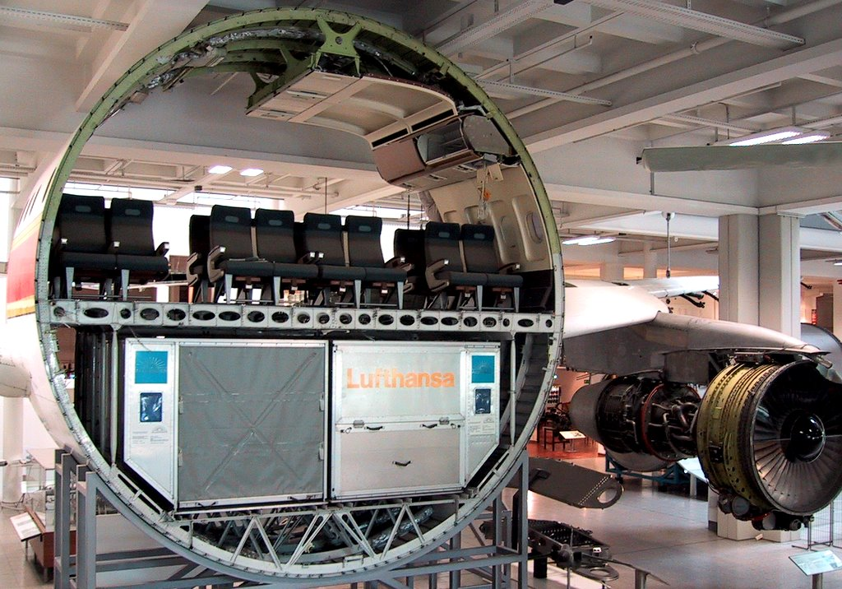
USE OF TRUSS STRUCTURES IN AVIATION
A300,
Europe, 1972
4

Slide 5
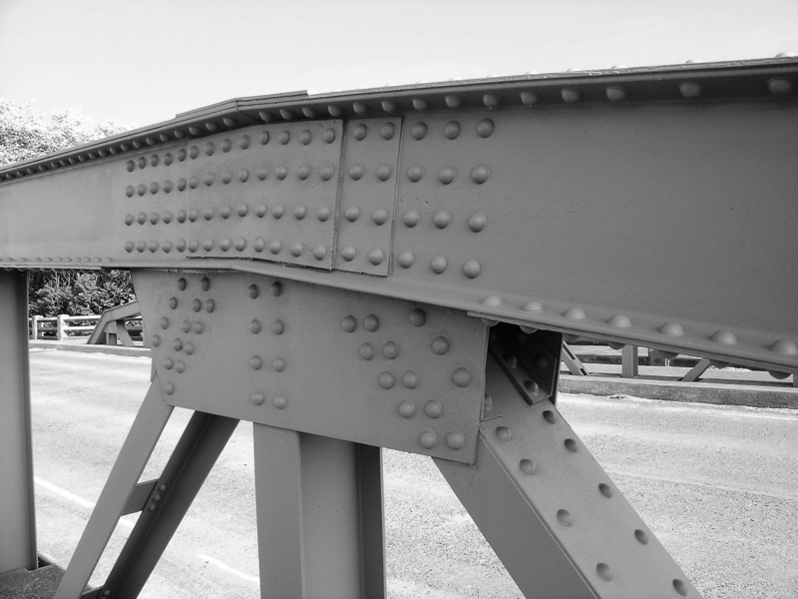
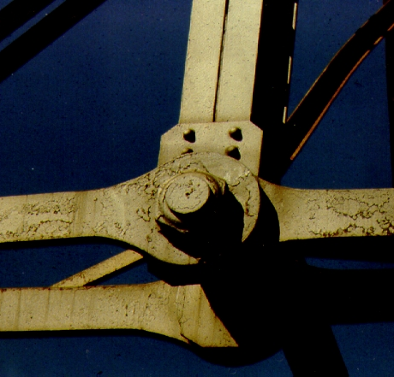
DIFFERENCE BETWEEN TRUSSES AND FRAMES
Connection by riveting,
moment-resistant
5

Slide 6
DIFFERENCE BETWEEN TRUSSES AND FRAMES
Trusses | Frames
Members are subjected to tension/compression only | At least one member is subjected to bending, shear or torsion
Composed of rods | Composed of bars
Usually more simple to calculate, more weight effective | Usually more simple to manufacture, and to place in tight layout
6

Slide 7
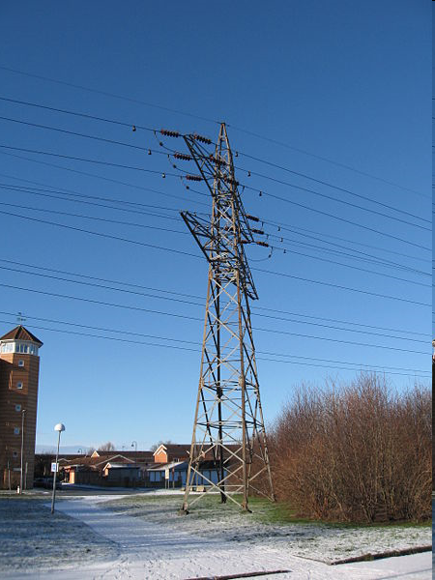

Plane truss
Space truss

Slide 8
Frames
A frame
  has at least one multiforce member,
  is stationary,
  and is designed to support/resist loads.

Slide 9
Machines
A machine
  has at least one multiforce member,
  is not stationary,
  and is designed to transmit loads from one thing to another.

Slide 10
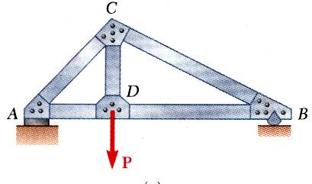
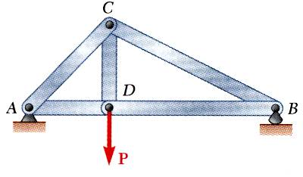
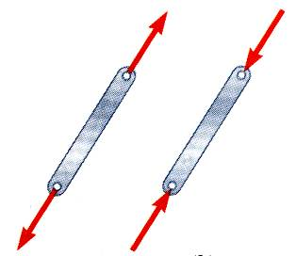
Definition of a Truss
A truss is a framework of members joined at ends with frictionless pins to form a stable structure.
Basic shape is a triangle.
Bolted or welded connections are assumed to be pinned together.
Only two-force members are considered.
When forces tend to pull the member apart, it is in tension. When the forces tend to compress the member, it is in compression.

Slide 11
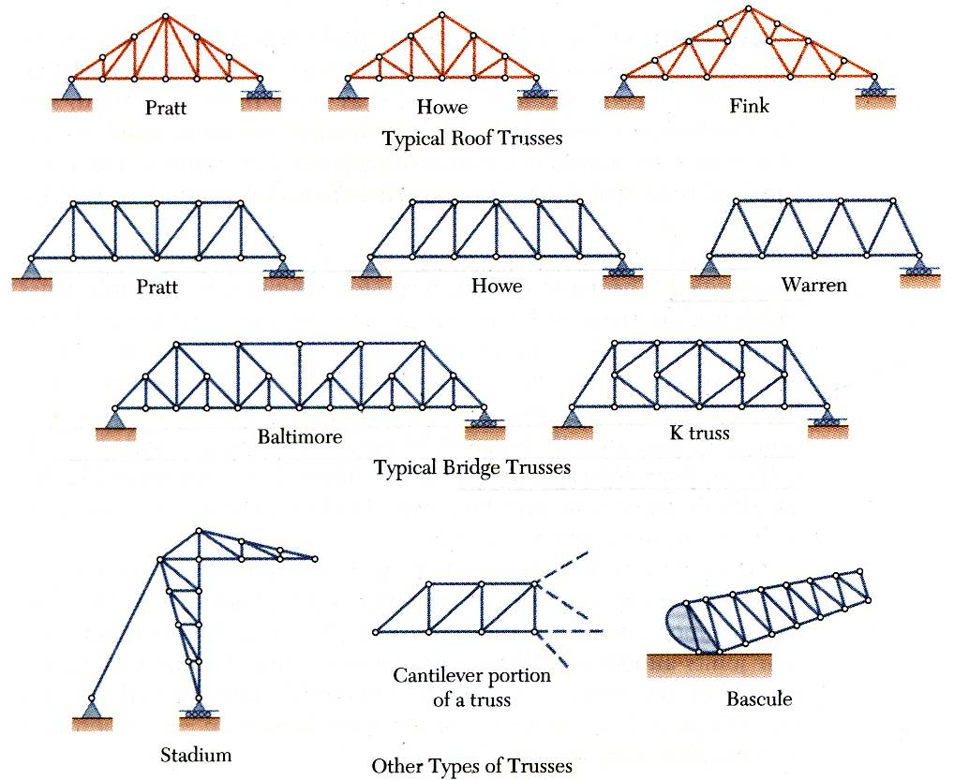
Types of Trusses

Slide 12
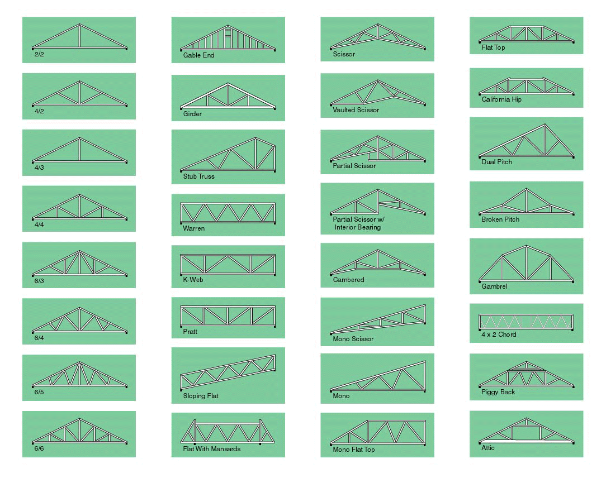
Yet More Trusses http://www.caltruss.com/products.htm

Slide 13
A truss is held in position by the supports and the loads are applied only at joints.
The free body diagram of a member shows that it is acted upon by two equal and opposite forces.
The hinged joint permits members to rotate with respect to each other and hence the members are subjected to purely axial forces.
T
T
Tension Member

Slide 14
C
C
Compression Member
The convention for internal forces, i.e., the action of forces in the members on the joints is shown.
T
C
TENSION
COMPRESSION

Slide 15
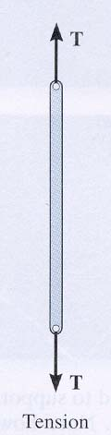
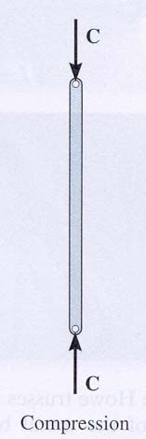
ANALYSIS & DESIGN ASSUMPTIONS
When designing both the member and the joints of a truss, first it is necessary to determine the forces in each truss member. This is called the force analysis of a truss. When doing this, two assumptions are made:
1. All loads are applied at the joints. The weight of the truss members is often neglected as the weight is usually small as compared to the forces supported by the members.
2. The members are joined together by smooth pins. This assumption is satisfied in most practical cases where the joints are formed by bolting the ends together.
With these two assumptions, the members act as two-force members. They are loaded in either tension or compression. Often compressive members are made thicker to prevent buckling.

Slide 16
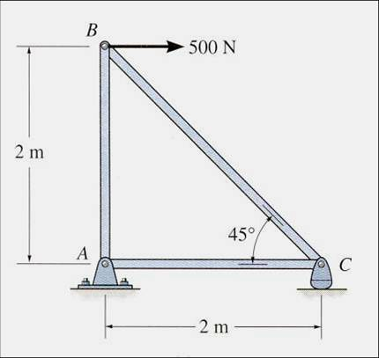
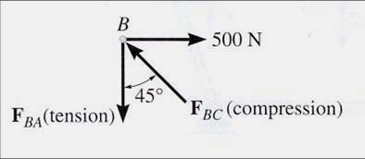
THE METHOD OF JOINTS (Section 6.2)
A free body diagram of Joint B
When using the method of joints to solve for the forces in truss members, the equilibrium of a joint (pin) is considered. All forces acting at the joint are shown in a FBD. This includes all external forces (including support reactions) as well as the forces acting in the members. Equations of equilibrium (∑ F_{X}= 0 and ∑ F_{Y} = 0) are used to solve for the unknown forces acting at the joints.

Slide 17
STEPS FOR ANALYSIS
If the truss’s support reactions are not given, draw a FBD of the entire truss and determine the support reactions (typically using scalar equations of equilibrium).
2. Draw the free-body diagram of a joint with one or two unknowns. Assume that all unknown member forces act in tension (pulling the pin) unless you can determine by inspection that the forces are compression loads.
3. Apply the scalar equations of equilibrium, ∑ F_{X} = 0 and ∑ F_{Y} = 0, to determine the unknown(s). If the answer is positive, then the assumed direction (tension) is correct, otherwise it is in the opposite direction (compression).
4. Repeat steps 2 and 3 at each joint in succession until all the required forces are determined.

Slide 18
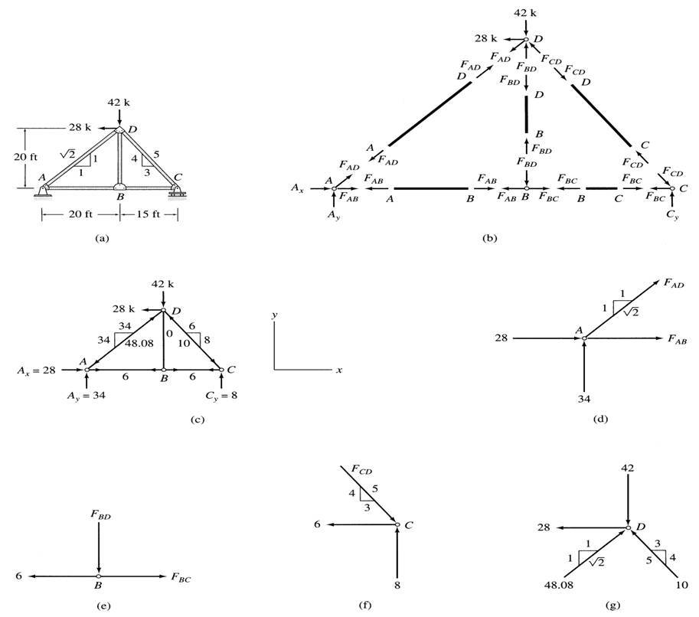
Method of Joints Example

Slide 19
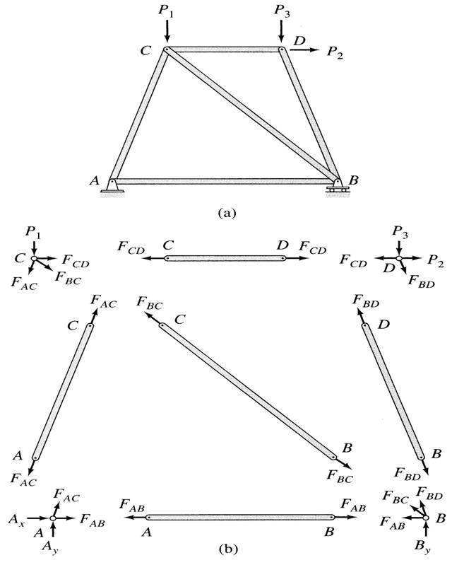
Method of Joints Example

Slide 20
Zero Force Members (ZFMs)
TWO-Member Version
  When only TWO members form a NON-CoLinear truss joint and NO external load or support reaction is applied to the joint then the members MUST be ZERO-FORCE members.
THREE-Member Version
  When THREE members form a truss joint for which two of the members are CoLinear and the third is forms an angle with the first two, then the NON-CoLinear member is a ZERO-FORCE member provided NO external force or support reaction is applied to the joint
    NOTE that The CoLinear members carry EQUAL loads.

Slide 21
Zero Force Members (ZFMs)
Truss members that canNOT carry load are called Zero Force Members.
Examples of Zero Force Members (ZFMs) are the colored members (AB, BC, and DG) in the truss shown at Right

Slide 22
Zero Force Members (ZFMs)
Again Consider
Summing the forces in the y-direction in the AB FBD shows that F_{AB} must be ZERO since it is NOT balanced by another y-force.
With F_{AB} =0 Summing forces in the x-direction shows that F_{BC} must also
be zero
FBD for AB & BC

Slide 23
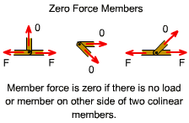
Zero Force Members (ZFMs)
Again Consider
Summing forces in the y-direction in the DG free-body-diagram, reveals that F_{DG} must be zero since it is not balanced by another y-force
The FBD for DG

Slide 24
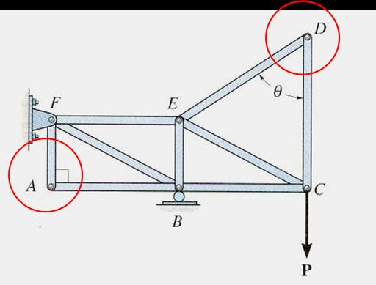
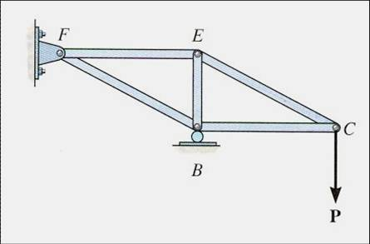
ZERO-FORCE MEMBERS (
If a joint has only two non-collinear members and there is no external load or support reaction at that joint, then those two members are zero-force members. In this example members DE, DC, AF, and AB are zero force members.
You can easily prove these results by applying the equations of equilibrium to joints D and A.
Zero-force members can be removed (as shown in the figure) when analyzing the truss.

Slide 25
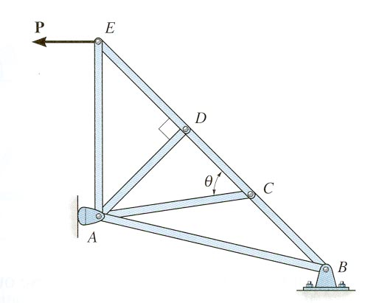
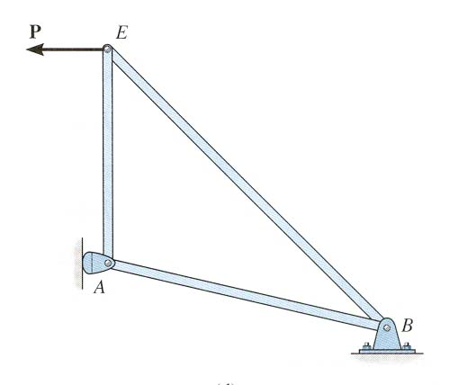
ZERO – FORCE MEMBERS (continued)
If three members form a truss joint for which two of the members are collinear and there is no external load or reaction at that joint, then the third non-collinear member is a zero force member.
Again, this can easily be proven. One can also remove the zero-force member, as shown, on the left, for analyzing the truss further.
Please note that zero-force members are used to increase stability and rigidity of the truss, and to provide support for various different loading conditions.

Slide 26
There is a simple relationship between the number of joints (j) and the number of members (m) is established as
where,
m is number of members,
j represents the number of joints and
3 represents the external support reactions.
m = 2j-3

Slide 27
Perfect truss
If m = 2j – 3
If m < 2j – 3
If m > 2j – 3
Deficient truss
Redundant truss

Slide 28
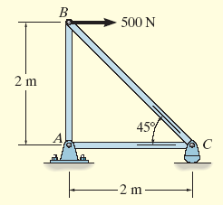
Example 6.1
Determine the force in each member of the truss and indicate whether the members are in tension or compression.

Slide 29
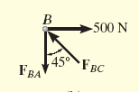
Solution
2 unknown member forces at joint B
1 unknown reaction force at joint C
2 unknown member forces and 2 unknown reaction forces at point A
For Joint B,

Slide 30
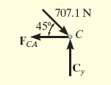
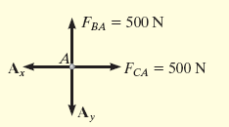
Solution
For Joint C,
For Joint A,

Slide 31
Solution
For Joint C,
For Joint A,

Slide 32
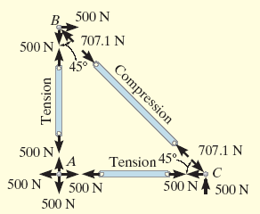
Solution
FBD of each pin shows the effect of all the connected members and external forces applied to the pin
FBD of each member shows only the effect of the end pins on the member

Slide 33
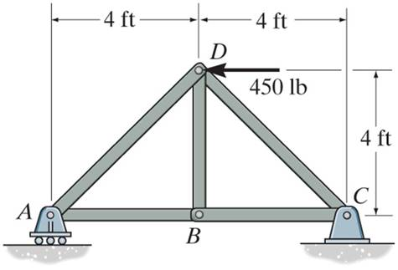
EXAMPLE
Given: Loads as shown on the truss
Find: The forces in each member
of the truss.
Plan:
Check if there are any zero-force members.
First analyze pin D and then pin A
Note that member BD is zero-force member. F_{BD} = 0
Why, for this problem, do you not have to find the external reactions before solving the problem?

Slide 34
EXAMPLE (continued)
D
450 lb
45 º
45 º
F_{AD}
F_{CD}
FBD of pin D
+ → ∑ F_{X} = – 450 + F_{CD} cos 45° – F_{AD} cos 45° = 0
+ ↑ ∑ F_{Y} = – F_{CD} sin 45° – F_{AD} sin 45° = 0
F_{CD} = 318 lb (Tension) or (T)
and F_{AD} = – 318 lb (Compression) or (C)

Slide 35
EXAMPLE (continued)
Analyzing pin A:
F_{AD}
A
45 º
F_{AB}
A_{Y}
FBD of pin A
+ → ∑ F_{X} = F_{AB} + (– 318) cos 45° = 0; F_{AB} = 225 lb (T)
Could you have analyzed Joint C instead of A?

Slide 36
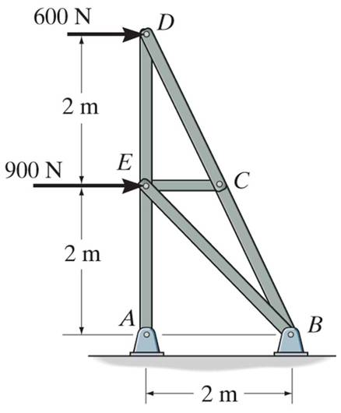
GROUP PROBLEM SOLVING
Given: Loads as shown on the truss
Find: Determine the force in all the truss members (do not forget to mention whether they are in T or C).
Plan:
a) Check if there are any zero-force members.
Draw FBDs of pins D and E, and then apply EE at those pins to solve for the unknowns.
Note that Member CE is zero-force member so F_{EC} = 0. If you didn’t see this simplification, could you still solve the problem?

Slide 37
GROUP PROBLEM SOLVING (continued)
FBD of pin D
From geometry, tan⁻¹(1/2)=26.57°
Y
600N
D
X
26.57°
F_{CD}
F_{DE}
Analyzing pin D:
→ + ∑F_{X} = 600 – F_{CD} sin 26.57° = 0
F_{CD} = 1341 N = 1.34 kN (C) (Note that F_{CD} = F_{BC}!)
+ ∑ F_{Y} = 1341 cos 26.57° – F_{DE} = 0
F_{DE} = 1200 N = 1.2 kN (T)

Slide 38
GROUP PROBLEM SOLVING (continued)
FBD of pin E
Y
F_{DE}
900 N
E
X
45°
F_{EB}
F_{EA}
Analyzing pin E:
→ + ∑F_{X} = 900 – F_{EB} sin 45° = 0
F_{EB} = 1273 N = 1.27 kN (C)
+ ∑ F_{Y} = 1200 + 1273 cos 45° – F_{EA} = 0
F_{EA} = 2100 N = 2.1 kN (T)

Slide 39
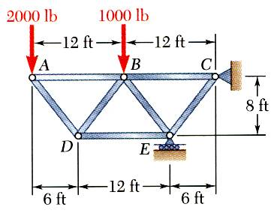
Example  2D Truss
SOLUTION PLAN
  Based on a free-body diagram of the entire truss, solve the 3 equilibrium equations for the reactions at E and C.
  Joint A is subjected to only two unknown member forces. Determine these from the joint (or pin) equilibrium requirements.
  In succession, determine unknown member forces at joints D, B, and E from pin equilibrium requirements.
  All member forces and support reactions are known at joint C. However, the joint equilibrium requirements may be applied
  to check the results
Using the method of joints, determine the force in each member of the truss.

Slide 40
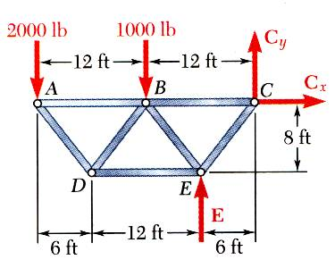
Example  2D Truss
SOLUTION
  Based on a free-body diagram of the entire truss, solve the 3 equilibrium equations for the reactions at E and C.
So-Far, So-Good

Slide 41
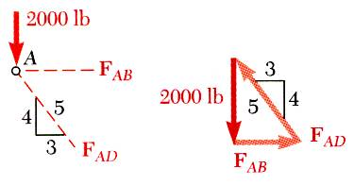
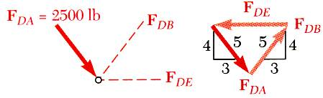
Example  2D Truss
Joint A is subjected to only two unknown member forces. Determine these from the pin (or joint) equilibrium requirements.
There are now only two unknown member forces at joint D.

Slide 42
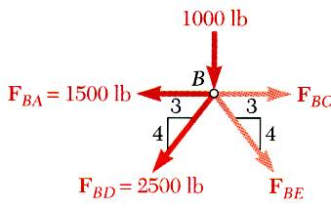
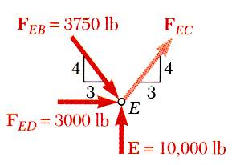
Example  2D Truss
There are now only two unknown member forces at joint B. Assume both are in tension.
There is one unknown member force at joint E. Assume the member is in tension.

Slide 43
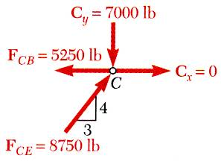
Example  2D Truss
CHECK
  All member forces and support reactions are known at joint C. However, the joint equilibrium requirements may be applied to check the results.
☑

Slide 44
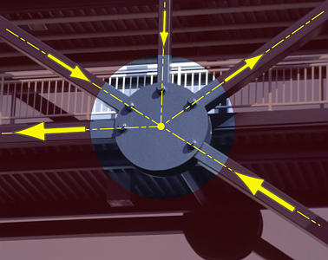
A Real Truss Joint Idealized
2 in Tension, 3 in Compression

Slide 45
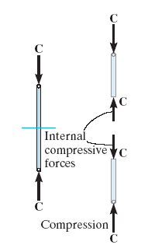
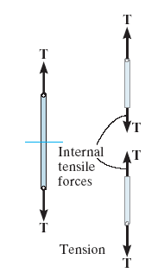
6.4 The Method of Sections
Used to determine the loadings within a body
If a body is in equilibrium, any part of the body is in equilibrium
To find forces within members, an imaginary section is used to cut each member into 2 and expose each internal force as external

Slide 46
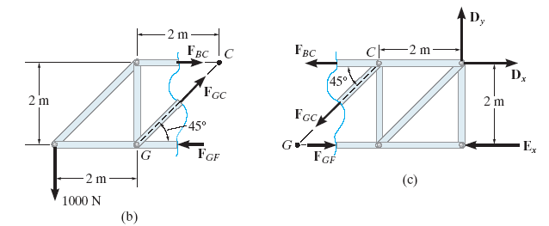
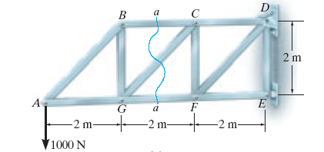
6.4 The Method of Sections
Consider the truss and section a-a as shown
Member forces are equal and opposite to those acting on the other part – Newton’s Law

Slide 47
6.4 The Method of Sections
Procedure for Analysis
Free-Body Diagram
Decide the section of the truss
Determine the truss’s external reactions
Use equilibrium equations to solve member forces at the cut session
Draw FBD of the sectioned truss which has the least number of forces acting on it
Find the sense of an unknown member force

Slide 48
6.4 The Method of Sections
Procedure for Analysis
Equations of Equilibrium
Summed moments about a point
Find the 3rd unknown force from moment equation

Slide 49
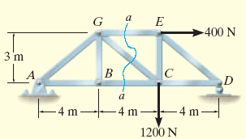
Example 6.5
Determine the force in members GE, GC, and BC of the truss. Indicate whether the members are in tension or compression.

Slide 50
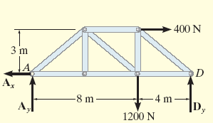
Solution
Choose section a-a since it cuts through the three members
Draw FBD of the entire truss

Slide 51
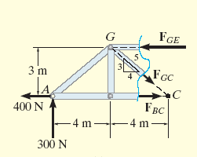
Solution
Draw FBD for the section portion

Slide 52
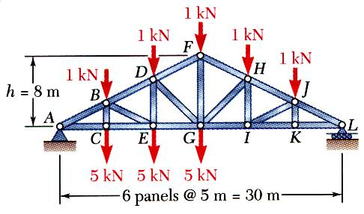
Sample problems 6.3
Determine the force in members FH, GH, and GI of the roof truss shown

Slide 53
SOLUTION:
Take the entire truss as a free body. Apply the conditions for static equilib-rium to solve for the reactions at A and L.
30 m
FG
8 m
α = 28.07º
tan α =
=
=
0.5333
GL
15 m

Slide 54
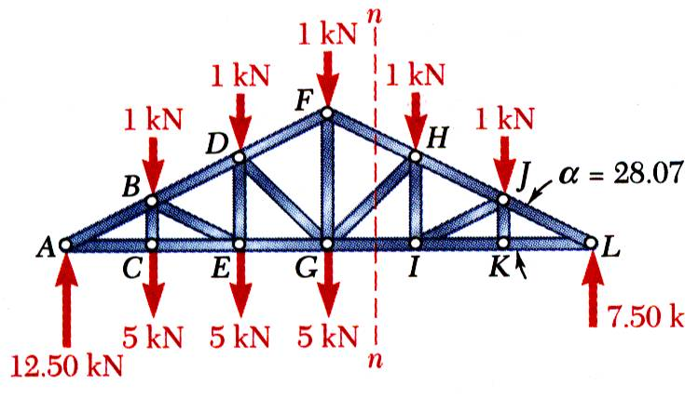

Force in member GI
Pass a section through members FH, GH, and GI and take the right-hand section as a free body.
Apply the conditions for static equilibrium to determine the desired member forces.

Slide 55


Force in member FH
Force in member GH
15

Slide 56


Space Trusses
An elementary space truss consists of 6 members connected at 4 joints to form a tetrahedron.
A simple space truss is formed and can be extended when 3 new members and 1 joint are added at the same time.
In a simple space truss, m = 3n − 6 where m is the number of members and n is the number of joints.
Conditions of equilibrium for the Ball-and-Socket joints provide 3n equations (no moments). For a simple truss, 3n = m + 6 and the equations can be solved for m member forces and 6 support reactions.
Equilibrium for the entire truss provides 6 additional equations which are not independent of the joint equations.

Slide 57

6.5 Space Trusses
Consists of members joined together at their ends to form 3D structure
The simplest space truss is a tetrahedron
Additional members would be redundant in supporting force P

Slide 58
6.5 Space Trusses
Assumptions for Design
Members of a space truss is treated as 2 force members provided the external loading is at the joints
When weight of the member is considered, apply it as a vertical force, half of its magnitude applied at each end of the member
Method of Joints
Solve ∑F_{x} = 0, ∑F_{y} = 0, ∑F_{z} = 0 at each joint
Force analysis has at least 1 unknown force and 3 unknown forces

Slide 59
6.5 Space Trusses
Method of Sections
When imaginary section is passes through a truss it must satisfied
∑F_{x} = 0, ∑F_{y} = 0, ∑F_{z} = 0
∑M_{x} = 0, ∑M_{y} = 0, ∑M_{z} = 0
By proper selection, the unknown forces can be determined using a single equilibrium equation

Slide 60

Example 6.8
Determine the forces acting in the members of the space truss. Indicate whether the members are in tension or compression.

Slide 61

Solution
For Joint A,

Slide 62

Solution
For Joint B,
To show,

