Slide 1

تفاضل وتكامل (1)
المستوي الأول
العلوم البيئية والكيمياء
النبات
علوم البحار البيولوجية
علم الحيوان
د/ ايمان الحديدي
2026/2025

Slide 2
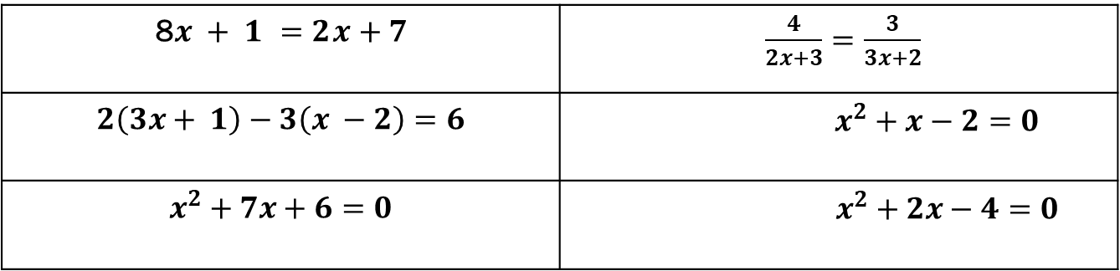
Assignment Review
1- Solve the following equations:
2- Find the equation for the line that passes through The points (-1, 3) and (4,6)
3- What is the slope and y intercept for equation $3x − 2y = 4$
$\frac{4}{2x+3}=\frac{3}{3x+2}$ | 8$x + 1 =2x+7$
$$x^{2}+x−2=0$$ | $$2\left(3x+ 1\right)−3\left(x −2\right)=6$$
$$x^{2}+2x−4=0$$ | $$x^{2}+7x+6=0$$

Slide 3
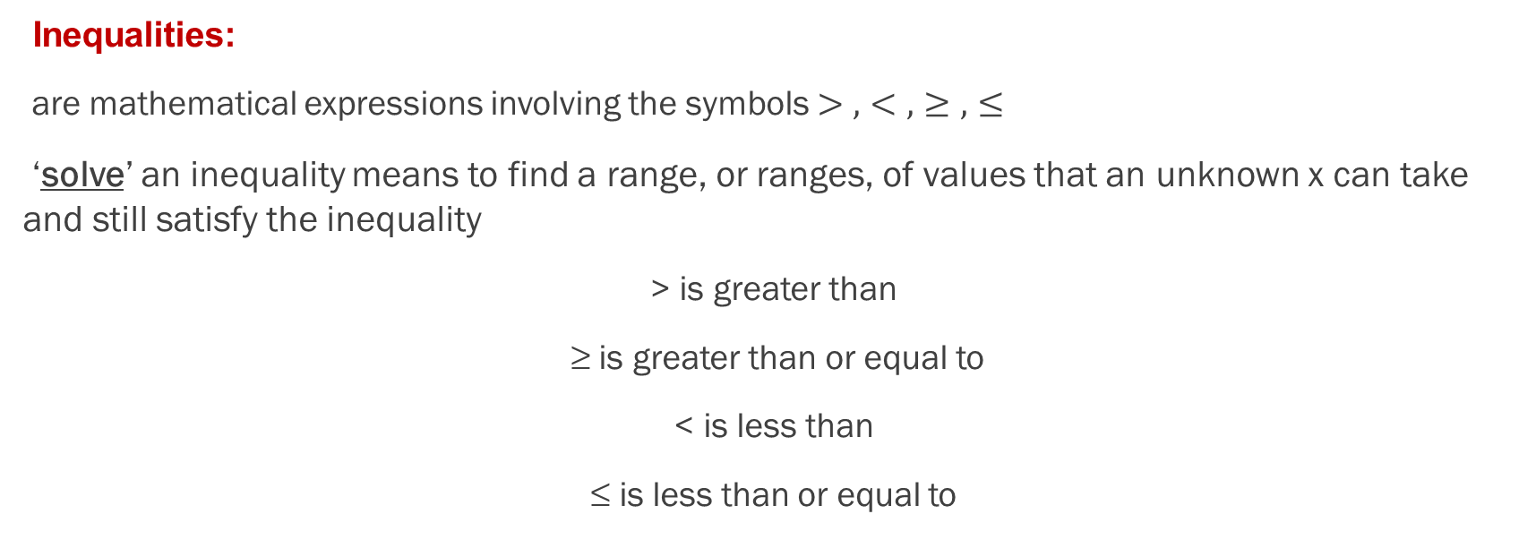
Inequality
Inequalities:
are mathematical expressions involving the symbols $>, <,≥, ≤$
‘solve’ an inequality means to find a range, or ranges, of values that an unknown x can take and still satisfy the inequality
> is greater than
≥ is greater than or equal to
< is less than
≤ is less than or equal to

Slide 4
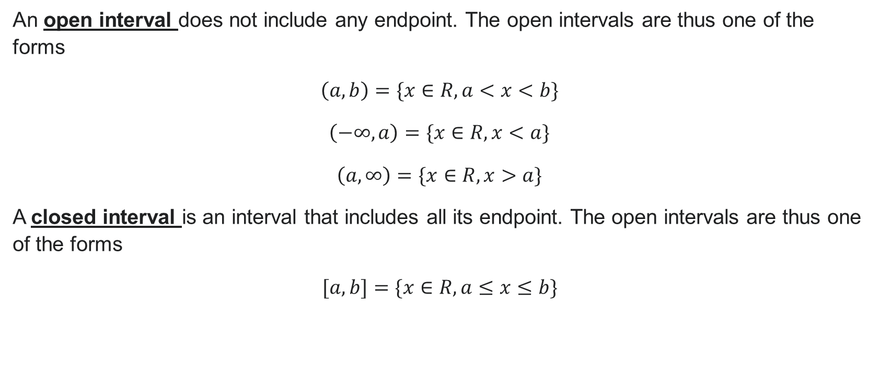
Inequality
An open interval does not include any endpoint. The open intervals are thus one of the forms
$\left(a,b\right)=\{x∈R,a<x<b\}$
$\left(−∞,a\right)=\{x∈R,x<a\}$
$\left(a,∞\right)=\{x∈R,x>a\}$
A closed interval is an interval that includes all its endpoint. The open intervals are thus one of the forms
$[a,b]=\{x∈R,a≤x≤b\}$

Slide 5
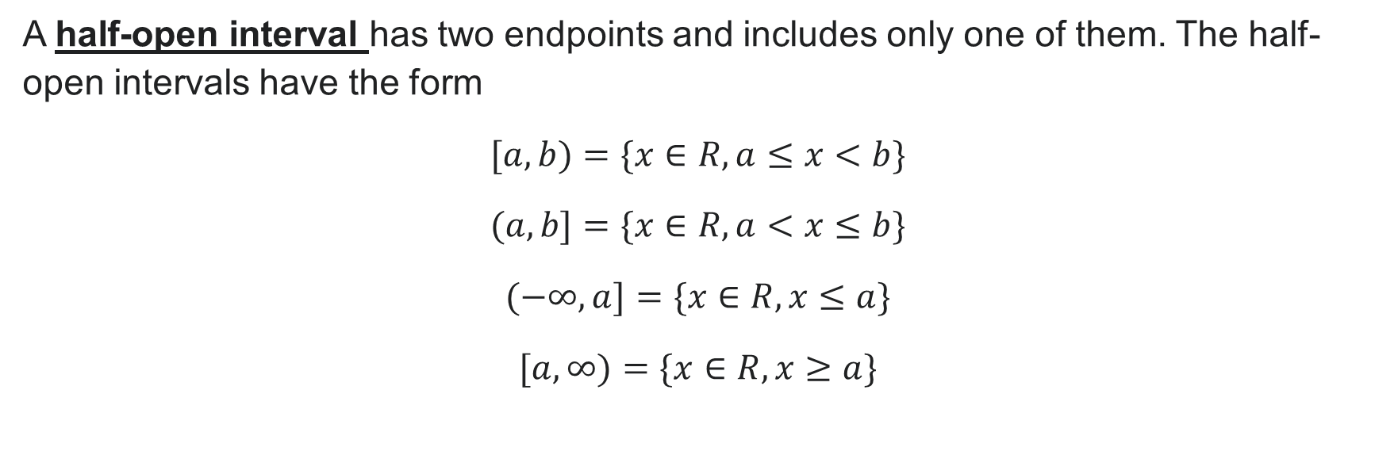
Inequality
A half-open interval has two endpoints and includes only one of them. The half-open intervals have the form
$[a,b)=\{x∈R,a≤x<b\}$
$(a,b]=\{x∈R,a<x≤b\}$
$(−∞,a]=\{x∈R,x≤a\}$
$[a,∞)=\{x∈R,x≥a\}$

Slide 6
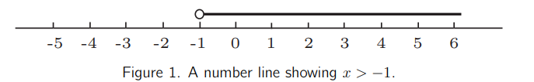

Inequality
Solve the inequality:
$x+3>2$
Solution:
We can solve this inequality by subtracting 3 from both sides:
$x+3−3>2−3$
$x>−1$
So the solution $x∈\left(−1,∞\right)$

Slide 7

Inequality
Solve the inequality:
$$2≤ 5x – 3 < 7$$
Solution:
We can solve this inequality by add 3 to both sides:
$$2+3≤ 5x – 3+3 < 7+3$$
$$5≤5x<10$$
divide both sides by 5
$$1≤x<2$$
So the solution $x∈[1,2)$

Slide 8
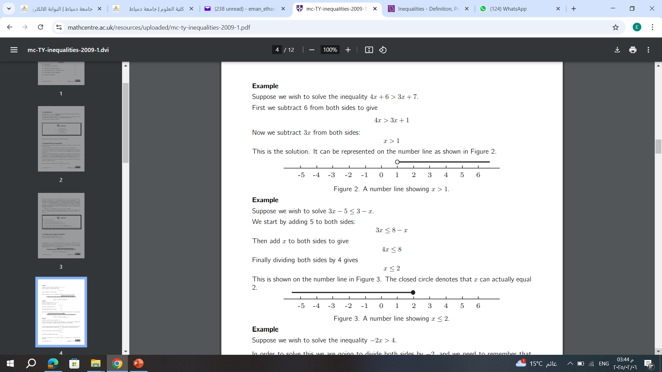

Inequality
Solve the inequality: $\text{4}x+6>3x+7$
Solution:
We can solve this inequality by subtracting 6 from both sides:
$\text{4}x+6−6>3x+7−6$
$4x>3x+1$
subtracting $3x$from both sides: $4x−3x>3x+1−3x$
$x>1$
So the solution $x∈\left(1,∞\right)$

Slide 9

Inequality
Solve the inequality: $\text{3}x−5≤3−x$
Solution:
We can solve this inequality by subtracting 5 from both sides:
$\text{3}x−5+5≤3−x+5$
$3x≤8−x$
add$x$to both sides: $3x+x≤8−x+x$
$4x≤8→x≤2$
So the solution $x∈(−∞,2]$

Slide 10

Inequality
Solve the inequality: $\text{−}\text{2}x>4$
Solution:
divide both sides by -2 and we need to remember that because we are dividing by a negative number we must reverse the inequality :
$x<−2$
So the solution $x∈(−∞,−2)$

Slide 11
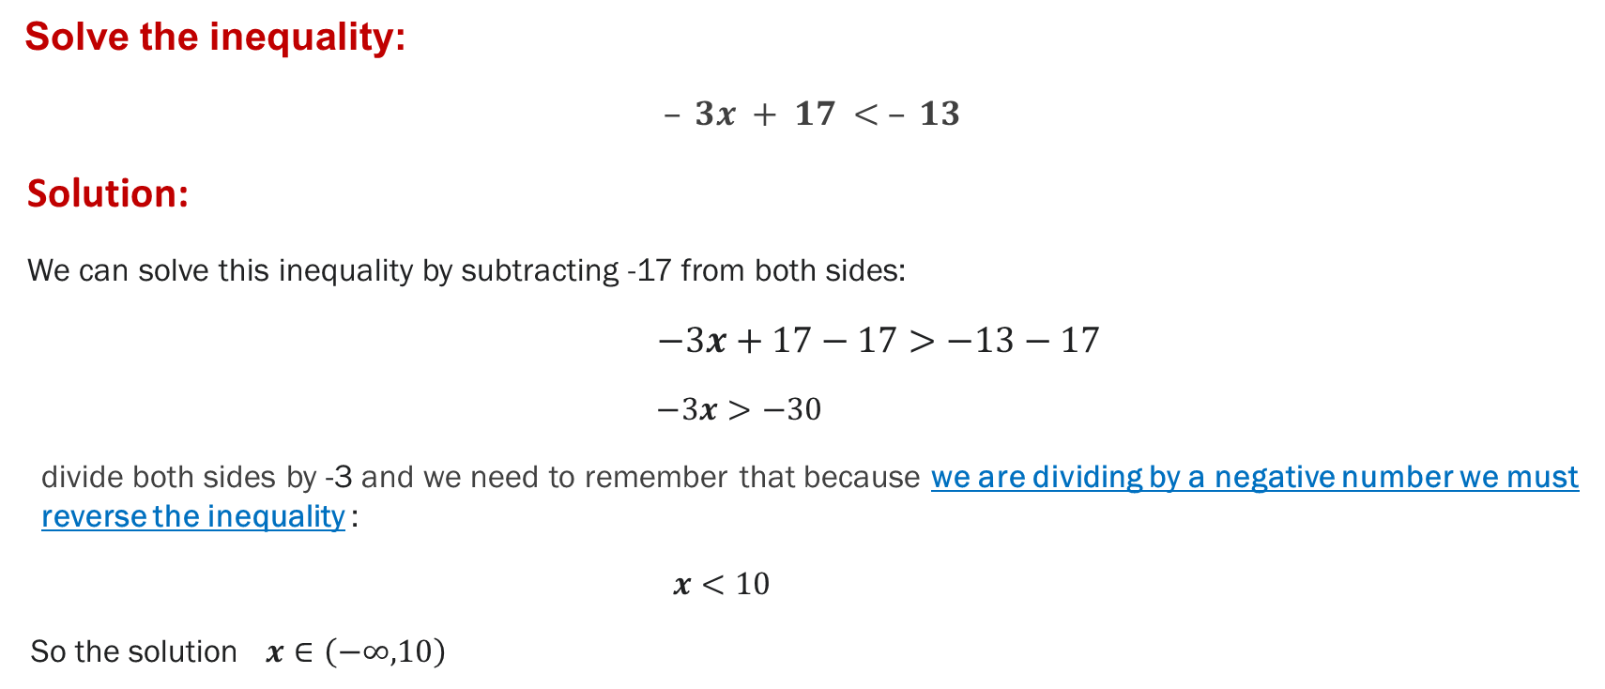
Inequality
Solve the inequality:
$– 3x + 17 < – 13$
Solution:
We can solve this inequality by subtracting -17 from both sides:
$−3x+17−17>−13−17$
$−3x>−30$
divide both sides by -3 and we need to remember that because we are dividing by a negative number we must reverse the inequality :
$x<10$
So the solution $x∈\left(−∞, 10\right)$

Slide 12













Inequality
Solve the inequality: $x^{2}+3x−4≤0$
Solution:
First let's factorize the quadratic expression $x^{2}+3x−4$
$x^{2}+3x−4=\left(x+4\right)\left(x−1\right)$
Hence, the values of x that satisfy the quadratic inequality are $\left[−4,1\right]$
$$\left(x+4\right)$$
$$−−−−$$
$$++++++++++$$
$$−4$$
$$\left(x−1\right)$$
$$−−−−$$
$$−−−−−−++++$$
$$1$$
$$\left(x+4\right)\left(x−1\right)$$
$$++++$$
$$−−−−−−++++$$
$$−4$$
$$1$$

Slide 13








Inequality
Solve the inequality: $x^{2}−7x+10<0$
Solution:
First let's factorize the quadratic expression $x^{2}−7x+10$
$x^{2}−7x+10=\left(x−5\right)\left(x−2\right)$
Hence, the values of x that satisfy the quadratic inequality are $(2,5)$
$$\left(x−2\right)$$
$$−−−−$$
$$++++++++++$$
$$2$$
$$\left(x−5\right)$$
$$−−−−$$
$$−−−−−−++++$$
$$5$$
$$\left(x−2\right)\left(x−5\right)$$
$$++++$$
$$−−−−−−++++$$
$$2$$
$$5$$

Slide 14








Inequality
Solve the inequality: $x^{2}−x−2≥0$
Solution:
First let's factorize the quadratic expression $x^{2}−x−2$
$x^{2}−x−2=\left(x−2\right)\left(x+1\right)$
Hence, the values of x that satisfy the quadratic inequality are $\left(−∞,−1\right]∪[2,∞)$
$$\left(x+1\right)$$
$$−−−−$$
$$++++++++++$$
$$−1$$
$$\left(x−2\right)$$
$$−−−−$$
$$−−−−−−++++$$
$$2$$
$$\left(x−2\right)\left(x+1\right)$$
$$++++$$
$$−−−−−−++++$$
$$−1$$
$$2$$

Slide 15








Inequality
Solve the inequality: $x^{2}+5x+6>0$
Solution:
First let's factorize the quadratic expression $x^{2}+5x+6$
$x^{2}+5x+6=\left(x+2\right)\left(x+1\right)$
Hence, the values of x that satisfy the quadratic inequality are $(−∞,−2)∪(−1,∞)$
$$\left(x+2\right)$$
$$−−−−$$
$$++++++++++$$
$$−2$$
$$\left(x+1\right)$$
$$−−−−$$
$$−−−−−−++++$$
$$−1$$
$$\left(x+2\right)\left(x+1\right)$$
$$++++$$
$$−−−−−−++++$$
$$−2$$
$$−1$$

Slide 16

Assignment
1- Solve the following inequalities:
1- $–8 ≤ 5x – 3 < 7$
2- $5x+2>2x+8$
3- $3x+1<4x−5$
4- $x^{2}+7x−8≤0$
5- $x^{2}−6x−7≥0$
6- $\frac{1}{x−1}≥0$
7- $x^{2}+2x−15≤0$

