Slide 1

تفاضل وتكامل (1) المستوي الأول العلوم البيئية والكيمياء النبات علوم البحار البيولوجية علم الحيوان
د/ ايمان الحديدي
2026/2025

Slide 2
Content
The course deals with the foundations of :
Algebra (Equation – Inequality)
introduction to calculus.
functions.
graphs.
exponential.
Logarithmic.
trigonometric functions.
differentials, integrals.

Slide 3
Equations
Equation:
is a mathematical formula that expresses the equality of two expressions, by connecting them with the equals sign =
For example
3x + 5 = 15
Equations can be solved to find the value of an unknown variable representing an unknown quantity
Degree of Equation:
The highest power of variables present in an equation

Slide 4
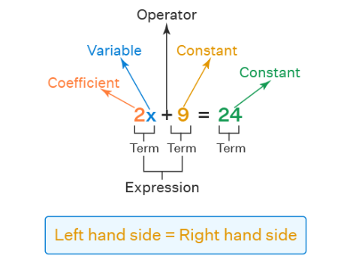
Equations

Slide 5
Equations
Types of Equations:
Based on the degree, equations can be classified into four types:
Linear Equations
Quadratic Equations
Cubic Equations
Biquadratic Equation
Linear Equation: Equations with 1 as the degree are known as linear equations in math.
Quadratic Equation: Equations with degree 2 are known as quadratic equations.
Cubic Equation: Equations with degree 3 are known as cubic equations.
Biquadratic Equation: Equations with degree 4 are known as biquadratic equations.

Slide 6
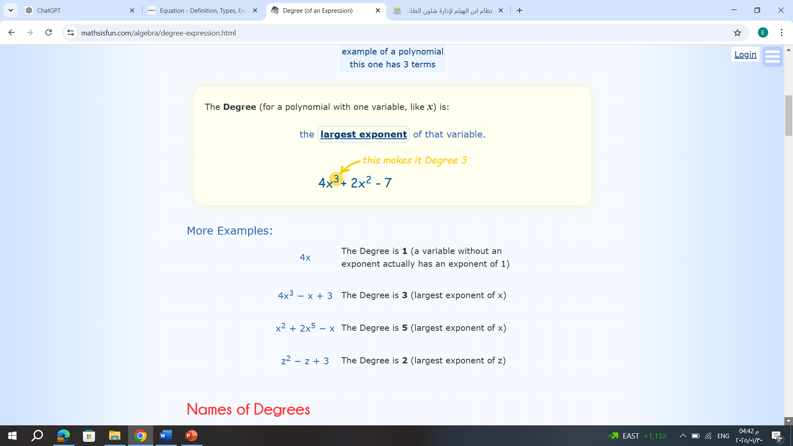
Equations

Slide 7

Equations
Example:
Classify the following equations by degree:
1- $13x2 + 5x3+17x+83$=0
2- $x+8=0$
3- $15x2+12x−7=0$
4- $32x^{4}− 23x^{2}+ 5x^{3}+ 7x − 4=0$

Slide 8
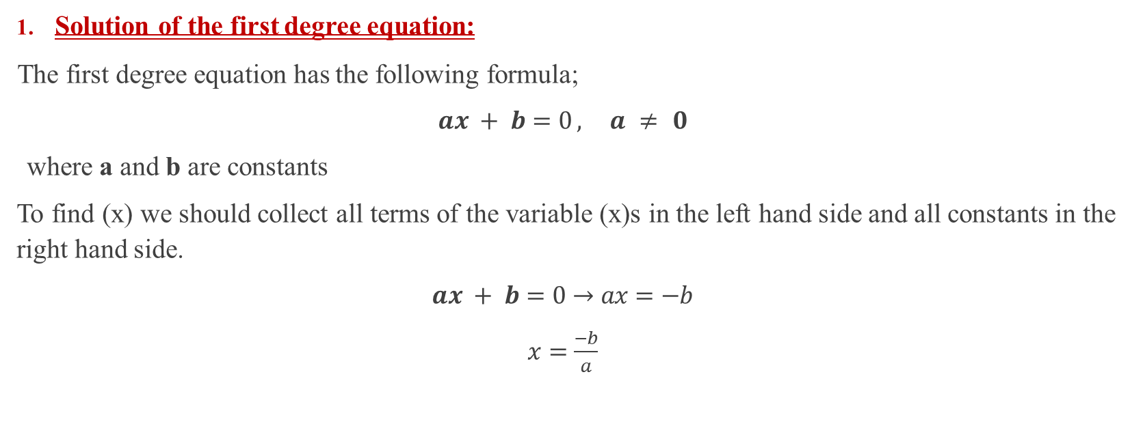
Equations
Solution of the first degree equation:
The first degree equation has the following formula;
$ax + b=0 , a ≠ 0$
where a and b are constants
To find (x) we should collect all terms of the variable (x)s in the left hand side and all constants in the right hand side.
$ax + b=0→ax=−b$
$x=\frac{−b}{a}$

Slide 9

Equations
Example:
Solve the following equations
$6x + 1 = 10x − 9$
Solution:
$6x + 1 = 10x − 9$
$6x −10x=− 9−1$
$−4x=−10$
$x=\frac{−10}{−4}$= $\frac{10}{4}$

Slide 10

Equations
$3(x − 1) + 2(2x + 1) = 4$
Solution:
$$3x −3 +4x+2= 4$$
$$3x +4x= 4+3−2$$
$$7x=5$$
$x=\frac{5}{7}$

Slide 11

Equations
Example:
$\frac{9}{x+2}=\frac{7}{2x+1}$
Solution:
$$9\left(2x+1\right)=7(x+2)$$
$$18x+9=7x+14$$
$$18x+7x=14−9$$
$$11x=5$$
$$x=\frac{5}{11}$$

Slide 12

Quadratic Equation
Example:
$x^{2}+5x+6=0$
Solution:
$$x^{2}+5x+6=0$$
$$\left(x+2\right)(x+3)=0$$
$$x+2=0,x+3=0$$
$$x=−2, x=−3$$

Slide 13

Quadratic Equation
Example:
2. $x^{2}+2x−3=0$
Solution:
$$x^{2}+2x−3=0$$
$$\left(x+3\right)(x−1)=0$$
$$x+3=0,x−1=0$$
$$x=−3, x=1$$

Slide 14
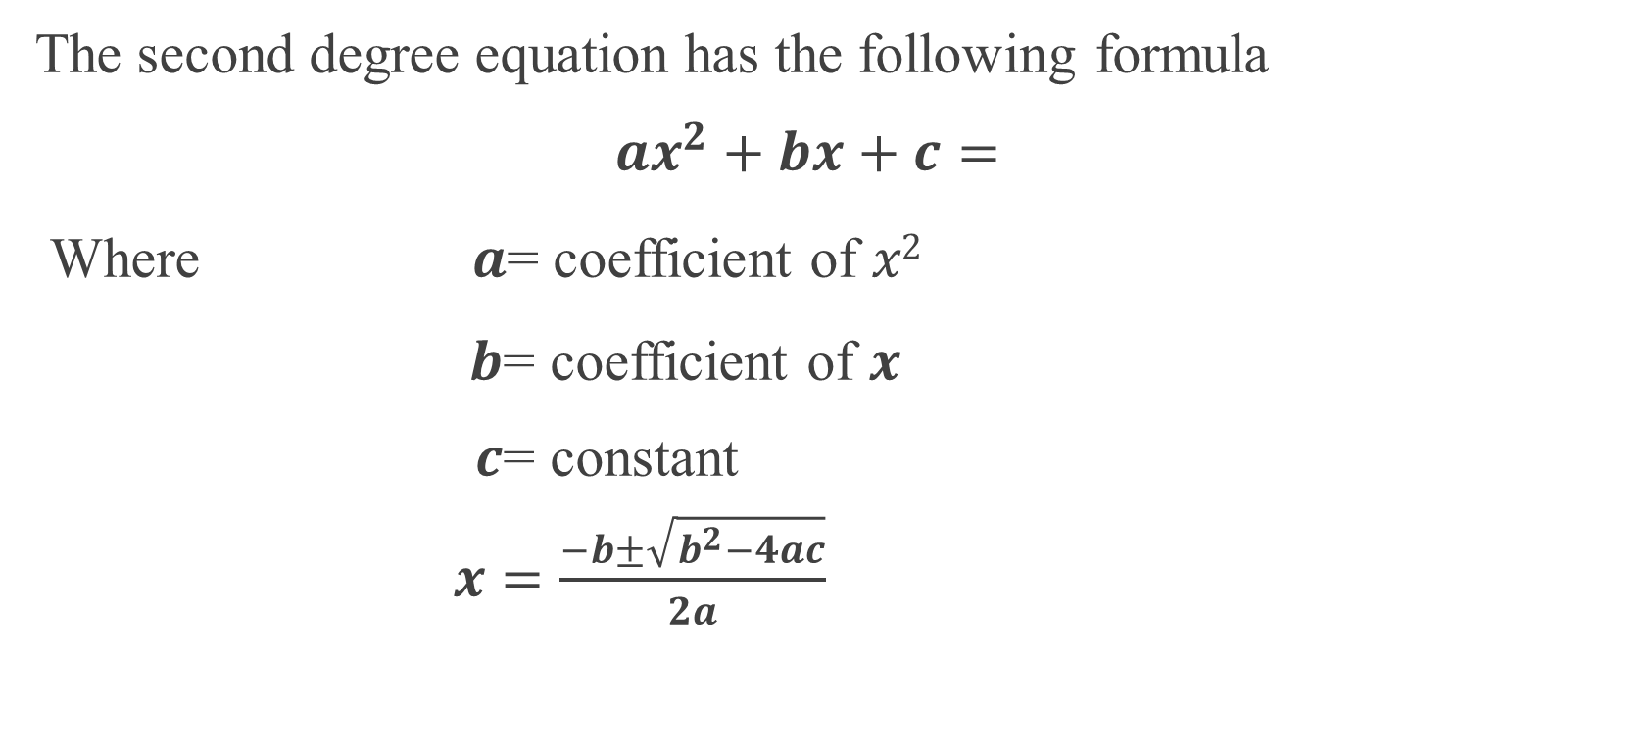
Quadratic Equation
The second degree equation has the following formula
$ax^{2}+bx+c=$
Where 𝒂= coefficient of 𝑥²
𝒃= coefficient of 𝒙
𝒄= constant
$x=\frac{−b±\sqrt{b^{2}−4ac}}{2a}$

Slide 15

Quadratic Equation
Example:
3.$x^{2}+2x−2=0$
Solution:
$a=1,b=2,c=−2$
$x=\frac{−2±\sqrt{4+8}}{2}$
$x=\frac{−2+\sqrt{12}}{2}, x=\frac{−2−\sqrt{12}}{2}$

Slide 16

Quadratic Equation
Example:
4.$x^{2}+x−1=0$
Solution:
$a=1,b=1,c=−1$
$x=\frac{−1±\sqrt{1+4}}{2}$
$x=\frac{−1+\sqrt{5}}{2}, x=\frac{−1−\sqrt{5}}{2}$

Slide 17

Equation of Straight lines
2. Straight lines and linear equations
A straight line equation can be formulated as
$y = mx + b$
where:
𝒙=The independent variable.
𝒚=The dependent variable
𝒎=The slope
𝒃=y-axis intercept

Slide 18
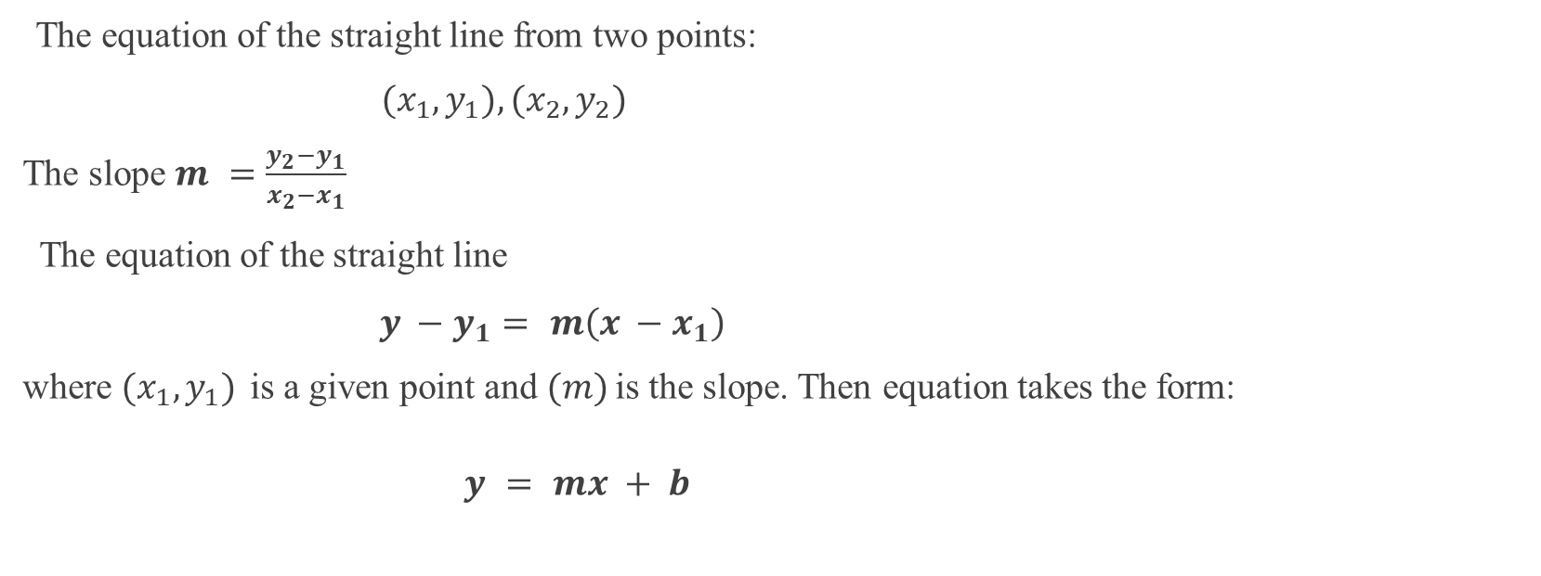
Equation of Straight lines
The equation of the straight line from two points:
$(x_{1},y_{1}), (x_{2},y_{2})$
The slope $m =\frac{y_{2}−y_{1}}{x_{2}−x_{1}}$
The equation of the straight line
$y −y_{1}= m\left(x −x_{1}\right)$
where $(x_{1},y_{1})$is a given point and (𝑚) is the slope. Then equation takes the form:
$y = mx + b$

Slide 19
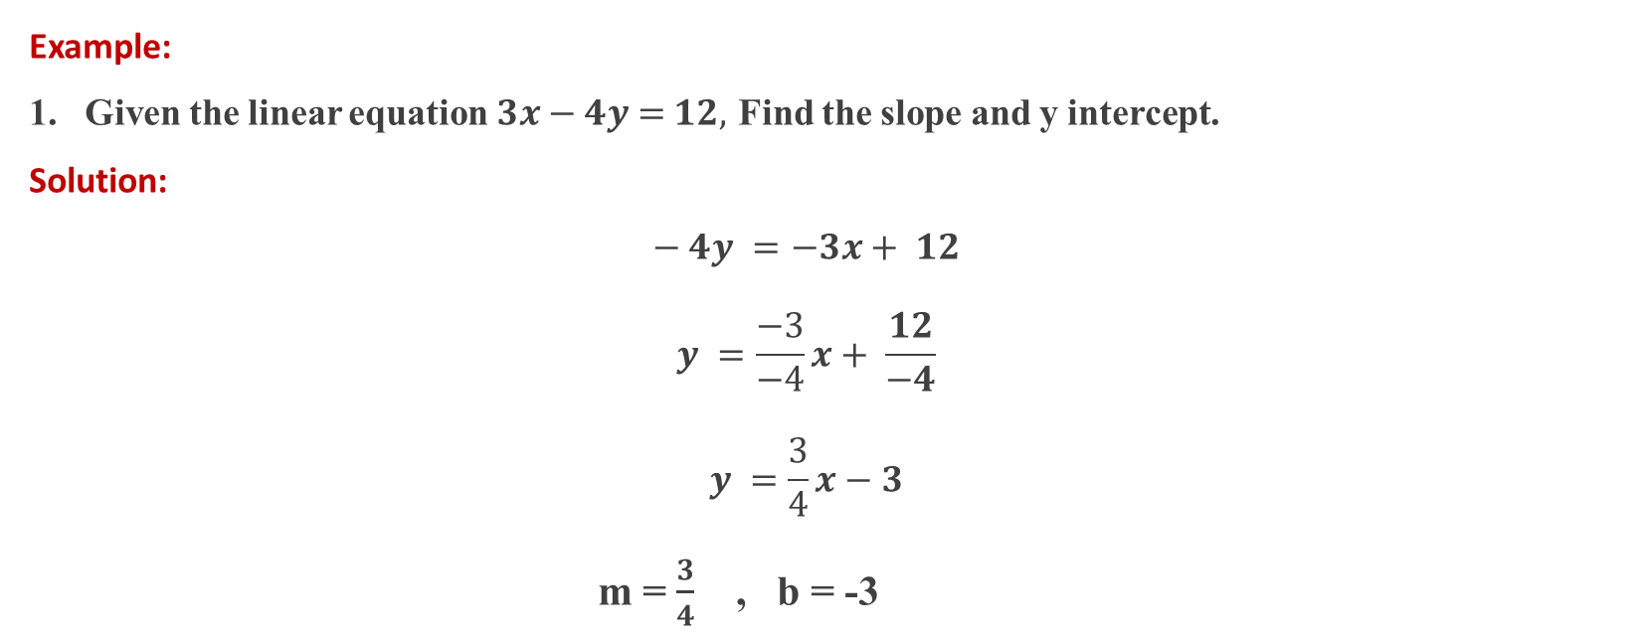
Equation of Straight lines
Example:
Given the linear equation 𝟑𝒙 − 𝟒𝒚 = 𝟏𝟐, Find the slope and y intercept.
Solution:
$$− 4y =−3x+ 12$$
$$y =\frac{−3}{−4}x+ \frac{12}{−4}$$
$$y =\frac{3}{4}x−3$$
m = $\frac{3}{4}$ , b = -3

Slide 20
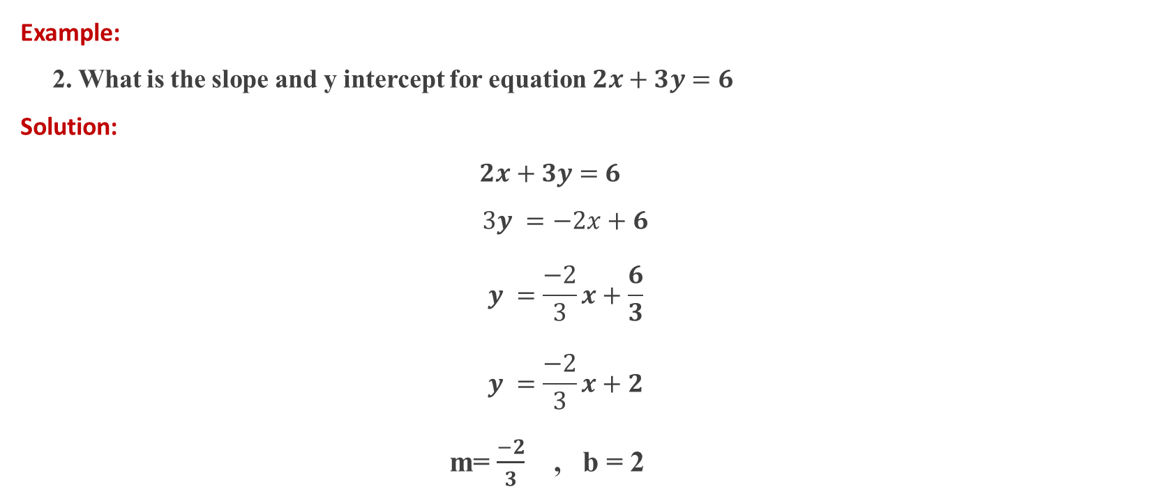
Equation of Straight lines
Example:
2. What is the slope and y intercept for equation 𝟐𝒙 + 𝟑𝒚 = 𝟔
Solution:
$$\text{2}\text{x} \text{+} \text{3}\text{y} \text{=} \text{6}$$
$$3y =−2x+6$$
$$y =\frac{−2}{3}x+\frac{6}{3}$$
$$y =\frac{−2}{3}x+2$$
m= $\frac{−2}{3}$ , b = 2

Slide 21

Equation of Straight lines
Example:
3. Find the equation for the line that passes through The points (-3, 2) and (-4, 5)
Solution:
$m =\frac{y_{2}−y_{1}}{x_{2}−x_{1}}$
$m =\frac{5−2}{−4−\left(−3\right)}$ = $\frac{3}{−4+3}$ = $\frac{3}{−1}$= -3
The equation of the straight line
$y −y_{1}= m\left(x −x_{1}\right)$
$y −2=−3\left(x −(−3)\right)$
$y −2=−3\left(x+3\right)$

Slide 22

Equation of Straight lines
Example:
5. Find the equation for the line that passes through The point (0, 5) and slope (m)= 4
Solution:
The equation of the straight line
$y −y_{1}= m\left(x −x_{1}\right)$
$y −5=4\left(x−0\right)$
$y −5=4x$

Slide 23
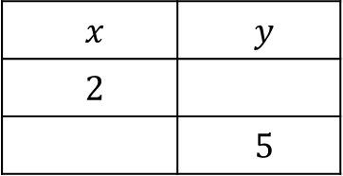

Equation of Straight lines
Example:
5. if $x+2y=8$ Complete the following table.
write down the coordinates
What is the slope and y intercept for this equation
$$y$$ | $$x$$
 | $$2$$
$$5$$

Slide 24
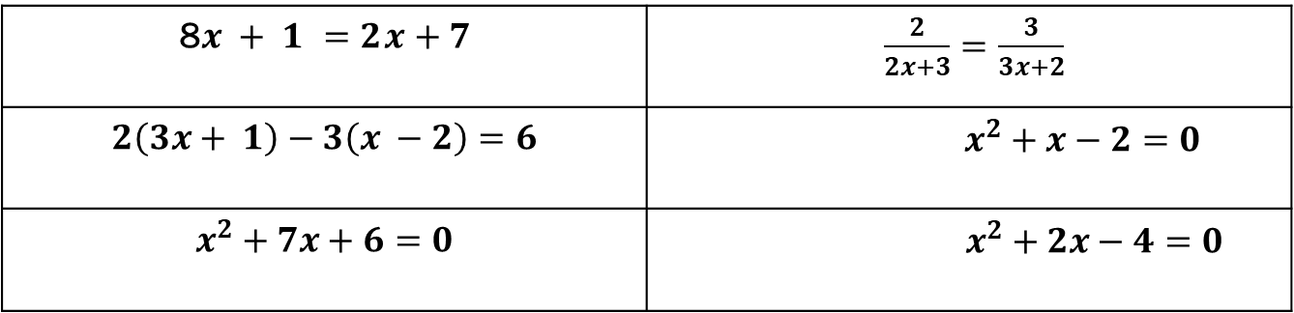

Assignment
1- Solve the following equations:
2- Find the equation for the line that passes through The points (-1, 3) and (4,6)
3- What is the slope and y intercept for equation $3x − 2y = 4$
$\frac{2}{2x+3}=\frac{3}{3x+2}$ | 8$x + 1 =2x+7$
$$x^{2}+x−2=0$$ | $$2\left(3x+ 1\right)−3\left(x −2\right)=6$$
$$x^{2}+2x−4=0$$ | $$x^{2}+7x+6=0$$

