Slide 1
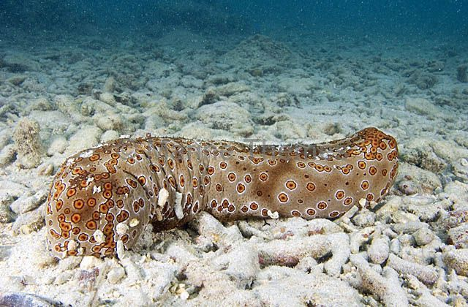
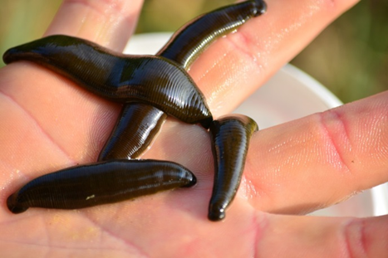
MEDICAL Invertebrates
Prof. Dr. Ola A. Abu Samak
Prof. of Parasitology
Zoology Department

Slide 2
COURSE SPECIFICATION
1ـ بيانات المقرر | أحد المقررات الاختيارية للحصول على درجة البكالوريوس تخصص الحيوان والكيمياء
الرمز الكودى : 218ح | اسم المقرر : لافقاريات طبية Medical Invertebrates | الفرقة: الثانية /علم الحيوان والكيمياء
التخصص: الحيوان والكيمياء | عدد الساعات: محاضرة:1 تمرين: 0 عملى: 2 (ساعة/الأسبوع) عدد الساعات المعتمدة: 2
2ـ هدف المقرر: | By the end of this course the student must be able to: Use pertinent biological information as well as state of science information pertaining in the field of invertebrate animal medicine to develop the familiarity with importance of invertebrates in biomedical research and ecosystems.
3-المخرجات التعليمية المستهدفة من المقرر:
أ ـ المعلومات والمفاهيم: | By the end of this course the student must be able to: a1. Identify the general concepts of natural history and taxonomy of certain invertebrates. a2. Identify the general information about anatomy and physiology of certain invertebrate groups. a3. Recognize the benefits as well as the environmental disorders and infectious diseases of certain invertebrate animals. a4. List the medically importance of certain invertebrates
ب ـ المهارات الذهنية | By the end of this course the student must be able to: b1. Report symptoms of infectious diseases to increase the familiarity with invertebrate importance. b2. Review the benefits as well as the environmental disorders to develop the familiarity with importance of invertebrates in ecosystems.
جـ ـ المهارات المهنية الخاصة بالمقرر : | By the end of this course the student must be able to: c1. Use the light microscope to identify the infectious diseases of certain invertebrate animals. c2. Examine various disorders in the selected examples of invertebrate animals to increase the information in the field of invertebrate animal medicine.
د ـ المهارات العامة: | By the end of this course the student must be able to: d1. Acquire self- and long life-learning during the study of the invertebrate medicine. d2. Apply scientific models, and tools effectively to understand the different symptoms of invertebrate diseases.

Slide 3
Content
W. | Topic | Lect | Pract | Tutor.
1 | Introduction | 1 | 2 | 0
2 | Porifera (Sponges) | 1 | 2 | 0
3 | Coelenterates | 1 | 2 | 0
4 | Turbellarians | 1 | 2 | 0
5 | Annelids | 1 | 2 | 0
6 | Custaceans | 1 | 2 | 0
7 | Midterm exam | 1 | - | 0
8 | Insects | 1 | 2 | 0
9 | Horseshoe Crabs | 1 | 2 | 0
10 | Spiders | 1 | 2 | 0
11 | Gastropods | 1 | 2 | 0
12 | Cephalopods | 1 | 2 | 0
13 | Bivalves | 1 | 2 | 0
14 | Echinodermats | 1 | 2 | 0
15 | Practical exam. | 0 | 2 | 0
16&17 | Writing and oral exam. | 1 | - | 0

Slide 4
Annelids
Quick Facts
The annelids include earthworms, polychaete worms, and leeches.
All are to some extent segmented. Segments each contain elements of such body systems as circulatory, nervous, and excretory tracts.
The body wall of annelids is characterized circular and longitudinal muscle fibers surrounded by a moist, acellular cuticle that is secreted by an epidermal epithelium.
All annelids except leeches also have chitonous hair-like structures, called setae, projecting from their cuticle. Sometimes the setae are located on paddle-like appendages called parapodia.

Slide 5
Annelids
Quick Facts
Annelids are schizocoelous and with a large and well-developed true coelom. Except in leeches, the coelom is partially subdivided by septa. Hydrostatic pressure is maintained across segments and helps maintain body rigidity, allowing muscle contractions to bend the body without collapsing it.
The internal organs of annelids are include a closed, segmentally-arranged circulatory system. The digestive system is a complete tube with mouth and anus. Gases are exchanged through the skin, or sometimes through specialized gills or modified parapodia. Each segment typically contains a pair of nephridia. The nervous system includes a pair of cephalic ganglia attached to double nerve cords that run the length of the animal along the ventral body wall, with ganglia and branches in each segment. Annelids have some combination of tactile organs, chemoreceptors, balance receptors, and photoreceptors; some forms have fairly well developed eyes, including lenses.

Slide 6
Annelids
Quick Facts
Annelids may be monoecious or dioecious. Larva may or may not be present; if present they are of the trochophore type. Some forms also reproduce asexually.
Members of the Phylum Annelida can be found throughout the world, in marine, freshwater, and terrestrial environments. Ecologically, they range from passive filter feeders to voracious and active predators.

Slide 7
Annelids
Medical Importance of Annelids
Leeches, from class Hirudinea, are of medical importance because of the antibiotics in it's saliva.
The leech saliva also contain an anticoagulant that help dissolve blood clots especially in surgery.
The medicinal leech was used by doctors to bleed their patients. More recently leeches have been used to assist in microsurgery, and their saliva has provided anti-inflammatory compounds and several important anticoagulants, one of which also prevents tumors from spreading.

Slide 8
Annelids
Medical Importance of Annelids
Medicinal leech is still used to heal severed appendages. They are also used in cosmetic surgeries and skin grafts because of their anesthetics and antibiotics powers.
Some earthworms are used in interior parts of China, India and Japan for preparing medicines for bladder stones, jaundice, piles and rheumatism.

Slide 9
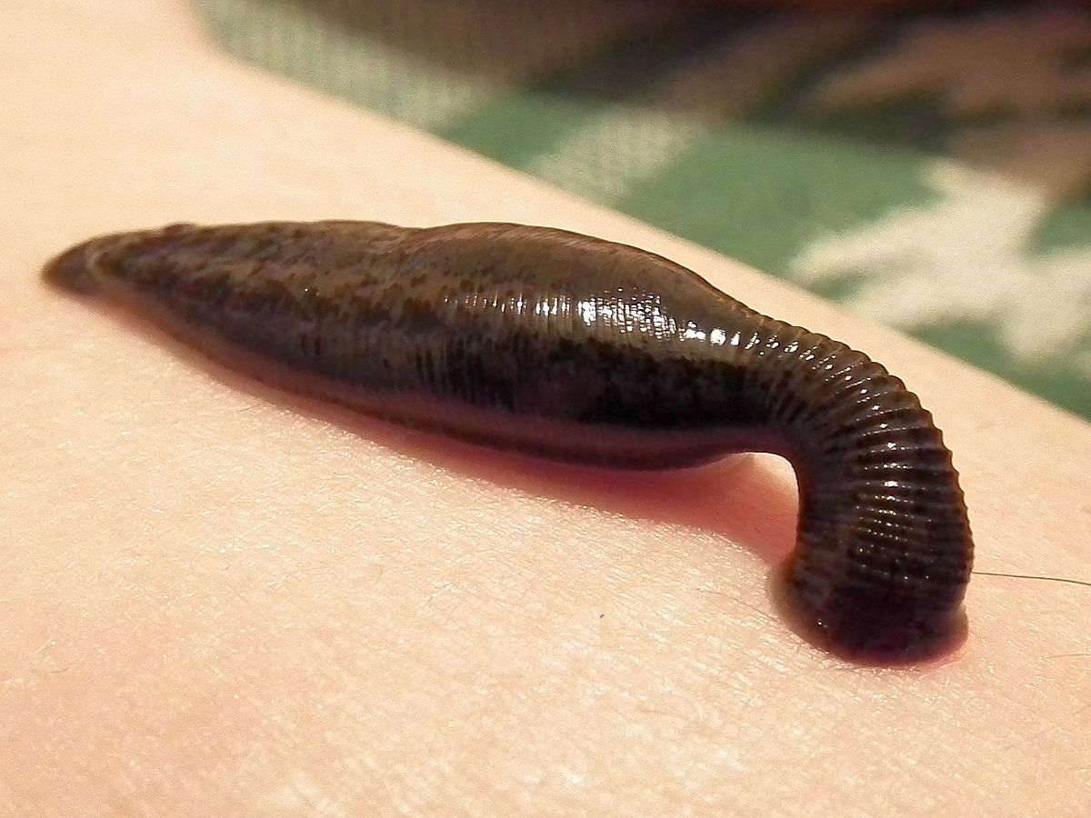
Annelids

Slide 10
Annelids
Earthworms have long been documented to exert medicinal effects as well as nutritional benefits. Moreover, this medicinal quality is associated with nutritional benefit and vice versa. This seems to be the basis of herbalistic medicines. An earthworm paste has some uses such as effects on inflammatory, oxidative, hematological, and biochemical serum indicators.

Slide 11
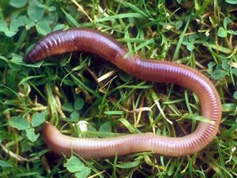
Annelids

Slide 12
Annelids
Harmful Earthworms:
A few species of earthworms may cause harm to man in various ways:
A few species live as ectoparasite on frogs and man. They also act as intermediate host of some parasites like the some tapeworm

Slide 13
See you in the next lecture

