Slide 1
Land reclamation
Dr. Rasha Abou Samra

Slide 2
Calcareous Soils
Calcareous soils are identified by the presence of the mineral calcium carbonate (CaCO₃ or lime) in the parent material and an accumulation of lime.
Soils are common in arid and semi-arid climates and occur as inclusions in more humid regions, affecting over 1.5 billion acres of soil worldwide

Slide 3
This is recognized by the fizzing that occurs when these soils are treated with dilute acid.
The pH of these soils is usually above 7 and may be as high as 8.5.
When these soils contain sodium carbonate, the pH may exceed 9.
In some soils, CaCO₃ can concentrate into very hard layers, termed caliche, that are impermeable to water and plant roots.

Slide 4
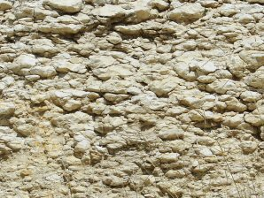

Slide 5
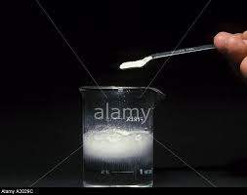

Slide 6
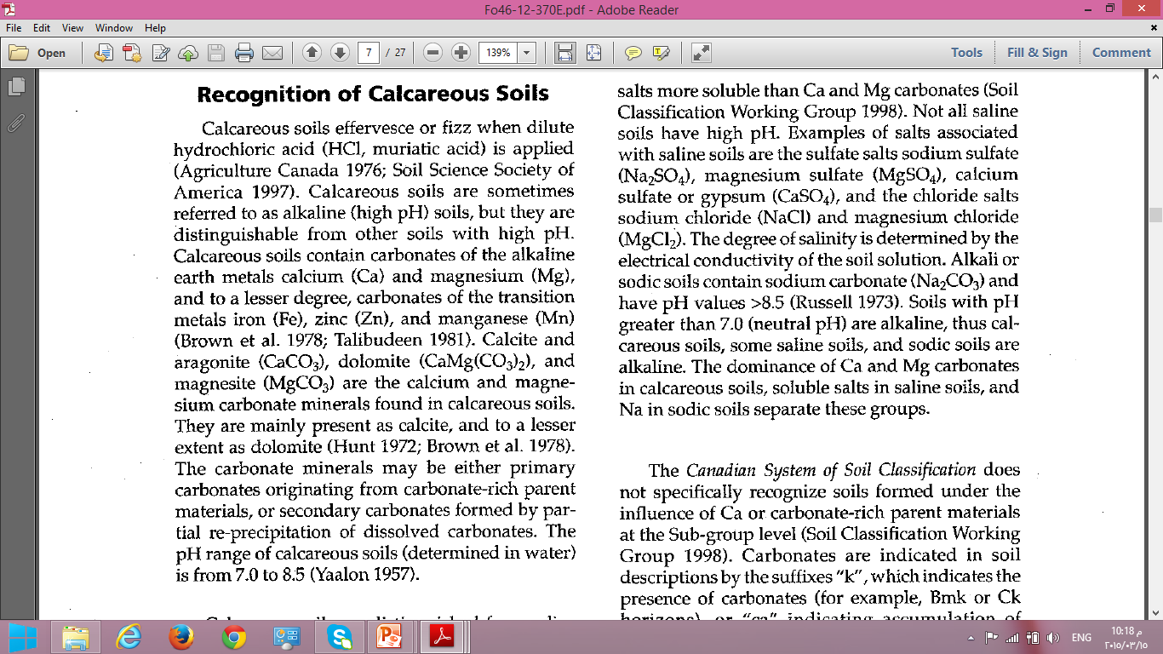

Slide 7
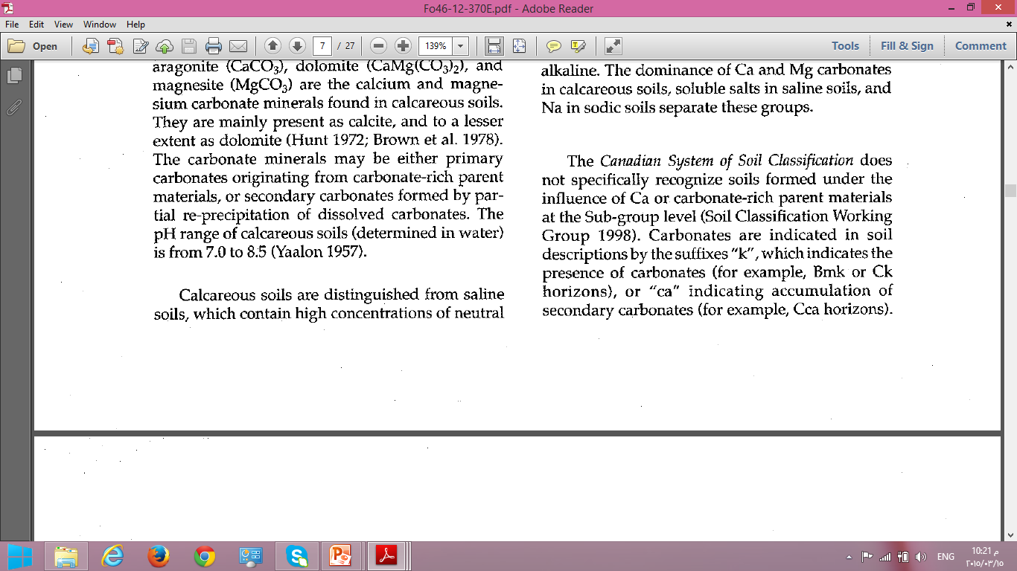

Slide 8
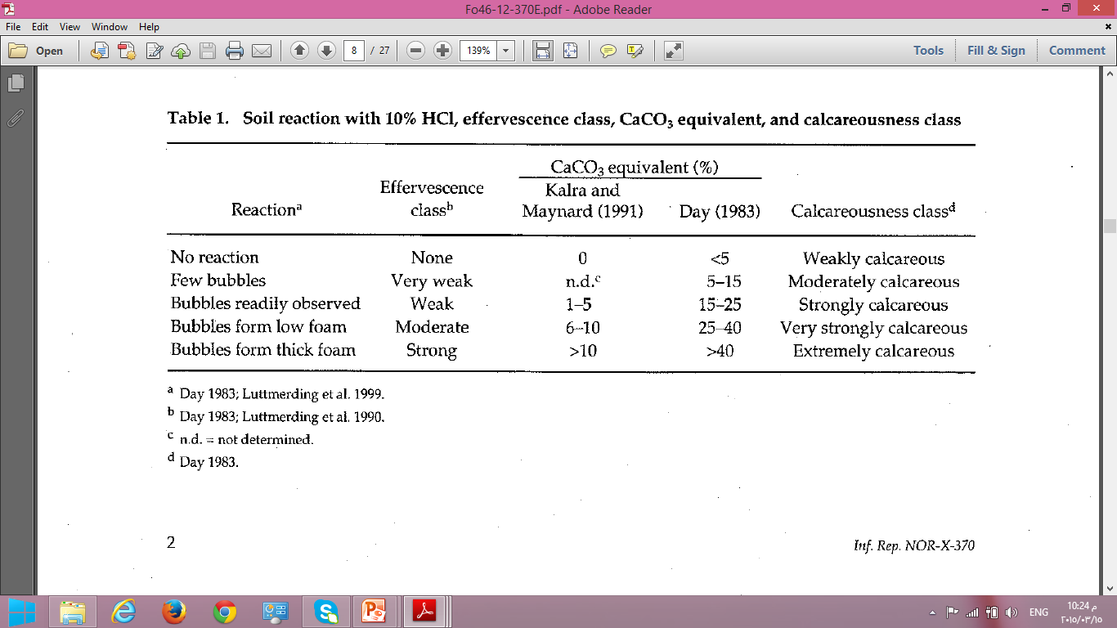

Slide 9
Calcareous soils can be extremely productive for agricultural use when they are managed properly.
Since they are most frequently found in semi-arid and arid regions, supplemental irrigation water is often the first barrier for crop production.
Limited availability of P is often the next most limiting factor for plant growth.

Slide 10
When P fertilizer is added to calcareous soils, a series of fixation reactions occur that gradually decrease its solubility and eventually its availability to plants.
Phosphorus "fixation" is a combination of surface adsorption on both clay and lime surfaces, and precipitation of various calcium phosphate minerals.

Slide 11
While the total lime content of a soil is important for predicting P reactions, the lime particle size (and its effect on reactive surface area) is often a better predictor of P behavior.
Although a calcareous soil may be dominated by free lime, it may also contain significant amounts of iron (Fe), aluminum (Al), and manganese (Mn)...either as discrete minerals, as coatings on soil particles, or complexed with soil organic matter.
These metals provide strong sorption sites for P and are frequently more significant in controlling P solubility in calcareous soils than lime itself.

Slide 12
As fertilizer P reacts in calcareous soils, it is converted to less soluble compounds such as dicalcium phosphate dihydrate or octacalcium phosphate. In some cases it may eventually convert to hydroxyapatite.
A variety of management practices can be used to slow these natural fixation processes and increase the efficiency of applied fertilizer for crop growth.

Slide 13
Number of the factors controlling P availability:
Time
Insoluble rock P is treated after mining from geologic deposits to enhance its solubility and usefulness for plants.
Fertilizer P is most soluble immediately after addition to soil, then it undergoes many chemical reactions that result in gradually diminished solubility .
Residual fertilizer P continues to be available for plant uptake for many years, but freshly applied P is generally most soluble and available for plant uptake.

Slide 14
Phosphorus Fertilizer Source
The selection of a specific P source should be based on other factors such as application equipment, suitability of fluids or granules, and price.
For example, recent work from Australia in extremely calcareous soils has suggested that fluid P sources may have somewhat greater solubility and enhanced plant availability than granular fertilizers.

Slide 15
There is large variability in the solubility and availability of P from various materials added to calcareous soil
These large differences are largely due to the unique properties of the materials, rather than any unique character associated with a specific soil.
For example, the polymer-coated, slow release P
source has very low apparent solubility, but is able to support high levels of plant P accumulation.
The soluble P sources and liquid manures have very high solubility and also are able to maintain high P recovery by barley.

Slide 16
Organic Matter
In the soil solution, there are several chemical components that will delay or prevent the reaction of P with lime.
Organic matter has been found to interfere in the fixation reactions of P with lime.
This inhibition of P fixation may account for the observation that P availability is frequently greater in manured soils and with the addition of humic substances in lime-rich soil.
Higher levels of soluble Fe, Al, and Mn are also related to increased P fixation in calcareous soils.

Slide 17
Temperature
Soil temperature has two opposing effects on soil P availability.
When fertilizer P is added to soil, it continually reacts and forms increasingly stable compounds for many months after application.
The kinetics of the conversion of P to less soluble forms is more rapid under warmer conditions than in cooler soil

Slide 18
An opposite effect occurs as increased soil temperature raises the solubility of soil P forms (both adsorbed or precipitated P).
This well-known phenomenon accounts for frequent crop responses from added P in cool soils in the spring.
In addition to improved solubility, higher soil temperature increases P diffusion to plant roots and enhances overall root activity and proliferation.

Slide 19
Adjusting for Calcareous Soils
Since the presence of lime in soils can reduce P availability to crops, fertilizer recommendations are frequently adjusted to account for this condition.

Slide 20
Calcareous land reclamation
land reclamation operations begin the process of land inventory.
Irrigation system, known contouring irrigation and sprinkler irrigation as well as allow the cultivation of this land.
Some areas may need to wash the salts.
Add organic matter to improve the natural qualities.

Slide 21
Addition Nile silt in the case provided economically.
Add green manures, which increases the organic matter.
When there are deaf calcareous layers must be disposed of deep plowing.
Selection of appropriate agricultural machinery to the characteristics of the soil.
Appropriate action irrigation program.

Slide 22
Choice of crops and varieties that adapt to the limestone land conditions in field crops.

Slide 23
Sandy soils
Sandy soils are characterized by less than 18% clay and more than 68% sand in the first 100 cm of the solum.
In the World Reference Base (WRB) soil classification system (ISSS Working Group R.B. 1998), sandy soils may occur in the following Reference Soil Groups: Arenosols, Regosols, Leptosols and Fluvisols.

Slide 24
These soils have developed in recently deposited sand materials such as alluvium or dunes.
They are weakly developed and show poor horizonation.
Soils characterized by a high proportion of sand in the first 100cm can also correspond to the upper part of highly developed soils formed in weathered quartz-rich material or rock, as evidence by the development of a highly depleted horizon.

Slide 25
Physical properties :
Weak structure or no structure,
Poor water retention properties
High permeability
Highly sensitivity to compaction with many adverse consequences.

Slide 26
Structure, porosity and bulk density
Sandy soils are characterized by a lack of structure or that it is weakly development.
When they dried, sandy soils develop very few thin cracks organized in a loose network.
The meagre shrinkage properties of these soils are related to the low clay content and the high proportion of low activity clays of many tropical sandy soils.

Slide 27
Sandy soils in the tropics show a large range of porosities and consequently bulk density (Db). Porosity ranges from 33% (Db = 1.78 g cm⁻³) to 47% (Db = 1.40gcm ⁻³).
The porosity in sandy soils is usually smaller than in clayey and silty soils.

Slide 28
Surface crusting and water infiltration
Because of the very small inter-particle cohesion that results in a very small aggregate stability, sandy soils are highly sensitive to surface crusting.
Crusts protect the soil surface from wind and interrill erosion but they also favour runoff and consequently rill and gully erosion

Slide 29
Interrill Erosion
Raindrops striking exposed soil detach the soil particles and splash them into the air and into shallow overland flows.
Rill erosion
the removal of soil by concentrated water running through little streamlets.
Gully erosion
an obvious form of soil erosion consisting of an open, incised and unstable channel generally more than 30 centimetres deep.

Slide 30
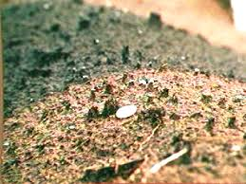

Slide 31
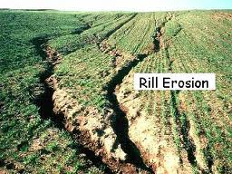

Slide 32
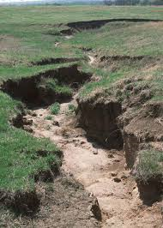

Slide 33
main types of structural crusts were recognised in sandy soils depending on the dominant forming process
(i) sieving crusts made of well sorted micro-layers with average infiltrability of approximately 30 mm h ⁻¹
(ii) and packing crusts made of sand grains closely packed with average infiltrability of 10 mm h ⁻¹

Slide 34
Compaction
Unlike other soils, the structure of sandy soils can be easily affected by mechanical compaction over a large range of scales.
Usually mechanical compaction preferentially affects large pores (i.e. macropores that result from tillage and biological activity) but in sandy soils it affects these large pores down to the small pores that result from the arrangement of the skeleton particles (sand and silt) within the clay fraction. That re-arrangement when submitted to mechanical compaction is possible because of the small cohesion between the skeleton particles

Slide 35
Adverse Effects
Restricted depth of penetration of roots
The plants utilize less volume of soil for moisture and nutrient absorption.
A reduced rate of water infiltration, slower exchange of air between the atmosphere and the soil.
slower air movement within the soil.

Slide 36
Causes
Soil compaction considered in this report has developed from pressure exerted on the soil by implements used in agricultural production.
Wheels, whether on tractors, planting and harvesting equipment, or trucks, apply pressure to the soil surface.

Slide 37
Keys to sandy soils success
Increasing Carbon Turnover
Organic matter provides an energy source for beneficial microbes in the soil. These microbes, like bacteria and fungi are vital for soil health as they break down organic matter in the soil and release and cycle nutrients, keeping them available for plant uptake.

Slide 38
Adding organic matter to the soil also improves soil cation exchange capacity (CEC), a measure of the soil’s ability to store nutrients so they are available for plant uptake.
The more organic matter in soils, the greater the soil’s ability to absorb nutrients like calcium, magnesium and potassium and keep them available for use by plants.

Slide 39
In the sandy soils often used to grow onions, organic carbon levels are extremely low (<1%), CEC levels are low (<5meq/100g) and water holding capacity is also low.
That means fertilizer and water use efficiency and microbial activity is low – the soil is unhealthy and fertility is low. Sandy soils stand to benefit the most from increasing organic matter levels.
compost can play an important role because by boosting organic matter levels whilst still growing a crop.

Slide 40
Using compost adds organic matter to soils and the flow on benefits from increasing organic matter levels are multiple.
Compost can increase microbial activity in soils by providing a food source for microbes.
Increased microbial activity improves soil structure and nutrient availability and cycling, making conditions more favourable for plant growth.

Slide 41
Using compost can also reduce the fluctuations in soil moisture that occur around irrigation events in sandy soils that drain quickly after irrigation.
Improvements in soil structure from compost use can also increase the ability of sandy soils to hold water, potentially meaning less water needs to be applied.

Slide 42
Comopomstinpg
Composting is the controlled aerobic biological decomposition of organic matter into a stable, humus like product called compost.
It is essentially the same process as natural decomposition except that it is enhanced and accelerated by mixing organic waste with other ingredients to optimize microbial growth.

Slide 43
The potential benefits of composting manure and other organic wastes are
Improved manure handling;
Reduced odor, fly, and other vector problems
Reduced weed seeds and pathogens.
Land applied compost improves soil fertility, tilth, and water holding capacity.
It is also free of offensive odors and can be stored for extended periods.
These qualities make it suitable for use on the farm or for sale.

Slide 44
General procedure
The principal elements in planning a compost facility include performing site investigations and developing the recipe design, facility design, waste utilization plan, and an operation and maintenance plan. it is necessary to decide among alternative methods, locations, and materials.
The decision depends on the management and economic aspects of the farm as well as on the physical limitations of the site. The planner needs to present the landowner with the different alternatives so that the owner can make the final decision.

Slide 45
Principles of composting
Composting is the process by which various aerobic micro-organisms decompose raw organic material to obtain energy and material they need for growth and reproduction.
The stable by-products of this decomposition, the biomass of both dead and living microorganisms, and the undegradable parts of the raw material make up the end product that is called compost.

Slide 46
b) Composting process
The activity of these micro-organisms is encouraged through management of the carbon-to nitrogen (C:N) ratio, oxygen supply, moisture content, temperature, and pH of the compost pile.
The composting process can be divided into two main periods:
(1) active composting
(2) curing.

Slide 47
Active composting is the period of vigorous microbial activity during which readily degradable material is decomposed as well as some of the more decay-resistant material, such as cellulose.
Curing follows active composting and is characterized by a lower level of microbial activity and the further decomposition of the products of the active composting stage.
When curing has reached its final stage, the compost is said to be stabilized.

Slide 48
The compost pile passes through a wide range of temperatures over the course of the active composting period.
As the temperature varies, conditions become unsuitable for some micro-organisms while at the same time become ideal for others.
The active composting period has three temperature ranges.
These ranges are defined by the types of micro-organisms that dominate the pile during those temperatures .

Slide 49
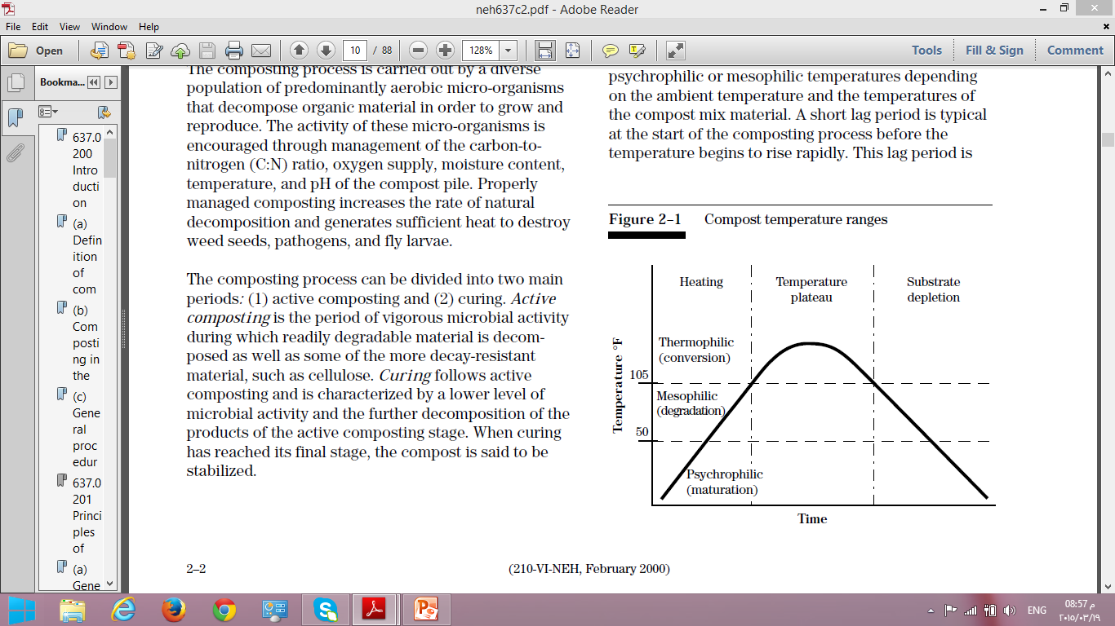
Psychrophilic temperatures are generally defined as those below 50 degrees Fahrenheit
Mesophilic between 50 and 105 degrees Fahrenheit
Thermophilic above 105 degrees Fahrenheit.

Slide 50
The initial stage of composting is marked by either psychrophilic or mesophilic temperatures depending on the ambient temperature and the temperatures of the compost mix material.
A short lag period is typical at the start of the composting process before the temperature begins to rise rapidly.
This lag period is the time necessary for the development of the microbial population.

Slide 51
As the microbial population begins to degrade the most readily degradable material and the population increases, the heat generated by the microbial activity is trapped by the self-insulating compost material.
As the heat within the pile accumulates, the temperature of the compost pile begins to rise. The temperature continues to increase steadily through the psychrophilic and mesophilic temperature ranges as the microbial population increases and diversifies.
Depending on the operation, the compost pile typically takes from 2 to 3 days to increase beyond mesophilic temperatures and reach the thermophilic stage of composting.

Slide 52
As the pile temperatures increase into the thermophilic range, the pile becomes inhabited by a diverse population of micro-organisms operating at peak growth and efficiency.
This intense microbial activity sustains the vigorous heating that is necessary for the destruction of pathogens, fly larvae, and weed seeds.
The temperatures continue to rise and peak at about 130 to 160 degrees Fahrenheit. Once this peak is reached, microbial activity begins to decrease in response to a depletion in readily degradable material and oxygen or to the excessively high temperature that is detrimental to their function.

Slide 53
Micro-organisms degrade material by moving soluble components through their body walls as is done for simple compounds or by using extracellular enzymes to break the material down before it is taken into the cell body.
If the temperature becomes too high, the enzymes responsible for the breakdown denature and become
nonfunctional so that the micro-organisms cannot get the nutrition they need to survive.
Elevated temperature may not be lethal for all micro-organisms, but may affect their efficiency and further contribute to the decrease in microbial activity.

Slide 54
As microbial activity decreases, more heat is lost from the pile than is generated, and the pile begins to cool.
The compost pile remains in the thermophilic range from 10 to 60 days, depending on the operation.
Once the temperature decreases to below 105 degrees Fahrenheit, the curing period may begin or the pile may be aerated to reactivate active composting.

Slide 55
Curing is marked by a lower level of microbial activity and is responsible for stabilizing the products resulting from active composting period.
Stabilization includes further decomposition of organic acids and decay resistant compounds, the formation of humic compounds, and the formation of nitrate-nitrogen.
Another benefit of curing is that certain fungi begin to inhabit the pile and contribute to the disease suppressant qualities of the compost.

Slide 56
Because microbial activity has decreased and is operating at a lower level, little heat is generated and the pile temperature continues to decrease or remains at a low level.
Proper management of moisture and oxygen is still required during the curing period to maintain microbial activity.
Management during the curing period is also required to ensure that the pile is not recontaminated with weed seeds.
This may require covering or relocating the curing piles to reduce the potential for recontamination.

Slide 57
The reactions that take place during curing are relatively slow and, as such, require adequate time.
The length of the curing period varies with the type of operation, the length of the active composting period, and the intended end use of the compost.
Curing is generally considered complete when the pile after repeated mixings returns to ambient temperature.
Curing generally lasts from 1 to 6 months.

Slide 58
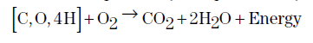
Chemical transformations
Respiration can be either aerobic or anaerobic. In aerobic respiration, the aerobic micro-organisms use molecular oxygen, O₂, to liberate the bulk of the energy from the carbon source, producing carbon dioxide and water in the process.

Slide 59
In anaerobic respiration, the micro-organisms use electron acceptors other than O2, such as nitrates (NO₃–), sulfates (SO₄^{2–}), and carbonates (CO₃ ^{2–}) to obtain energy.
Their use produces odorous or undesirable compounds, such as hydrogen sulfide (H₂S) and methane (CH₃).
Anaerobic respiration also leads to the formation of organic acid intermediates that tend to accumulate and are detrimental to aerobic micro-organisms.

Slide 60
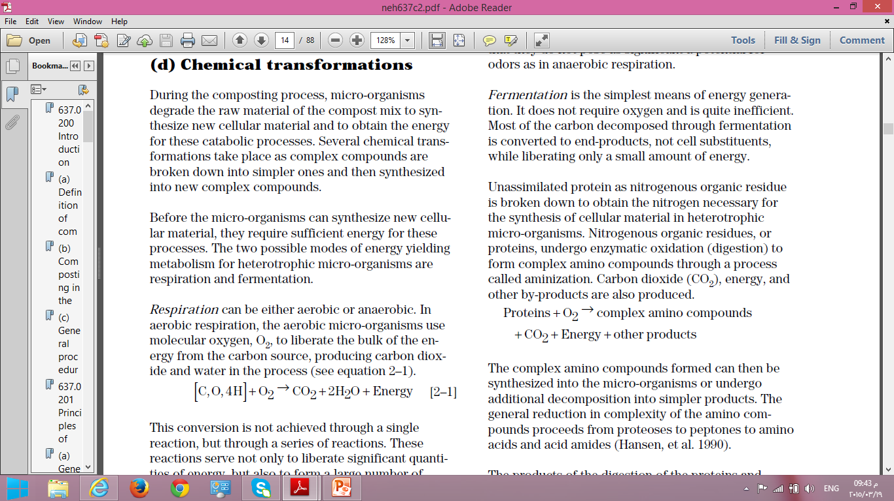
Fermentation
is the simplest means of energy generation.
Most of the carbon decomposed through fermentation is converted to end-products, while liberating only a small amount of energy.
The complex amino compounds formed can then be synthesized into the micro-organisms or undergo additional decomposition into simpler products.

Slide 61
Conditions of growth of M.O.
Temperature
Oxygen
Moisture
PH.
Time

Slide 62
Oxygen and Aeration
minimum oxygen concentration of 5% within the pore spaces of the composting material is recommended for a well managed compost facility.
Moisture
Efficient activity is achieved when the moisture is maintained between 40% and 60%.
At moisture levels above 60%, water displaces much of the air in the pore spaces of the composting materials. This limits air movement and leads to anaerobic conditions.

Slide 63
Nutrients
Carbon provides microorganisms with both energy and growth; nitrogen is essential for protein and reproduction.
C:N ratios of 25:1 to 30:1 are ideal for active composting .For some applications, C:N ratios of 50:1 and higher are acceptable.
The excess nitrogen may be lost to the atmosphere as ammonia or nitrous oxide, and odor can become a problem.

Slide 64
pH:
The preferred pH is in the range of 6.5-8.0.
A high pH, above 8.5, encourages the conversion of nitrogen compounds to ammonia.
Time
Depends on many factors.
Proper moisture content, C:N ratio and frequent aeration ensure the shortest composting period.
A well-managed composting operation should produce quality compost within four months.

Slide 65
Environmental Implications of Composting
Water Quality
Composting of organic wastes must be performed only in locations where leaching of pollutants from the operation is minimized.
The leachable pollutants in agricultural waste include bacteria (some pathogenic), phenolic compounds, ammonium nitrogen, nitrate nitrogen, potassium, and water containing a high biochemical oxygen demand.

Slide 66
Potential pollutants from composting municipal or industrial wastes include heavy metals and petrochemical compounds.
Composting wastes must be protected from rainfall that can leach pollutants.
Composting should be performed on an impervious surface, such as a concrete pad.

Slide 67
Air Quality
Odor
Odor problems result when compost piles deplete the available oxygen supply and anaerobic conditions develop.
Therefore, odours can be minimized with proper aeration.
Prevailing wind direction and proximity to residential areas are important factors to take into consideration in selecting sites for composting.
Biofilters are an option with aerated static pile composting, or if the compost facility is enclosed within a building.

Slide 68
Ammonia (NH₄)
Ammonia acidifies rain, contaminates surrounding areas with excess nitrogen (N) and causes foul odours.
Low C:N ratios wastes will result in the greatest ammonia losses.
Addition of wastes with high C:N ratios may reduce ammonia loss only if the carbon (C) is easily degradable.

Slide 69
Nitrous Oxide and Other NOx Gases
During intense microbial activity, as occurs in the compost process, there is significant loss of nitrogen as nitrous oxide and other NO_{x} gases, particularly nitric oxide (NO).
Nitrous oxide (N₂O), for example, is 240 times more harmful than CO₂ in contributing to global warming. It is a stable gas and diffuses to the stratosphere where it destroys ozone.

Slide 70
Methane (CH₄)
There is some indication that the diversion of organic wastes away from landfills will reduce the production of anthropogenic (produced by human activities) methane.
Disease and Weed Transmittance
If composted properly, potentially harmful bacteria, viruses, and weed seeds, are destroyed by high temperatures of 55º to 60 ºC (130º to 140 ºF ) for three days.
Achieving these temperatures should therefore be a priority. Potential users will be reluctant to utilize compost if they have experienced disease or weed infestations resulting from improper management.

Slide 71
Management of a sandy soil
1- Organic matter
2- Water supply :
Watering is essential, but you can reduce the need for water by planting further apart, so plants have more soil.
Mulching to limit loss of soil moisture by evaporation is also helpful.

Slide 72
3- Rotation
Intensive cropping can really improve sandy soils as fertilizing every year leads to greater production and turnover of organic matter and carbon, which is vital for building soil biota.
Disease control through rotation is also vital for turning sandy soils around. For example, in lower rainfall areas farmers have found that cropping two successive years of cereal rye has provided excellent soil cover, a good disease break and returned high levels of organic matter.

Slide 73
4- Microbial populations
Increased microbial populations and biological activity can
1-suppress soil diseases
2- improve crop production on sandy soils.

