Slide 1
Growth Physiology
Second Year
Botany/Chemistry Students
Prof. Dr. Nemat M. Hassan
22-3-2020

Slide 2
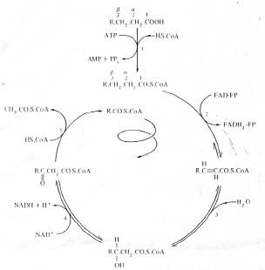
β– Oxidation spiral of fatty acids

Slide 3
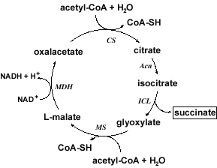
Glyoxylate cycle

Slide 4
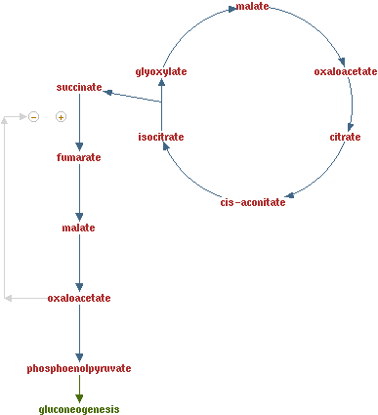

Slide 5
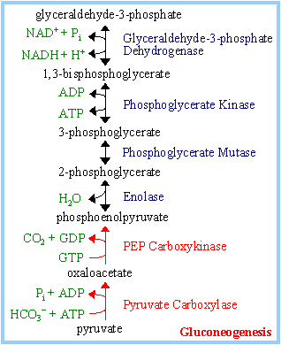
Reversed Glycolysis

Slide 6
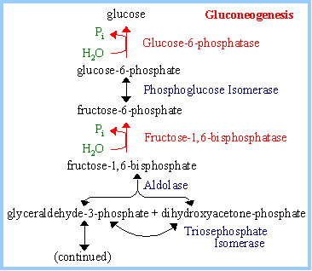

Slide 7
Nitrogen and phosphorus
Mobilization of nitrogen
Porteins comprise the most abundant nitrogenous reserves in seeds with endosperm
The contribution of other compounds such as RNA and soluble amino acids.
In cereal grains the aleurone layer is richer in protein than the bulk of the endosperm.

Slide 8
Proteins of the aleurone cells are localized in protein bodies (aleurone grains or vacuoles).
These protein bodies are characterized by the presence of globoid
It appears that the most abundant protein fraction is utilized most rapidly.

Slide 9
Role of peptide hydrolase during and after germination
There are distinct stages of proteolysis in germinating seeds.
In the first stage, hydrolysis provides amino acids for the synthesis of those hydrolytic enzymes

Slide 10
The second stage accounts for the hydrolysis of the main reserve proteins and results in the provision of amino acids to the growing seedling.
The third and final stage includes the senescence of the reserve- depleted storage tissue.

Slide 11
Nomenclature and classification of peptide hydrolases
The peptide hydrolases have been classified into two major sub-groups, based on the position of the peptide bond hydrolysed.
The proteinases, or endopeptidases cleave bonds distant from the ends of the polypeptide
exopeptidases cleave bonds only near the end of the polypeptide.

Slide 12
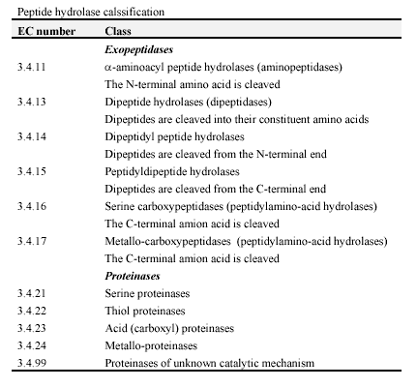

Slide 13
Role of the scutellum or cotyledons in the transfer of nitrogen from endosperm to embryo
Scutellum
The concerted action of the endopeptidases and carboxypeptidases is most likely to result in a mixture of amino acids and peptides.
Complete hydrolysis is unlikely because of the inability of carboxypeptidases to act on dipeptides and tripeptides

Slide 14
The scutellum, an absorptive organ responsible for the transfer of nutrients between the endosperm and seedling, shows high levels of exopeptidase activity, especially aminopeptidases and alkaline dipeptidases
This suggests that the scutellum may have a dual function: absorption of amino acids and peptides and hydrolysis of the absorbed peptides.

Slide 15
The cotyledons of castor bean and Scots pine function in an analogous manner to the scutellum of the cereals.
They are the site of absorption of sucrose and nitrogenous compounds from the endosperm and facilitate transfer of these compounds throughout the developing axis.

Slide 16
Mobilization of phosphorus
The phosphorus-containing constituents of seed can be described in terms of four groups of compounds: phytic acid, nucleic acid, lipid and protein
Phytic acid (myo-inositol hexakis dihydrogen phosphoric acid) is always the most abundant phosphorus - containing compound

Slide 17
Phytin
Phytin is the insoluble complex of phytic acid with a range of cations.
The proportions of the associated cations vary with tissue and with species.

Slide 18
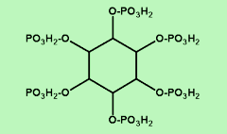
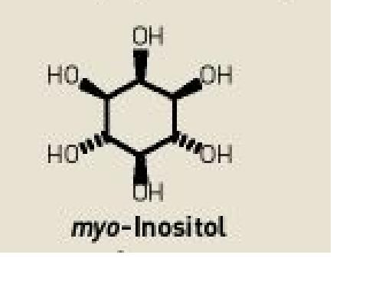
Phytin

Slide 19
In the phytin of rice, potassium and magnesium predominate
In general, phytates account for about 1% by weight of cereal grains,

Slide 20
Phytase
Phytase, myo-inositol hexakis (dihydrogen phosphate) phosphohydrolase is a phosphomonoesterase which can hydrolyse phytin to yield inorganic orthophosphate and a series of lower phosphate esters of myo-inositol.
Myo-inositol is the ultimate product derived from continued hydrolysis of these lower phosphate esters.

Slide 21
Myo-inositol is a precursor of all pentosyl and uronosyl sugar residues and so contributes directly to the synthesis of pectin and other polysaccharides associated with developing cell walls. It also contributes to certain lipids.
Most of the phytases of plant origin are non-specific acid phosphomonoesterases

Slide 22
Regulation of phytin degradation
In germinating maize seeds, increased phytase activity is readily detected within 24 h of imbibition.
The increase in activity of acid phosphatase is apparently due to do novo synthesis, but gibberellic acid also affects secretion of this enzyme(s) across the plasmalemma- a phenomenon which is well characterized for -amylase.

Slide 23
Nucleic acids
About 12% of the phosphorus in oat seed is present in the form of nucleic acid.
During germination the nucleic acid phosphorus of the endosperm declines with a concomitant increase in amount of phosphorus of the developing axis

Slide 24
Phosphate release from RNA requires the concrete action of RNase and a 3'-nucleotidase.
The effect of gibberellic acid was inhibited by inhibitors of protein and RNA synthesis.

Slide 25
Phospholipids
About 80% of the phospholipid of whole wheat grains is associated with the starch granules.
Starch-bound phospholipid is in the form of lysophosphatidylcholine (LPC).

