Slide 1
Plant tIssue culture
Prof.Dr. Nemat Mohamed Hassan, Department of Botany and Microbiology, Faculty of Science, University of Damietta
Lecture 17.03.2020

Slide 2
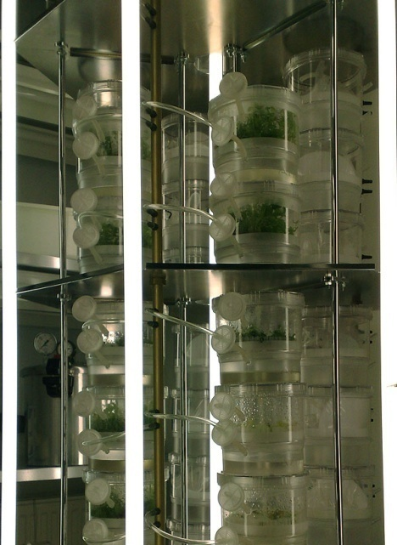
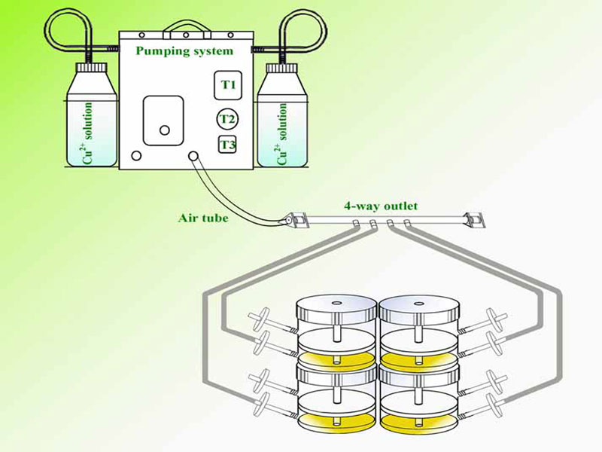
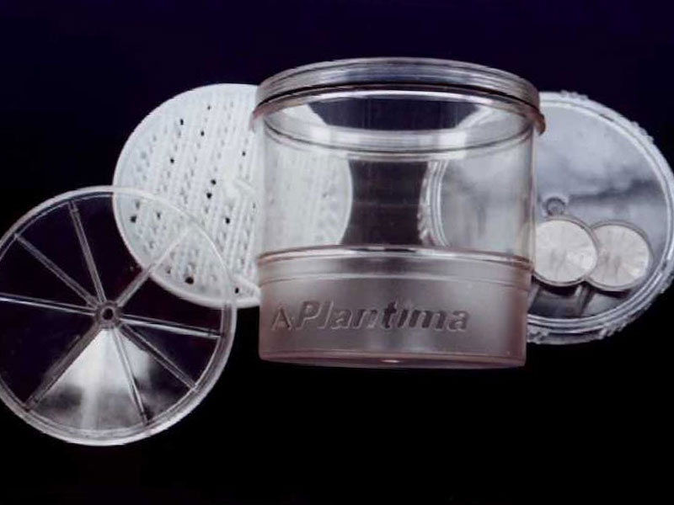
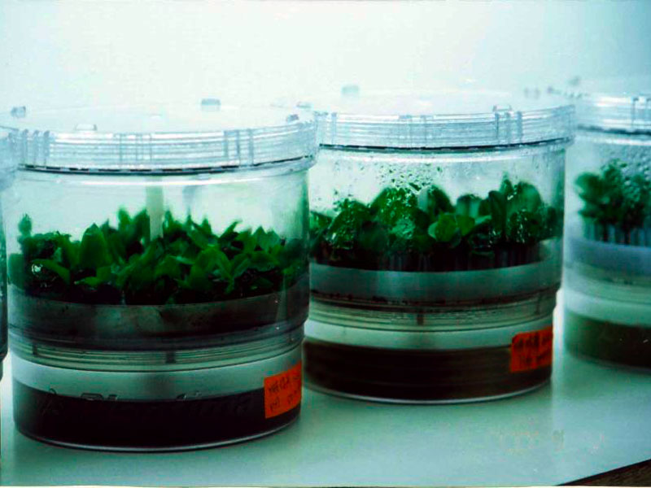
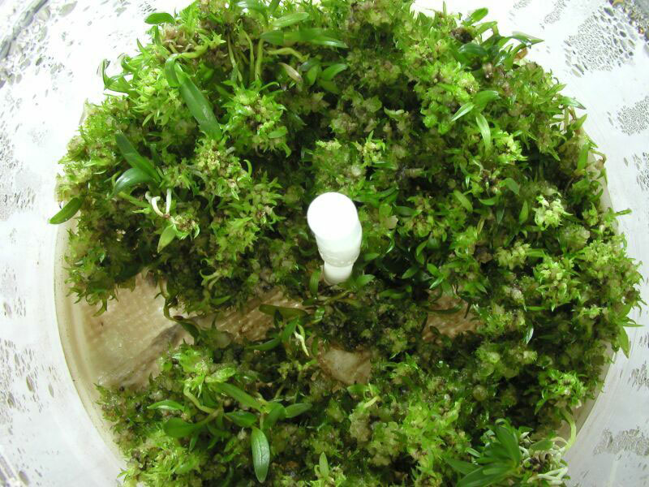
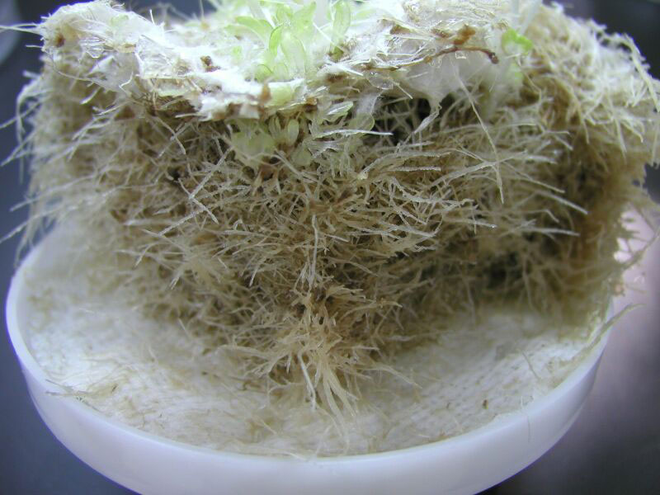
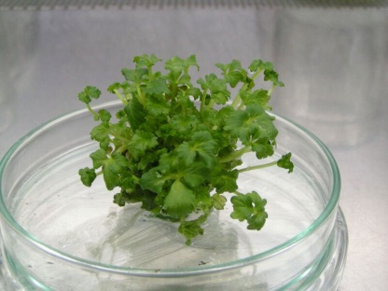
MICROPROPAGATION IN BIOREACTORS
Bioreactor;tissue culture containers
Automated culture system
The design of separate compartments

Slide 3
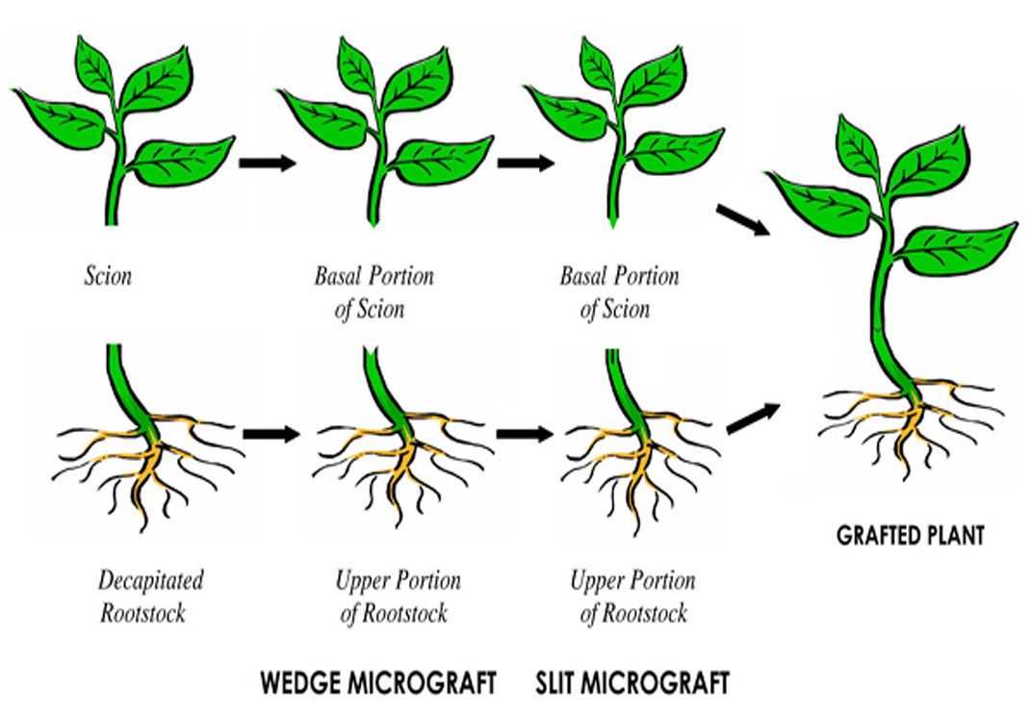
WHAT IS MICROGRAFTING?

Slide 4
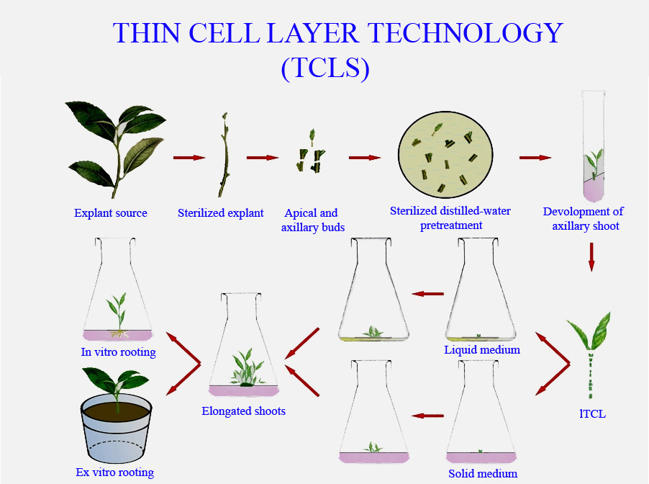
The thin cell layer (TCL) system consists of explants of small size excised from different plant organs either longitudinally (lTCL) or transversally (tTCL)

Slide 5
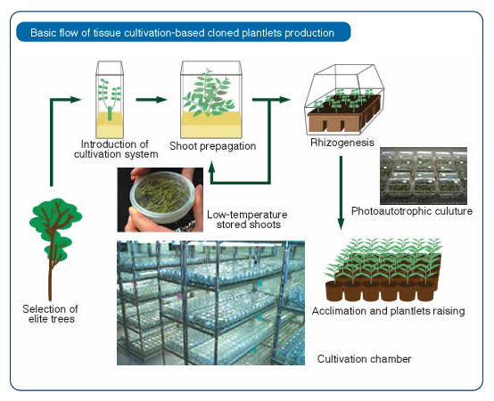
PHOTOAUTOTROPHIC CULTURE

Slide 6
APPLICATIONS OF MICROPROPAGATION
Through micropropagation, it is now possible to provide clean and uniform planting materials in plantations for several plant species such as oil palm, plantain, pine, banana, abaca, date, rubber tree; field crops – eggplant, jojoba, pineapple, tomato; root crops – cassava, yam, sweet potato; and many ornamental plants such as orchids and anthuriums
Bioreactor cultures are being established in several commercial laboratories for micropropagation of
ferns, spathiphylum, philodendron, banana, potato, lilies, poinsettia, sugar-cane, and some forest tree species such as eucalyptus, poplar, and early stages of conifer somatic embryos And plant products, pharmaceuticals, food ingredients and cosmetics
Micrografted seedlings are commercialised to avoid the serious crop loss caused by infection of soil-borne diseases for fruit trees and several vegetables.

Slide 7
Transverse thin layer section technology may be ideal for large scale micropropagation of ornamental plants Photoautotrophic flow-through systems for enhanced micropropagation for Gerbera; Hypericum, Myrtus communis, Momordica grosvenori, Eucalyptus
The development of transgenic methods and the growth of agricultural biotechnology started during the 1980s and the global biotech crophas increased hundred million of hectares area
Efficient doubled haploid technology enables breeders to reduce the time and the cost of new cultivar development relative to conventional breeding practices.

Slide 8
WHAT’S IN THE FUTURE
Adaptation of tissue culture technology to more species
Fast and mass propagation of transformed plants with “designer genes”
Chloroplast transformation methods
Efficient, computer-controlled flow-through systems to cut down the labor cost
Mass production of plant constituents
New technologies

Slide 9
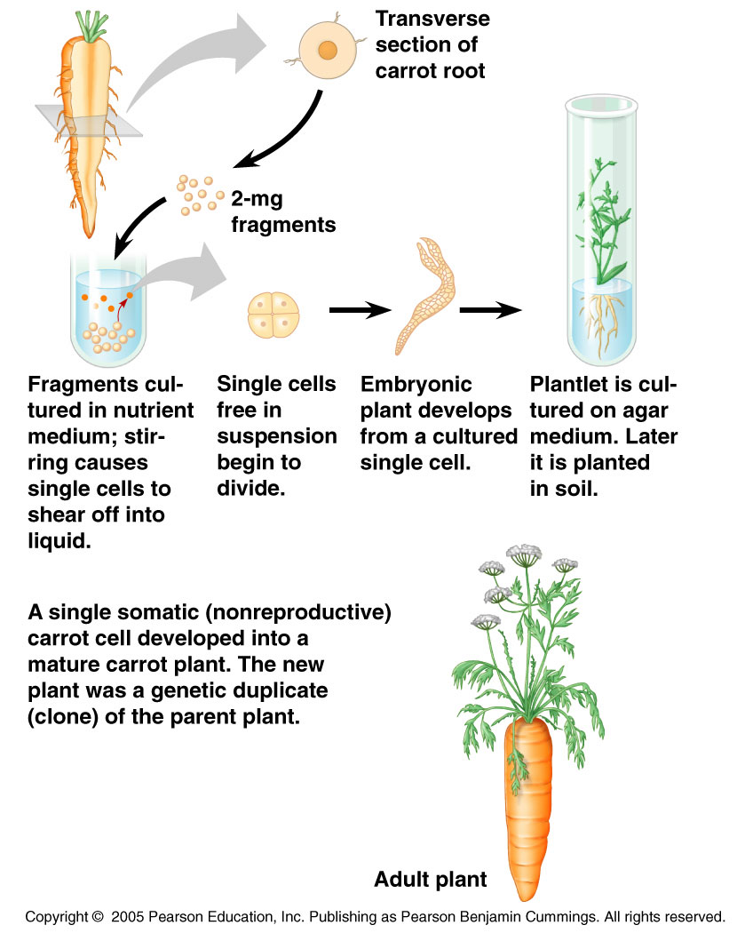

Slide 10
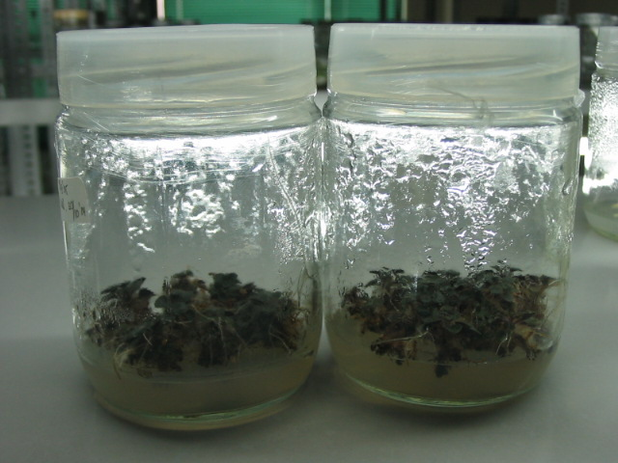
Microcutting propagation
The production of shoots from pre-existing meristems only.

Slide 11
Plant Tissue Culturing
(micropropagating steps)
Stage 0 – Selection & preparation of the mother plant
  sterilization of the plant tissue takes place
Stage I - Initiation of culture
  explant placed into growth media
Stage II - Multiplication
  explant transferred to shoot media; shoots can be constantly divided
Stage III - Rooting
  explant transferred to root media
Stage IV - Aclimatization
Transfer to soil explant returned to soil; hardened off

Slide 12
Stage I:
Establishment of axenic cultures – Introduction of the surface disinfected
explants into culture, followed by initiation of shoot growth. The objective of this stage is to place selected explants into culture, avoiding contamination and providing an environment that promotes shoot production .
Depending on the type of explant, shoot formation may be initiated from apical and axillary buds.

Slide 13
Stage II:
Multiplication – shoot proliferation and multiple shoot production.
At this stage, each explant has expanded into a cluster of small shoots. Multiple shoots are separated and transplanted to new culture medium. Shoots are subcultured every 2–8 weeks.
Material may be subcultured several times to new medium to maximise the quantity of shoots produced.

Slide 14
Stage III:
Root formation – shoot elongation and rooting. The rooting stage prepares the regenerated plants for transplanting from in vitro to vivo conditions in controlled environment rooms, in the glasshouse and, later, to their ultimate loca-
tion.
This stage may involve not only rooting of shoots, but also conditioning of the plants to increase their potential for acclimatization and survival during transplanting.

Slide 15
The induction of adventitious roots may be achieved either in vitro or ex vitro in the presence of auxins.
The main advantage of ex vitro compared
to in vitro rooting is that root damage during transfer to soil is less likely to occur.
The rates of root production are often greater and root quality is optimized when
rooting occurs ex vitro .

Slide 16
Stage IV:
Acclimatization – transfer of regenerated plants to soil under natural
environmental conditions [16]. Transplantation of in vitro-derived plants to soil is
often characterized by lower survival rates. Before transfer of soil-rooted plants
to their ﬁnal environment, they must be acclimatized in a controlled environment room or in the glasshouse.

Slide 17
Plants transferred from in vitro to ex vitro conditions, undergo gradual modiﬁcation of leaf anatomy and morphology, and their stomata begin to function (the stomata are usually open when the plants are in culture). Plants also form a protective epicuticular wax layer over the surface of their leaves.
Regenerated plants gradually become adapted to survival in their new environment.

Slide 18

THANK YOU！

