Slide 1
Plant tIssue culture
Prof.Dr. Nemat Mohamed Hassan, Department of Botany and Microbiology, Faculty of Science, University of Damietta
Lecture 24.03.2020

Slide 2
Plant Regeneration Pathways
Existing Meristems (Microcutting)
Uses meristematic cells to regenerate whole plant.
Organogenesis
Relies on the production of organs either directly from an explant or callus structure
Somatic Embryogenesis
Embryo-like structures which can develop into whole plants in a way that is similar to zygotic embryos are formed from somatic cells
(Source:Victor. et al., 2004)
Notes:
2

Slide 3
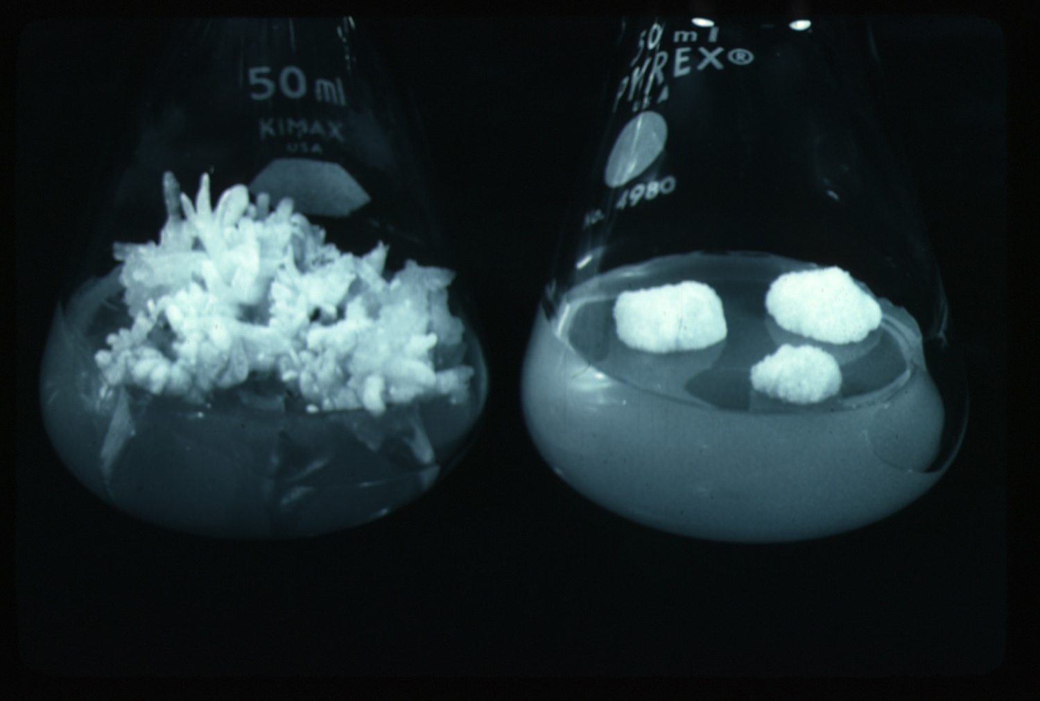
II-Organogenesis

Slide 4
The ability of non-meristematic plant tissues to form various organs de novo.
The formation of adventitious organs
The production of roots, shoots or leaves
These organs may arise out of pre-existing meristems or out of differentiated cells
This may involve a callus intermediate but often occurs without callus.

Slide 5
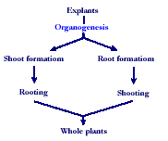

Slide 6
Indirect organogenesis
Explant
Callus
Meristemoid
Primordium

Slide 7
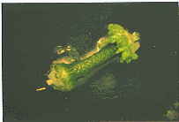
Direct Organogenesis
Direct shoot/root formation from the explant

Slide 8
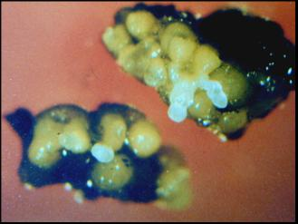
III-Somatic Embryogenesis

Slide 9
The formation of adventitious embryos
The production of embryos from somatic or “non-germ” cells.
It usually involves a callus intermediate stage which can result in variation among seedlings

Slide 10
Types of embryogenic cells
Pre-embryogenic determined cells, PEDCs
  The cells are committed to embryonic development and need only to be released. Such cells are found in embryonic tissue.
Induced embryogenic determined cells, IEDCs
  In majority of cases embryogenesis is through indirect method.
  Specific growth regulator concentrations and/or cultural conditions are required for initiation of callus and then redetermination of these cells into the embryogenic pattern of development.

Slide 11
Various terms for non-zygotic embryos
Adventious embryos
Somatic embryos arising directly from other organs or embryos.
Parthenogenetic embryos (apomixis)
Somatic embryos are formed by the unfertilized egg.
Androgenetic embryos
Somatic embryos are formed by the male gametophyte.

Slide 12
Somatic Embryogenesis and Organogenesis
Both of these technologies can be used as methods of micropropagation.
It is not always desirable because they may not always result in populations of identical plants.
The most beneficial use of somatic embryogenesis and organogenesis is in the production of whole plants from a single cell (or a few cells).

Slide 13
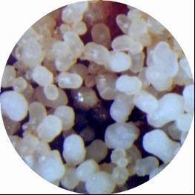
Somatic embryogenesis differs from organogenesis

Slide 14
Bipolar structure with a closed radicular end rather than a monopolar structure.
The embryo arises from a single cell and has no vascular connection with the mother tissue.

Slide 15
Two routes to somatic embryogenesis
(Sharp et al., 1980)
Direct embryogenesis
  Embryos initiate directly from explant in the absence of callus formation.
Indirect embryogenesis
  Callus from explant takes place from which embryos are developed.

Slide 16
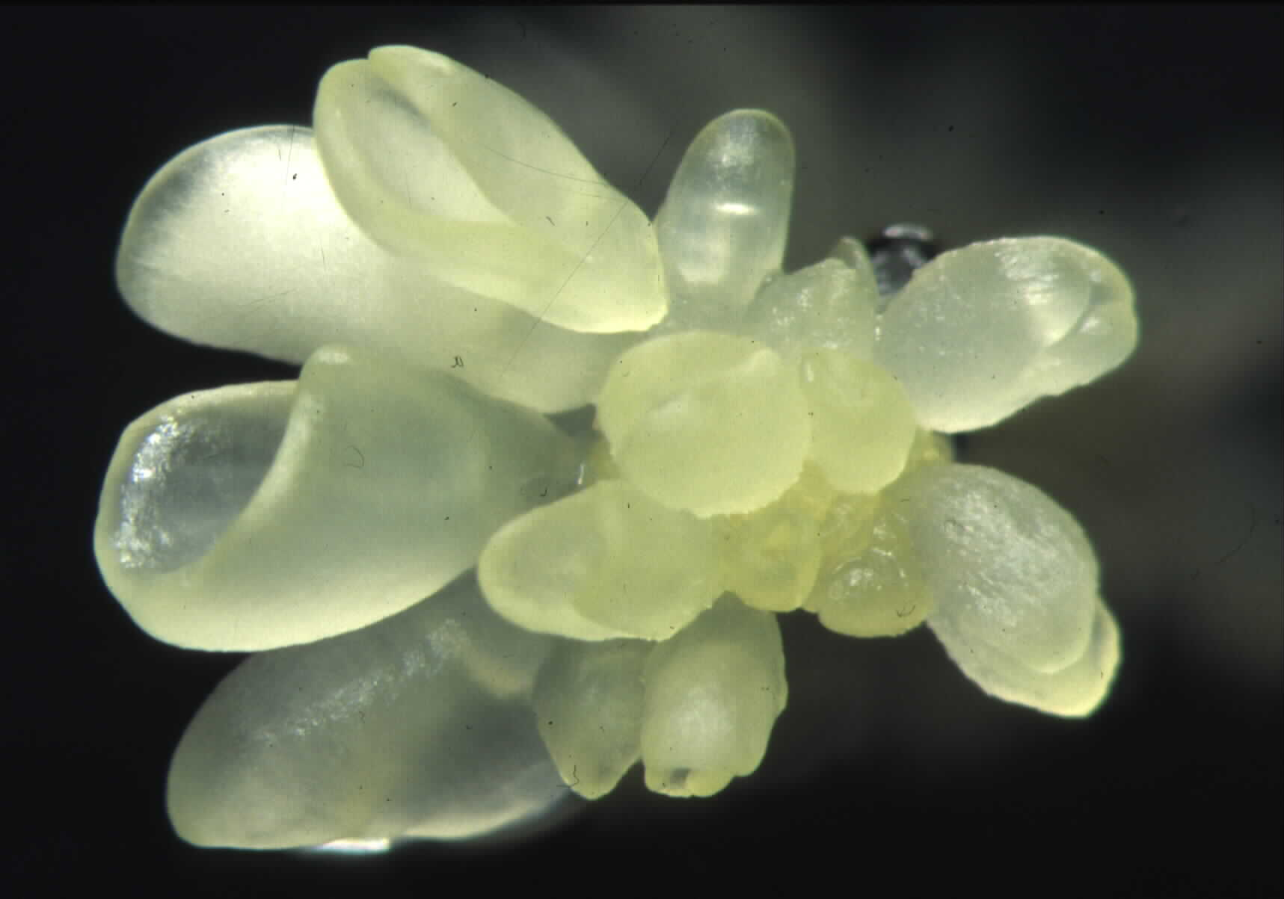
Direct somatic embryogenesis
Direct embryo formation from an explant

Slide 17
Indirect Somatic Embryogenesis
Explant → Callus Embryogenic → Maturation → Germination
Calus induction
Callus embryogenic development
Multiplication
Maturation
Germination

Slide 18
Induction
Auxins required for induction
  Proembryogenic masses form
  2,4-D most used
  NAA, dicamba also used

Slide 19
Development
Auxin must be removed for embryo development
Continued use of auxin inhibits embryogenesis
Stages are similar to those of zygotic embryogenesis
  Globular
  Heart
  Torpedo
  Cotyledonary
  Germination (conversion)

Slide 20
Maturation
Require complete maturation with apical meristem, radicle, and cotyledons
Often obtain repetitive embryony
Storage protein production necessary
Often require ABA for complete maturation
ABA often required for normal embryo morphology
  Fasciation
  Precocious germination

Slide 21
Germination
May only obtain 3-5% germination
Sucrose (10%), mannitol (4%) may be required
Drying (desiccation)
  ABA levels decrease
  Woody plants
  Final moisture content 10-40%
Chilling
  Decreases ABA levels
  Woody plants

Slide 22
Somatic embryogenesis as a means of propagation is seldom used
High probability of mutations
The method is usually rather difficult.
Losing regenerative capacity become greater with repeated subculture
Induction of embryogenesis is very difficult with many plant species.
A deep dormancy often occurs with somatic embryogenesis

Slide 23
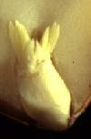
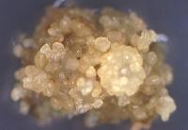
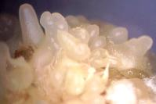
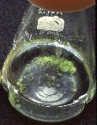
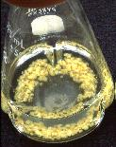
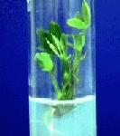
Peanut somatic embryogenesis

Slide 24
Callus
During callus formation there is some degree of dedifferentiation both in morphology and metabolism, resulting in the lose the ability to photosynthesis.
Callus cultures may be compact or friable.
Compact callus shows densely aggregated cells
Friable callus shows loosely associated cells and the callus becomes soft and breaks apart easily.
Habituation:
The lose of the requirement for auxin and/or cytokinin by the culture during long-term culture.

Slide 25
Cell-suspension cultures
When friable callus is placed into the appropriate liquid medium and agitated, single cells and/or small clumps of cells are released into the medium and continue to grow and divide, producing a cell-suspension culture.
The inoculum used to initiate cell suspension culture should neither be too small to affect cells numbers nor too large too allow the build up of toxic products or stressed cells to lethal levels.
When callus pieces are agitated in a liquid medium, they tend to break up.

Slide 26
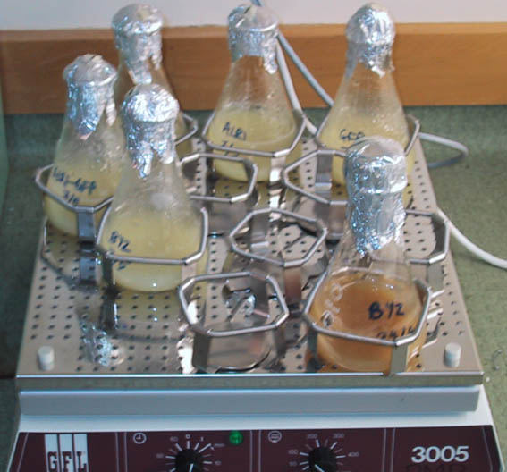
Cell suspension culture

Slide 27
Suspensions are much easier to bulk up than callus since there is no manual transfer or solid support
Cell suspension culture techniques are very important for plant biotransformation and plant genetic engineering.

Slide 28
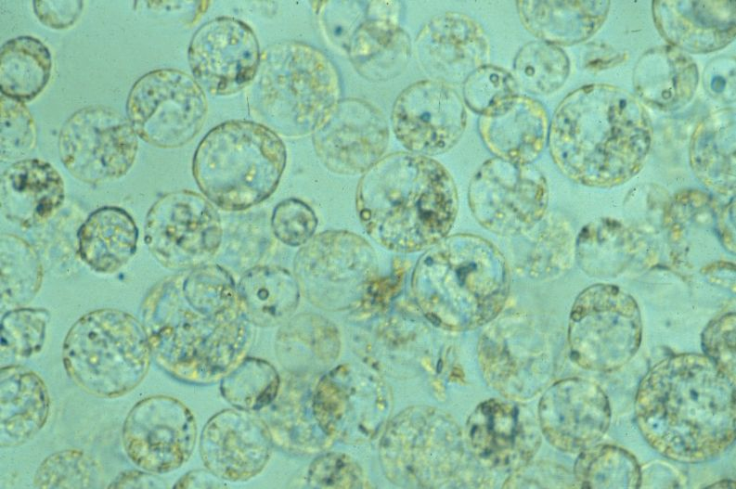
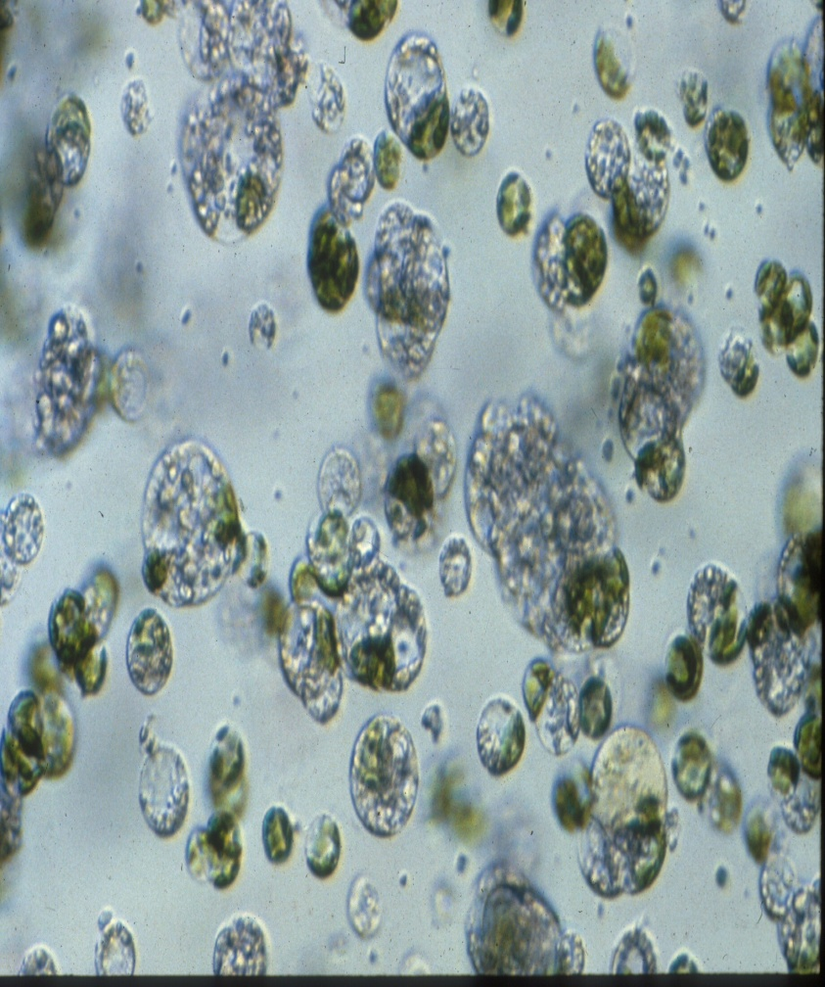
Protoplast culture
The isolation and culture of plant protoplasts in vitro

Slide 29
Protoplast
The living material of a plant or bacterial cell, including the protoplasm and plasma membrane after the cell wall has been removed.

Slide 30
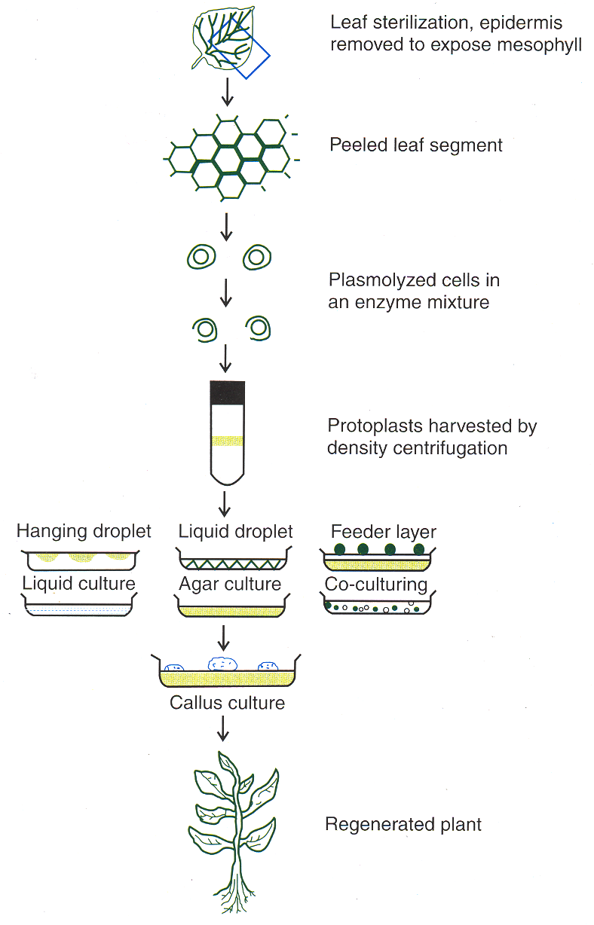

Slide 31
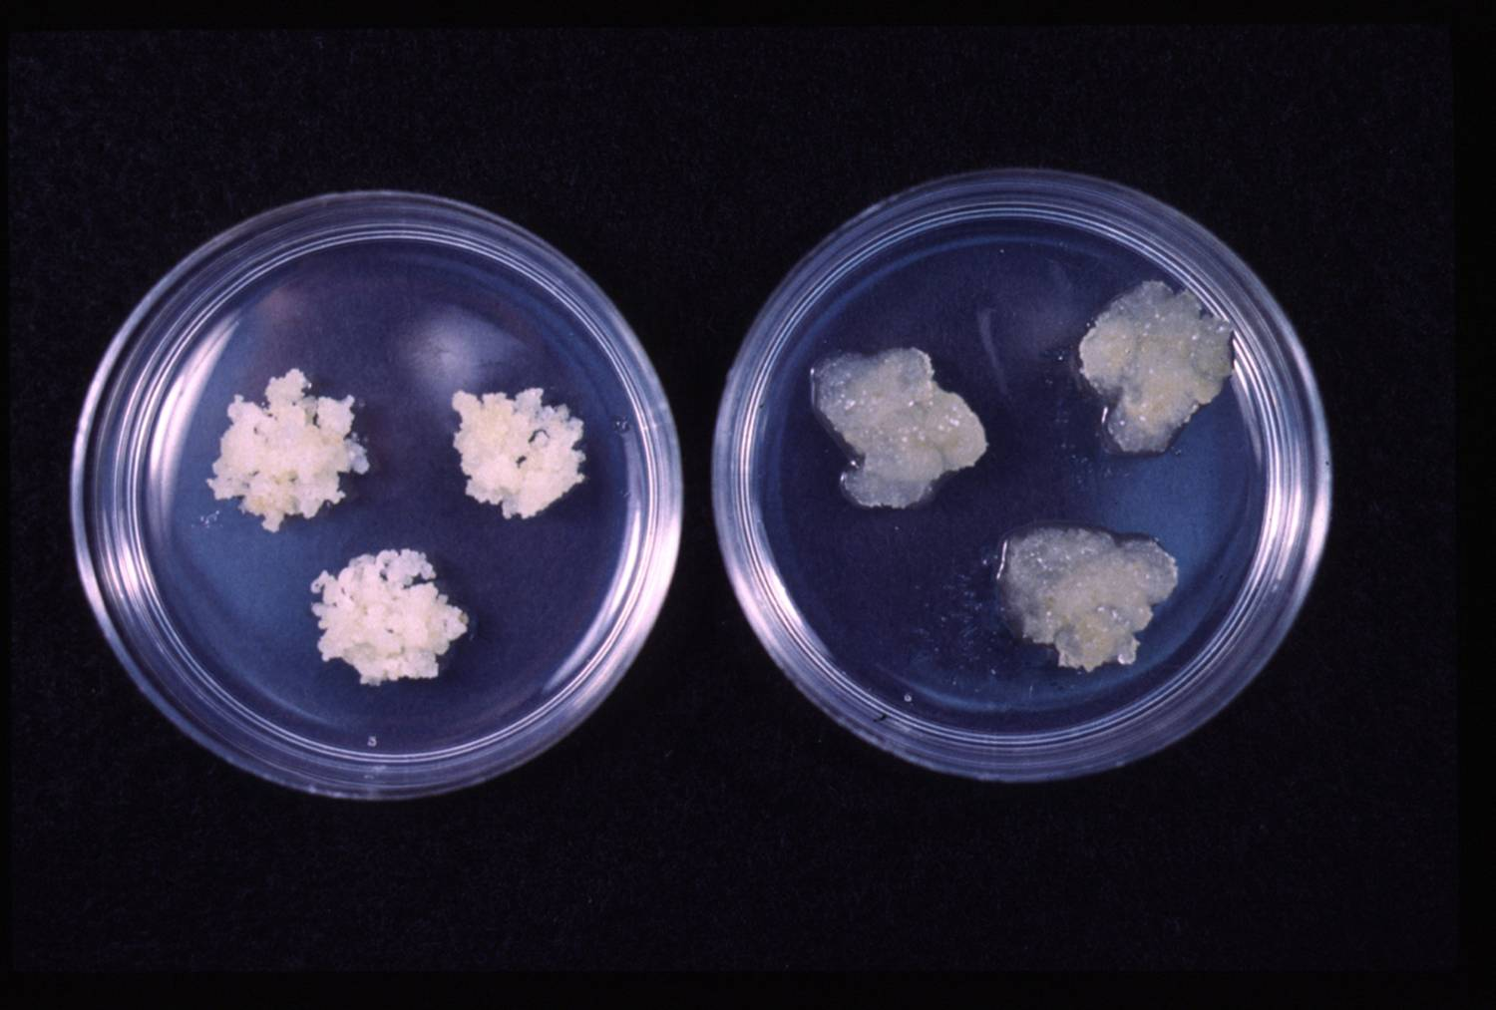
Callus Culture
Callus:
An un-organised mass of cells, produced when explants are cultured on the appropriate solid medium, with both an auxin and a cytokinin and correct conditions.
A tissue that develops in response to injury caused by physical or chemical means
Most cells of which are differentiated although may be and are often highly unorganized within the tissue

Slide 32
Callus formation
1. Meristems
2. Leaf sections
3. Bulb sections
4. Embryos
5. Anthers
6. Nucellus
De-differentiation
Re-differentiation
Explants Callus
Protoplasts
Development
Suspension cells
Organs
(leaves, roots, shoots, flowers,...)
?

Slide 33
Cloning
Using the somatic cells of a multicellular organism to generate a new organism
Each clone is genetically identical to the parent plant.

Slide 34
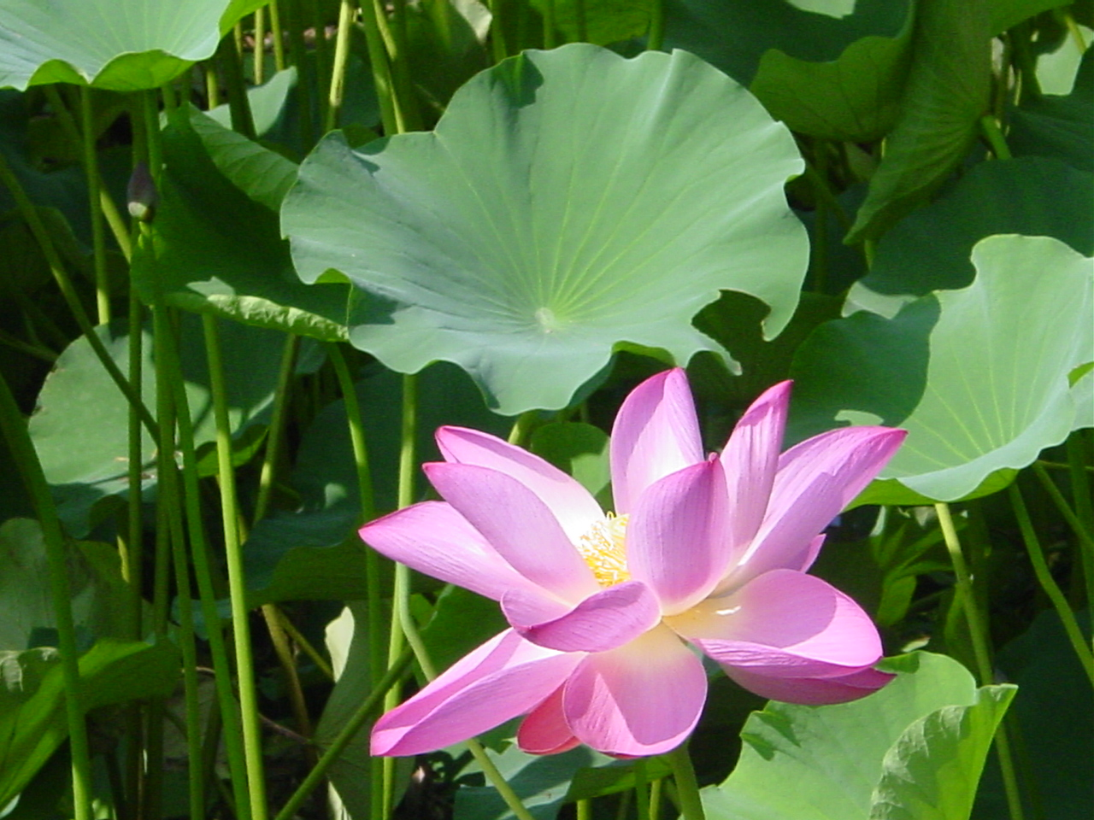
THANK YOU！

