Slide 1
LECTURE 4
CORRELATION

Slide 2

CORRELATION
Correlation Coefficient
The Correlation Coefficient is calculated according to the following formula:
=CORREL(array1, array2)
Example: =CORREL({3,2,4,5,6},{9,7,12,15,17})

Slide 3
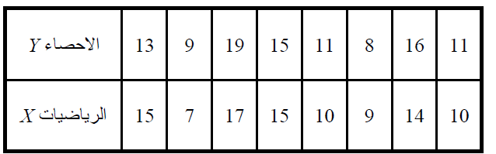
Example
The following table shows the degrees of 8 students in Statistics and Math is there any relationship between the student degrees in both subjects?

Slide 4
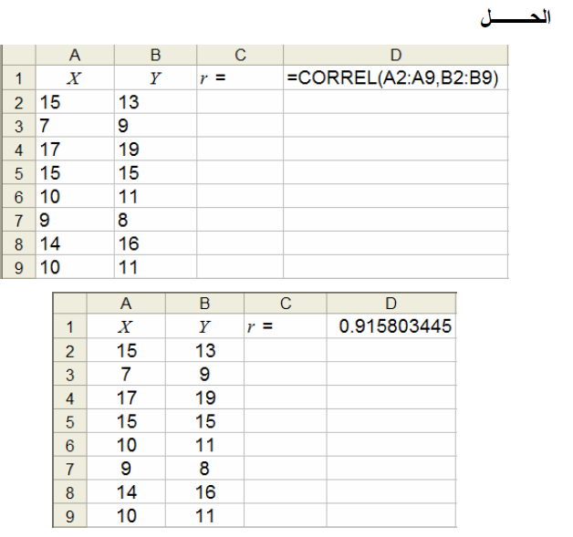

Slide 5
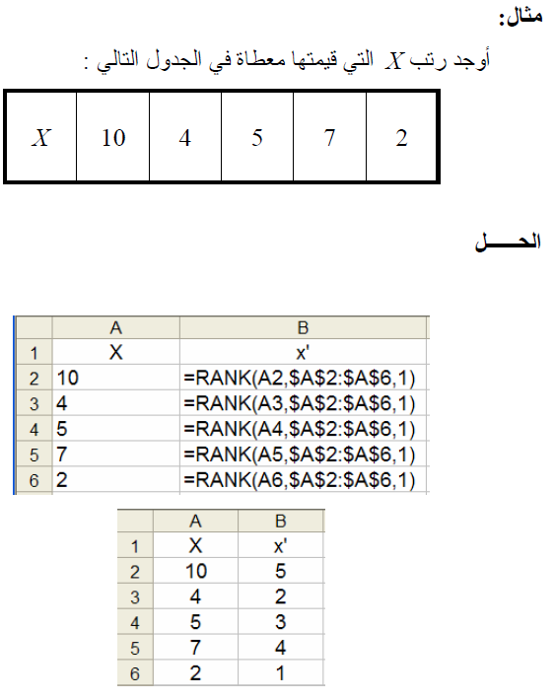
Example-Rank
Find X ranks for the following values:

Slide 6
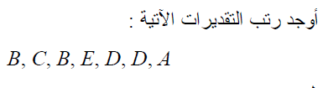
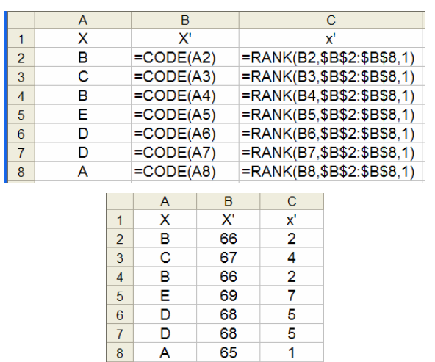
Example-Rank

Slide 7
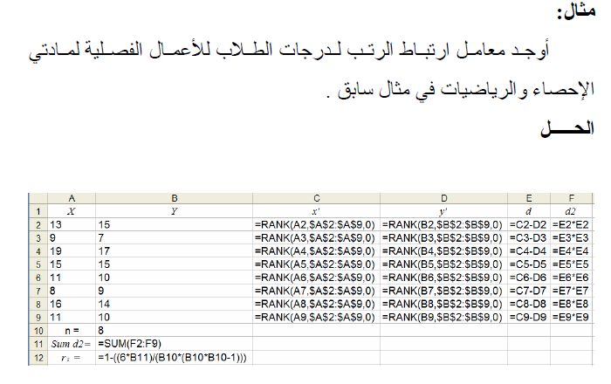
Example
Find Rank correlation coefficients معامل ارتباط الرتبfor student degrees for statistics and Math:

Slide 8
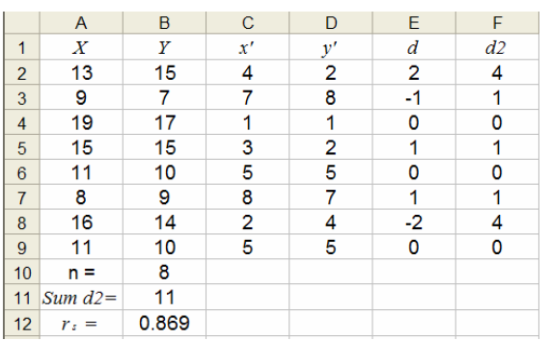

Slide 9
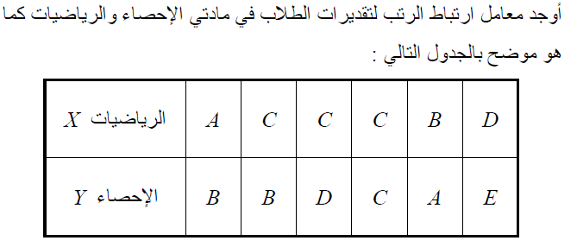
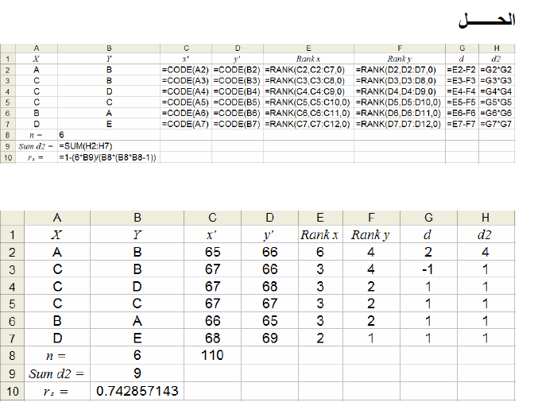
Correlation Coefficients
Find Rank correlation coefficients معامل ارتباط الرتبfor student degrees for statistics and Math shown in the table:

Slide 11
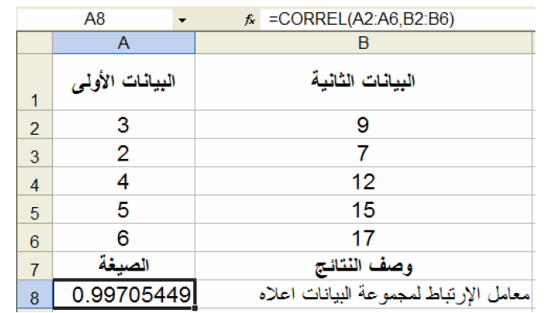
CORREL Example

Slide 12
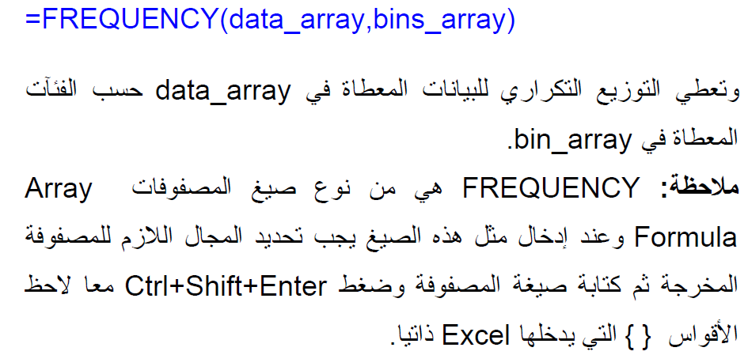
FREQUENCY التكرارات

Slide 13
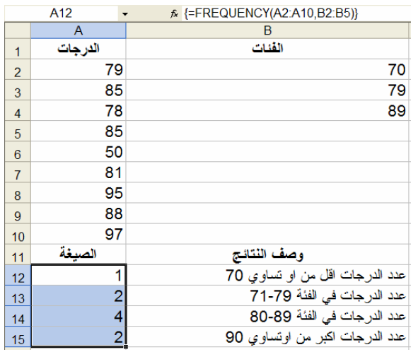

Slide 14
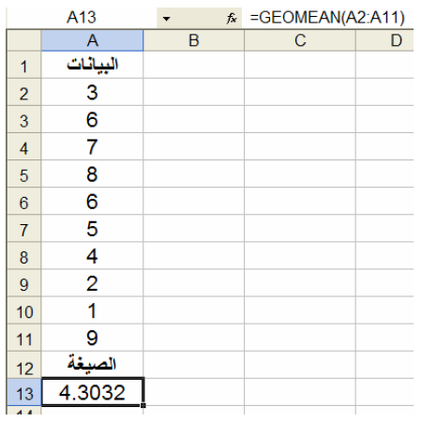
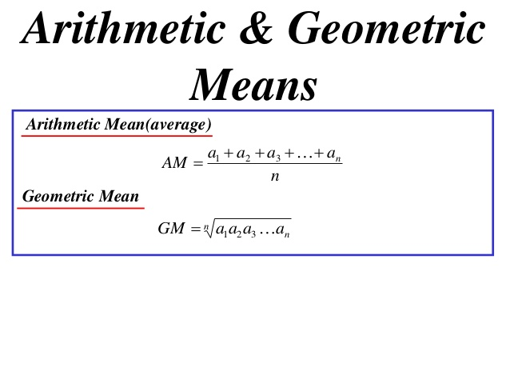
geomean المتوسط الهندسي
=GEOMEAN(Number1,NUMBER2, …)
Ex: =GEOMEAN(A2:A11)

Slide 15
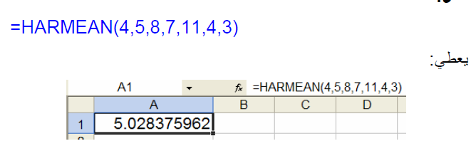
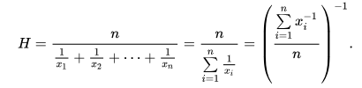
HARMEAN المتوسط التوافقي
=HARMEAN(Number1, Number2, …)

Slide 16
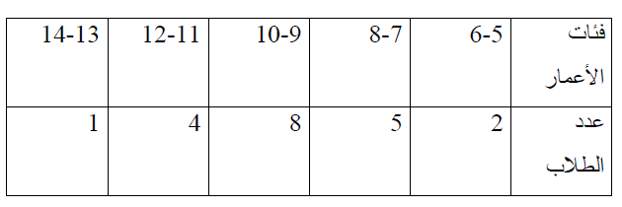
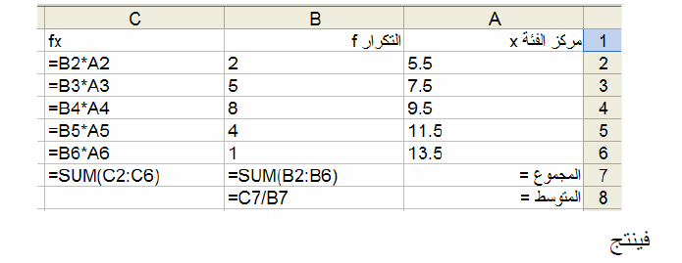
المتوسط الحسابي للبيانات المجمعة
Example:
Calculate the mean for the following data:

Slide 17
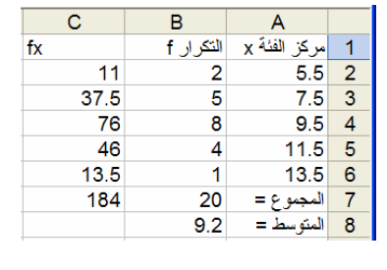

Slide 18
Iterative Calculations by Excel
Iteration means repetition of certain activities .
The iteration in mathematics and numerical methods is a process of applying a function f repeatedly, using the output value x_{n+1} of the function as input argument x_{n} of the function in the next step.
This can be written by mathematical formula:
x_{n+1}=f(x_{n})

Slide 19
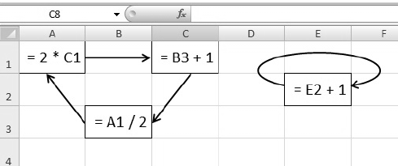
Iterative Calculations by Excel
Examples of circular reference in MS Excel

Slide 20
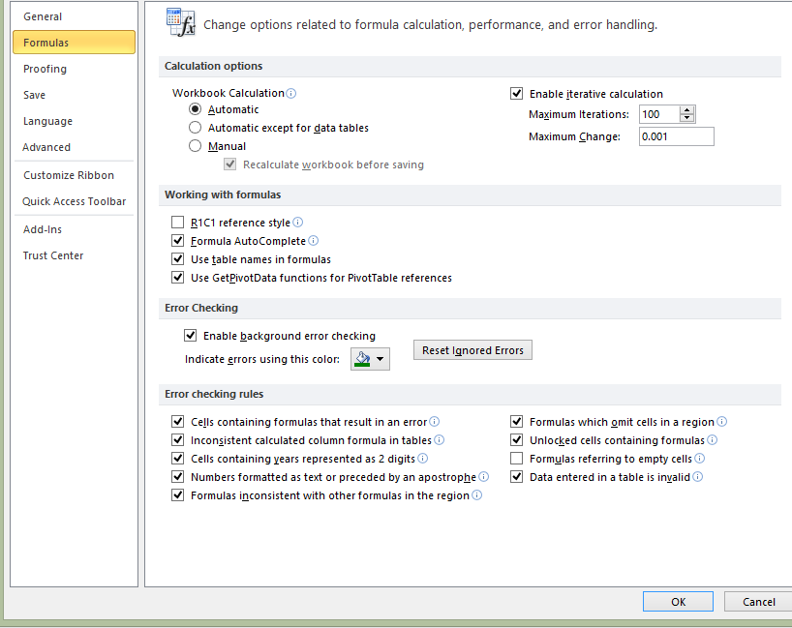
Iterative Calculations
The iterative calculation can be enabled in the ”Excel Options“ dialog box

Slide 21
Iterative Calculations
“Maximum Change” sets the accuracy of the iterative calculation - the value of the cell before and after the iteration is compared.
If the absolute difference of the both values is smaller than the accuracy of the calculation, the iteration is stopped.
The default value of “Maximum Iterations” is set to 100 and the default value of “Maximum Change” is set to 0.001.

Slide 22
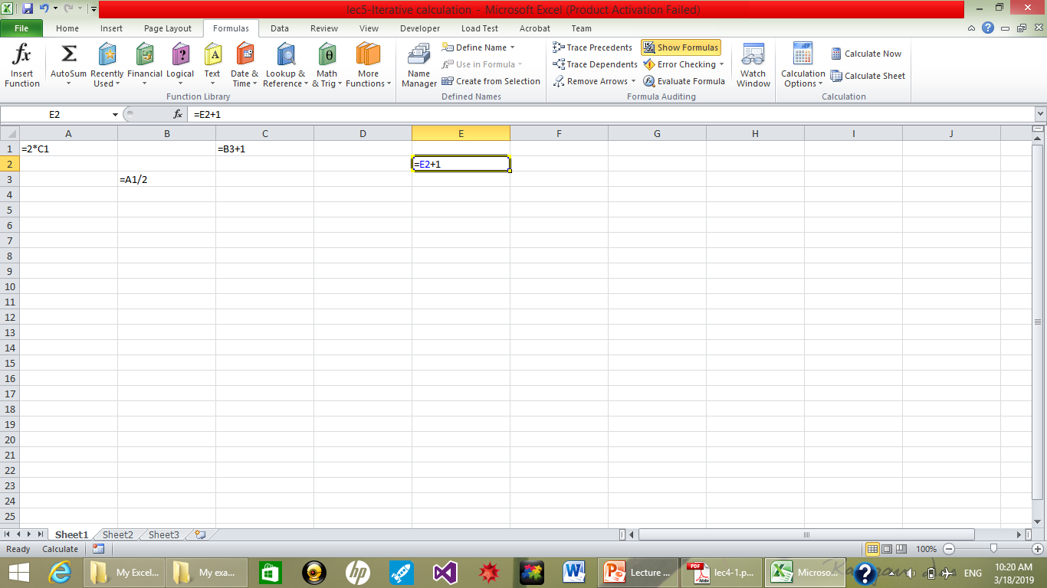
Iterative Calculations

Slide 23
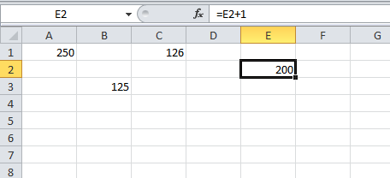
Iterative Calculations
Results of Iterative Calculations:

