Slide 1
Plant Physiology
Dr. Enas Budran

Slide 2
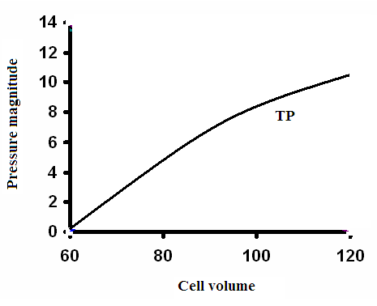
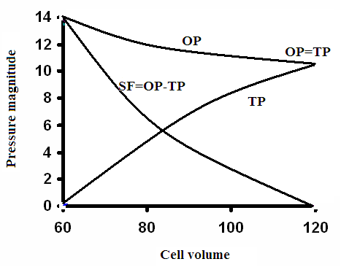
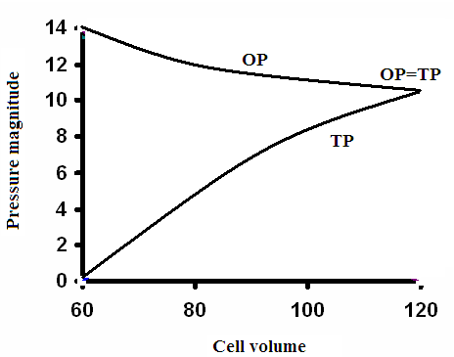
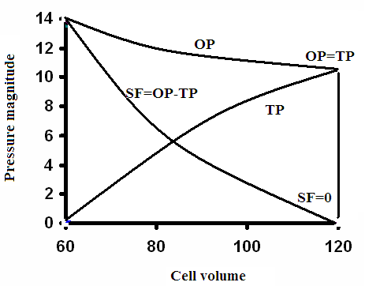
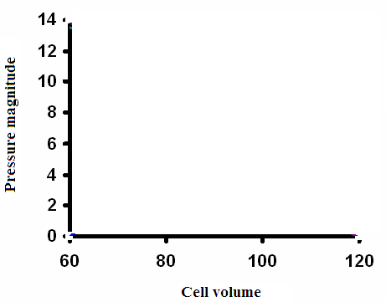
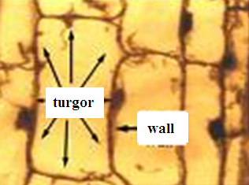
Plant cells as osmotic systems
OP
TP
WP
TP=WP
DPD (SF)
Notes:
2

Slide 3
In pure solvent
SF is related with OP and TP
SF = OP –TP
For fully turgid cells
SF = 0
OP = TP
For fully plasmolyzed cells
the value of TP = 0
SF = OP
In a hypotonic solution (OP1)
SF = (OP – OP1) – TP
Sf= OP – (TP+OP1)
OP=3
TP=2
SF=1
OP=4
TP=2
SF=2
Entry of water depends on SF
OP=3
TP=1
SF=2
OP=4
TP=3
SF=1
Notes:
3

Slide 4



Factors affecting osmotic pressure
1- The habitat of the growing plant
OP changes according to the surrounding medium.
Salt increases OP of the growing plants due to
absorption and accumulation of salts
decomposition of the organic substances.
hydrophytes
mesophytes
xerophytes
halophytes
Notes:
4

Slide 5
2- Plant type
OP differs from plants to another.
trees
shrubs
herbs
annuals
perennial
Notes:
5

Slide 6

3- Age of plant cell or tissue
The OP in old plants
In the young leaves
growing regions
4- Position of cells or tissues in the plant
OP near the source of water
root
leaves
5- Timing factors
OP changes during the different times of the same day
In the morning
at the noon
Notes:
6

Slide 7
Permeability
passage of substances through membranes.
some soluble substances can pass
some others can not because
the selective permeability of membranes.
Membranes
Permeable membranes
Impermeable membranes
Semipermeable (Selective) membranes

Slide 8
Undissociated (organic) substances
sugar, ethyl alcohol, methyl alcohol, glycerin, ...
Simple laws of diffusion.
from a medium having a higher concentration to another with lower concentration until the equilibrium.
The differentiation in permeability is due to the differentiation in
the solubility in oils
the size particles.

Slide 9
Dissociated substances (inorganic or electrolytes)
independent of the laws of diffusion.
May be from lower to higher concentration
In the form of ions
independently.
For balancing the differential absorption
Dissociation of water
Replacement of some ions

Slide 10
Factors influencing Permeability
Temperature
Light
Toxic substances
Balanced solutions
Unbalanced solutions
4. Soluble substances in plant habitat
Antagonism
Synergism

Slide 11
The Water Relations of the Plant
Water absorption
Ascent of sap
Transpiration
Water absorption
Gravitational (adsorption) water
Hygroscopic water
Capillary water

Slide 12
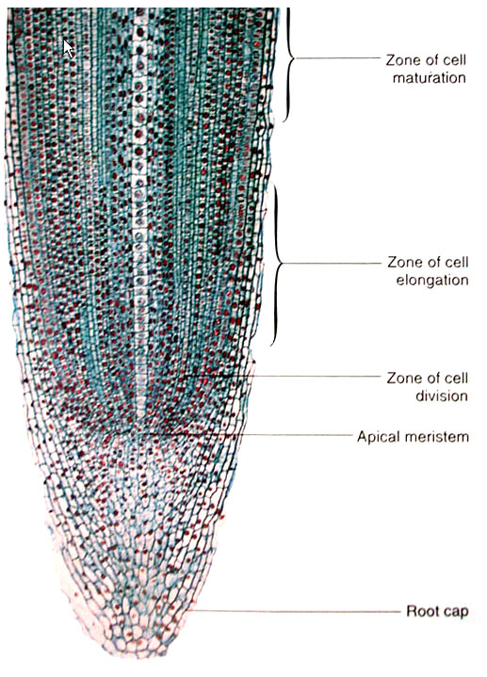
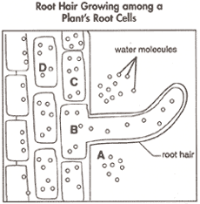
Water absorption
Through root hairs in absorption zone
root hairs
Extension from epidermis
Thin walls
Unicellular
Replacement
Age
OP

Slide 13
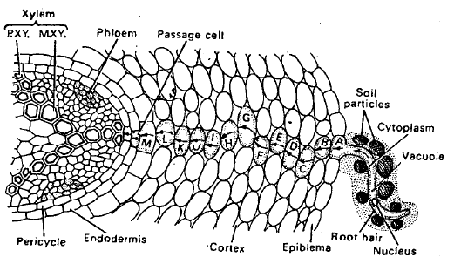
Water absorption
Active absorption
OP1 of root hair (3-5 AP)> soil OP2 (1OP)
DPD < OP1
DPD>OP2
Water enters
Movement
From cell
to cell
To xylem

Slide 14
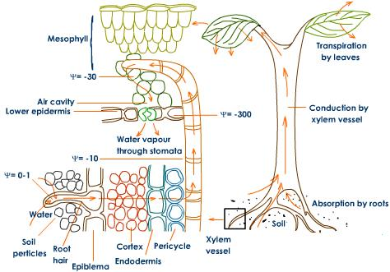
Passive absorption
In leaves
Transpirational pull
Transpiration elevated DPD
The elevation moves from cell to cell
To xylem
Water column from leaves to absorption zone

Slide 15
Factors affecting absorption
Available soil water
Soil temperature
It affects
chemical potential of water.
permeability of cell membrane.
activity of enzymes.
viscosity of capillary water.
Soil Air
Soil Salt
α 1/Concentration
Halophytes
Transpiration
α Transpiration

Slide 16
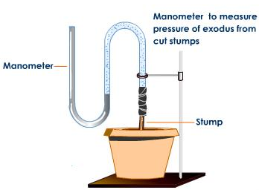
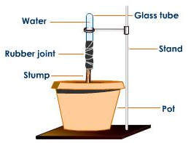
Ascent of sap
upward movement of water through the stem
Most of the water is lost by the transpiration
Only small amount of water utilized in vital activities of the plant.
Vital force theory
Root Pressure Theory

Slide 17
Ascent of sap
upward movement of water through the stem
Most of the water is lost by the transpiration
Only small amount of water utilized in vital activities of the plant.
Vital force theory
Root Pressure Theory
Physical Force Theory
Capillary force theory
Imbibition force theory
Transpiration pull - cohesion force theory

Slide 18
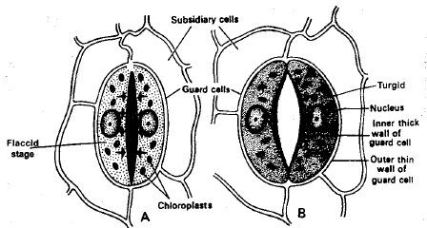
Transpiration
Evaporation
Structure of stomata
Types of transpiration
Cuticular
Lenticular
Stomatal
Notes:
18

Slide 19

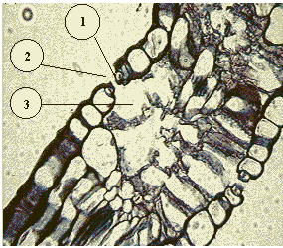
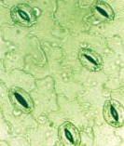
Guard cells
Stomatal aperture
Stomatal room
Chloroplasts
Guard cells
Shape
Thickness
Notes:
19

Slide 20


Mechanism of opening and closing of stomata
1)Photosynthetic products….Depend on G.C…O.P
2)starch-sugar inter conversion
3)Modern theory..K-H PUMP….PEP carboxylase..blue light
in Succulent Plants
During the night
During the day
Notes:
20

Slide 21
Diurnal fluctuations in the rate of stomatal transpiration (daily periodicity of transpiration)
In the morning
Before noon
At about noon
Afternoon
In the evening
At night
stomatal transpiration
1 2 3 4 5 6
Daily hours
Notes:
21

Slide 22
Factors affecting the rate of transpiration
A) External factors
Light..blue
Temperature..value of Q10
Atmospheric humidity
Wind velocity
Atmospheric pressure
Available soil water
Anti transpirants
B) Internal factors
Transpiring areas
Anatomical characteristics of Leaf
Stomatal characteristics
Leaf orientation
Water status of leaves
Root - shoot ratio
Notes:
22

Slide 23
Significance of transpiration
Transpiration is a necessary evil
Water absorption
Mineral absorption
Distribution of absorbed salts
Ascent of sap
Regulation of temperature
Quality of fruits
Root system
Mechanical tissues
Drainage of soil water regulation of temp.
Notes:
23

Slide 24
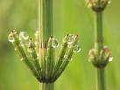


Guttation
watery drops ooze out from the uninjured leaf margins.
in the morning
when
The watery drops consist of
After the drops have dried
Notes:
24

Slide 25
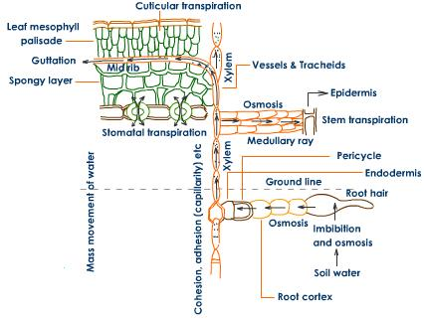
Notes:
25

