Slide 1
WATER MICROBIOLOGY

Slide 2
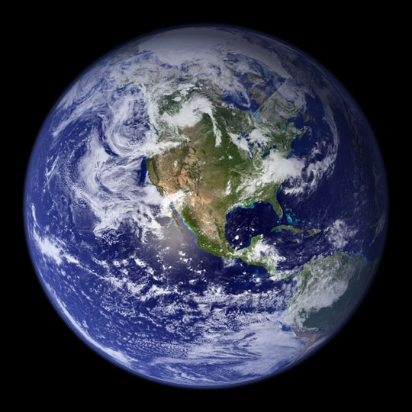
The Essentialness of Water
Water covers 70% of the world.
97% of the water is in the oceans
Essential for All living organisms.

Slide 3
Why do we need water?
Your body is estimated to be about 60 to 70% water.
Blood is mostly water, and your muscles, lungs and brain all contain a lot of water.
Your body needs water to regulate body temperature and to provide the means for nutrients to travel to all your organs.
Water also transports oxygen to your cells, removes waste and protects your joints and organs.

Slide 4
Types Of Water
1- Rain water
2- Surface water
3- Stored water
4- Ground water
5- Salt water

Slide 5
1- Rain Water
General Characters:
1- It is free from microorganisms except during the early period of storm.
2- Count of microorganisms is rarely more than a few score per million.
When the rain washes floating microorganisms from the air.

Slide 6
Sources Of Microorganisms In Rain Water
From the air
From the soil
It is blown upward by wind
Examples of Rain Water Microorganisms:-
1- Bacteria
2- Algae
3- Fungi
4- Protozoa
Cysts
Spores

Slide 7
2- Surface Water
General Characters:
1- This water formed from the rain water which has collected in:
2- Bacterial count as high as several hundred thousand per milliliter.
Rivers
Brooks

Slide 8
This count depending on:
The extent of soil contamination.
e.g.
(The rivers and streams are contaminated by sewage)
This leads to increasing of bacteria.
Examples of Surface Water Microorganisms:-
1- Algae
2- Fungi
3- Protozoa (few)

Slide 9
Bacteria Found In Surface Water
Bacteria | Disease/ infection | Symptoms
Aeromonas | Enteritis | Very thin, blood- and mucus-containing diarrhea
Campylobacter jejuni | Campilobacteriose | Flue, diarrhea, head- and stomachaches, fever, cramps and nausea
Escherichia coli | Urinary tract infections, neonatal meningitis, intestinal disease | Watery diarrhea, headaches, fever, homiletic uremia, kidney damage
Plesiomonas shigelloides | Plesiomonas-infection | Nausea, stomachaches and watery diarrhea, sometimes fevers, headaches and vomiting
Typhus | Typhoid fever | Fevers
Salmonella | Salmonellosis | Sickness, intestinal cramps, vomiting, diarrhea and sometimes light fevers
Streptococcus | (Gastro) intestinal disease | Stomach aches, diarrhea and fevers, sometimes vomiting
Vibrio El Tor (freshwater) | (Light form of) Cholera | Heavy diarrhea

Slide 10
3- Stored Water
General Characters:
1- This water present in:
2- Bacterial counts are usually no more than a few hundred per milliliter.
3- The gradual settling of microorganisms tends to reduce the population in the main part of a large body of water.
Reservoir
Lakes
Ponds

Slide 11
Examples of Stored Water Microorganisms:-
1- Algae
2- Protozoa (Particularly during warm seasons because the water surface temperature is high).

Slide 12
4- Ground Water
General Characters:
1- It is subterranean water that has been filtered through successive layers of soil.
2- It appears in springs and wells (Water nearly sterile).
3- Bacterial counts range from zero to a score or so per milliliter.

Slide 13
Examples of Ground Water Microorganisms:-
1- Chromogenic bacteria (Pigment producing bacteria) are prominent.
2- This water are usually free from other microorganisms which are larger and more effectively removed by filtration through the soil.

Slide 14
5- Salt Water
General Characters:
1- Most water eventually reaches to the sea carrying with it dissolved minerals and some microorganisms.
**Coastal waters
Near the coast, rivers maintain a concentration of mineral nutrients sufficient to support multiplication of algae.

Slide 15
Note that:- Rivers that drain a heavily populated area are likely to carry large quantities of sewage, either raw or only partially treated.
This means that:
Not only are intestinal and other bacteria discharged into the coastal waters but also the sufficient organic matter permit their survival in areas near the large city.

Slide 16
So, These organisms may be a health hazard to those using the beaches for recreation.
The health problems are also created by dumping garbage from large coastal cities at the sea.
e.g. In the vicinity of New York, garbage has been detected slowly drifting many miles toward beach and residential areas.

Slide 17
Algae
Phytoplankton
(Free floating)
Benthic
(Attached to bottom)
Algae are either:
In the latter case, protozoa ingest the bacteria in any event.
Zooplankton are consumed by large invertebrates which in turn eaten by fish.
Eaten by protozoa and zooplankton
Die and decompose owing to bacterial action

Slide 18
The food chain in an aqueous environment begin with algae as following:
Algae Zooplankton Invertebrates Fish
Algae utilize the light energy in the initial production of organic matter so, it called primary producers.
The biological activity of marine environment depends on the area of primary production.
Note that:

Slide 19
There are 5 principal population of microorganisms in the sea
1- In the open sea:
Especially in the upper 300 meters, where the phytoplankton release about 25% of their photosynthesized in the form of:
Bacterial count of 10 000 to 100 000 per ml.
Amino acids
Sugars
Fatty acids

Slide 20
2- At the sea- air interface:
There are a very thin film about 0.1µm thickness containing a high concentration (0.2%) of dissolved organic carbon.
nitrogenous compound.
other nutrients.
Bacterial count is 100 000 to 100 000 000 per ml.

Slide 21
3- At the surfaces:
Most surfaces, whether in animate or living are covered with considerable number of attached microorganisms.
Bacteria colonize surfaces by reversibly and irreversibly mechanisms as following:
A- Reversibly: by adsorption because of Vander walls forces or electric attraction.
B- Irreversibly: by chemotactic attraction to organic substances such as protein polysaccharide complexes.
In the later case, they attach by means of polysaccharide and multiply forming a dense microbial film.
e.g.
1- Diatoms are accumulated.
2- Protozoa which then feed on the smaller microorganisms.

Slide 22
4- Associated with the waste products in water:
A large population of microorganisms is associated with the waste products and remains of large organisms.
Waste products formed from invertebrates and vertebrates which are convert about one fourth of their food into excrement which provides nutrients for heterotrophic microorganisms.

Slide 23
5- Associated within the gut and in the environment:
Microorganisms are present within the gut and in the environment often excretion, in addition, the animal bodies themselves after death due to normal, seasonal or catastrophic causes.
These materials often macroscopic or particulate in nature, settle to the sea bottom, where a large and varied population organisms can be found.

Slide 24
The deep sea is dark, cold (2ºC) and under high pressure (200 to 1000 atm). So, the microbial activity is limited to forms adapted to these conditions.
Examples:-
Bacteria are the primary decomposers in the upper, aerobic zones succeeded by flagellates and cilliates in deeper, anaerobic layers such as Desulfovibrio which reduce sulfates and release hydrogen sulfide.

Slide 25
Number of microorganisms in water
The number of microorganisms in water depends on the initial and the ability of microorganisms to multiply.
The multiplication is a function of:
1- Food supply
2- Oxygen
3- pH
4- Temperature
5- Other factors

Slide 26
Food supply is determined by: 1- The surrounding terrain (gravels, rich agricultural loam). 2- Waste materials introduced by man.
Water containing organic matter supports a more luxuriant microbial population than a pure one.

