Slide 1
Bacteria
General Characters:
1- Single-celled organisms without cell nuclei.
2- They are found in all portion of the water column, the sediment surface and the sediment itself.
3- Some are aerobic, whereas others are anaerobic.
4- Most bacteria are free living but some live as symbiotic within other organisms.
e.g. Many deep-sea fish harbor symbiotic bacteria that emit light (Bioluminescence), which the fish use to signal other members of their species.

Slide 2
Bacterial Morphological Plasticity
Bioluminescence: It is a phenomenon which most noticeable at the surface but present at all depth and causes water to glow.
It is refers to evolutionary changes in the shape and size of bacterial cells.
As bacteria evolve morphology changes have to be made to maintain the consistency of the cell.
However, this consistency could be affected in some circumstances such as environmental stress. Changes in bacterial shape and size but especially the transformation into filamentous organisms have been recently showed.

Slide 3
Bacterial shape and size under selective forces
Normally, bacteria have different shapes and sizes which include:
Coccus (May have access to small pores, creating more attachment sites per cell and hiding themselves from external shear forces)
Rods (Allow bacteria to attach more readily in environments with shear stress)
Helical/Spiral Combine some of the characteristics cocci and of filaments, where more surface area on which shear forces can act and the ability to form an unbroken set of cells to build biofilms.

Slide 4
Several bacteria alter their morphology in response to the types and concentrations of external compounds.
Bacterial morphology changes help to:
** Optimize interactions between cells and the surfaces to which they attach.

Slide 5
Marine bacteria are unique in the requirement for Na for optimal growth. Using a marine bacterium Vibrio alginolyticus, it was confirmed that Na is essential for the active uptake of all amino acids.
Some marine bacteria can interact with diatoms in such a way that influences the cycling of silicon in the oceans.

Slide 6
Microbiological Analysis of Water Purity
Monitoring and detection of indicator and disease-causing microorganisms are a major part of sanitary microbiology.
Bacteria from the intestinal tract generally do not survive in the aquatic environment, which under a physiological stress gradually lose their ability to form colonies on differential and selective media.

Slide 7
Their die-out rate depends on:
1- The water temperature
2- The effect of sunlight
3- The populations of other bacteria present
4- The chemical composition of water.
A wide range of viral, bacterial and protozoan diseases result from the contamination of water with human fecal wastes.
Although many of these pathogens can be detected directly, environmental microbiologists have generally used indicator organisms as an index of possible water contamination by human pathogens.

Slide 8
The suggested criteria for such an indicator
The indicator bacterium should be:
1- Suitable for the analysis of all types of water (Tap, river, ground, impounded, recreational, estuary, sea and waste).
2- Present whenever enteric pathogens are present.
3- Survive longer than the hardiest enteric pathogens.
4- The indicator bacterium should not reproduce in the contaminated water and produce an inflated value.

Slide 9
5- The assay procedure for the indicator should have great specificity (Other bacteria should not give positive results. In addition, the procedure should have high sensitivity and detect low levels of the indicator).
6- The testing method should be easy to perform.
7- The indicator should be harmless to humans.
8- The level of the indicator bacterium in contaminated water should have some direct relationship to the degree of fecal pollution.

Slide 10
Coliforms
General characters:
1- They are members of the family Enterobacteriaceae.
2- These bacteria make up approximately 10% of the intestinal microorganisms of humans.
3- They lose viability in water at slower rates than most of the major intestinal bacterial pathogens.
4- When such foreign enteric indicator bacteria are not detectable in a specific volume (100 ml) of water, the water is considered potable (suitable for human consumption).

Slide 11
5- The coliform group includes E. coli, Enterobacter aerogenes and Klebsiella pneumonia.
6- Coliform are defined as facultative anaerobic, gram-negative, non- spore forming, rod- shaped bacteria that ferment lactose with gas formation within 48 hours at 35˚C by make presumptive or MPN, confirmed and completed tests.

Slide 12
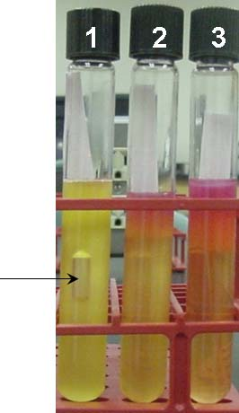
Presumptive Test

Slide 13
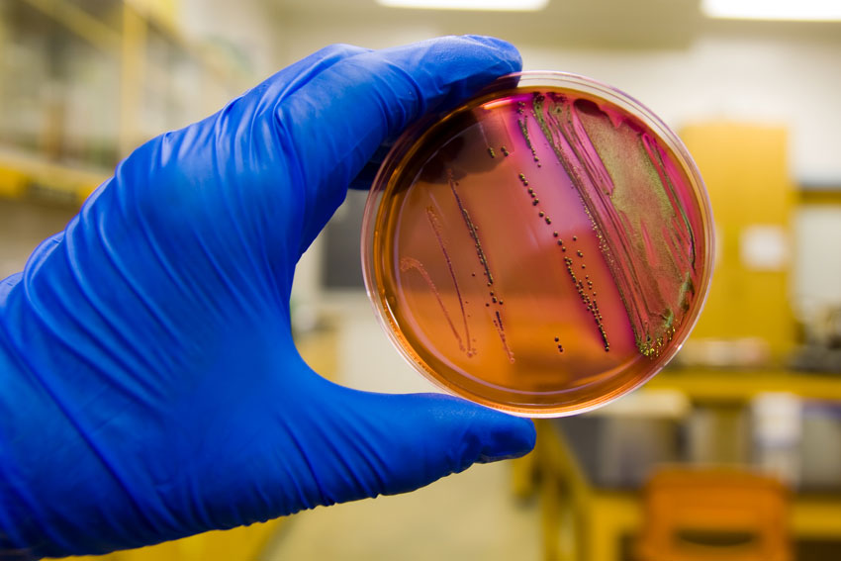
Confirmed Test

Slide 14
The Membrane Filter Technique
This method has become a common and often preferred of evaluating the microbiological characteristics of water.
The water sample is passed through a membrane filter.
The filter with its trapped bacteria is transferred to the surface of a solid medium or to an absorptive pad containing the desired liquid medium.

Slide 15
Use of the proper medium allows the rapid detection of total coliforms or fecal streptococci by the presence of their characteristic colonies.
Membrane filters have been widely used with water that does not contain high levels of sediment or heavy metals.

Slide 16
Advantages and Disadvantages of the Membrane Filter Technique
Advantages:
1- Good reproducibility.
2- Single-step result often possible.
3- Filters can be transferred between different media.
4- Large volumes can be processed to increase assay sensitivity.
5- Time savings are considerable.
6- Ability to complete filtrations on site.
7- Lower total cost in comparison with MPN procedure.

Slide 17
Disdvantages:
1- High- turbidity waters limit volumes sampled.
2- High populations of background bacteria cause overgrowth.
3- Metals and phenols can adsorb to filters and inhibit growth.

Slide 18
