Slide 1
Algal Blooms and its toxins
Christine Trinh

Slide 2
Definition of algal bloom:-
It is a rapid increase or accumulation in the population of microscopic algae in aquatic ecosystem.
Algal blooms may occur in fresh water as well as marine environments
The blooms may be recognized by discoloration of the water resulting from the high density of pigmented cells.
This directly caused by nutrient pollution of nitrogen and phosphorous from agriculture, intensive animal farming fertilizers and household cleaning products.

Slide 3
Algal bloom concentrations may reach millions of cells per milliliter.
Colors of algal blooming:
Algal blooms are often green, yellow-brown or red. They depending on the species of algae.
For Example:
* Bright green blooms are a result of cyanobacteria (blue-green algae) such as Microcystis.

Slide 4
What are blue green algae (Cyanobacteria)?
They are microscopic organisms that are naturally present in lakes and streams.
They are usually present in low numbers. However, blue green algae can grow quickly and become very abundant in warm, shallow and undisturbed surface water that receives a lot of sunlight.
They can form blooms that discolor the water or produce floating rafts on the surface of the water.

Slide 5
Are blue green algae or algal toxins harmful to my health?
Some blue green algae produce algal toxins (microcystin, anatoxin and saxatoxin).
The most common toxin is microcystin that could pose a health risk to most people and animals when exposed to them in large enough quantities.
Health effects could occur when surface scums or waters containing high levels of blue green algae toxins are swallowed come in contact with skin or when airborne droplets containing toxins are inhaled while swimming, boating, waterskiing, tubing, bathing or showering.

Slide 6
How do I Know if I am being exposed to blue-green algae?
People should suspect that blue-green algae are present in water that is visibly discolored or that has surface scums.
Colors can induce shades of green, blue green, yellow, brown or red. Water affected by blue-green algae blooms often is so strongly colored that it can develop a paint-like appearance.
The presence of toxins from algae can only be verified through laboratory analysis.

Slide 7
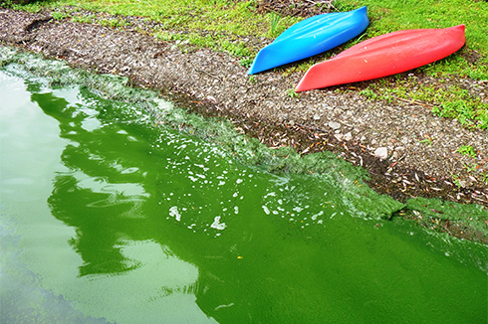
Harmfull algal blooms make the water is look like bright green colour:

Slide 8
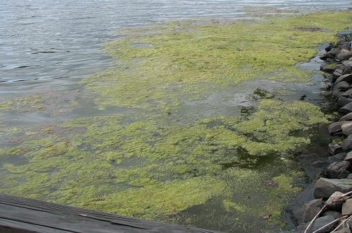
Green algae blooms (non toxic)

Slide 9
Are children more vulnerable than adults to blue-green algal toxins?
Unpleasant tastes or odors are not reliable indicators of blue-green algae toxins because the algae may or may not also produce chemicals that affect the taste or odors of drinking water.
Similarly, the absence of unpleasant tastes and odors doesn't guarantee the absence of blue-green algal toxins.
Yes, because of:
1- Their comparatively low body weight, it takes fewer toxins to make children sick from exposure to blue green algae.
2- Children have more sensitive skin than adults.

Slide 10
Can I eat fish caught in water with high amounts of blue-green algae or algal toxins?
Toxins from algae can accumulate in the guts and in the muscle of fish.
Levels in fish depend upon the severity of the bloom in the area where the fish are caught.
In general, fish that are caught in areas of a water body where major blue-green algae blooms occur may be safe to eat, as long as the guts of the fish are discarded.
However, there is some uncertainty about the levels of algal toxins that can accumulate in muscle, so anglers may want to wait a week or two after algal blooms are over before eating fish from waters where a bloom is occurring.

Slide 11
How can I stop or reduce exposures to blue-green algae or algal toxins?
1- Never drink untreated surface water, whether or not algae blooms are present. For example: Water from lakes, rivers or streams may contain other bacteria, parasites or viruses as well as algal toxins that all caused illness if consumed.
2- People should avoid contact with water that is discolored or has scum on the surface and restrict the access of their pets and livestock to this water. This includes swimming, water skiing, tubing, boating … etc.
3- If contact does occur, wash with soap and water or rinse thoroughly with clean water to remove algae.

Slide 12
Factors affecting cyanobacteria blooming
1- Adaptation of Cyanobacteria to unfavorable conditions.
2- Light
3- Temperature
4- Alkalinity and pH
5- Nutrients
6- Carbon
7- Nitrogen
8- Phosphorous

Slide 13
Classification of Algal Toxins
1- Hepatotoxins:
A- Microcystins:
Microcystin is a toxin produced by cyanophyta and it is the most toxic one.
These toxins are heptapeptides.
Microcystins have been identified from Microcystis, Oscillatoria, Nostoc and Anabaena that are the main cyanobacterial genera forming mass occurrences in freshwaters.

Slide 14
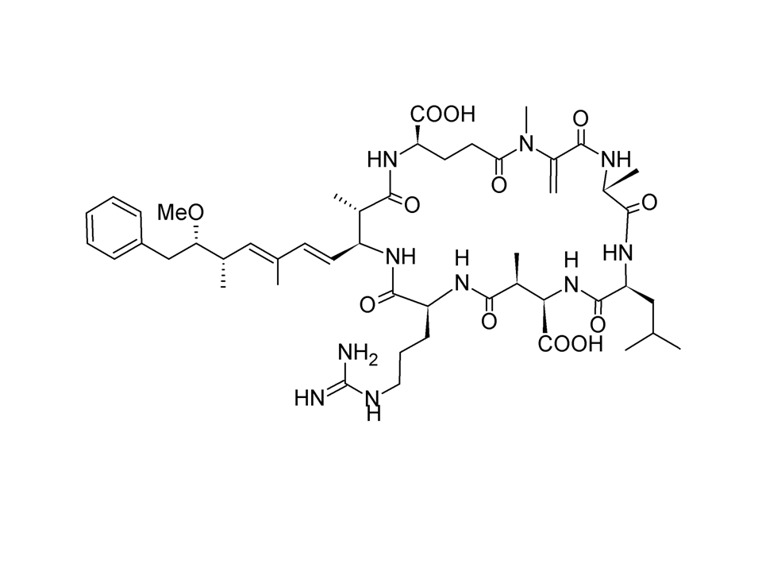
Microcystin
How the toxins work?
Microcystins are inhibitors of protein phosphatases enzymes.
The liver is particularly susceptible to these toxins because unlike many other cell types, these toxins are able to penetrate the liver cells and are specifically taken up through the bile acid transport pathway Which lead to damage the liver’s cells

Slide 15
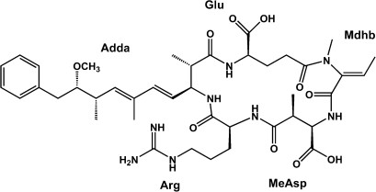
B- Nodularins:
Nodularin is a cyclic pentapeptide that is produced by Nodularia spumigena and it has been detected in Australia, New Zealand, Baltic Sea and North Sea coastal lakes and basins.
Nodularin penetrates into hepatocytes more easily than microcystins and is itself a liver carcinogen.

Slide 16
2- Neurotoxins:
1- Anatoxin-a, homoanatoxin-a and Anatoxin´a (S):
The anatoxins are a group of low molecular weight neurotoxic alkaloids.
It was first described as a “very fast death factor” from fresh water bloom samples and isolates of Anabaena from Canada, except Homoanatoxin-a produced by: Oscillatoria Formosa

Slide 17
