Slide 1
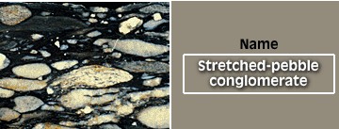
Description of metamorphic rocks at field
1- parental features of sedimentary and igneous rocks:
Sedimentary bedding
Lava flows and pillow lava
So: the prefix meta can be added (meta-greywacke, meta andesite)
Use the metamorphic names: gneiss- schist and slate

Slide 2
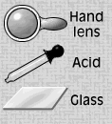
2- Identification of the Mineral assemblages
Arranging the minerals descendingly.
By identification of the minerals at the field.

Slide 3
3- Metamorphic Fabrics
Differentiation between the preferred orientation and non preferred orientation.
*Preferred orientation fabrics:
Foliation: (slatey cleavage, schistosity, gneissose banding.
lineation.
*Non preferred orientation: ( nondirectional fabrics)
Granoblastic texture
Porphyroblastic texture

Slide 4
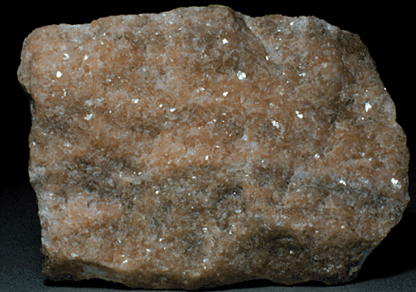
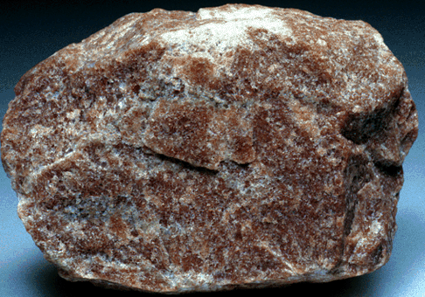
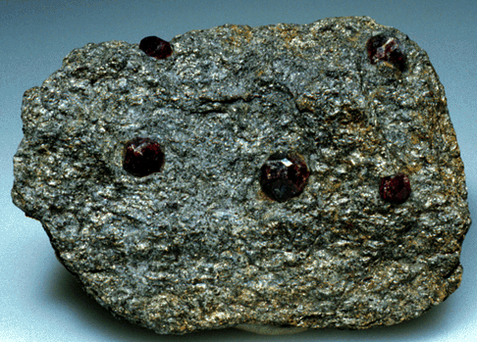
Nonprefered
Orientation
Granoblastic
texture
Pophyroblastic texture

Slide 5
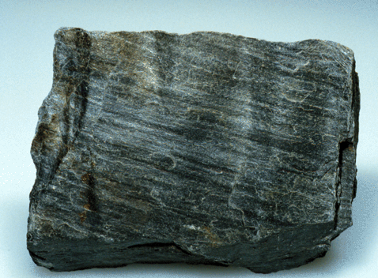
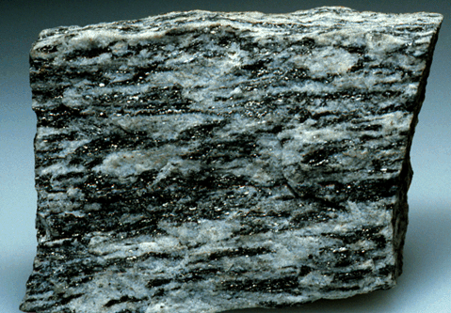
schistosity
gneisosity

Slide 6
Contact Metamorphism
The perfect example for the contact metamorphism is the pelitic rocks as they shows mineralogical and textural changes.
For example: Skiddaw aureole.
The country rocks are slate formed after low grade of regional metamorphism then, Injection of biotite granite within the slate of Skiddow (pelitic rocks).
So, the contact metamorphic aureole is overprinted.
The metamorphic aureole:
Igneous injection) 1- inner hornfels) 2- intermediate porphyroblastic slate) 3-outer spotted slate) country rocks(unaltered slate).

Slide 7
country rocks (unaltered slate).
Low grade of metamorphism ( sericite, chlorite, quartz chloitoids and opaque minerals).
3-outer spotted slate:
Increasing the grain size, unclear cleavage, small dark spots at clevage cant identified at the field.
2- intermediate porphyroblastic slate:
The porphyoblasts are identified as Cordierite and andalusite. (quartz, biotite, muscovite and opaque minerals).
1- inner hornfels:
Cordierite and andalusite. (quartz, biotite, muscovite and opaque minerals) +graphite.
More massive.The quartz is equdimentional forming granoblastic texture.

Slide 8
The Comrie aureole
The country rocks are schist formed after low to medium grade of regional metamorphism then, Injection of diorite within the schist of Comrie (pelitic rocks).
*410 meters between the first appearance of the spots and the contact line.
*The hornfels is characterized by the (spinel Mg Al₂O₄) qurandoum Al₂O₃ and no quartz+ orthoclase, biotite, cordirite and magnetite. Granoblstic texture.
*Inner zone is hypersthene pyroxene (orthoclase, biotite, cordirite and magnetite).
Progressive dehydration

Slide 9
Hydration/ Dehydration Reactions
Metamorphic reactions involving the expulsion or incorporation of water (H₂O)
Example:
Al₂Si₄O₁₀(OH)₂ <=> Al₂SiO₅ + 3SiO₂ + H₂O
Pyrophyllite And/Ky Quartz water

Slide 10
Isle of Skye aureole
The country rocks are carbonate (Dolostone) with chert nodules.
Near to the igneous intrusion dedolomitization is happened.
Ca Mg (CO₃)₂ ←→ CaCO₃+ MgO(perclase) + CO₂
MgO at surface forms (brocite) Mg (OH)₂.
The chert nodules react with the carbonates to form talc (tremolite)
(tremolite, Ca₂(Mg, Fe)₅Si₈O₂₂(OH)₂)
then diaposide (pyroxene) (CaMgSi₂O₆ and foresterite( Mg₂SiO₄).

Slide 11
Carbonation / Decarbonation Reactions
Reactions that involve the evolution or consumption of CO₂
CaCO₃ + SiO₂ = CaSiO₃ + CO₂
calcite quartz wollastonite
Reactions involving gas phases are also known as volatilization or devoltilization reactions
These reactions can also occur with other gases such as CH₄ (methane), H₂, H₂S, O₂, NH₄⁺ (ammonia) – but they are not as common

Slide 12
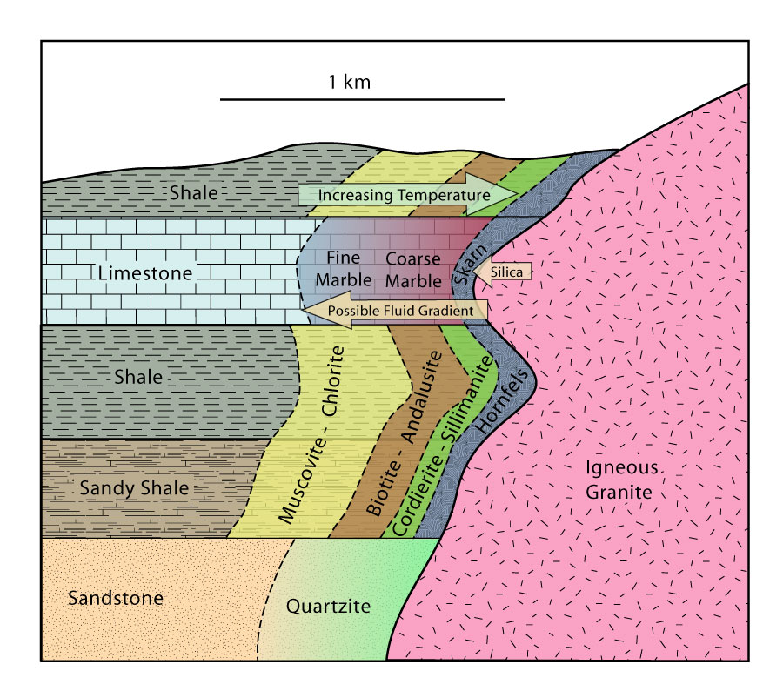
Contact or Thermal Metamorphism

