Slide 1
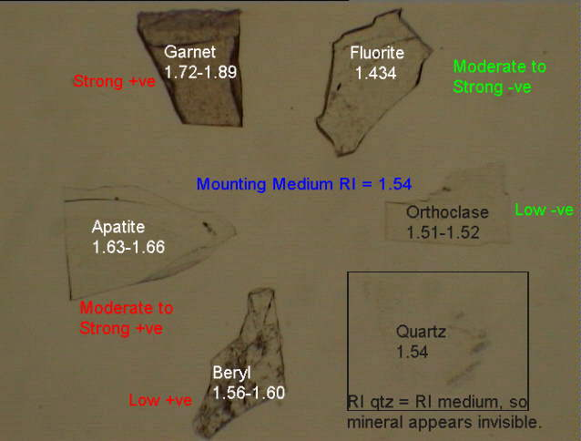
RELIEF - the degree to which a mineral grain or grains appear to stand out from the mounting material, whether it is an immersion oil, Canada balsam or another mineral.

Slide 2
How to detect the relief?
Abbe Refractometer.
immersion method:
Refractometry involves the determination of the refractive index of minerals, using the immersion method. This method relys on having immersion oils of known refractive index and comparing the unknown mineral to the oil.

Slide 3
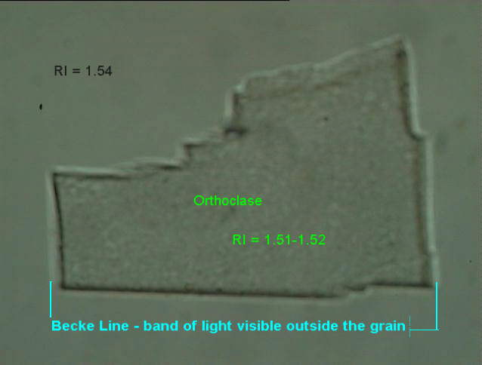
BECKE LINE - a band or rim of light visible along the grain boundary in plane light when the grain mount is slightly out of focus.

Slide 4
To observe the Becke line:
use medium or high power,
close aperture diaphragm,
for high power flip auxiliary condenser into place.

Slide 5
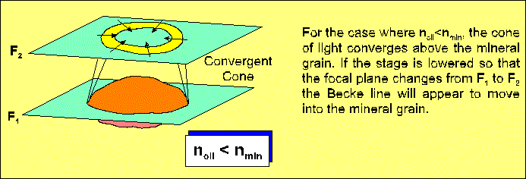

Slide 6
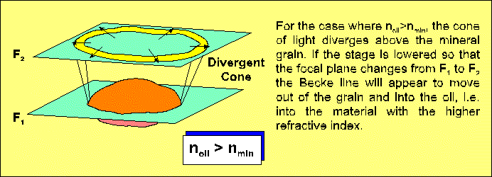

Slide 7
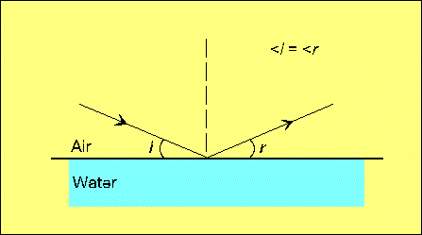
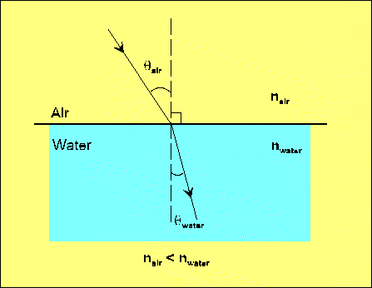

Slide 8
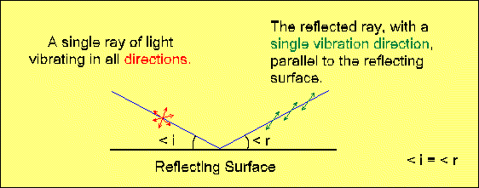
POLARIZATION OF LIGHT
Reflection
Unpolarized light strikes a smooth surface, such as a pane of glass, tabletop, and the reflected light is polarized such that its vibration direction is parallel to the reflecting surface. The reflected light is completely polarized only when the angle between the reflected and the refracted ray = 90°.

Slide 9
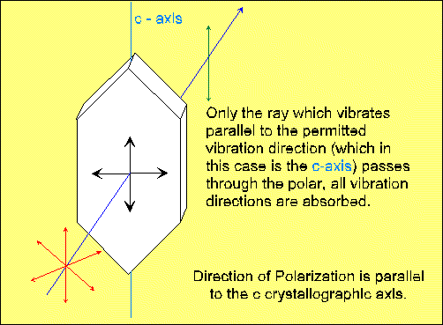
Selective Absorption
This method is used to produce plane polarized light in microscopes, using polarized filters.

Slide 10
Double Refraction

