Slide 1
HYDROGEOLOGY

Slide 2
Course Objectives
Introduction to groundwater, including:
  Groundwater in the hydrologic cycle
  Characteristics of porous media
  Darcy's law of flow in porous media
  Well hydraulics and aquifer testing
  Applications of groundwater hydraulics
  Characteristics of unsaturated flow

Slide 3
What is the hydrogeology?
Origin of the term (from Greek):
Hydro = water; Geo = Earth - ology = science
It is the science that deals with the occurrence, movement, and quality of water beneath the Earth's surface.
The study of Water properties, distribution, and effects on the Earth’s surface, soil, and atmosphere

Slide 4
Water Management
  Sustainable use of water resources
  Manipulating the hydrologic cycle
  Hydraulic structures, water supply, water treatment, wastewater treatment & disposal, irrigation, hydropower generation, flood control, etc.

Slide 5
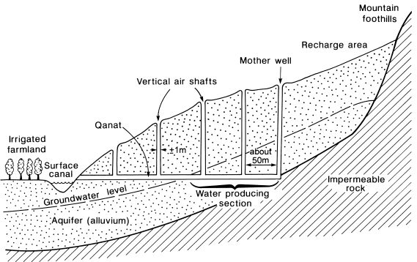
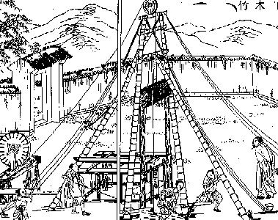
Some History
Qanats
  Subterranean tunnels used to tap and transport groundwater
  Originally in Persia
  Kilometers in length
  Up to 3000 years old
  Many still operating
Chinese Salt Wells
  1000 years ago: Drilled wells
  Over 300 meters deep
  Bamboo to retrieve cuttings
  By year 1858: 1000 meters deep
  Called “cable tool” drilling today
Ancient Persian Qanat
Ancient Chinese Salt Well

Slide 6
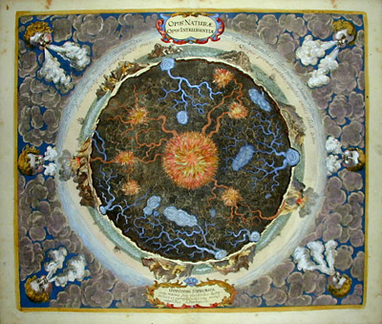
Old Theories
Homer (~1000 BC)
  “from whom all rivers are and the entire sea and all springs and all deep wells have their waters”
Vitruvius (~80-20 BC)
  8th Book on Water and Aqueducts. Rain and snow on land reappears as springs and rivers
Seneca (3 BC -65 AD)
  “You may be quite sure that it not mere rainwater that is carried down into our greatest rivers.”
Da Vinci (1452-1519)
  accurate representation of the hydrologic cycle
Palissy (1509-1590).
  French scientist and potter - accurate representation of the hydrologic cycle

Slide 7
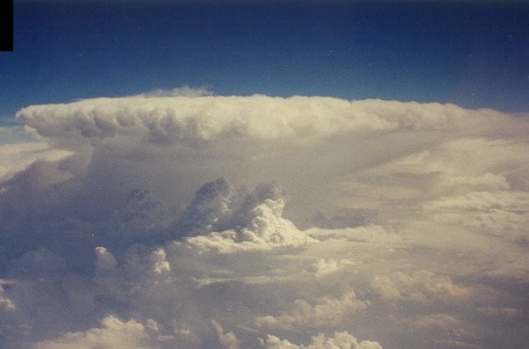
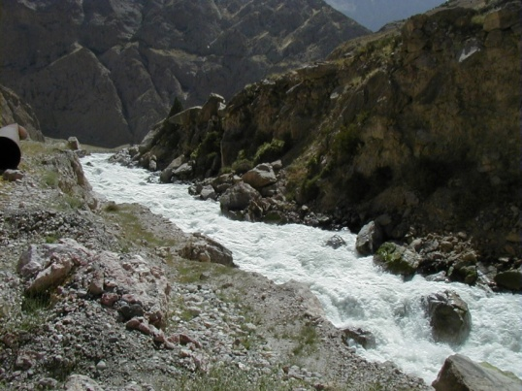
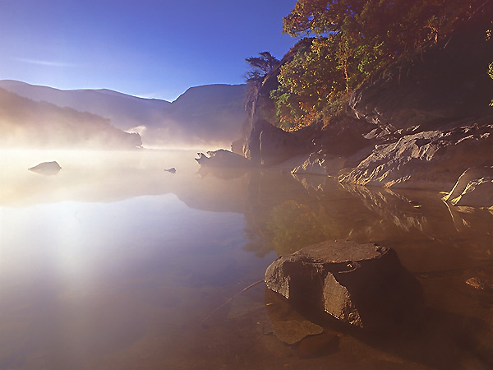
Old Theories (Cont.)
Descartes (1596-1650)
  Vapors are drawn up from the earth and condensed…
Kircher (1615-1680)
  Water from the ocean is vaporized by the hot earth, rises, and condenses inside mountains.
Perrault (1670):
  Water balance on the Seine. River flow explained by rainfall.
Mariotte (1620-1684).
  French physicist. First recharge estimates. Leaky roof analogy.

Slide 8
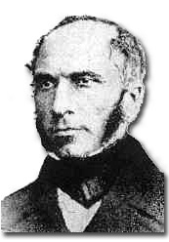
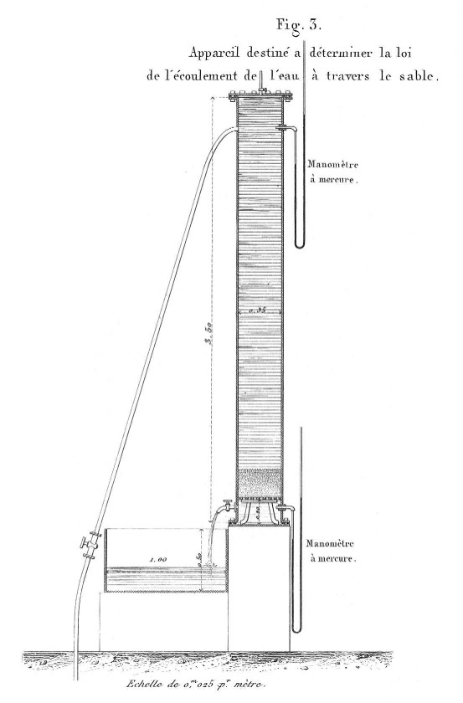
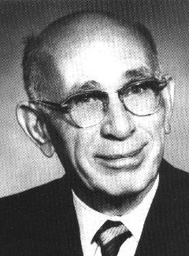
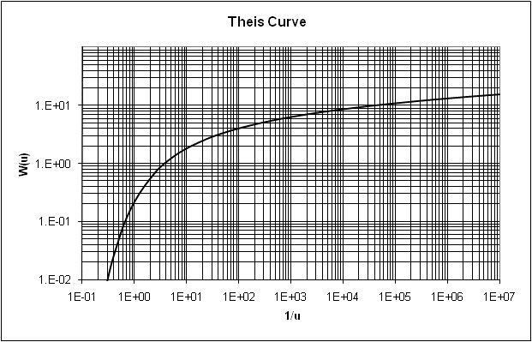
Modern Theories
Henri Darcy (1856)
  Relationship for the flow through sand filters. Resistance of flow through aquifers. Solution for unsteady flow.
King (1899)
  Water table maps, groundwater flow, cross-section
Hazen, Slichter, O. E. Meinzer (1900s)
  Practical applications, basing on theoretical principles of French hydrogeology
C.V. Theis (1930s)
  Well Hydraulics
Henri Darcy
C.V. Theis

Slide 9
Definitions
Hydrogeology:
Emphasizes the hydrologic aspects of geology, e.g. lithologic or facies influences on groundwater movement.
Geohydrology:
Emphasizing geologic aspects of hydrology, particularly the effects of the porous medium through which groundwater flows.
In principle Hydrogeology and Geohydrology have different
meanings, in common usage they are identical
Hydrosphere:
That region of the Earth occupied by water, including lakes, rivers, oceans, subsurface water, glaciers, +/- atmospheric water (clouds, vapor, precipitation)

Slide 10
Surface Water Hydrology:
The study of sub aerial waters (in contact with the atmosphere), excluding oceans. Civil engineers usually mean "lakes and bays", geologists usually mean "rivers and streams" when using this term.
Ground Water Hydrology:
The study of the origin, distribution, movement and physical/chemical properties of ground water. A subset of hydrology, the study of all terrestrial waters.

Slide 11
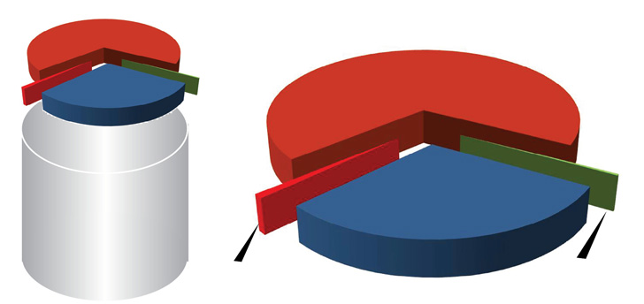
Global Water Resources
TOTAL GLOBAL (Water)
2.5% OF TOTAL GLOBAL (Freshwater)
68.9% Glaciers & Permanent
Snow Cover
29.9% Fresh
Ground water
97.5%
Salt
Water
0.3% Freshwater Lakes &
River Storage. Only this portion is renewable
0.9% Other including
soil moisture, swamp
water and permafrost
Groundwater Management in IWRM: Training Manual, GW-MATE, 2010

Slide 12
Water cycle
Evaporation from vegetation, land surface and from the ocean forming clouds.
Return the water to the land surface or oceans in the form of precipitation.
The rain wets vegetation and other surfaces then infiltrate into the ground.
Infiltration rates vary widely, depending on land use, the character and moisture content of the soil, and the intensity and duration of precipitation.
When and if the rate of precipitation exceeds the rate of infiltration, overland flow occurs.
The first infiltration replaces soil moisture, and, thereafter, the excess percolates slowly across the intermediate zone to the zone of saturation.
Water in the zone of saturation moves downward and laterally to sites of ground-water discharge such as springs on hillsides or seeps in the bottoms of streams and lakes or beneath the ocean.

Slide 13
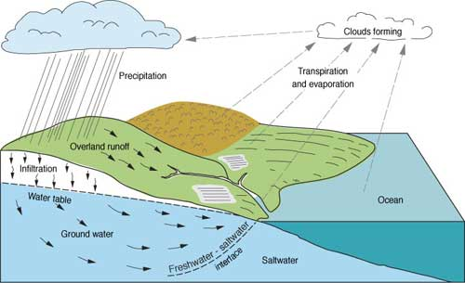
Water cycle

Slide 14
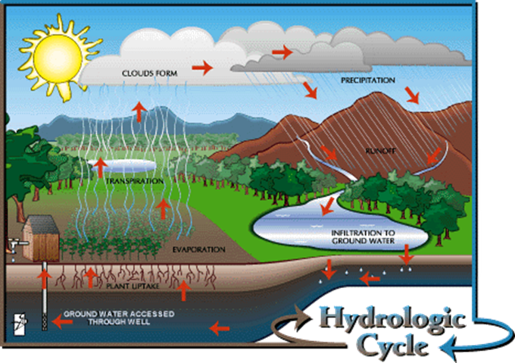
Hydrologic cycle:
circulation of water in the environment
Hydrogeology examines the relationships of geologic materials and flowing water

Slide 15
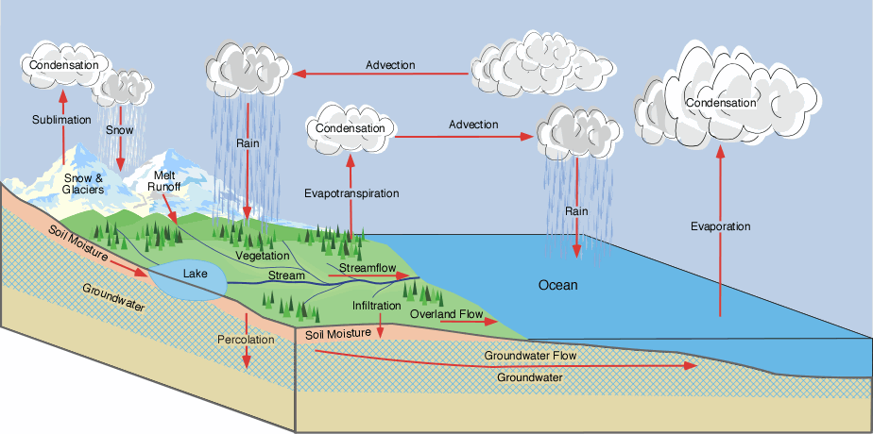
Quantified Hydrologic Cycle

Slide 16
Water Balance
much of hydrology is based on determining the water balance for all or some part of the hydrosphere
(e.g. a groundwater basin)
water balance is just a mass balance:
rate of _ rate of = change in
mass in mass out content

Slide 17
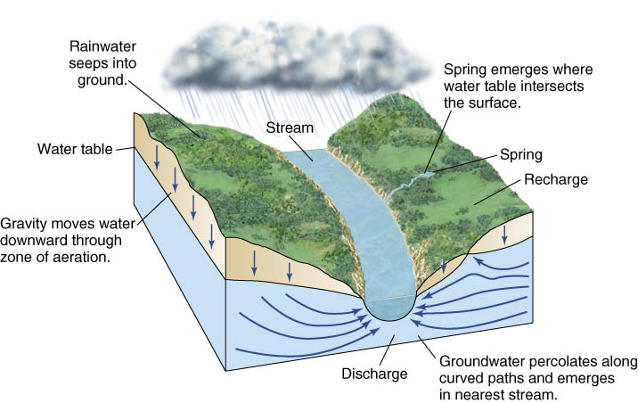
Basin Hydrologic Cycle – GW/SW Interaction

Slide 18
Soil Texture

Slide 19
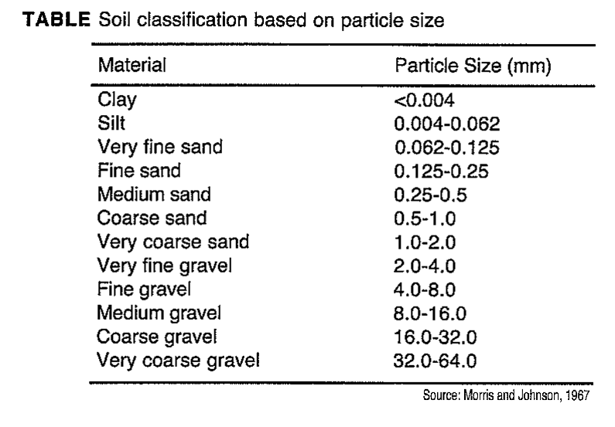

Slide 20
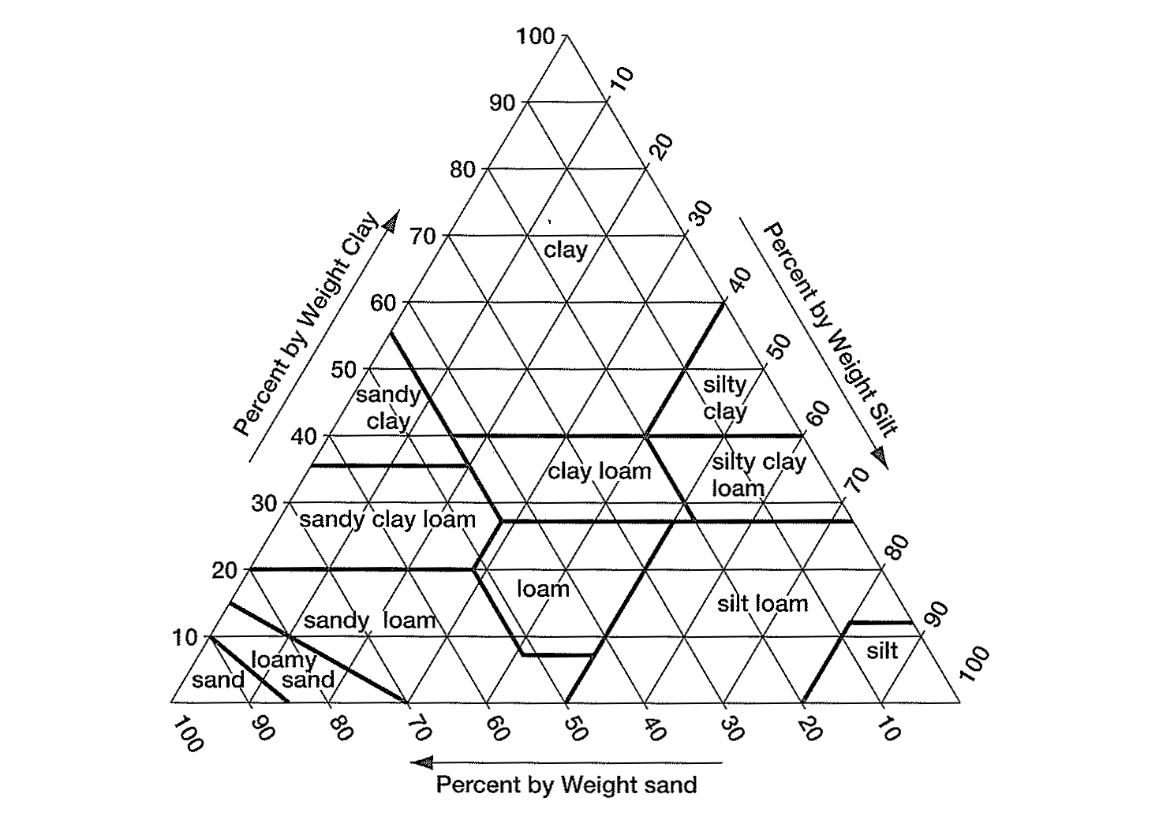
Particle Size Distribution

Slide 21
Porosity and Density

Slide 22
Porosity
The ratio of openings (voids) to the total volume of a soil or rock.
$n=\frac{Vt−Vs}{Vt}=\frac{Vv}{Vt}$ * 100

Slide 23
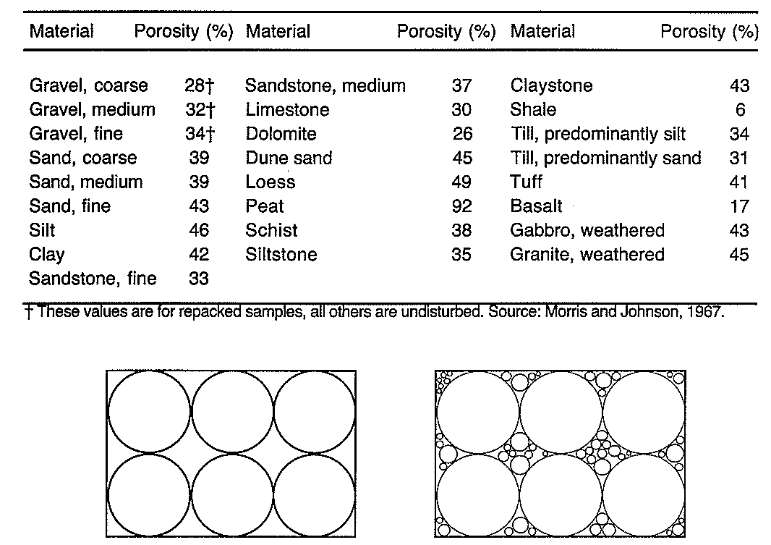
Typical Values of Porosity

Slide 24
Primary and secondary porosity

Slide 25
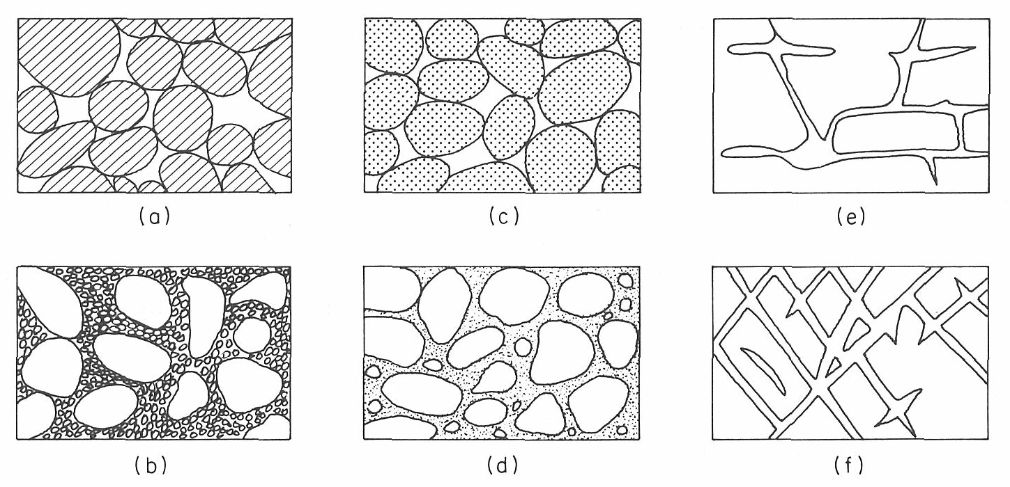
Types of Porous Media

Slide 26
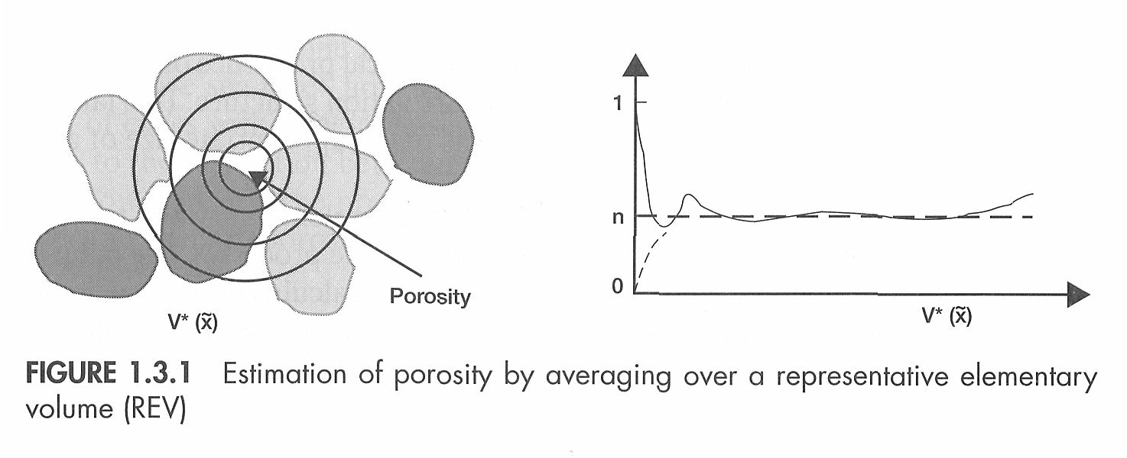
REV – Representative Elementary Volume

Slide 27
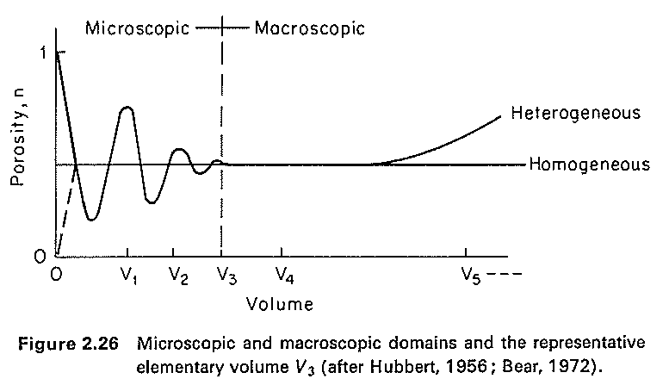
REV – Scale Effect

Slide 28
Specific yield and specific retention
Specific yield:
the part of water that will drain under the influence of gravity.
Or How much water is available for man's use?
specific retention
the part that is retained as a film on rock surfaces and in very small openings.
Or How much water remains in the rock after it is drained by gravity?

Slide 29
Specific yield and specific retention
n =Sy +Sr $Sy=\frac{Vd}{Vt}$ $Sr=\frac{Vr}{Vt}$

Slide 30
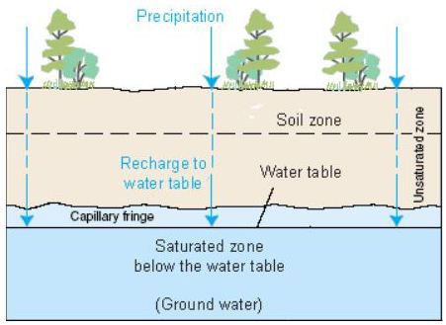
Underground water
The underground water occurs in two different zones:
Unsaturated zone occurs immediately below the land surface in most areas, contains both water and air.
Saturated zone all interconnected openings are full of water.

Slide 31
Soil Horizons
The soil zone extends from the land surface to depth that supports plant growth.
The intermediate zone extends from the soil zone to the capillary fringe.
The capillary fringe is the lowest part of the unsaturated zone that results from the attraction between water and rocks as the water clings as a film on the surface of rock particles and rises in small-diameter pores against the pull of gravity.
Water in the capillary fringe and in the overlying part of the unsaturated zone is under a negative hydraulic pressure-that is, it is under a pressure less than the atmospheric (barometric) pressure.
The water table is the level in the saturated zone at which the hydraulic pressure is equal to atmospheric pressure and is represented by the water level in unused wells.
Below the water table, the hydraulic pressure increases with increasing depth.

Slide 32
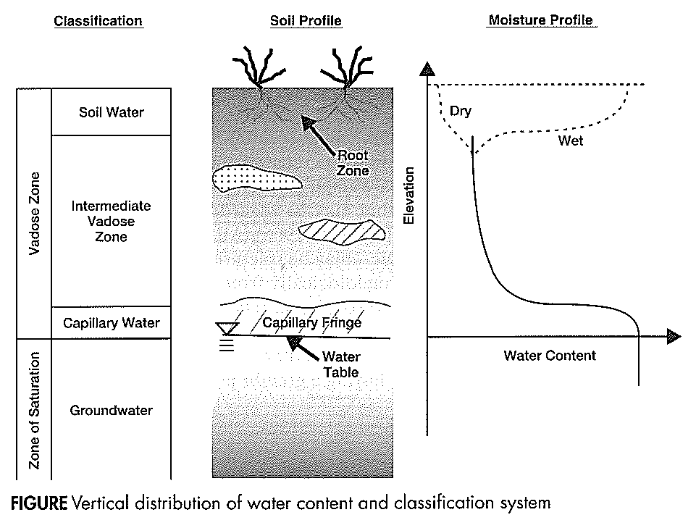

Slide 33
Definitions
Water Table
the undulating plane below the ground surface at which pore water pressure is equal to atmospheric
also the dividing line between the unsaturated and saturated zones
Phreatic surface:
the level to which water will rise in a well open only within the aquifer, different than the water table only for conned aquifers
when phreatic surface lies at or above the ground surface, an artesian well or spring is possible

Slide 34
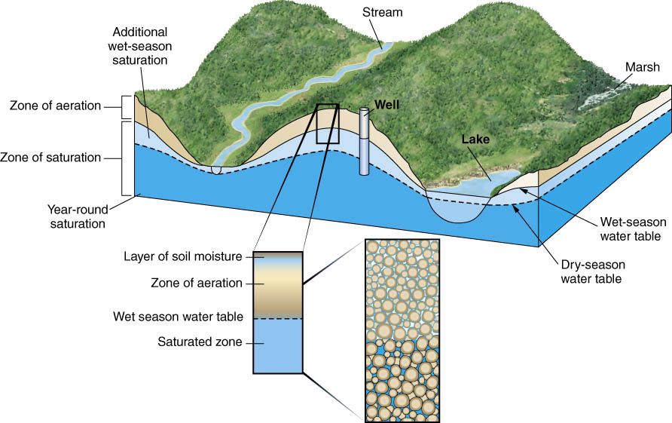

Slide 35
Types of water bearing formations
Aquifer
Porous water bearing formations are capable of yielding exploitable quantities of water.
Aquitard
a confining bed that retards but doesn’t prevent the flow of water to or form adjacent aquifer.
Leaky confining bed such as sandy clay
It doesn’t yield water but may serve as a storage unit for groundwater

Slide 36
Aquiclude
Porous and capable of storing water
Doesn’t transmit sufficient rates of water to wells
Aquifuge
Has no interconnected openings
Cannot store or transmit water
Unsuitable for groundwater occurrence.
Massive granites and quartizite

Slide 37
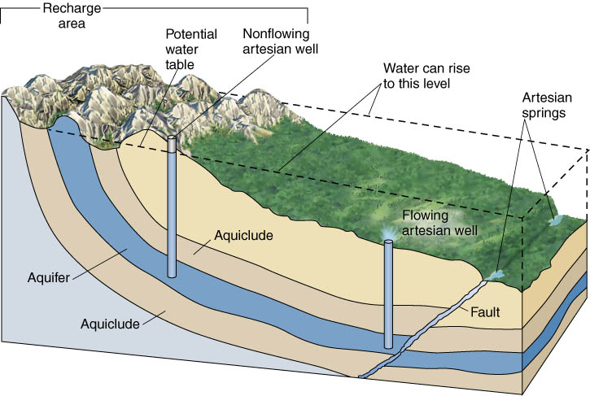

Slide 38
Aquifers
Definition: A geological unit which can store and supply significant quantities of water.
Principal aquifers by rock type:
Unconsolidated
Sandstone
Sandstone and Carbonate
Semiconsolidated
Carbonate-rock
Volcanic
Other rocks

Slide 39
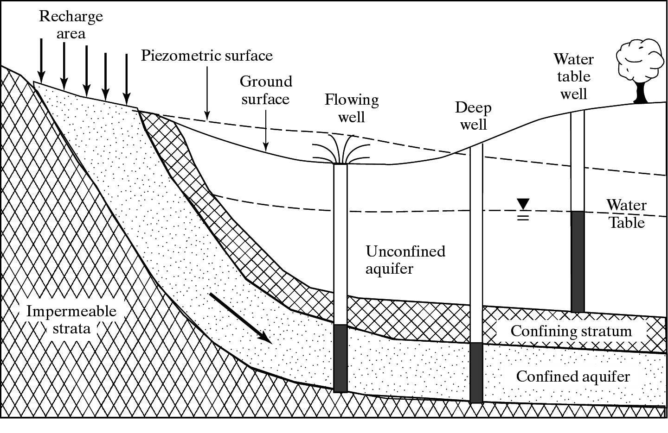
Example Layered Aquifer System

Slide 40
Types of Aquifers
Free aquifer
The water table, is free to rise and decline.
The aquifer is referred to as unconfined aquifer or the water-table aquifer.
Wells open to unconfined aquifers are referred to as water table wells.
Confined aquifer
Water completely fills the aquifer
It is overlain by a confining bed (impervious bed)
Such aquifers are referred to as confined aquifers or as artesian aquifers.
Wells drilled into confined aquifers are referred to as artesian wells.
The water level in artesian wells stands at some height above the top of the aquifer.
The water level is called the potentiometric level of the aquifer.

Slide 41
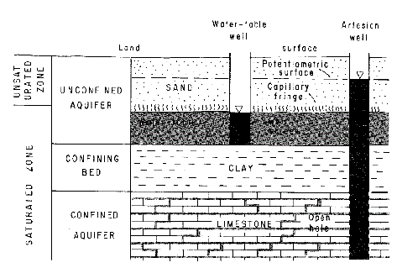
Aquifer Features
Figure: Important features of groundwater systems, including aquifer/aquitard, water table, etc. After Heath (1978)

Slide 42
confining layer (aquiclude):
low-permeability bed or unit
confined aquifer:
an aquifer overlain by a conning layer
unconfined aquifer (phreatic or water table):
water table lies below the top of the aquifer
semi-confined:
an aquifer exhibiting confined and unconfined behavior at different locations (e.g. a sand layer in an alluvial fan)
Artesian:
can simply mean conned, in common usage it means an aquifer from which water will flow upward to the surface given an appropriate conduit (e.g. a borehole)
Perched:
a saturated zone lying above unsaturated rock

Slide 43
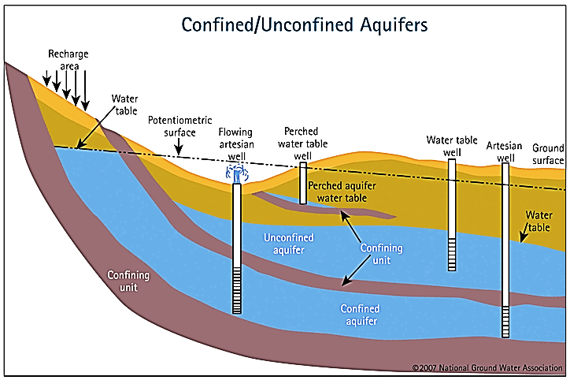

Slide 44
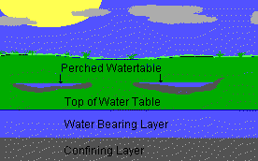
Leaky and Perched Aquifers
Leaky confined aquifer: represents a stratum that allows water to flow from above through a leaky confining zone into the underlying aquifer
Perched aquifer: occurs when an unconfined water zone sits on top of a clay lens, separated from the main aquifer below

