Slide 1
Hydraulic Head

Slide 2
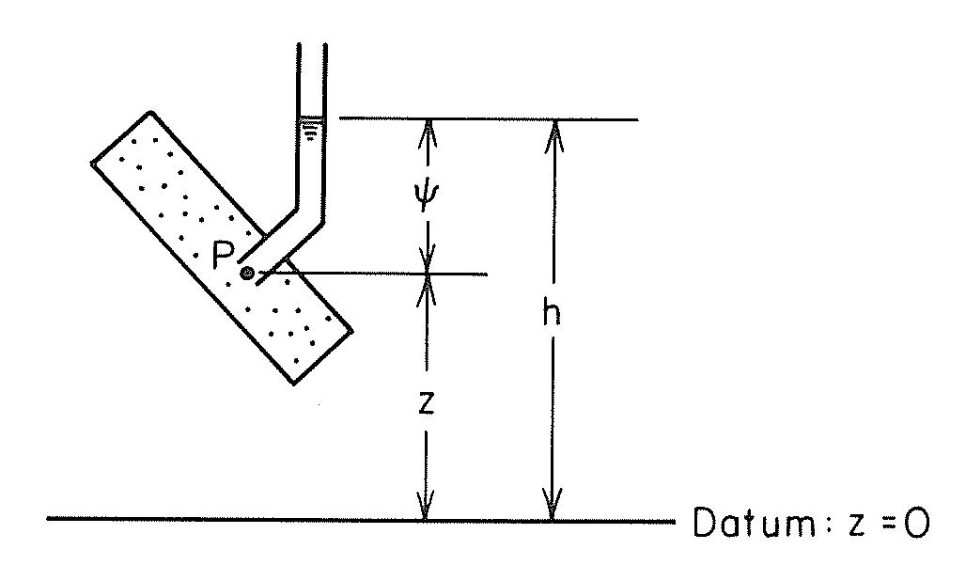
Pressure and Elevation Heads - Laboratory
ψ = pressure head
z = elevation head
h = total head
Freeze and Cherry, 1979.

Slide 3
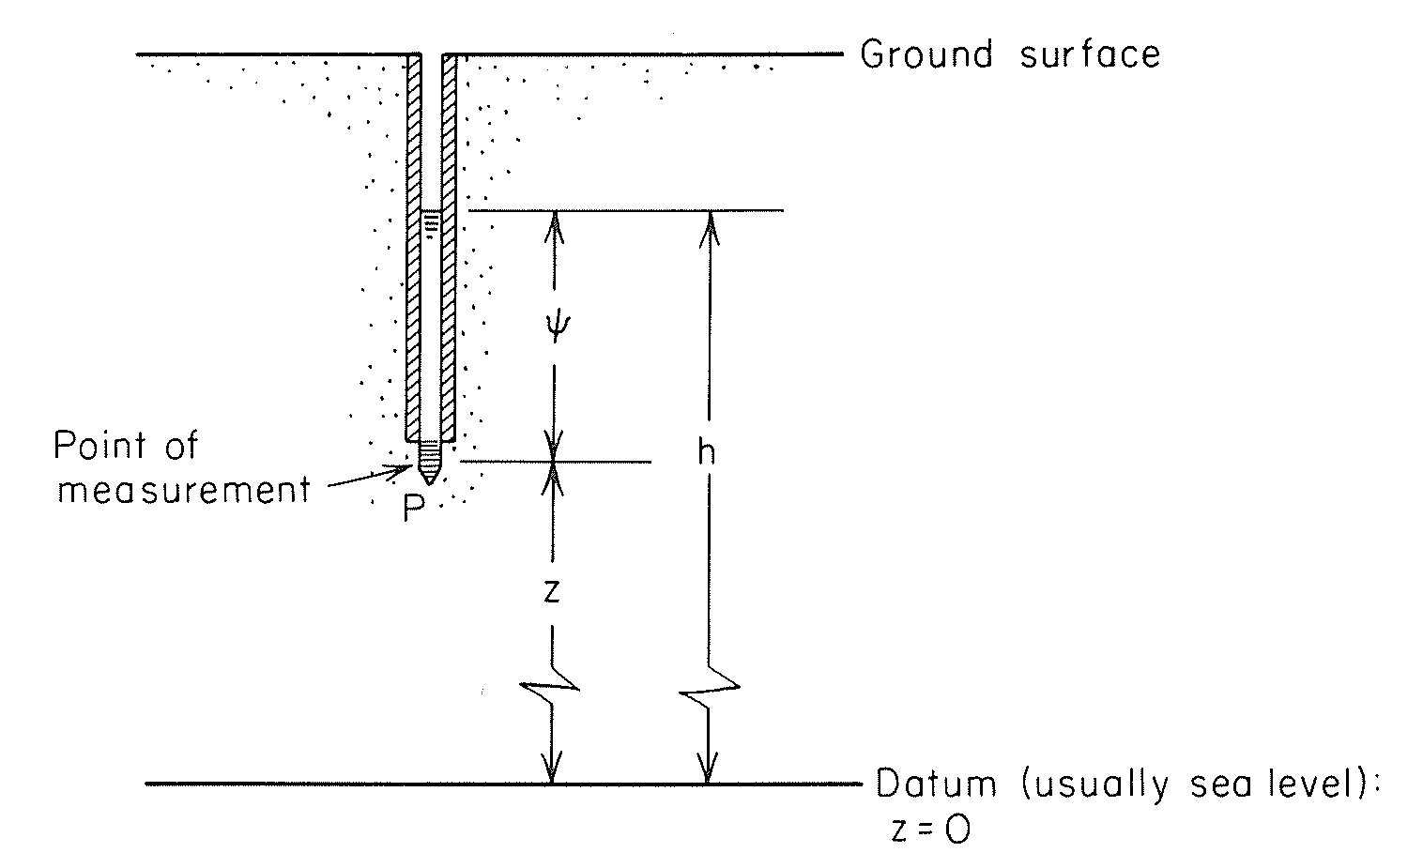
Pressure and Elevation Heads - Field
ψ = pressure head
z = elevation head
h = total head
Freeze and Cherry, 1979.

Slide 4
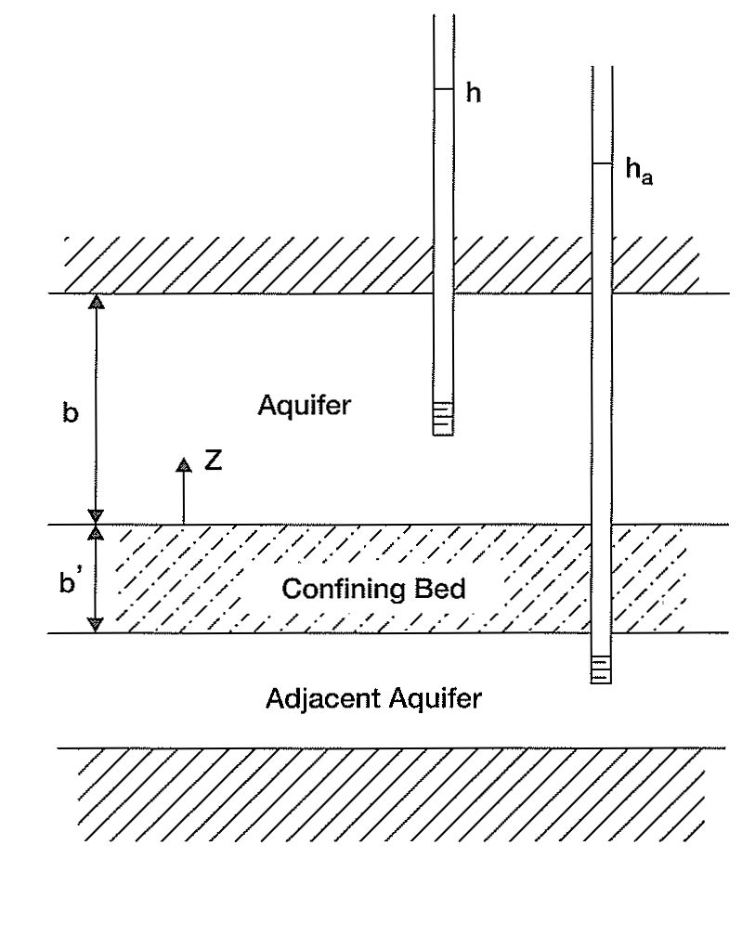
Two Confined Aquifers with Different Heads
Groundwater will tend to flow from the top aquifer to the bottom aquifer.
We can’t make any conclusion about horizontal head gradients from this picture.
Charbeneau, 2000.

Slide 5
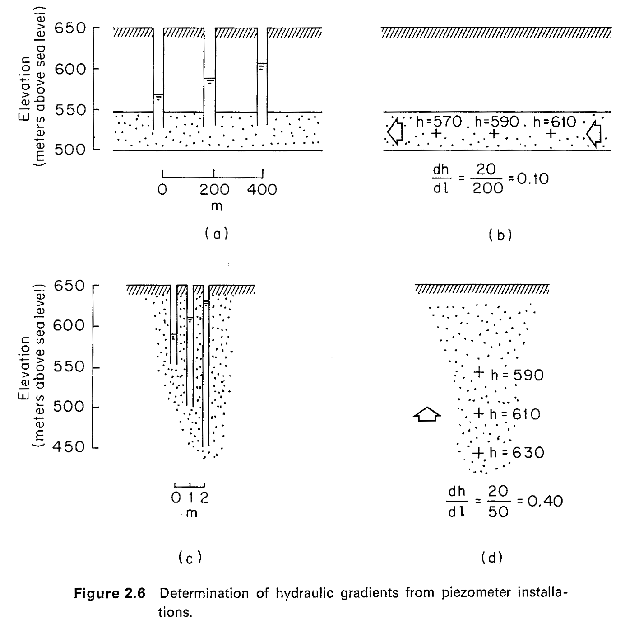
Horizontal and Vertical Head Gradients
Freeze and Cherry, 1979.

Slide 6
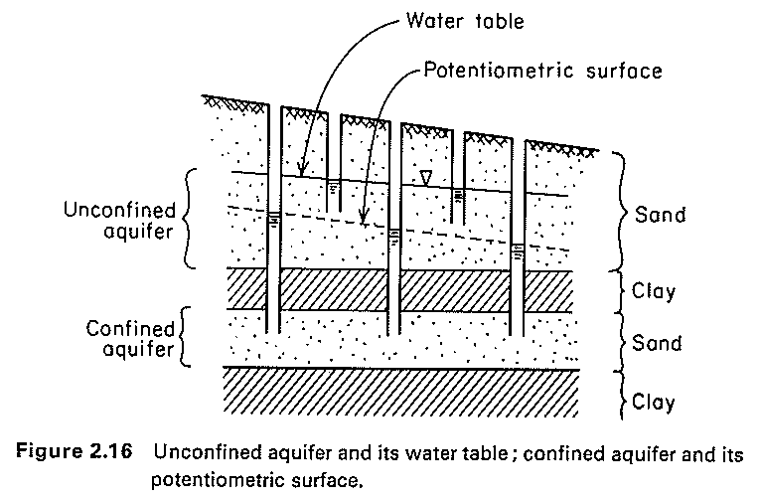
Horizontal and Vertical Head Gradients
Freeze and Cherry, 1979.

Slide 7
Heads and gradients
Subtraction of the depth to water in a non-flowing well from the altitude of the measuring point refers to the total head at the well.
Total head at an observation well involves two components: elevation head and pressure head.
Ground water moves in the direction of decreasing total head.

Slide 8
Heads and gradients
The rate of groundwater movement depends on the hydraulic gradient that is the change in head per unit of distance in a given direction.
the hydraulic gradient is hL/L, where hL is the head loss between wells 1 and 2 and L is the horizontal distance between them.

Slide 9
Hydraulic conductivity
Q is the quantity of water per unit of time;
K is the hydraulic conductivity and depends on the size and arrangement of the water-transmitting openings (pores and fractures) and on the dynamic characteristics of the fluid (water) such as kinematic viscosity, density, and the strength of the gravitational field;
A is the cross-sectional area, at a right angle to the flow direction, through which the flow occurs
dh/dl is the hydraulic gradient.
Darcy's law is

Slide 10
Hydraulic conductivity
Hydraulic conductivity replaces the term "field coefficient of permeability".
If the hydraulic conductivity is essentially the same in any area, the aquifer in that area is said to be homogeneous.
If, on the other hand, the hydraulic conductivity differs from one part of the area to another, the aquifer is said to be heterogeneous
If the hydraulic conductivity is essentially the same in all directions, the aquifer is said to be isotropic. If it is different in different directions, the aquifer is said to be anisotropic.

