Slide 1
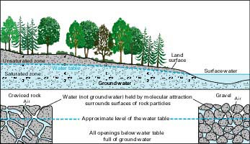
Occurrence of Ground Water
Ground water occurs when water recharges the subsurface through cracks and pores in soil and rock
Shallow water level is called the water table

Slide 2
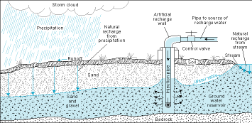
Recharge
Natural
Precipitation
Melting snow
Infiltration by streams and lakes
Artificial
Recharge wells
Water spread over land in pits, furrows, ditches
Small dams in stream channels to detain and deflect water

Slide 3
Groundwater recharge and discharge
Water enters groundwater systems in recharge areas by hydraulic gradients and hydraulic conductivities, to discharge areas.
The rate of movement of ground water from recharge areas to discharge areas depends on the hydraulic conductivities of the aquifers and on the hydraulic gradients.

Slide 4
Groundwater recharge and discharge
Natural discharge includes:
the flow of springs and the seepage of water into stream channels or wetlands
evaporation from the upper part of the capillary fringe and the low-lying areas.
Discharge is a continuous process as long as groundwater heads are above the level at which discharge occurs.
Between periods of recharge, groundwater heads decline, and the rate of discharge also declines.

Slide 5
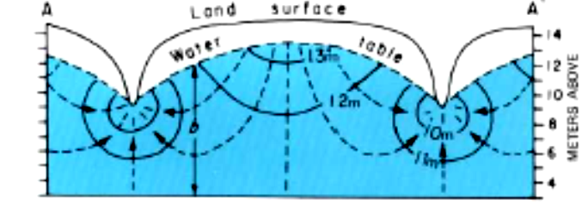
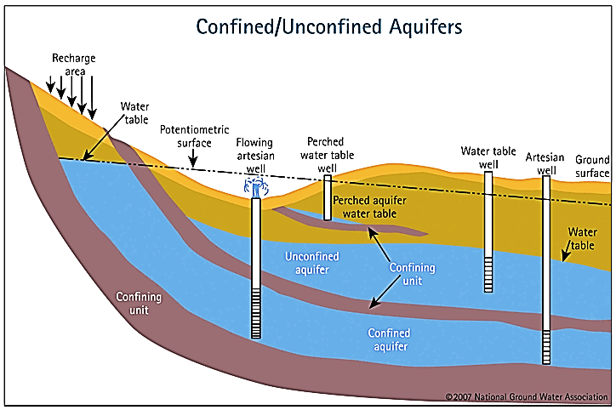
Groundwater movement and topography
Groundwater moved by effect of gravity.
The groundwater in the saturated zone moves from interstream areas toward streams or the coast.
The water table usually is a subdued replica of the land surface.
Septic tanks, waste ponds, and other waste-disposal sites should not be located downhill from supply wells.

Slide 6
Groundwater flow net
The equipotential lines, connects points of equal head and represents the height of the water table, or the potentiometric surface of a confined aquifer, above a datum plane.

Slide 7
Groundwater flow net
Flow net.
Flow lines originate in the area of higher heads that indicates the presence of recharge to the aquifer in this area.
The stream gains water from the aquifer due to decreasing head into the stream. The stream is known as effluent stream.

Slide 8
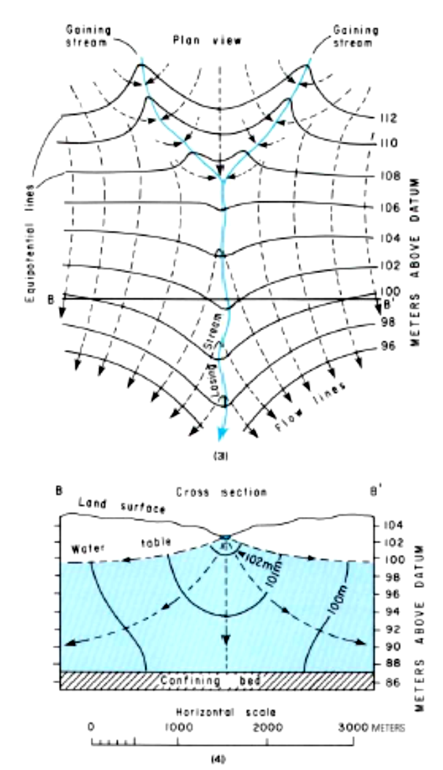
Groundwater flow net
Flow net.
The stream gains water in its headwaters and loses water as it flows downstream.
In the gaining reaches, the equipotential lines form a V pointing upstream; in the losing reach, they form a V pointing downstream, and the stream is called effluent and influent at upstream and downstream respectively.

