Slide 1
Aquifer contamination
Sources of groundwater pollution are:
Point source pollution arises from a specific site such as a septic tank, a gasoline spill, or a factory.
Non-point source pollution is generated over a broad area. Fertilizers and pesticides spread over fields fall into this latter category.

Slide 2
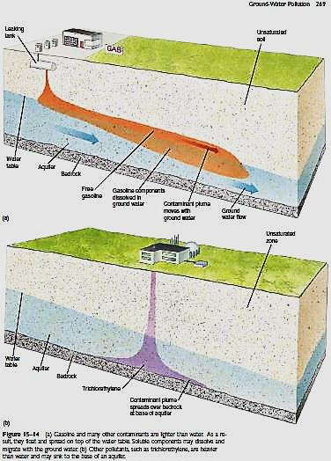
Aquifer contamination
The natural flow of groundwater disperses it as a growing plume of contamination.
Gasoline and diesel fuel float on top of the water table as they spread.
Others are water soluble and mix with ground water.
Still other contaminants are nonsoluble and denser than water. These chemicals sink to an impermeable layer and then flow slowly downslope.

Slide 3
Treating a contaminated aquifer
Bioremediation uses microorganisms to decompose a contaminant..
Chemical remediation occurred where chemical compound reacts with a pollutant to produce harmless products, the compound can be injected into an aquifer to destroy contaminants.
Oxygen may react with a pollutant directly or provide an environment favorable for microorganisms, which then degrade the pollutant.
Acids or bases may precipitate dissolved pollutants.

Slide 4
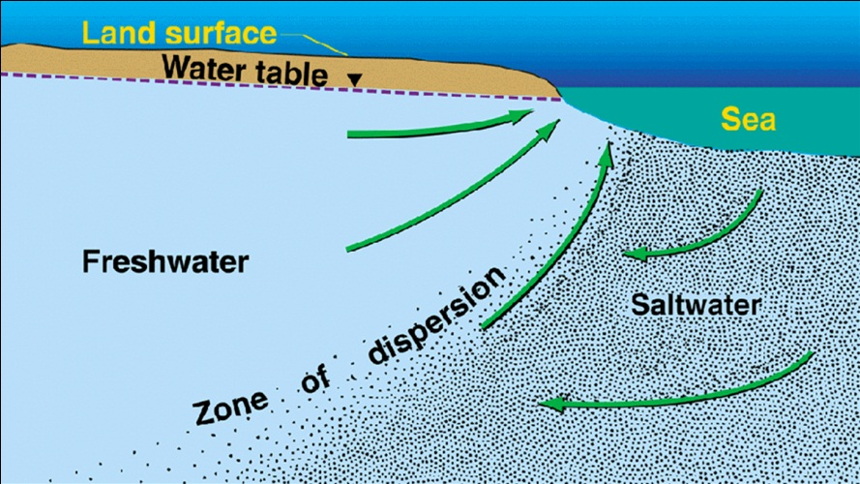
Sea water encroachment on coastal area
Seawater intrusion associated with groundwater overdraft and lowering of groundwater levels has occurred in many of the coastal aquifers .
The interface between freshwater and seawater is maintained .
The weight of the overlying freshwater depresses the seawater below sea level.

Slide 5
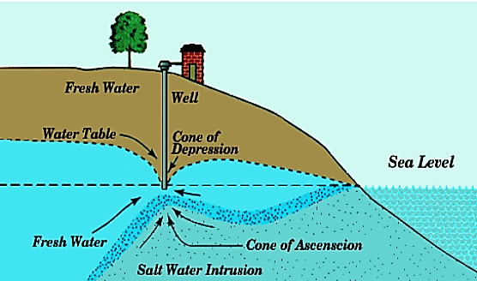
Sea water encroachment on coastal area
When groundwater is pumped from an aquifer, freshwater flow toward coastal discharge area can cause seawater to be drawn toward the freshwater zones of the aquifer. The intruding seawater decreases the freshwater storage in the aquifers.

