Slide 1
Coastal landforms

Slide 2
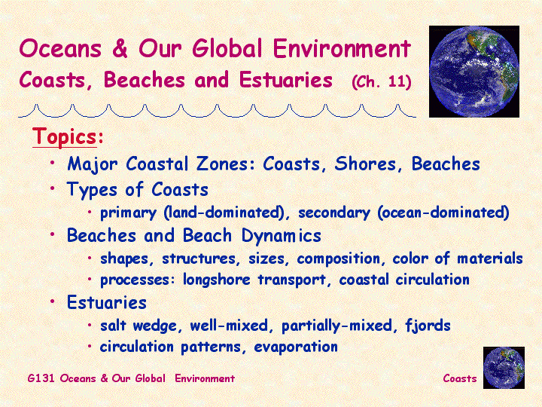

Slide 3
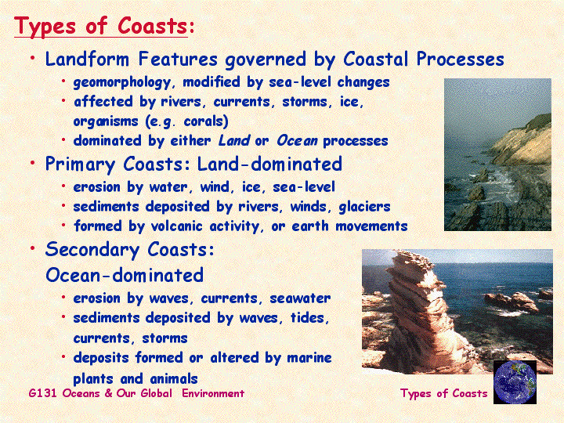

Slide 4
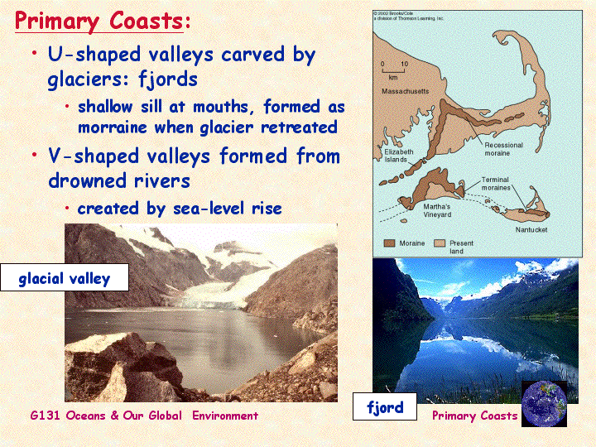

Slide 5
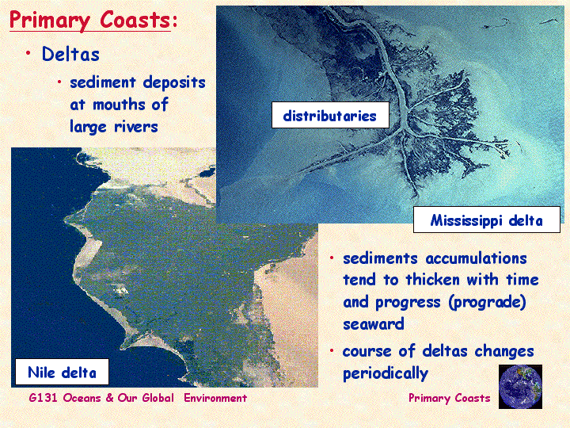

Slide 6
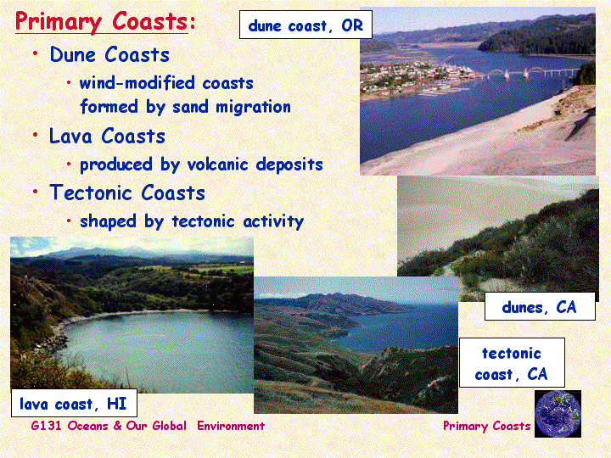

Slide 7
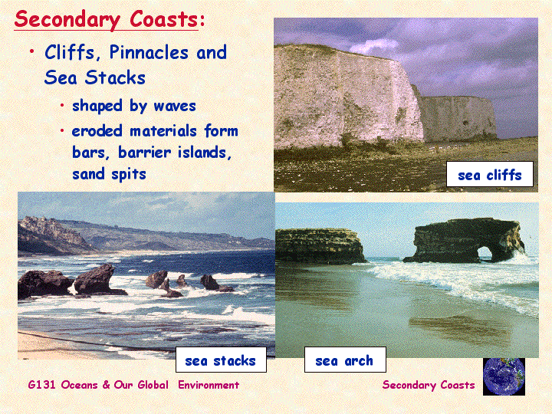

Slide 8
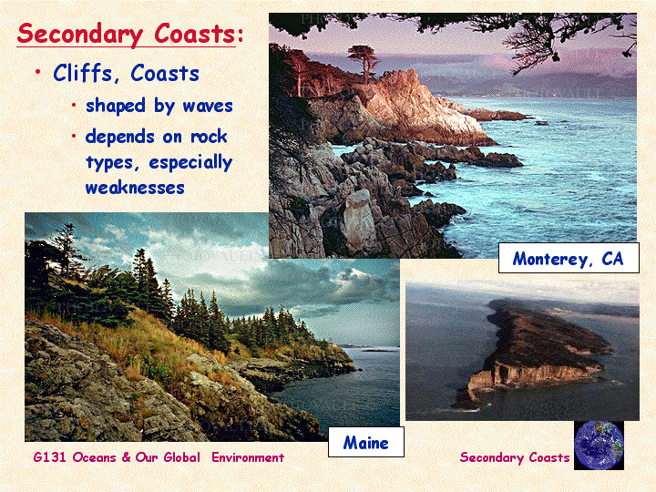

Slide 9
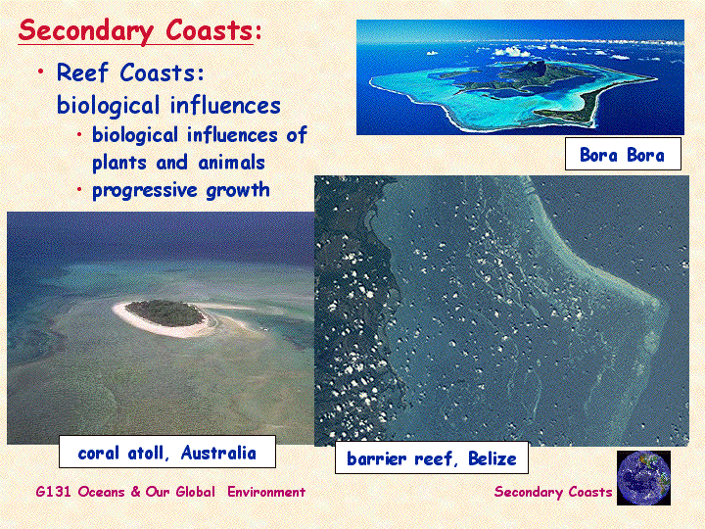

Slide 10
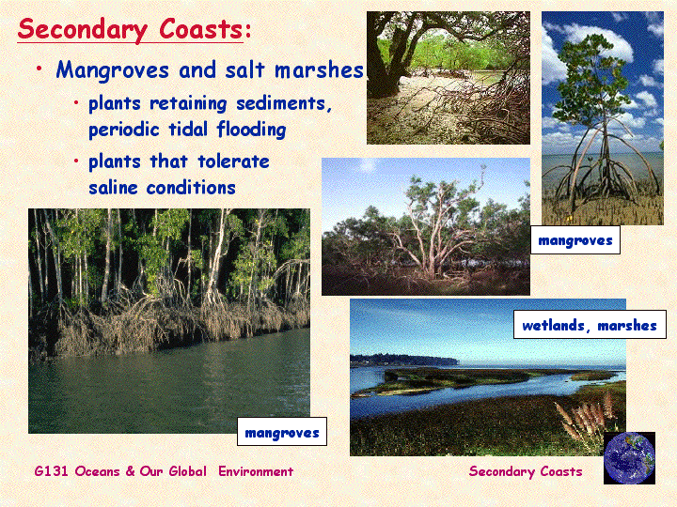

Slide 11
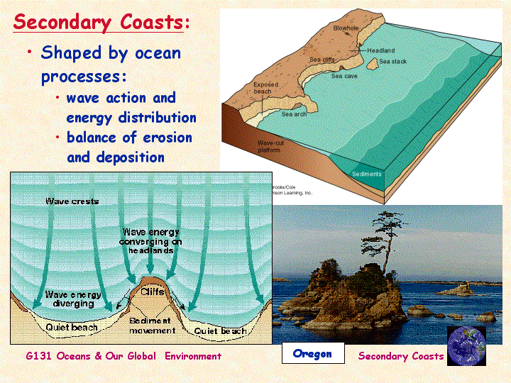

Slide 12
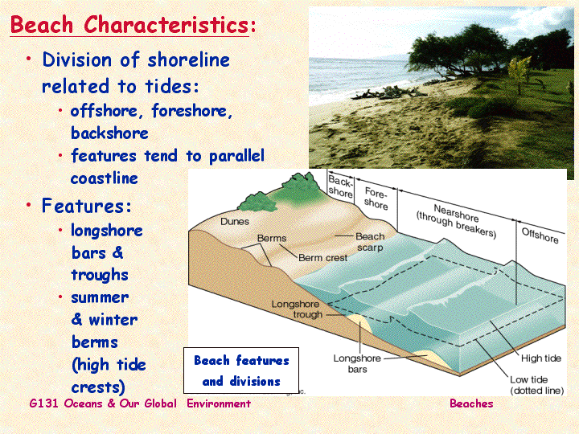

Slide 13
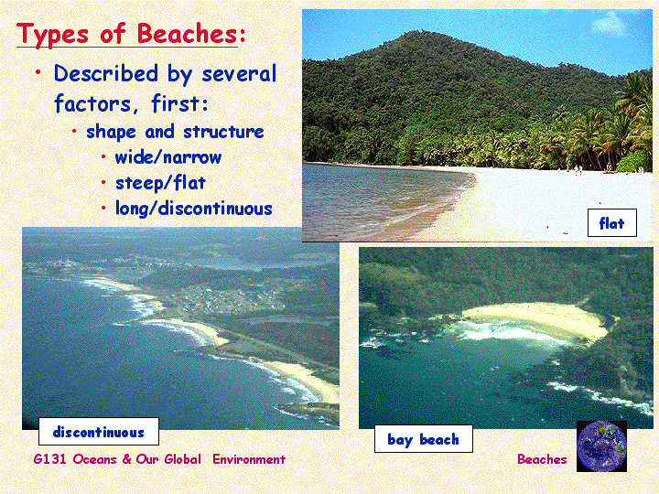

Slide 14
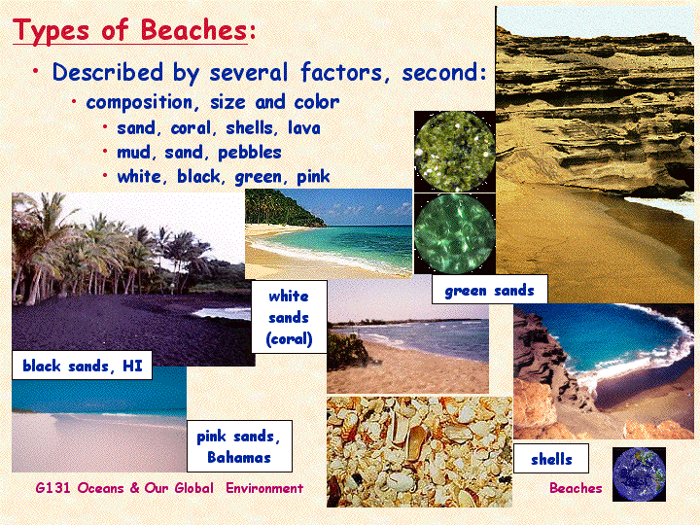

Slide 15
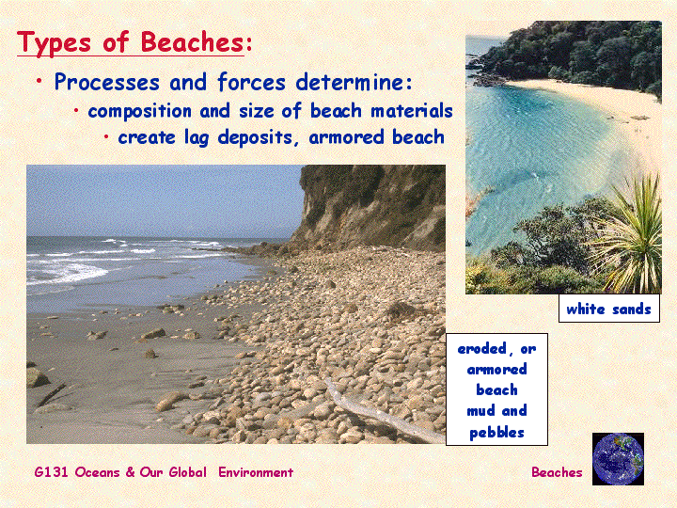

Slide 16
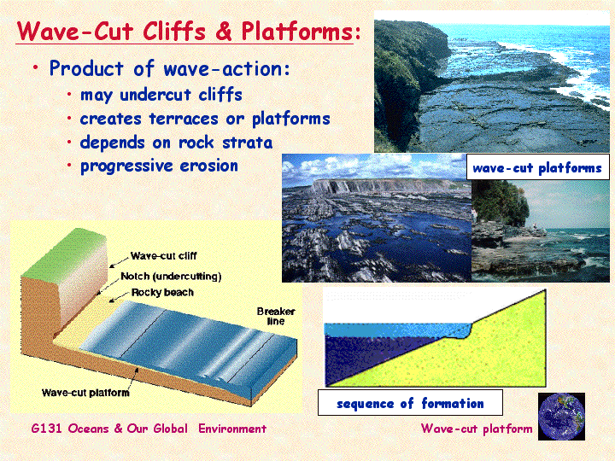

Slide 17
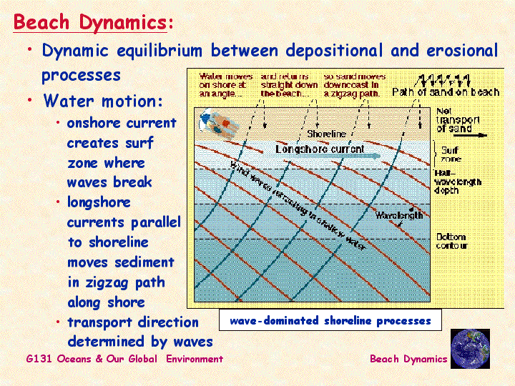

Slide 18
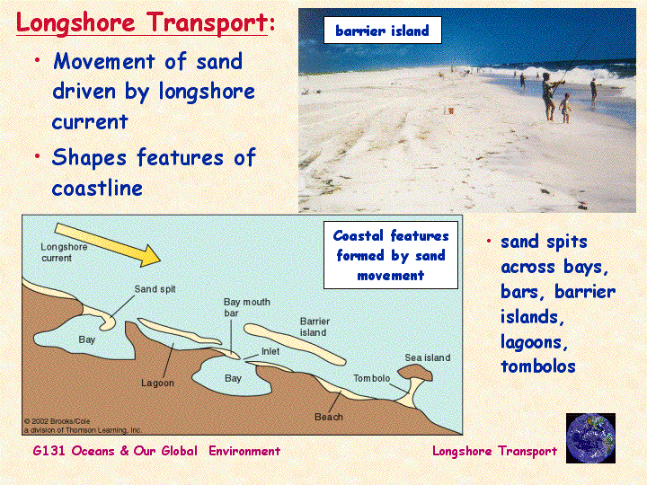

Slide 19
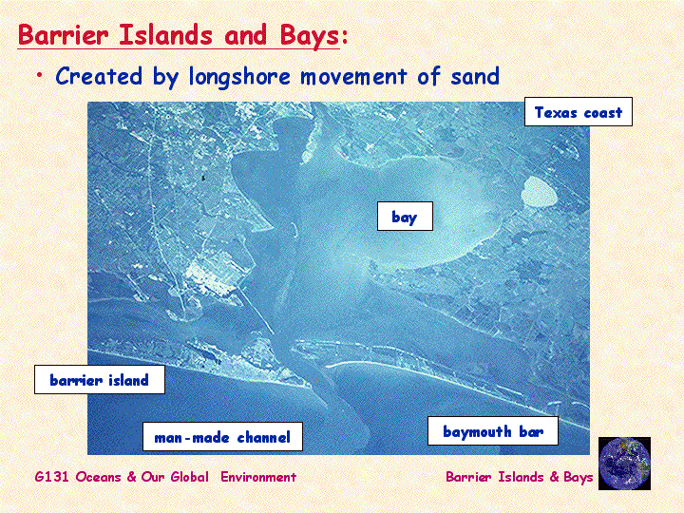

Slide 20
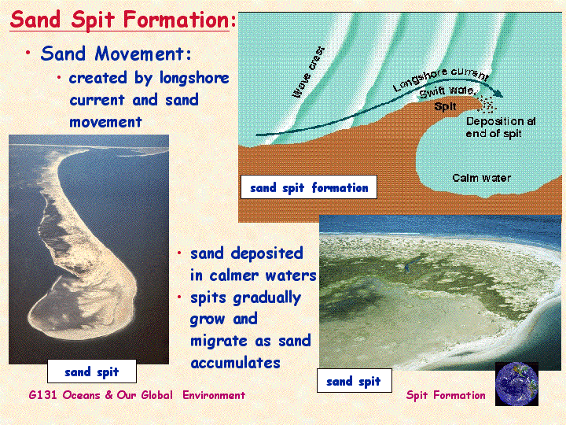

Slide 21
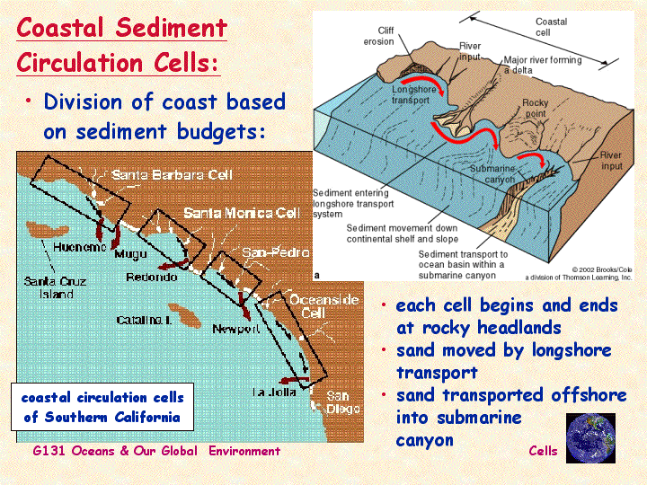

Slide 22
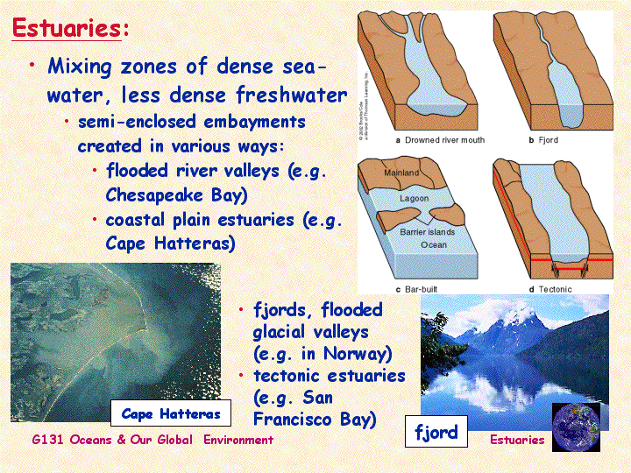

Slide 23
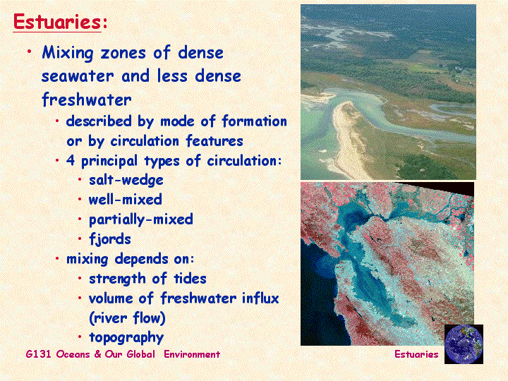

Slide 24
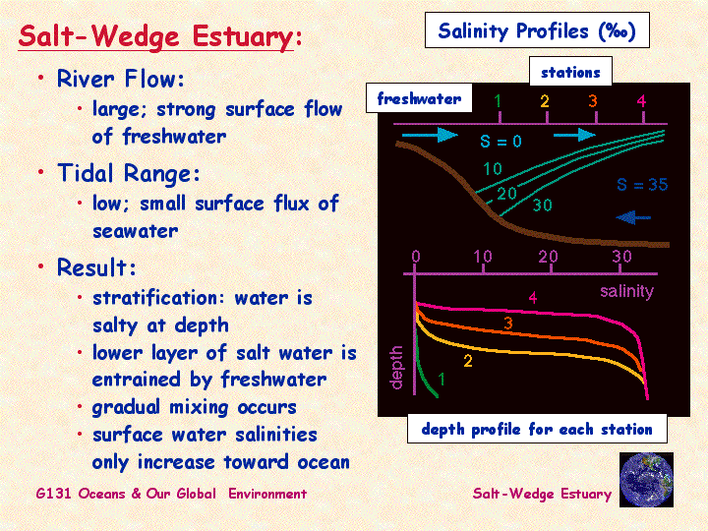

Slide 25
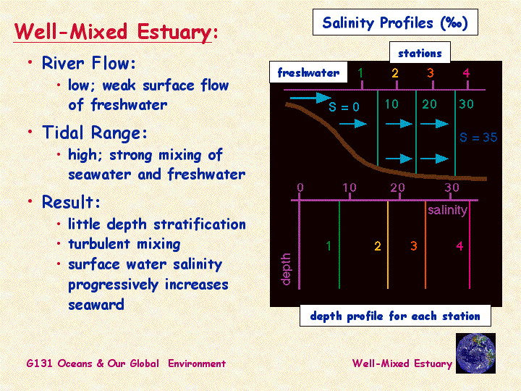

Slide 26
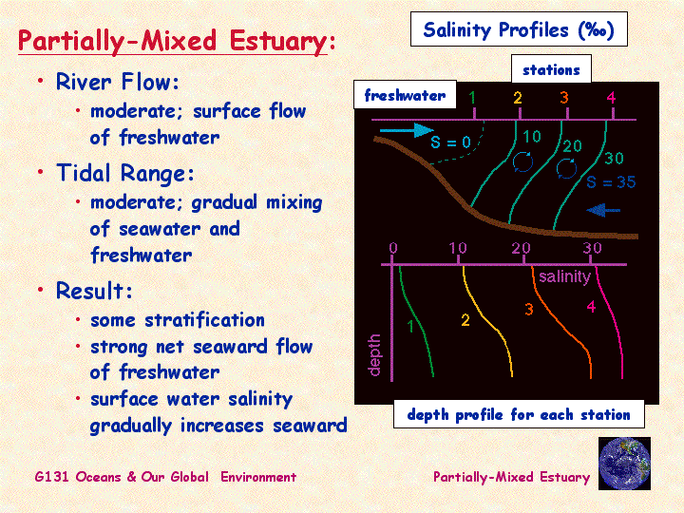

Slide 27
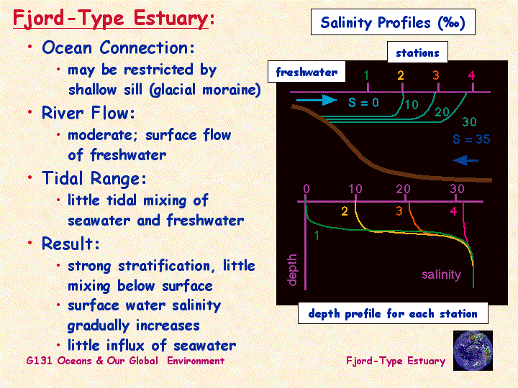

Slide 28
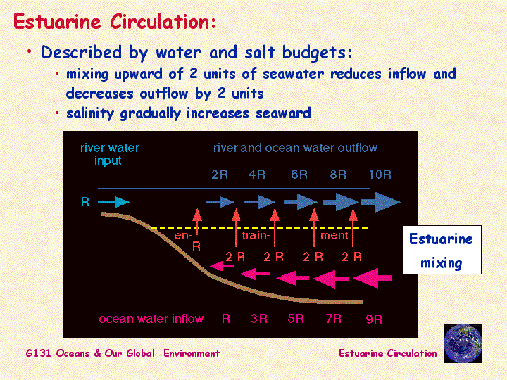

Slide 29
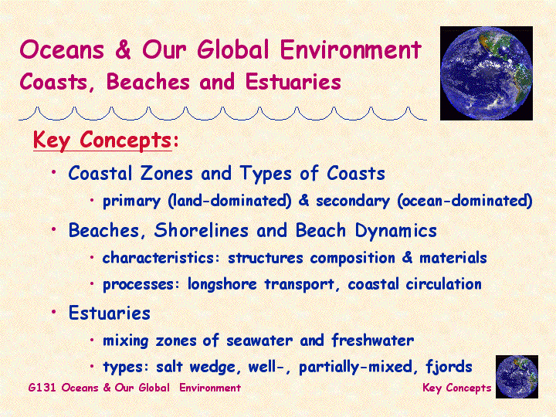

Slide 30
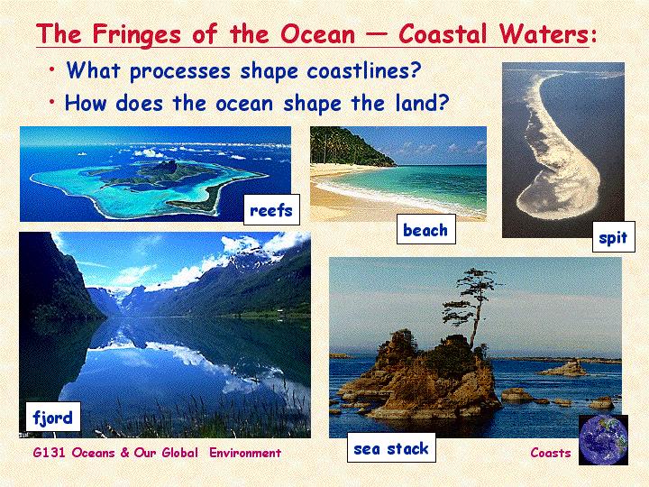

Slide 31
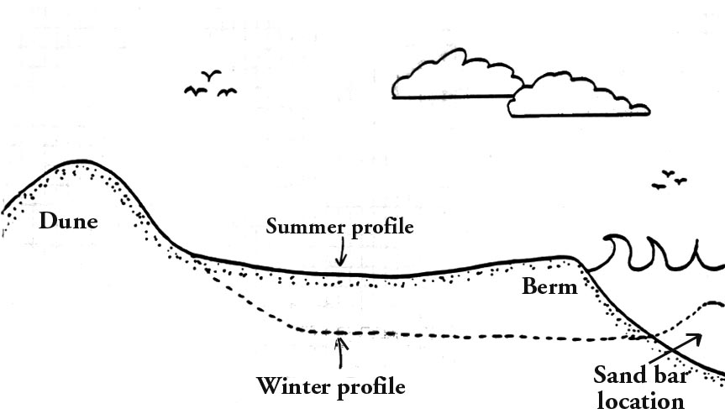

Slide 32
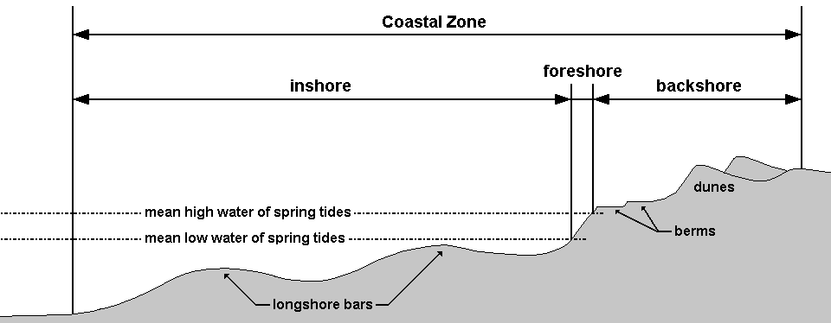
Beach profile
The beach is the strip of the shoreline that is washed by waves and tides.
It is divided into two zones:
The foreshore, called the intertidal zone that lies between the high and low tide lines.
The backshore is usually dry but is washed by waves during storms.
The berm is a higher point on the beach separating the backshore-foreshore boundary.

Slide 33
A wave is a periodic oscillation of water.
A current is a continuous flow of water in a particular direction.
If waves regularly strike shore at an angle, they create a longshore current that flows parallel to the beach.

Slide 34
The Atolls are a circular coral reef that forms a ring of islands around a lagoon and are surrounded by deep water of the open sea.

Slide 35
Emergent and submergent coastlines
An emergent coastline forms when a portion of a continent that was previously under water becomes exposed as dry land.
A submergent coastline develops when the shoreline moves inland

Slide 36
Emergent and submergent coastlines
Tectonic processes, such as mountain building or basin formation, and isostatic adjustment depress or elevate a portion of a coastline. These processes cause local or regional sea level changes but do not affect global sea level.
Sea level can also change globally. A global sea level change, called eustatic change, occurs by three mechanisms;
1 changes in water temperature,
2 changes in the volume of the mid-oceanic ridge,
3 growth and melting of glaciers.

Slide 37
Sandy, rocky coastalines
Sandy coastlines are developed with emergent coasts due to abundant sediments
Rocky coastlines are characteristic features of submerged coastal line and occur where sandy size sediment is scarce.

Slide 38
Sandy coastalines
Longshore currents form a long ridge of sand extending out from a beach that is called a spit.

Slide 39
Sandy coastalines
A spit may block the entrance to a bay, forming a baymouth bar.

Slide 40
Sandy coastalines
A barrier island is a long, low-lying island that extends parallel to the shoreline; and is separated from the mainland by a sheltered body of water called a lagoon.

Slide 41
Sandy coastalines
At shallow coast, breaking storm waves may carry sand toward shore and deposit it just offshore as a barrier island.
Alternatively, if a longshore current veers out to sea, it slows down and deposits sand where it reaches deeper water.
Other mechanisms involve sea-level change.
Sand dunes or beaches may form barrier islands if a coastline sinks.

Slide 42
Rocky coastalines
Submergent coastlines are commonly sediment poor and are characterized by steep, rocky shores.
Irregular coastaline with many bays and headlands.

Slide 43
Rocky coastalines
Small sandy beaches form in protected coves, but most of the headlands are rocky and steep.

Slide 44
Rocky coastalines
A wave-cut cliff forms when waves erode a rocky headland into a steep profile.
As the cliff erodes, it leaves a flat or gently sloping wave-cut platform.

Slide 45
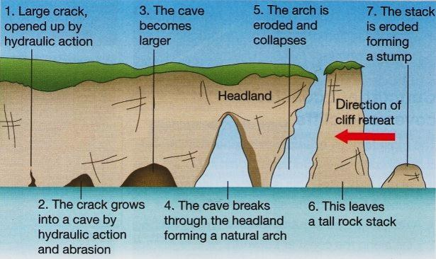
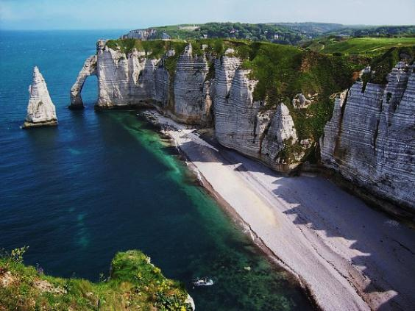
Rocky coastalines
If waves cut a cave into a narrow headland, the cave may eventually erode all the way through the headland, forming a scenic sea arch.

Slide 46
Rocky coastalines
When an arch collapses or when the inshore part of a headland erodes faster than the tip, a pillar of rock called a sea stack forms.

