Slide 1
  بسم الله الرحمن الرحيم
HISTOCHEMISTRY
for 4th students

Slide 2
Definition of Histochemistry
Histochemistry is the study of the identification and distribution of chemical compounds within and between biological cells using histological techniques such as histology stains, indicators and light (optical) and electron microscopy.
Histochemistry is the aspect of histology concerned with the identification of chemical components in biological cells and tissues.
So, whereas histology in general is the study of biological cells and tissues in fine microscopic detail using special histological techniques, histochemistry is concerned specifically with the chemicals within, between, and forming the biological cells and tissues themselves.

Slide 3
  CARBOHYDRATES

Slide 4
The carbohydrates are organic compounds formed of C, H, & O with the latter two in the same ratio by which they are present in water.
Carbohydrates are defined chemically as aldehyde or ketone derivatives of the higher polyhydric alcohols or as compounds which yield these derivatives on hydrolysis.

Slide 5
Classification of Carbohydrates
The Monosaccharides: are simple sugars which cannot be hydrolysis, the general formula is Cn(H2O)n . It is subdivided as trioses, tetroses, pentoses, hexoses, or heptoses depending upon the number of carbon atoms; and aldoses or ketoses depending upon whether the aldehyde or ketone groups are present.
The most important example of monosaccharides in cell are pentoses & hexoses.

Slide 6
2-The Oligosaccharides (Disaccharides):
are the results of condensation of two molecules of monosaccharides with loss of one molecule of water.
-H2O
2 C6H12O6 C12H22O11
The most important are sucrose (cane sugar) and lactose (milk sugar).
Lactose is built up of glucose and galactose , thus disaccharides yield on hydrolysis two molecules of the same of different monosaccharides.

Slide 7
3- The Polysaccharides: are formed by the condensation of many molecules of monosaccharides with corresponding loss of water molecules
- n H2O
n C6H12O6 (C6H10O5)n
The most important of the polysaccharides are glycogen in animals.

Slide 8
Classification of Polysaccharides:
1- Simple polysaccharides
Glycogen is the simple polysaccharide of the animal body and called animal starch.
2- Mucoid substances which built up of sugar units in which a hydroxyl group is substituted by an amino group , then knwon as amino sugars or glucosamines and include 3 main groups:- mucopolysaccharides, mucoproteins & glycoproteins.

Slide 9
Mucopolysaccharides: occur naturally unassociated with proteins e.g. hyaluronic acid and condroitin sulphates.
Mucopolysaccharides are subdivided into
Neutral Mucopolysaccharides e.g Chitin.
- Acid Mucopolysaccharides which classified into : a- Simple acid Mucopolysaccharides and b- Complex acid Mucopolysaccharides

Slide 10
3- Glycolipids: The principal members of this group are cerebrosides represented by phrenosin and kerasin and found in central nervous system. This group are soluble in pyridine and hot alcohol but insoluble in water, and +Ve PAS reaction , also stained by lipid methods.
4- Ascorbic acid ( also known as Vit C): is strong reducing agent. The acid silver nitrate technique of Bourne used to demonstrating it in tissue.

Slide 11
IDENTIFICATION of CARBOHYDRATES
1-Periodic Acid – Shiff Reaction: is a strong oxidizing agent which breaks the C-C bonds in all structures. It reacts on glycol structure present in the tissue and for amino –substituted alcohols. It give +Ve result s for monosaccharides, poly saccharides mucoproteins, glycoproteins etc……………………
2- The Alcian Blue Method: is a specific dye availabe for acid mucopolysaccharides. It is a copper
phthalocyanin dye which gives a blue color.
3- Diamine Methods
4- Blocking Techniques:- including a- Block of aldehydes
b- Methylation c- Saponification
d- Sulphation.
5- Enzyme Digestion Methods: a-Hyaluronidase b- Sialidase

Slide 12
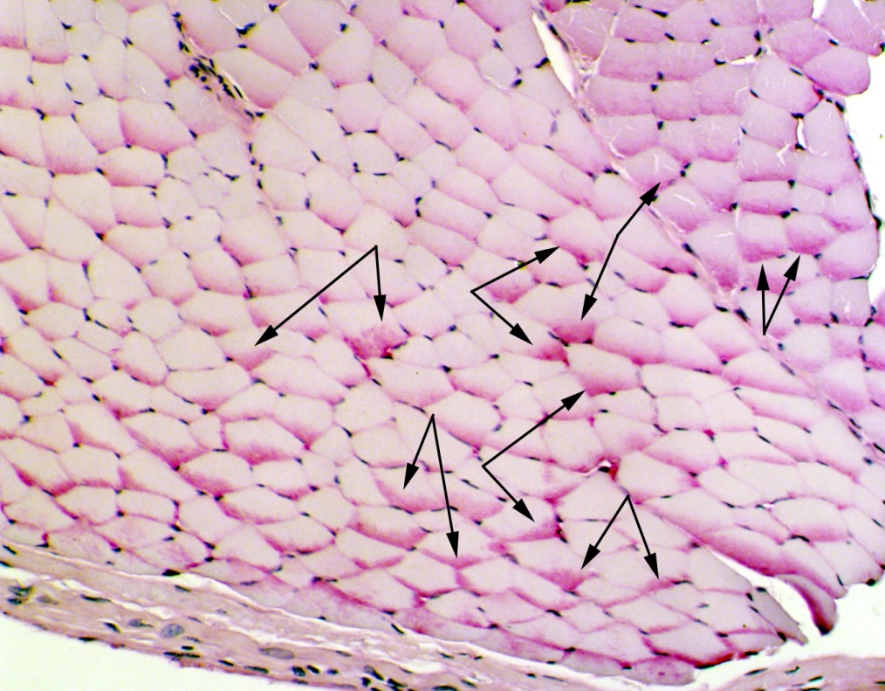
Methods for Histochemical Demonesration of Carbohydrates
1- PAS reaction
Results: PAS +ve material = magenta
Nuclei: blue.
Glycogen in muscle

Slide 13
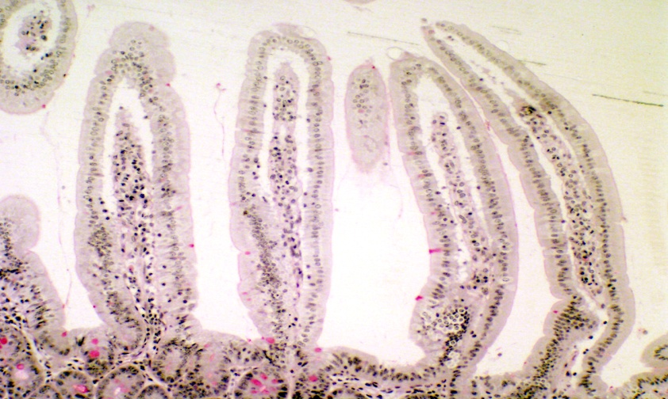
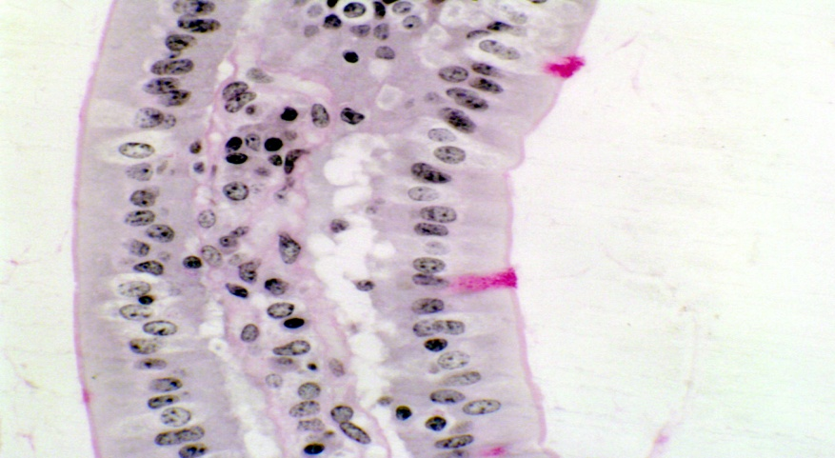
This is an example of the periodic acid-Schiff reaction. These images show villi in the jejunum of a mouse; the right hand rollover image shows the PAS positive cells at higher magnification, and the villi cut longitudinally (as at left) and in cross section as well.

Slide 14
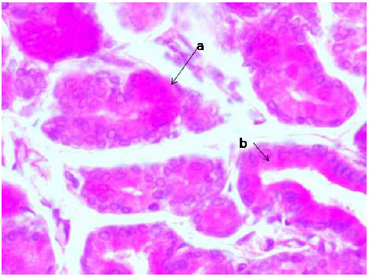
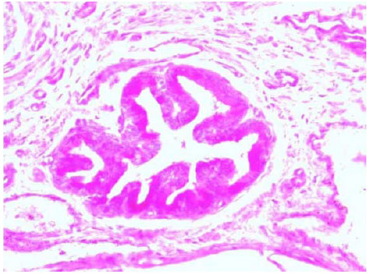
PAS reaction in the epithelium of a large duct.

Slide 15
2- Diastase digestion for Glycogen.
3- Bulmer’s Glycogen Method:- is based on the fact that dimedone will block most staining with Schiff’s reagent in a relatively short time and will block glycogen staining only after long treatment
Results : Glycogen = red
4- Glycogen Bauer-Feulgen Method:- gives the best result for demonstrating glycogen in frozen sections
Results: Glycogen = red, the nuclei blue.

Slide 16
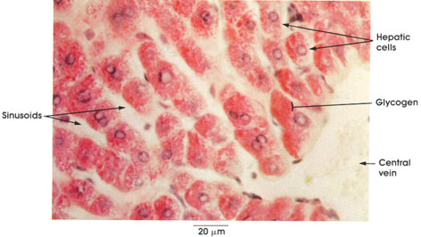
5- Best’s Carmine method :- is used for paraffin, frozen and freeze dried sections
Results: Glycogen will show the characteristic red stain. Nuclei stained blue.
Section of Liver Rabbit, absolute alcohol, Best's*
carmine and hematoxylin stains

Slide 17
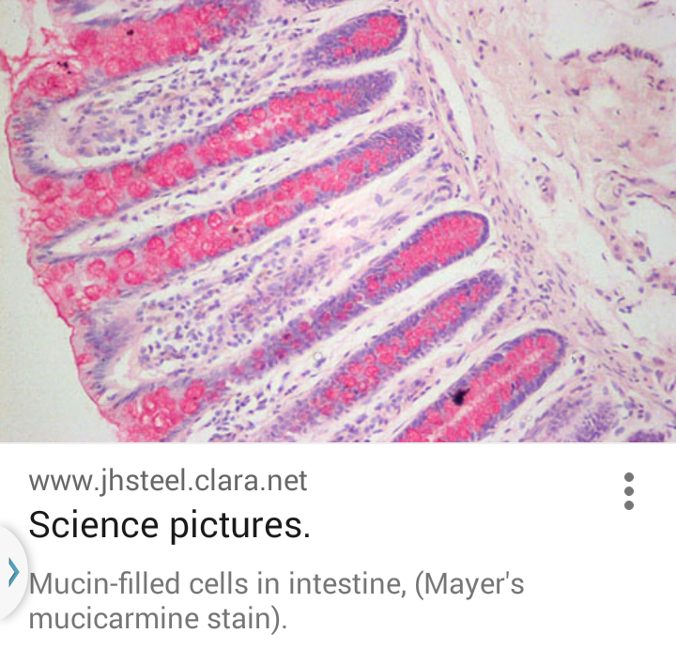
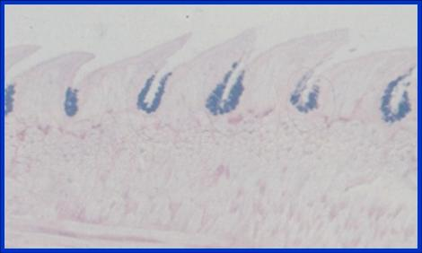
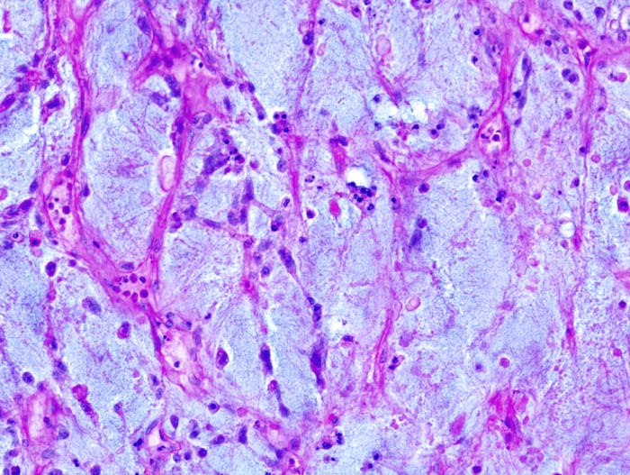
6-Mucicarmine for Mucosubstances
Results: Mucosubstances stain red and nuclei blue.
7- Alcian blue –PAS method: Results
Acid Mucosubstances: blue
Neutral Mucosubstances: red
Mixture: purple
1-myxoid liposarcoma arising in the deep soft tissue of the thigh. Alcian blue-PAS stain for glycogen 2- T.S in lingual salivary gland of lizard stained Alcian blue –PAS

Slide 18
8- Acid Mucopolysaccharides: Toluidine blue method
Results: Acid Mucosubstances pink nuclei blue.
9- Acid Mucosubstances: Alcian blue (pH 2.5 , pH 0.2)
Results:
Alcian blue PH 0.2: sulphated acid mucosubstances blue color
Alcian blue PH 2.5 most acid mucosubstances appear blue.
9-Silver method for ascorbic acid(Bacchas 1950 and Jensen& Kavalijian 1956).
Results: ascorbic acid black

Slide 19
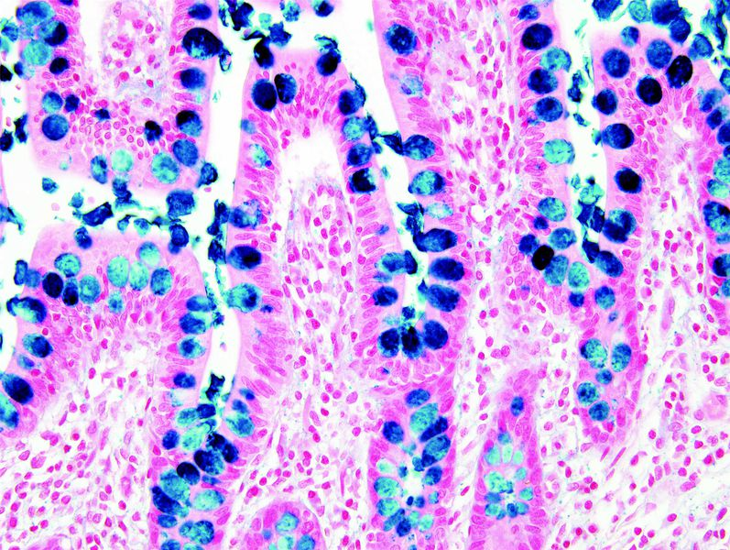
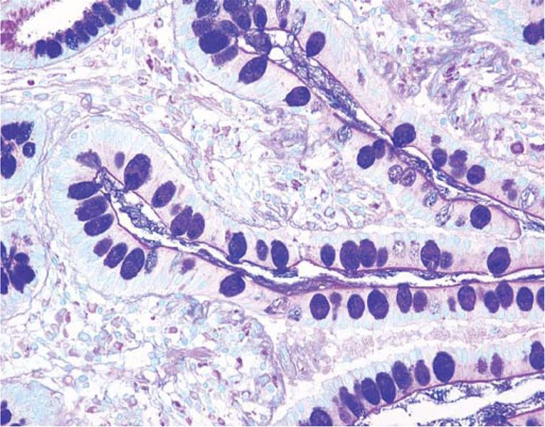
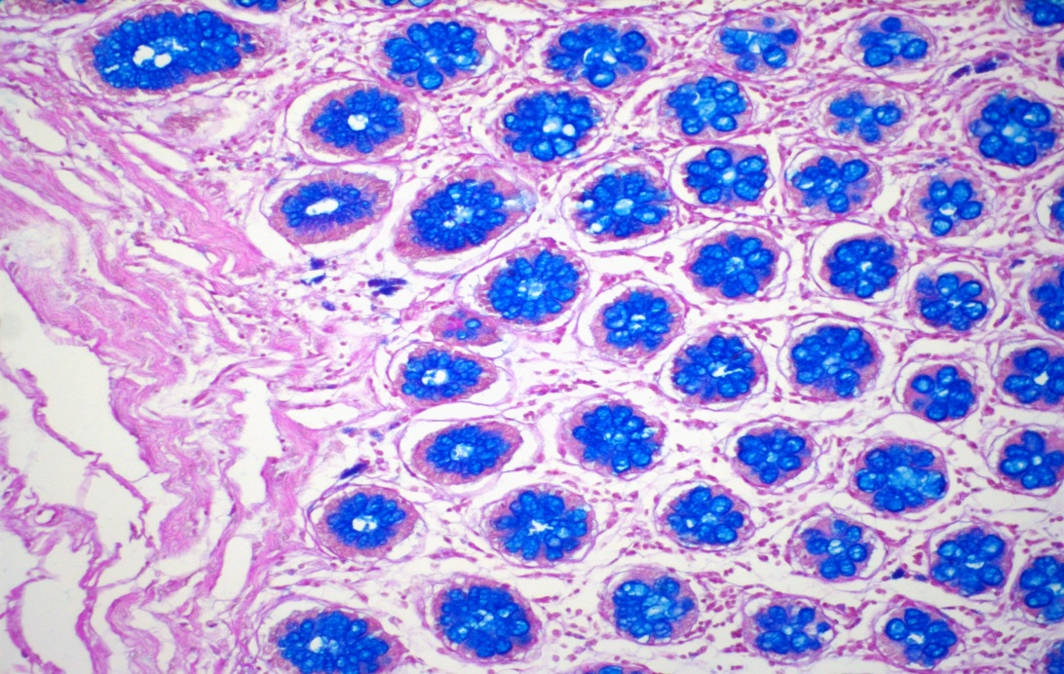
Human colon stained with Alcian blue PAS

Slide 20
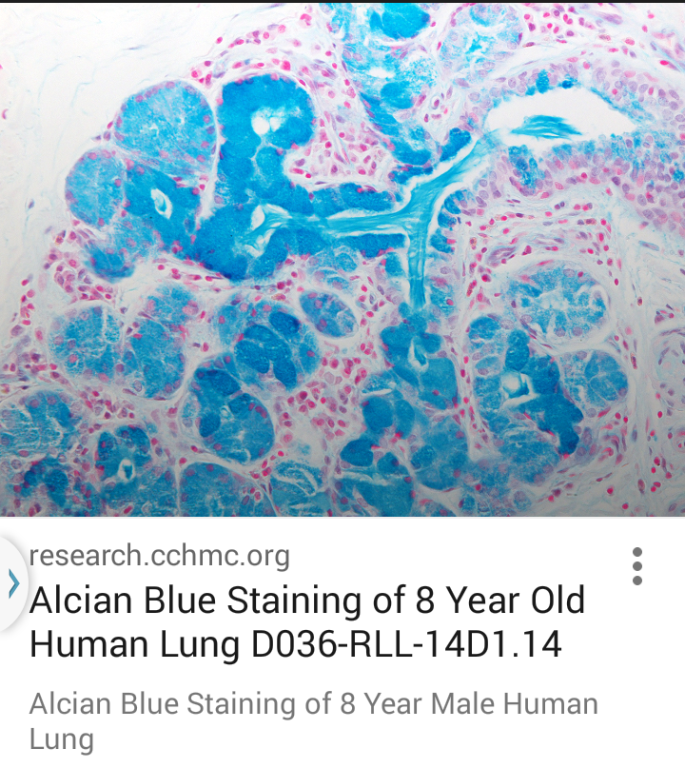
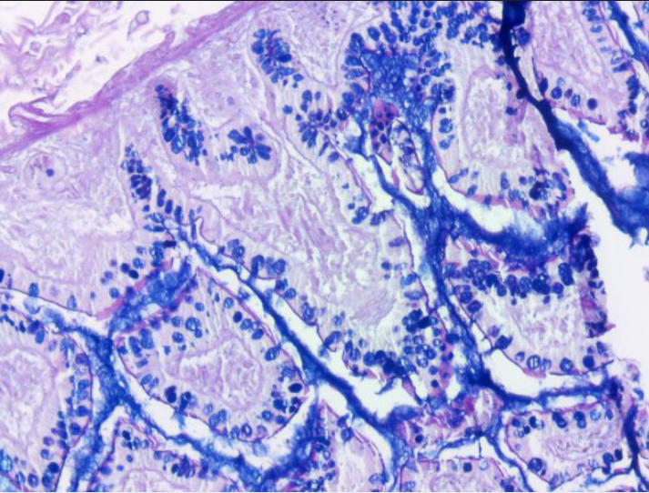
1- Alcian blue PAS 2-Alcian blue in human lung

Slide 21
NUCLEIC ACIDS

Slide 22
Nucleic acids (DNA & RNA, are found in all animal tissues, and usually combined with basic proteins to form nucleoproteins). DNA is found in the nucleus associated with the chromosomes. On the other hand, RNA is found in cytoplasm, and small amount of it occurs in the nucleolus. Hydrolysis of nucleic acids yields these compounds:-
1- Phosphate groups
2- Five-carbon sugars
3- Nitrogenous bases, purines and pyrimidines ( are 4 types, two of which are purines and two are pyrimidines).
Both DNA & RNA as the same structure, but differ in two important aspects:-
A- Sugar content : in DNA the 5-carbon sugar is the deoxyribose. But in RNA is ribose.
B- purine and pyrimidine content : in DNA purines are adenine and guanine, the pyrimidine are thymine and cytosine. In RNA the same purines, but pyrimidine are uracil and cytosine.

Slide 23
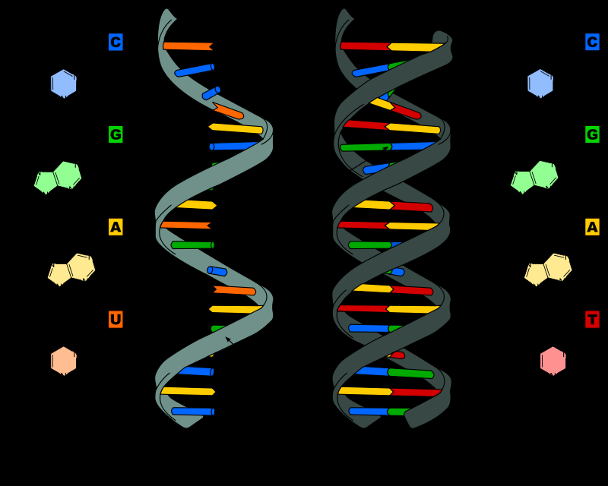
Deoxyribonucleic acid
Main article: DNA
Deoxyribonucleic acid (DNA) is a nucleic acid containing the genetic instructions used in the development and functioning of all known living organisms. The DNA segments carrying this genetic information are called genes.
Ribonucleic acid
Main article: RNA
Ribonucleic acid (RNA) functions in converting genetic information from genes into the amino acid sequences of proteins.
A comparison of the two principal nucleic acids: RNA (left) and DNA (right), showing the helixes and nucleobases each employs.

Slide 24
DNA related to genetic information, but RNA associated with protein synthesis.
Molecular organization of DNA
The DNA molecule regards as “tetranucleotide hypothesis” made up of repeating units of 4 bases in equal amounts (adenine , guanine , thymine and cytosine) in ratio 1:1:1:1. Other authors described DNA as double helical structure in which the two polynucleotides are coiled.

Slide 25
Biological significance of NUCLEIC ACIDS:
Role of DNA in genetics:-
DNA is a heriditary material ( when extract it from bacteria or virus) but in plant virus only RNA, other animal viruses have both DNA and RNA .
The genetic or heriditary material of the cell have 2 separate functions:-
1- it capable of self duplication and
Initiating certain actions to expressed in a given cell structure or function.
2- DNA capable both of duplicating itself and information of protein synthesis.

Slide 26
inter- relation BETWEEN dna AND rna:-
Dna of chromosomes has specification for the synthesis of glycolytic enzymes. But most of the enzymatic material, and much of the cellular synthetic mechanism is in the cytoplasm and the information for duplication of the material is also in chromosomes. This substance is the RNA which has the ability of controling the synthesis.

Slide 27
Role of RNA
Information between DNA in nucleus and synthesizing machinery in nucleus and cytoplasm is tied up with the metabolism of RNA. The rest of the RNA includes certain fraction which occurs in the nucleoplasm connected with the chromatin and remaining fraction form small particles namely ribosomes found in cytoplasm.
Hypothesis for RNA yield or synthesized in nucleus and when completed move out into cytoplasm .
Types of RNA:-
1- rRNA
2- mRNA
3- tRNA
These different types are similar in the presence of A,G,C and U, but some are double stranded as DNA and others appear single stranded.

Slide 28
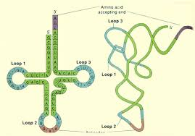
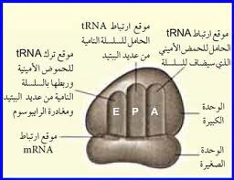
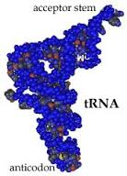
mRNA
rRNA
tRNA

Slide 29
Evidence of the role RNA in protein synthesis
Action of reagents on DNA.
Action of two nucleases ( ribonucleases & deoxyribonucleases) on nucleic acids

Slide 30
Identification of nucleic acids in cells:-
1- Feulgen method for ……………DNA
2- Methyl Green- Pyronin method for …RNA_DNA
3-Gallocyanin- Vhrome Alum method for….” - “
4-NAH- Feulgen method for…………DNA
5-Acridine Orange method for……. RNA_DNA
6-Deoxyribonuclease extraction for……DNA
7- Ribonuclease extraction for……RNA

Slide 31
Methods for Histochemical Demonstration of Nucleic Acids
1- Feulgen nuclear reation (DNA)
results: DNA appears reddish purple.
When put in a light green stain as a counterstain
cytoplasm: green

Slide 32
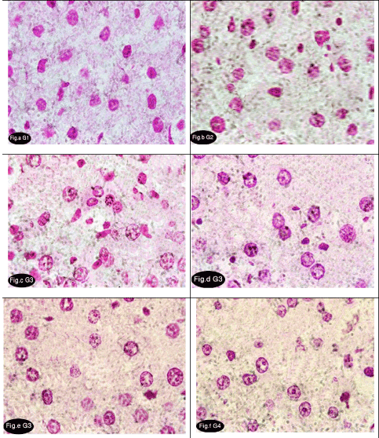

Slide 33
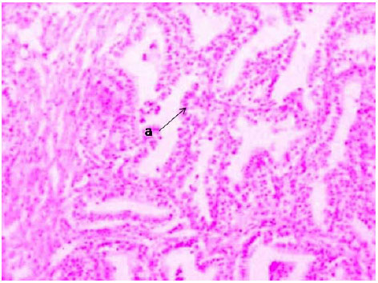
DNA in the nuclei of acinar cells (a). Feulgen's reaction X 100

Slide 34
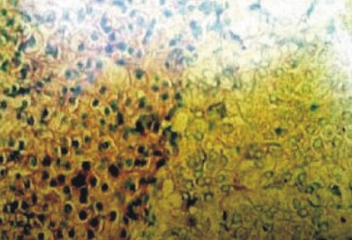
2- Methyl Green – Pyronin method (DNA & RNA)
results: DNA : green RNA: red
The Methyl Green Pyronin (RNA DNA Stain) is intended for use in the histological visualization of
DNA, RNA and Mast Cell Granules.
Section of adrenal in control male mice showing green stained DNA in the nuclei and purple stained RNA in the cytoplasm. (Paraffin section, Methyl green thionin stain. Photomicrograph x320.)

Slide 35
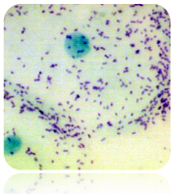
DNA Blue-Green
RNA Pink-Red
Mast Cell Granules Pink
Some Mucins Red
Plasma Cell Cytoplasm Red
Nuclei: Blue-Green
DNA: Blue-Green to Green
RNA: Red to Violet
Mast Cell Granules: Red to Violet
Plasma Cell Cytoplasm: Pink to Violet

Slide 36
3-Hibiscus method (DNA)
results: Nucleus: dark blue When put in a eosin stain as a counterstain cytoplasm: light red.

Slide 37
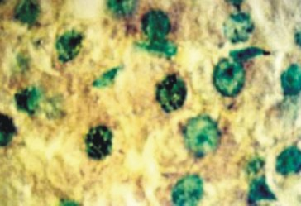
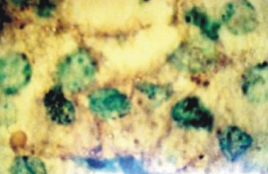
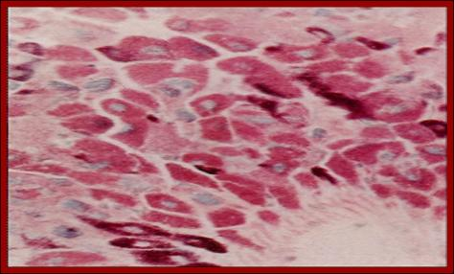
Methyl green – pyronin
Comment??????

Slide 38
PROTEINS AND AMINO ACIDS

Slide 39
Summery:-
Proteins are organic substances of high molecular weight
Proteins are found by a number of amino acids derived from aliphatic acids by replacement of one H atom by the amino group (-NH2)
H H
H - C - COOH H - C - COOH
H NH2
Acetic acid Aminoacetic acid (glycine)

Slide 40
Proteins are polymers – specifically polypeptides -sequences formed from various L-α-amino acids. Each unit of a protein is called an amino acid residue because it is the residue of every amino acid that forms the protein by losing a water molecule. By convention, a chain under 40 residues is often identified as a peptide.
Protein structures range in size from tens to several thousand residues (long chain). By physical size, proteins are classified as nanoparticles, between 1–100 nm. Very large aggregates can be formed from protein subunits. For example, many thousands of actin molecules assemble into a microfilament.

Slide 41
the characteristic that distinguishes one amino acid from another is its unique side chain, and it is the side chain that dictates an amino acids chemical properties. Examples of three amino acids are shown below, and structures of all 20 are available. Note that the amino acids are shown with the amino and carboxyl groups ionized, as they are at physiologic pH.

Slide 42
Amino acids has a fundamental design composed of a central carbon (also called the alpha carbon) and joined together by peptide bonds to:
a hydrogen
a carboxyl group
an amino group
a unique side chain or R-group

Slide 43
Levels of Protein Structure
Structural features of proteins are usually described at four levels of complexity:
1-Primary structure: the linear arrangment of amino acids in a protein and the location of covalent linkages such as disulfide bonds between amino acids.
2-Secondary structure: areas of folding or coiling within a protein; examples include alpha helices and pleated sheets, which are stabilized by hydrogen bonding.
3-Tertiary structure: the final three-dimensional structure of a protein, which results from a large number of non-covalent interactions between amino acids.
4-Quaternary structure: non-covalent interactions that bind multiple polypeptides into a single, larger protein. Hemoglobin has quaternary structure due to association of two alpha globin and two beta globin polyproteins.

Slide 44
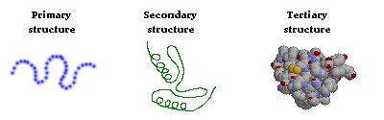

Slide 45
Classification of Protein (with examples):
(Types of proteins)
Based on composition B) Based on structure
A) Based on Composition:
i) Simple Proteins
ii) Conjugated Proteins
iii) Derived proteins
Simple Proteins: Classified according to solubility
yield on hydrolysis amino acids as:-
a) Albumins
b) Globulins
c) Glutelins
d) Histones
e) Protamine
f) prolamines
g) Scleroproteins

Slide 46
ii) Conjugated Proteins: Contain amino acid + prosthetic group yield on hydrolysis other substances of non amino acids as:
a) Glycoproteins
b) Chromoproteins
c) Lipoproteins
d) Nucleoproteins
e) Phosphoprotein
iii) Derived Proteins: Derivatives of proteins due to action of heat, enzymes, or chemical reagents.
a) Primary Derived
As proteoses, peptones and polypeptides.
b) Secondary Derived
As synthesized protein

Slide 47
B) Based on Structure:
(simple proteins)
i) Fibrous (insoluble )
Contain collagen, reticulin, elastin, keratin and fibrin.
ii) Globular (soluble)
As globulin, histone, proteins and albumin

Slide 48
Collagen and reticulin
1- physical characters
2- biochemical features
3- effect of temperature
Elastic tissue
Keratin
Process of keratinization.
Keratosis Pharyngis is a medical condition where keratin grows on the surface of the pharynx, that is the part of the throat at the back of the mouth. Keratin is a protein that normally occurs as the main constituent of hair and nails. It is characterized by the presence of whitish-yellow dots on the pharyngeal wall, tonsils or lingual tonsils. They are firmly adherent and cannot be wiped off. The surrounding region does not show any sign or inflammation or any other constitutional signs. The disease usually shows spontaneous regression.
One patient who was diagnosed with Keratosis Pharyngis had white spots on the base of the tongue and on the pharynx, and hurt a little when swallowing. No treatment was found to help, but the condition went away by itself eventually.

Slide 49
General Identification of Proteins
1-Millon’s reaction
2-The diazonium reaction
3-The xanthoproteic reaction
4- The Saguchi reaction
5-The nitroprusside test
6- The ferric ferricyanyde method
7- Lead acetate method
8- Masson’s trichrome stain

Slide 50
Methods for Histochemical Demonstration of protein
1- The Millon reaction:-
Result: Proteins containing tyrosine stain orange to rose red
2- Millon’s reaction:-
Result: Proteins containing tyrosine are red pink or yellowish-red
3- Mercury-bromophynol blue method:-
Result: Proteins deep blue
4- Morel and Sisley diazotizayion method:-
Result: Proteins containing tyrosine stain purplish-red to pink
5- The Coupled tetrazonium reaction:-
Result: tissue components stain in shades deep reddish brown or in case of collagen is purplish red
6- The ferric ferricyanide method:-
Result: sulphydryls group blue with counter stain eosin nuclei red

Slide 51
7- Hydroxynaphthaldehyde method for NH2 group:-
Result: NH2 groups are stained blue
8- Disulphides : Performic acid-alcian blue method:-
Result: disulphides group are stained dark blue small amounts of disulphides appear light blue
9- Arginine: Saguchi method:-
Result: Arginine appears orange-red
10- Tryptophan: DMAB-nitrate method:-
Result: Tryptophan stains deep blue

Slide 52
Some photos of staining protein

Slide 53
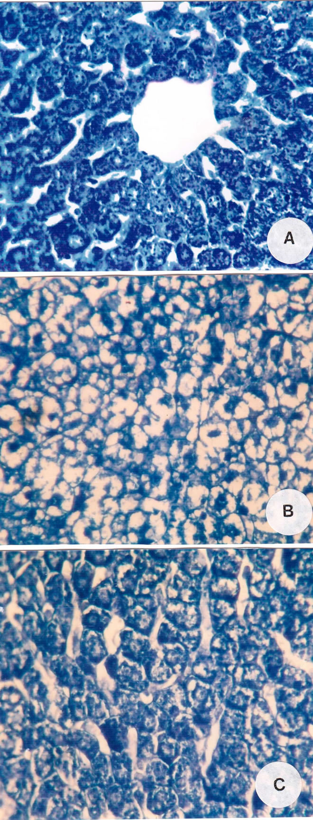
Total proteins contents of the liver cells of control rats are positively reflected by the appearance of blue color after staining with bromophenol blue. Generally, the cytoplasm of the hepatocytes contains excessive amount of total proteins in the form of fine granules

Slide 54
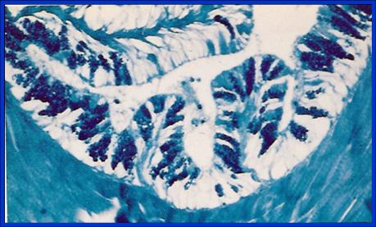
T.S of large intestine of rabbit stained with bromophenol blue

Slide 55
Gomori one-step trichrome stain - a connective tissue stain using haematoxylin and a dye mixture containing chromotrope 2R and light green or aniline blue. Muscle fibres appear red, collagen is green (or blue if aniline blue is used), and nuclei are blue to black.Left is a photo of a muscular artery stained using Gomori's one step trichrome. Collagen and nerve cells have stained blue. Muscle, elastic fibers and blood stained red. Cytoplasm of cells stained red. Nuclei stained purple.
The stain can be used to differentiate fibrous or nerve tissue from muscular tissue.

Slide 56
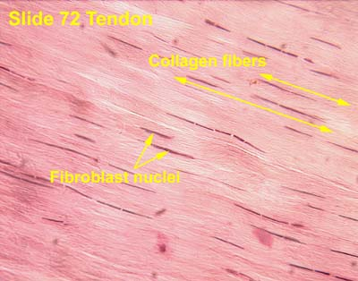
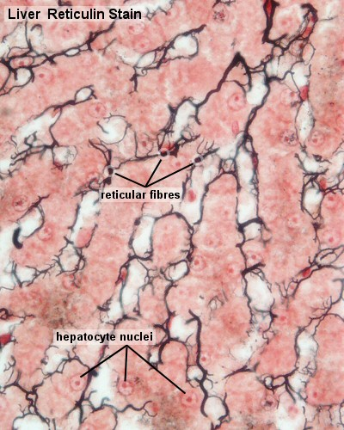
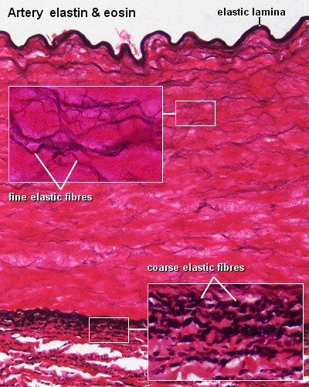

Slide 57
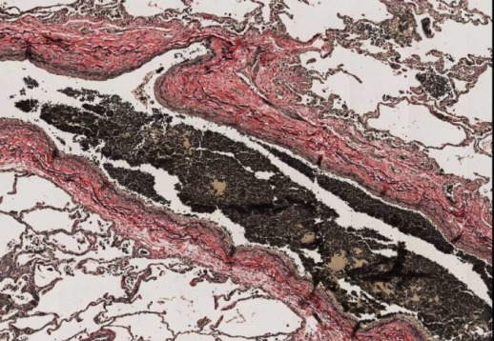
Verhoeff van Gieson
Classification: connective tissue stain
Mechanism of staining: ionic bonding/van de Waals forces for elastin fibers
Purpose: stain elastin
Control tissue: aorta, skin, lung
Elastic fibers – blue-black to black
Nuclei – blue/grey/black
Collagen – red
Muscle – orange
RBCs, cytoplasm – yellow

Slide 58
LIPIDS

Slide 59
The lipids are organic substances which are insoluble in water but soluble in fat solvents, related to fatty acids as esters. Most lipids are completely or partly soluble in organic solvents, so the histochemical technique are applied to frozen sections . A great proportion of the lipids present in tissues associated with proteins. Two types of lipids are histochemically identified visible and invisible or masked lipids. Visible is easily demonstrated in the cells and tissues by specific lipid methods as the Sudan dyes, oil red O and Nile blue sulphate. The invisible or masked lipid denoted lipids which could not be demonstrated directly. Lipids are a group of naturally occurring molecules that include fats, waxes, sterols, fat-soluble vitamins (such as vitamins A, D, E, and K), monoglycerides, diglycerides, triglycerides, phospholipids, and others.

Slide 60
Classification of Lipids
Lipids may be classified as a mixed group of substances with the common characteristics of solubility in organic solvents and insolubility in water. They can be organized as simple lipids, compound lipids or derived lipids.
• Simple lipids: esters of fatty acids with alcohols, including fats, oils and waxes. Fats are neutral esters of glycerol with saturated or unsaturated fatty acids. Oils may be similar to fats but are liquid at room temperature. Waxes are esters of higher alcohols with long-chain fatty acids. Simple lipids are usually found in the body as energy stores in adipose tissue. Waxes are usually found in plant and some animal species.
• Compound lipids: usually consist of a fatty acid, an alcohol and one or more other groups such as phosphorus or nitrogen. These can be found in the brain and central nervous system.
• Derived lipids: fatty acids that can originate from the simple and compound lipids by means of hydrolysis. Cholesterol, bile acids etc………..
• Caroteniods

Slide 61
lipids may be divided into eight categories: fatty acids, glycerolipids, glycerophospholipids, sphingolipids, saccharolipids, and polyketides (derived from condensation of ketoacyl subunits); and sterol lipids and prenol lipids (derived from condensation of isoprene subunits).

Slide 62
Identification of lipids
1- Sudan black B
2- Oil red O
3- Nile blue
4- Osmium tetroxide
PHYSICAL METHODS
A) Staining with oil-soluble dyes.-There is a large number
of oil-soluble dyes known, many of which are suitable for histological purposes B) Fluorescence microscopy C) Polarization microscopy

Slide 63
Methods for histochemical demonstration of lipids
1- (a) Lipid material:- (chromic acids and osmic acids in (addition to fixative
Results: blue – black
(b) Lipid material:- ( potassium bicarbonate & formalin ) as the same result both methods are differences in prepare tissue section the former by freezing section and the later with paraffin section.
2- Lipid material:- ( for smear & teased material) with Sudan black.
Results: lipids blue – black.
3- Lipid material:- Oil red O
Results: lipids: red nuclei blue.
4- Lipid material:- Sudan black B
Results: lipids including phospholipid: black nuclei blue.
5- Acidic lipids : Nile blue ( with different per cent)
Results: lipids blue for acidic lipid, while red color for non acidic lipid.
Results: Phosphlipids dark blue

Slide 64
6- Phosphlipids: Acid heamatin method:-
Results: Phosphlipids dark blue
7- Otan Method:-
Results: Phosphlipids: orange- red
Tryglycerides: black
Cholesterol esters: black

Slide 65
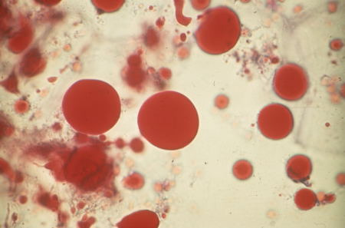
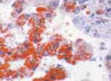
OIL RED O METHOD FOR FATS
This is a histology stain used for lipids. Lipids will stain red. Nuclei will stain blue/black.

Slide 66
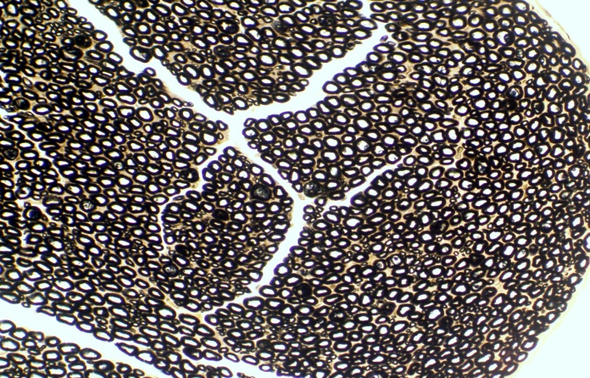
The low magnification image is a cross section of a peripheral nerve.
Osmium Tetroxide Stain for Lipids

Slide 67
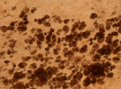
Osmium Tetroxide
This histology stain can be used to stain lipids. Collagen and erythrocytes will stain brown. Myelin and lipids will stain black

Slide 68
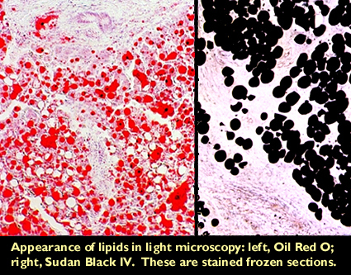

Slide 69
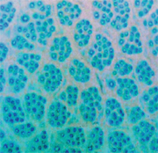
Follicle groups, follicles and fibres in a horizontal skin section from a high density alpaca (x 50 magnification: Nile blue sulphate stain).

