Slide 1
Chapter 38C - Atomic Physics
A PowerPoint Presentation by
Paul E. Tippens, Professor of Physics
Southern Polytechnic State University
© 2007

Slide 2
Objectives: After completing this module, you should be able to:
Discuss the early models of the atom leading to the Bohr theory of the atom.
Demonstrate your understanding of emission and absorption spectra and predict the wavelengths or frequencies of the Balmer, Lyman, and Pashen spectral series.
Calculate the energy emitted or absorbed by the hydrogen atom when the electron moves to a higher or lower energy level.

Slide 3
Properties of Atoms
Atoms are stable and electrically neutral.
Atoms have chemical properties which allow them to combine with other atoms.
Atoms emit and absorb electromagnetic radiation with discrete energy and momentum.
Early experiments showed that most of the mass of an atom was associated with positive charge.
Atoms have angular momentum and magnetism.

Slide 4
Thompson’s Model for the Atom
J.J. Thompson’s plum pudding model consists of a sphere of positive charge with electrons embedded inside.
Positive pudding
Electron
This model would explain that most of the mass was positive charge and that the atom was electrically neutral.
Thompson’s plum pudding
The size of the atom (≈10⁻¹⁰ m) prevented direct confirmation.

Slide 5
Rutherford’s Experiment
The Thompson model was abandoned in 1911 when Rutherford bombarded a thin metal foil with a stream of positively charged alpha particles.
Rutherford Scattering Exp.
Most particles pass right through the foil, but a few are scattered in a backward direction.
Alpha source
Gold foil
Screen

Slide 6
The Nucleus of an Atom
If electrons were distributed uniformly, particles would pass straight through an atom. Rutherford proposed an atom that is open space with positive charge concentrated in a very dense nucleus.
Alpha scattering
-
+
-
Gold foil
Screen
Electrons must orbit at a distance in order not to be attracted into the nucleus of atom.

Slide 7
Electron Orbits
Consider the planetary model for electrons which move in a circle around the positive nucleus. The figure below is for the hydrogen atom.
e⁻
-
Coulomb’s law:
Centripetal F_{C}:
F_{C}
r
+
Nucleus
Radius of Hydrogen atom

Slide 8
Failure of Classical Model
When an electron is acceler-ated by the central force, it must radiate energy.
v
e⁻
-
+
Nucleus
The loss of energy should cause the velocity v to de-crease, sending the electron crashing into the nucleus.
This does NOT happen and the Rutherford atom fails.

Slide 9
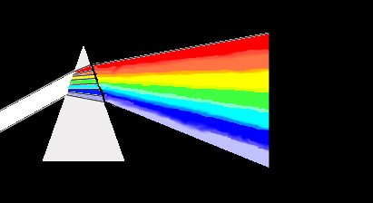

Atomic Spectra
Earlier, we learned that objects continually emit and absorb electromagnetic radiation.
In an emission spectrum, light is separated into characteristic wavelengths.
Emission Spectrum
λ₁
Gas
λ₂
Absorption Spectrum
In an absorption spectrum, a gas absorbs certain wave lengths, which identify the element.

Slide 10

Emission Spectrum for H Atom
Characteristic wavelengths
434 nm
n = 3
n = 4
n = 5
n6
653 nm
486 nm
410 nm
Balmer worked out a mathematical formula, called the Balmer series for predicting the absorbed wavelengths from hydrogen gas.
R 1.097 x 10⁷ m⁻¹

Slide 11
Example 1: Use the Balmer equation to find the wavelength of the first line (n = 3) in the Balmer series. How can you find the energy?
R = 1.097 x 10⁷ m⁻¹
λ = 656 nm
The frequency and the energy are found from:
c = fλ and E = hf

Slide 12
The Bohr Atom
Atomic spectra indicate that atoms emit or absorb energy in discrete amounts. In 1913, Neils Bohr explained that classical theory did not apply to the Rutherford atom.
e⁻
An electron can only have certain orbits and the atom must have definite energy levels which are analogous to standing waves.
+
Electron orbits

Slide 13
Wave Analysis of Orbits
n = 4
Stable orbits exist for integral multiples of de Broglie wavelengths.
e⁻
+
2πr = nλ n = 1,2,3, …
Electron orbits
Recalling that angular momentum is mvr, we write:

Slide 14
The Bohr Atom
An electron can have only those orbits in which its angular momentum is:
Energy levels, n
+
The Bohr atom
Bohr’s postulate: When an electron changes from one orbit to another, it gains or loses energy equal to the difference in energy between initial and final levels.

Slide 15
Bohr’s Atom and Radiation
Emission
When an electron drops to a lower level, radiation is emitted; when radiation is absorbed, the electron moves to a higher level.
Energy: hf = E_{f} - E_{i}
Absorption
By combining the idea of energy levels with classical theory, Bohr was able to predict the radius of the hydrogen atom.

Slide 16
Radius of the Hydrogen Atom
Radius as function of energy level:
Bohr’s radius
Classical radius
By eliminating r from these equations, we find the velocity v; elimination of v gives possible radii r_{n}:

Slide 17
Example 2: Find the radius of the Hydrogen atom in its most stable state (n = 1).
m = 9.1 x 10⁻³¹ kg
e = 1.6 x 10⁻¹⁹ C
r = 53.1 pm
r = 5.31 x 10⁻¹¹ m

Slide 18
Total Energy of an Atom
The total energy at level n is the sum of the kinetic and potential energies at that level.
But we recall that:
Substitution for v and r gives expression for total energy.
Total energy of Hydrogen atom for level n.

Slide 19
Energy for a Particular State
It will be useful to simplify the energy formula for a particular state by substitution of constants.
m = 9.1 x 10⁻³¹ kg
ε_{o} = 8.85 x 10⁻⁻¹² C²/Nm²
e = 1.6 x 10⁻¹⁹ C
h = 6.63 x 10⁻³⁴ J s
Or

Slide 20
Balmer Revisited
Total energy of Hydrogen atom for level n.
Negative because outside energy to raise n level.
When an electron moves from an initial state n_{i} to a final state n_{f}, energy involved is:
Balmer’s Equation:

Slide 21
Energy Levels
We can now visualize the hydrogen atom with an electron at many possible energy levels.
The energy of the atom increases on absorption (n_{f} > n_{i}) and de-creases on emission (n_{f} < n_{i}).
Emission
Energy of nth level:
Absorption
The change in energy of the atom can be given in terms of initial n_{i} and final n_{f} levels:

Slide 22
Spectral Series for an Atom
The Lyman series is for transitions to n = 1 level.
The Balmer series is for transitions to n = 2 level.
The Pashen series is for transitions to n = 3 level.
n =1
The Brackett series is for transitions to n = 4 level.
n =2
n =3
n =4
n =5
n =6

Slide 23
Example 3: What is the energy of an emitted photon if an electron drops from the n = 3 level to the n = 1 level for the hydrogen atom?
Change in energy of the atom.
ΔE = -12.1 eV
The energy of the atom decreases by 12.1 eV as a photon of that energy is emitted.
You should show that 13.6 eV is required to move an electron from n = 1 to n = ∞.

Slide 24
Modern Theory of the Atom
The model of an electron as a point particle moving in a circular orbit has undergone significant change.
The quantum model now presents the location of an electron as a probability distribution - a cloud around the nucleus.
Additional quantum numbers have been added to describe such things as shape, orientation, and magnetic spin.
Pauli’s exclusion principle showed that no two electrons in an atom can exist in the exact same state.

Slide 25
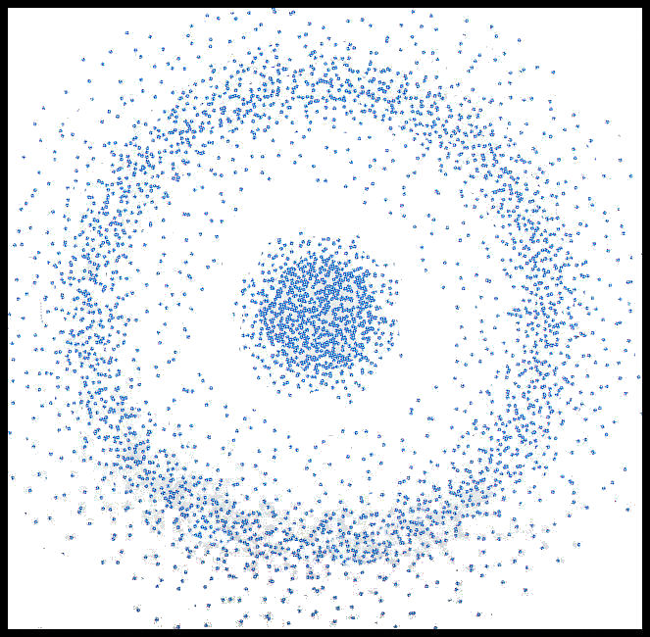
Modern Atomic Theory (Cont.)
The Bohr atom for Beryllium suggests a planetary model which is not strictly correct.
The n = 2 level of the Hydrogen atom is shown here as a probability distribution.

Slide 26
Summary
Bohr’s model of the atom assumed the electron to follow a circular orbit around a positive nucleus.
e⁻
-
F_{C}
r
Radius of Hydrogen Atom
+
Nucleus

Slide 27
Summary (Cont.)
In an emission spectrum, characteristic wavelengths appear on a screen. For an absorption spectrum, certain wavelengths are omitted due to absorption.
Emission Spectrum
λ₁
Gas
λ₂
Absorption Spectrum

Slide 28
Summary (Cont.)
Spectrum for n_{f} = 2 (Balmer)
434 nm
n = 3
n = 4
n = 5
n6
Emission spectrum
653 nm
486 nm
410 nm
The general equation for a change from one level to another:
Balmer’s Equation:

Slide 29
Summary (Cont.)
Bohr’s model sees the hydrogen atom with an electron at many possible energy levels.
The energy of the atom increases on absorption (n_{f} > n_{i}) and de-creases on emission (n_{f} < n_{i}).
Emission
Energy of nth level:
Absorption
The change in energy of the atom can be given in terms of initial n_{i} and final n_{f} levels:

Slide 30
CONCLUSION: Chapter 38C
Atomic Physics

