Slide 1
Course: Plant Physiology
Code: 308 Bot
Students: Third year Botany
Lecture 3 (Plant Mineral Nutrition)
Dr. Taha Mohamed El-Katony

Slide 2
Chapter 3
Functions of mineral nutrients and deficiency symptoms
Macronutrients
1- Nitrogen
Functions
N is the largest mineral element required by plants.
It amounts to about 1–5% of total plant dry matter.
N nutrition (NH₄⁺; NO₃⁻) affects
a) cation–anion relationships in plants because about 70% of the cations and anions taken up by plants are either NH₄⁺ or NO₃⁻.
b) pH of the rhizosphere: NH₄⁺ lowers pH, whereas NO₃⁻ increases pH of rhizosphere.

Slide 3
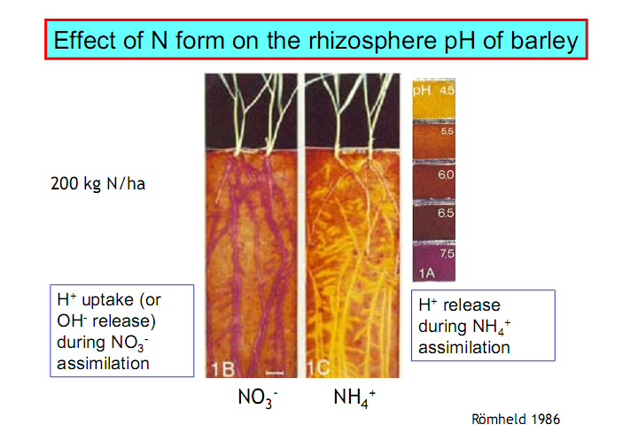

Slide 4
Nitrogen enters in the structure of proteins.
In addition to the 20 amino acids of protein there is about 200 non-protein amino acids found particularly in the seeds.
In addition to amino acids, N is found in purines, pyrimidines and porphyrins.

Slide 5
Purines (adenine and guanine) and pyrimidines (thymine, uracil and cytosine) are found in the nucleic acids.
There are many non-nucleic acid purines and pyrimidines.
Porphyrins are found in chlorophyll and cytochrome essential for photosynthesis and respiration.
N also occurs in coenzymes and vitamins, alkaloids, cyanogenic compounds and amines.

Slide 6
Deficiency symptoms
1- Extensive yellowing (chlorosis) of old, mature leaves.
Because N is highly mobile in the plant, younger leaves retain their N and also withdraw N from older leaves.
2- Under severe deficiency, old leaves will be yellow dry and will abscise and the topmost leaves are pale green.
3- Production of anthocyanins in the petioles, veins and stems.
4- Decrease in protein synthesis, which leads to decrease in cell size and cell number (cell division).

Slide 7
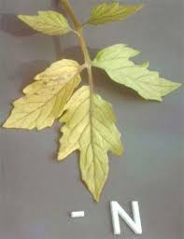
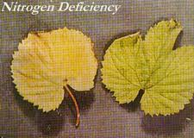
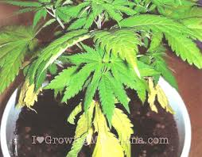
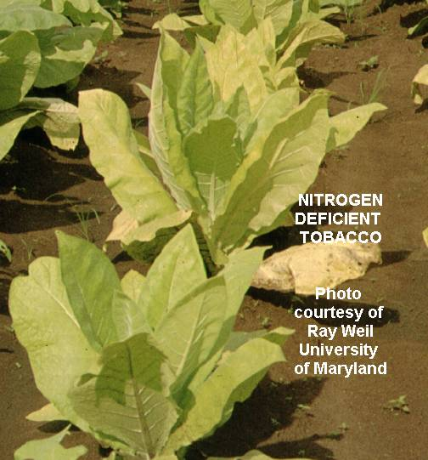

Slide 8
Phosphorus
Functions
The average P content of plant tissues is about 0.5%.
P conc. > 2% in leaves can be considered toxic.
P along with N and K are the fertilizer elements.
P is a constituent of nucleic acids and phospholipids of the membranes.
The phosphate group is responsible for:
1- The acidic behavior of DNA and RNA (the sugar-phosphate backbone).
2- The polar behavior of the phospholipid head (along with other groups such as alcohols and sugars).

Slide 9
P is a constituent of the coenzymes NAD, NADP and ATP (and the other high-energy compounds).
NAD and NADP are hydrogen carriers in respiration, photosynthesis, nitrogen metabolism, carbohydrate and fatty acid syntheses.
ATP and its analogues GTP, CTP, ….etc are important for energy transfer within the cell.

Slide 10
Phosphorus is found also in inositol phosphate (phytic acid) and sugar phosphates.
In contrast to N and S, which must be reduced within the cell before assimilation, P is not reduced and remains in the oxidized state.
Heavy concentrations of P are found in the meristematic regions, where it is involved in the synthesis of nucleoproteins.

Slide 11
P has a dual role in nucleoprotein synthesis:
1- as a constituent of the nucleic acid moiety.
2- in the activation of amino acids (through ATP) for the synthesis of the protein moiety.

Slide 12
Deficiency symptoms
Like N
Stunted growth, premature leaf fall and purple/red anthocyanin pigmentation of petioles and veins.
Unlike N:
1. Dark green or blue-green leaves as a result of greater retardation in leaf expansion than in chlorophyll formation (higher chlorophyll content per unit leaf area).
2. Development of necrotic areas on leaves, petioles or fruits.

Slide 13
3. Distortion of leaves (like Zn).
Deficiency symptoms appear first in older leaves (P is highly mobile in the plant).
4. Formation of large pith and small vascular tissues.
5. Phloem and xylem elements are poorly developed with thin walls.
6. Central pith cells disintegrate and those remained are large, succulent and thin walled with large intercellular spaces.
7. Accumulation of carbohydrates in plant tissues due to greater inhibition in respiration than in photosynthesis.

Slide 14
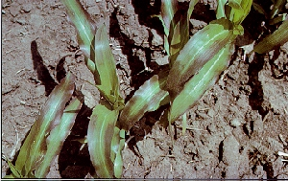
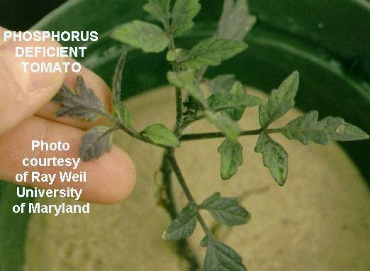
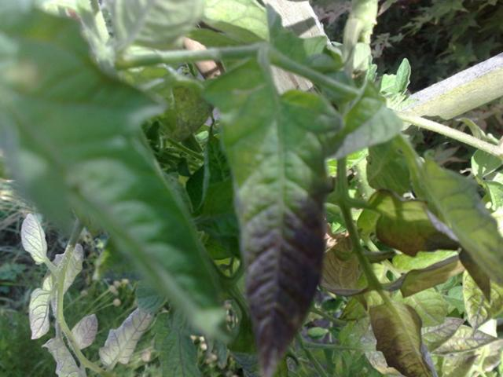
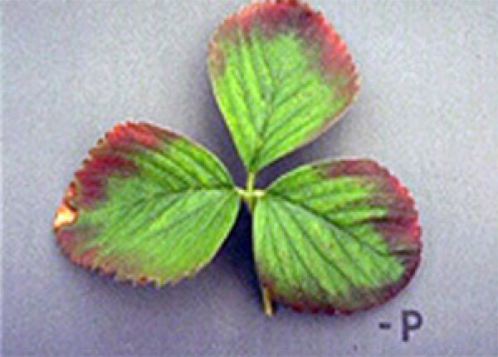

Slide 15
Calcium
1- Functions
Ca can reach > 10% plant DW without toxicity.
Ca is located mainly in the apoplasm and vacuoles, with low concentration in the cytosol.
The mobility of Ca in the symplasm and in the phloem is low.
Ca is a constituent of middle lamella in the form of calcium pectate.
Ca salt of lecithin is involved in the organization of cell membranes.

Slide 16
Treatment of Avena coleoptile with EDTA stimulates growth as a result of:
1- increased wall plasticity by removal of pectate-bound Ca.
2- increased cell permeability by removal of membrane-bound Ca.
Ca is necessary for chromatin or spindle organization, and thus for normal mitosis,
Nucleoprotein particles are held together by Ca²⁺.
Ca deficiency increases chromosome abnormalities.

Slide 17
Ca is an activator for certain enzymes such as:
phospholipase, arginine kinase, ATPase, adenylate kinase and potato apyrase.
Ca is essential for mitochondrial integrity, and (like B) for carbohydrate translocation within the plant.

Slide 18
Deficiency symptoms
1- Meristematic regions are affected and die, thus terminating growth.
2- Roots are short, stubby and brown.
3- Chlorosis, then necrosis along the margins of younger leaves.
4- Malformation (distortion) of younger leaves with hooking of leaf tip.
Symptoms appear first in younger leaves and meristems as a consequence of immobility of Ca in the plant.

Slide 19
5- Cell wall is brittle, and cell enlargement, vacuolation and differentiation occur closer to the apex.
6- : Blossom end rot and bitter pits of fleshy fruits.
Blossom-end rot
Is a disorder of tomato, squash and pepper.
It develops as a dry sunken decay on the blossom end of early fruits.
Bitter pits
Appears as small sunken pits on the surface of the apple.
The flesh beneath the pits is discolored and dry, with an unpleasant, bitter taste.

Slide 20
