Slide 1
Course: Plant Physiology
Code: 308 Bot
Students: Third year Botany
Lecture 3 (Water relationships)
Dr. Taha Mohamed El-Katony

Slide 2
Translocation of water
Root pressure
The stump of a detopped herbaceous plant exudes watery sap, which can build up if the stump is attached with a rubber sleeve to a glass tube containing water.
Root pressure is the pressure developing in xylem vessels as a result of the metabolic activities of the root.
Root pressure is an active process; due to osmotic mechanisms, as a result of the active absorption of salts by the root.

Slide 3
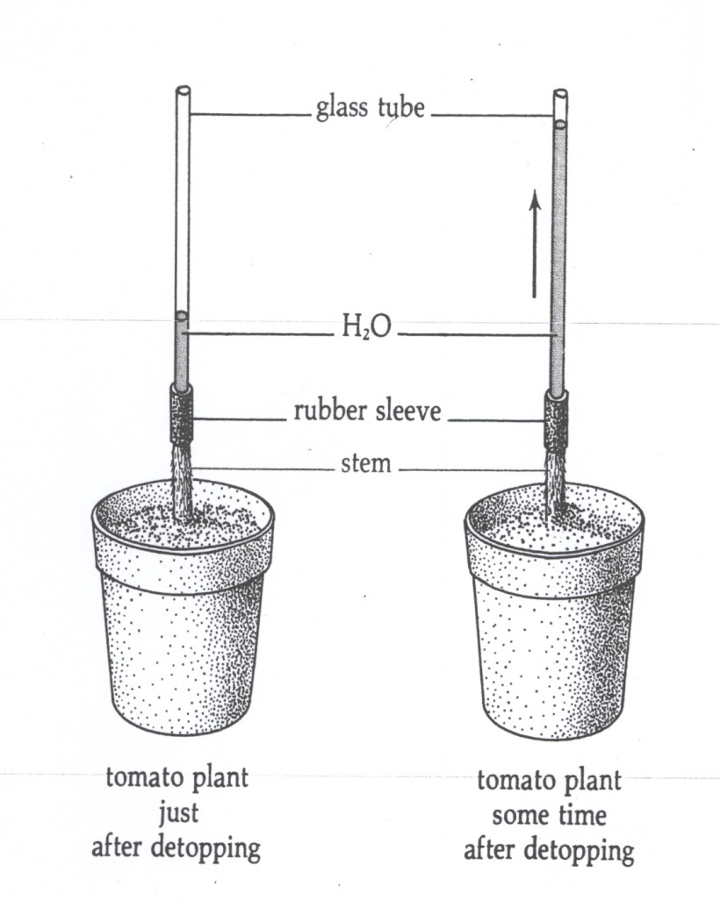

Slide 4
Root pressure is affected by factors that affect respiration (e.g. O₂ tension, narcotics, auxin and respiration inhibitors).
The exudations caused by root pressure exhibit diurnal fluctuation and there is a close agreement between the periodicity of root pressure and the exudation rate.
Exudation rate is the speed of release of liquid at the cut surface of the stem.

Slide 5
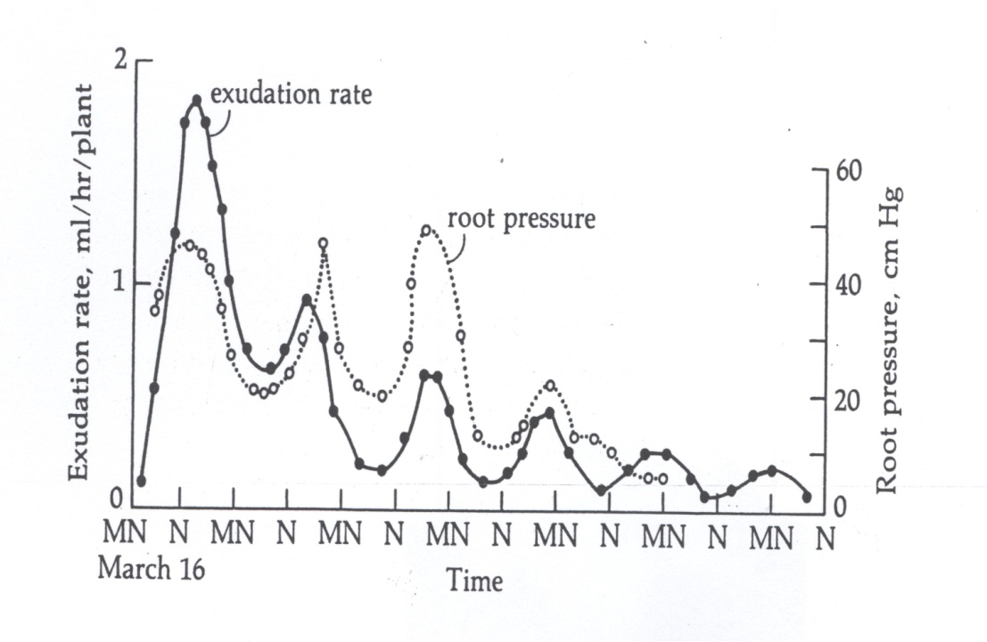

Slide 6
Exudation rate of detopped plants is proportional to the concentration of salt in the medium.
The diurnal fluctuation of exudation rate is caused by a periodicity of salt transfer into the xylem.
This causes a periodicity in Ψ_{s} of the xylem ducts, which affects the rate of water absorption in accordance with a change in Ψ_{w} gradients.
Absorption of water does not require a direct expenditure of energy.
Energy is expended in the absorption and accumulation of salts; but the Ψ_{w} gradient is the driving force for water absorption.

Slide 7
Participation of root pressure
Earlier opinion: Rise of water in plants is primarily the result of root pressure.
But now, root pressure has a minor role in ascent of sap because:
1. It is of low magnitude, not sufficient to push water in most trees. Root pressure averages around 2 atm; occasionally may reach 6 atm and is absent in conifers which are among the tallest trees.
In addition, the friction encountered in the passage of water through the xylem ducts should be considered.

Slide 8
2. Exudation rates are generally much slower than normal transpiration rates. Xylem sap is usually under tension instead of pressure.
Nevertheless, when transpiration is low, root pressure may be a significant factor in the ascent of sap.
In some plants, liquid water loss, (guttation), caused by root pressure, is observed under conditions unfavorable for transpiration.

Slide 9
The vital theory
Early investigators believed that the ascent of water in plants is controlled by vital activities in the stem.
Evidence: Xylem tissue contains living cells (xylem parenchyma and xylem ray cells).
However, stems in which the living cells were poisoned are still capable of water translocation.

Slide 10
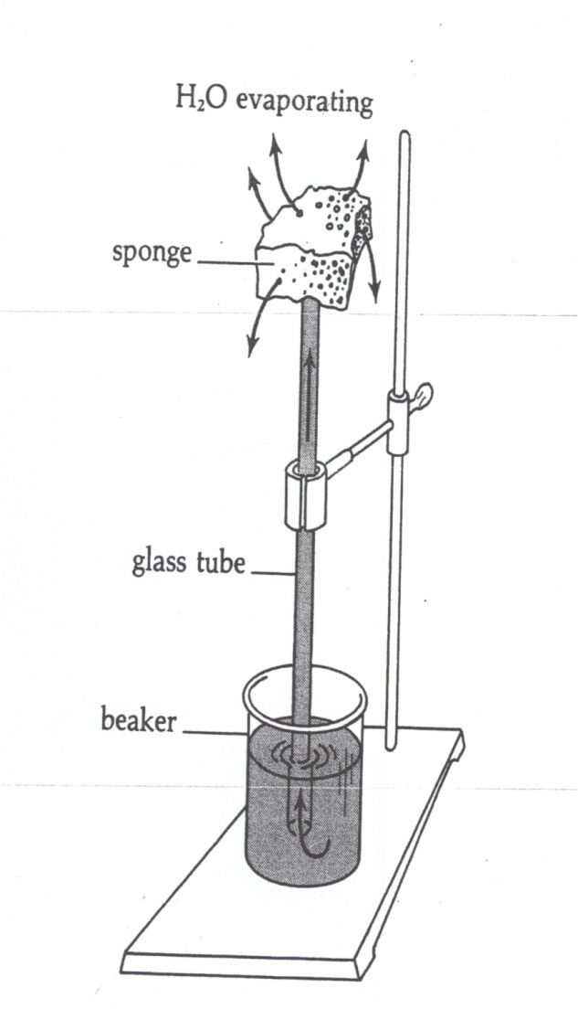
The cohesion-tension theory
In the figure: a long tube full of water is submerged by one of its ends in water and a soaked sponge was put at the other end of the tube so as water is continuous in the system.
Observation: an unbroken column of water is pulling up from the beaker.

Slide 11
The process can be accelerated by * a fan to move dry air over the sponge and by * heat to increase temperature of the air surrounding the sponge.
The rate of water ascent in the tube is directly related to its rate of evaporation from the sponge.
As water evaporates from the sponge it is replaced by water from the tube, which in turn is replaced by water from the beaker.

Slide 12
Two questions:
1. How can a column of water be pulled up in the tube without break?
2. Why does not the column of water when under tension pull away from the wall of the tube?
The answer is in the cohesive⁽¹⁾ and adhesive⁽²⁾ properties of water.
Water molecules (1) cohere to each other and (2) adhere to the wall of the tube.
Therefore, the water column will not break (this can done by an interruption of the column by air.

Slide 13
This physical example is comparable to the plant.
Water in the beaker is analogous to the soil water.
The glass tube is analogous to the tracheary elements (xylem vessels) of the stem.
The sponge is similar to the leaf mesophyll.
As water evaporates from the leaf's mesophyll cells their Ψ_{w} becomes more negative.
Water lost is replaced by water moving from cell to cell within the mesophyll along the Ψ_{w} gradient.

Slide 14
Finally the pull of water within the leaf will be transmitted to water in the xylem elements in the veins, hence putting water in the lumina of xylem vessels under tension.
This tension is continuous through unbroken columns of water (due to the cohesive and adhesive properties of water) from the leaves to the root system.
The Ψ_{w} in living cells of root becomes more negative relative to the Ψ_{w} of soil solution, thus promoting absorption.

Slide 15
Evidence in favor of the presence tension in xylem vessels.
A leafy shoot cut under water and sealed to a manometer supports a column of mercury above barometric level.
If a twig of a transpiring plant is cut, water in the xylem elements snaps away from the cut surface; this is the basis for the pressure bomb procedure used to determine ψ_{w}.

Slide 16
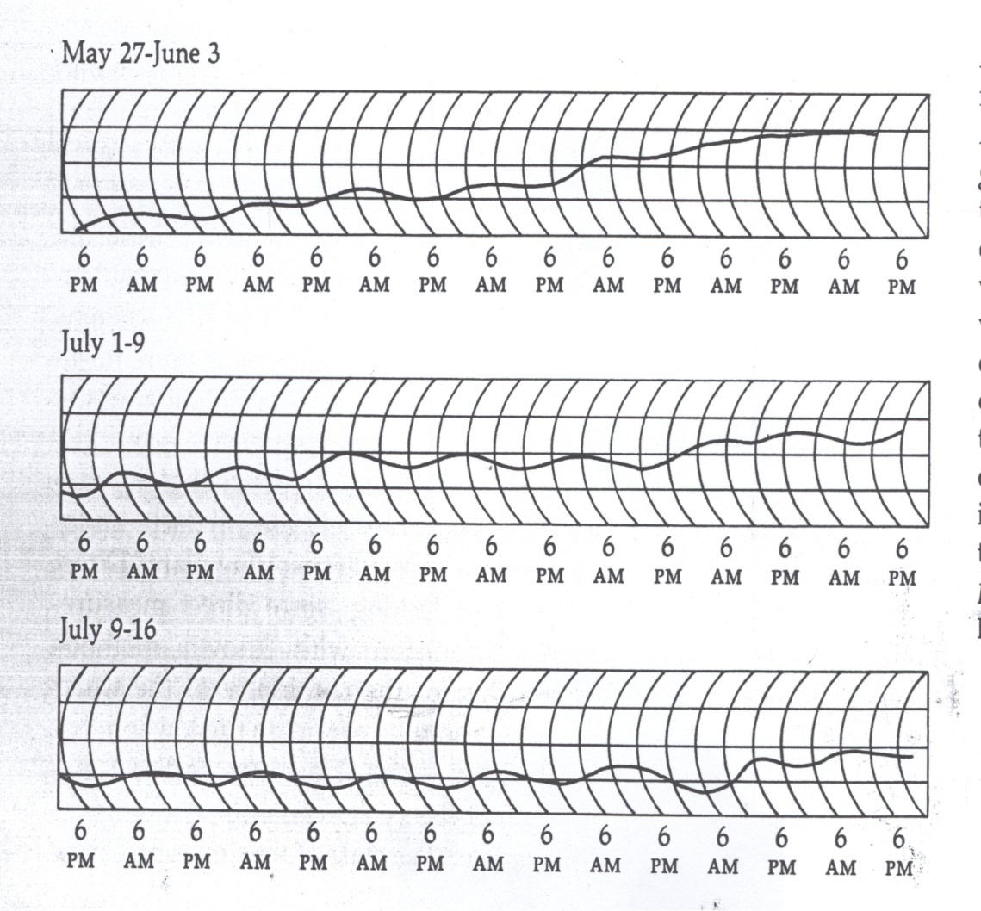
3.The Dendrograph measures diurnal variation in diameter of tree trunks.

Slide 17
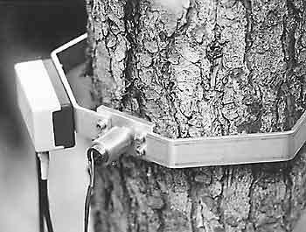
When water in the xylem elements is under tension, it will, because of its adhesive properties, cause a shrinkage in the diameters of xylem vessels.
This decrease in diameter is small in individual vessels, but the total effect can be recorded by a dendrograph.

Slide 18
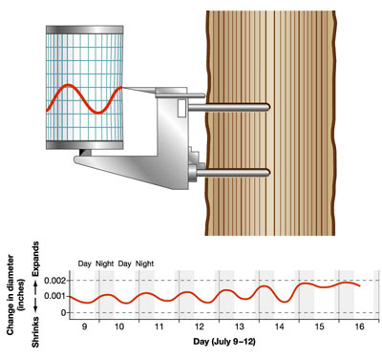
This instrument gives a continuous record of changes in the diameter of a trunk over a period of time.
Diameter decreases during periods of high transpiration (summer, day) and increases in periods of low transpiration (spring, night).

Slide 19
The question now is: Can the tensile strength of water support rise of water to the tops of the highest trees?
The tensile strength of water > 300 bars.
Raising water to the top of 400 feet tree requires a difference in pressure of 12 bars between the top and bottom.
In addition, water encounters considerable friction as it moves through the xylem tissue.
The tensile strength of water is sufficient to overcome the frictional and gravitational forces encountered in its rise in the plant.

Slide 20
In conclusion:
1- The cohesion-tension theory is the most plausible explanation of the translocation of water in a vigorously transpiring plant.
2- Root pressure can raise water, but not in the proper quantity and height.
3- In general, any physiological event (water loss, solute buildup or translocation, mineral absorption) that causes more negative ψ_{w} (high ψ_{w} gradients between two points) will influence water movement.

