Slide 1
Course: Plant Physiology
Code: 308 Bot
Students: Third year Botany
Lecture 1 (Water relationships)
Dr. Taha Mohamed El-Katony

Slide 2
Chapter II
Absorption and translocation of water
Large amounts of water are continuously absorbed from the soil and translocated through the plant.
Most of the water absorbed is lost to the atmosphere by transpiration and a small proportion is used in the physiological processes.
Water use by the plant is inefficient.
It is easy to account for rise of water in herbaceous plants.
But this is difficult in case of the tall trees.

Slide 3
Water translocation depends on:
The adhesive and cohesive properties of water and
The Ψ_{w} gradient from the soil all the way through the leaves and into the atmosphere.
Although physically water runs uphill to the tops of trees ( > 100 m) energetically it follows a downhill gradient.
While water physically ascends the tree, it in reality descends.
The Ψ_{w} gradient (between what and what) is influenced by several factors particularly those of the soil and the atmosphere.
Soil conditions are more important than atmospheric conditions.
Soil factors are: (1) temperature, (2) Ψ_{s} of soil solution, (3) aeration, (4) concentration of CO₂ and (5) availability of water.

Slide 4
Temperature
Low soil temperature inhibits water absorption.
Placing crushed ice on the surface of soil in which a plant is growing under conditions good for transpiration led to wilting of the plant.
If the ice was removed the plant will gradually regain turgidity.
At low temperature:
* water is more viscous and less mobile,
* the protoplasm is less permeable to water (Short term)
* root growth is inhibited (long term).
All these factors reduce water absorption.

Slide 5
2. Osmotic potential of soil solution
A Ψ_{w} gradient between the soil solution and cell sap or the interior of root cells is necessary for water absorption.
The Ψ_{w} of the soil solution is usually higher (less -ve) than that of the root cells.
If the Ψ_{w} of the soil solution is lower than that of the cell sap of the root cells, water will move out of the plant instead of being absorbed.

Slide 6
Halophytes
tolerate high salt concentrations (very -ve Ψ_{w}) in the soil solution.
They can lower the Ψ_{w} of their cells to more negative value than in the soil solution for the water balance to be in their favor.
This can be accomplished through accumulation of:
* inorganic salts or
* compatible organic solutes.

Slide 7
3. Aeration
Much water makes the plant thirsty.
Saturation of a field with water leads to wilting of growing plants particularly in bright sunlight.
This phenomenon is called "flopping".
Flopping of leaves is most severe under poor drainage. Why?
Flopping is caused by a retardation of water absorption as a result of displacement of soil gases by water, thereby leaving the roots poorly aerated.
Rapid transpiration in the bright sunlight enhances the development of water deficit in the plant.

Slide 8
Root growth and metabolism are retarded under low oxygen tension.
In the short term: immediate effects of reduced metabolic rate of the root and the capability of the root to take up and accumulate salt would seriously affect its water absorption. (efficiency factor)
In the long term: inhibited root growth have a significant effect on water absorption. (volume factor).
A direct effect of lowered oxygen tension on water absorption is also probable. (water channels or aquaporins).

Slide 9
4. Concentration of CO₂
The inhibitory effect of CO₂ on water absorption is greater than that of lowered oxygen tension.
How ? Plants wilted more rapidly when the soil air was replaced by CO₂ than when it was replaced by N₂.
Additional effect of CO₂
High CO₂ levels retard water absorption through increasing the viscosity of protoplasm and decreasing the root's permeability to water.
However, this factor is of minor importance since: CO₂ rarely accumulates in the soil atmosphere to toxic levels under field conditions.
this is because roots can tolerate high CO₂ levels.

Slide 10
5. Availability of water
Not all of the soil water is available to the plant.
As the soil dries up the absorption of water by roots slows down due to the decreased Ψ_{w} gradient between roots and soil solution.
Eventually the physical factors that hold water to the soil overcome the physical factors involved in the uptake of water by roots.
Three parameter of soil-water relationships:
* Field capacity (FC),
* Permanent wilting percentage (PWP) and
* Total soil moisture stress (TSMS).

Slide 11
Field capacity (FC) is the water content of the soil after cessation of the capillary movement of water.
Permanent wilting percentage (PWP) is the percentage of soil water left when the leaves of a plant growing in the soil first exhibit the symptoms of permanent wilting – that is the leaves do not regain turgor when placed in a saturated atmosphere.
TSMS = Ψ_{s} of the soil solution + soil moisture tension.
Soil moisture tension is the sum of gravitational, adsorptive and hydrostatic forces that hold water to the soil. (non osmotic forces).

Slide 12
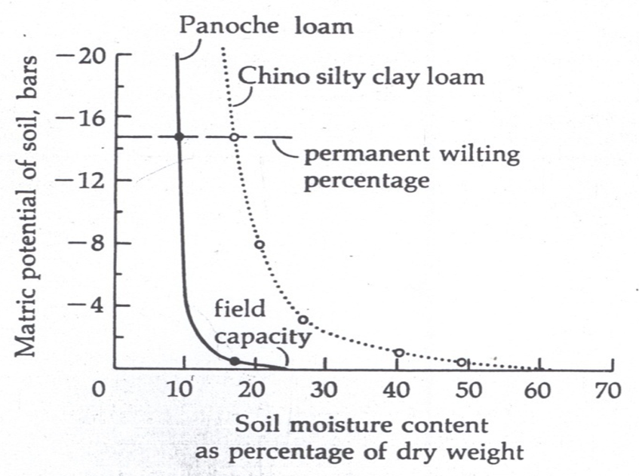

Slide 13
FC and PWP of clay soil >> than those of sand.
FC is a soil moisture constant; it depends only on type of soil.
PWP depends on type of soil and particularly on the test plant.
The plant osmotic factors rather than the soil factors determine the PWP of a soil.
A mesophytic leaf has Ψ_{s} of -20 bars, while a halophytic leaf has Ψ_{s} of < -200 bars.
This large difference in Ψ_{s} means different capacity to draw water from the soil.

Slide 14
During the day, as the soil dries up the TSMS increases (more –ve Ψ_{w}).
The TSMS decreases during the night (less –ve Ψ_{w} , night recovery) as water moves from bulk soil to the surface of the root.
The Ψ_{w} of the plant follows the same pattern; more –ve during the day and less –ve during the night.
The plant Ψ_{w} always remains more –ve than the TSMS; for water to move into rather than out of a plant.
As the soil dries up a little more each day, the TSMS and also the plant Ψ_{w} become progressively more negative.
The daily progressive –ve Ψ_{w} coupled with progressive slower night recoveries lead to loss of turgor by the leaves.

Slide 15
Finally, a point is reached at which the TSMS equals Ψ_{s} (also Ψ_{w}) of plant leaves (about -14 bars).
Recovery of turgor at this level is impossible because the leaf Ψ_{w} – TSMS equilibrium established at night is at a lower Ψ_{w} that allows for only zero Ψ_{p}.
The PWP is obtained at this point.
PWP can be redefined as the soil water content when the plant Ψ_{w} or Ψ_{s} and the soil TSMS are at equilibrium, and the Ψ_{p} of plant leaves is zero.

Slide 16
