Slide 1
Course: Plant Physiology
Code: 308 Bot
Students: Third year Botany
Lecture 2 (Plant Mineral Nutrition)
Dr. Taha Mohamed El-Katony

Slide 2
Absorption and translocation
The path of ions across the root
Absorption of salts by roots is both passive and active.
The movement of ions into the AFS (apoplasm) is passive (by free diffusion).
Ions can move freely in the wet cell walls (apoplast) of the root as far as the endodermis.
Further penetration is retarded by the Casparian strip.
The continuum of cytoplasm and the connecting palsmodesmata is called the symplast.

Slide 3
The endodermal cells by virtue of the Casparian strip present a barrier to the passive diffusion of ions.
The protoplast of endodermal cells is tightly attached to the Casparian strip.
Ions can not pass through the walls of the endodermal cells.
The only route available is through the protoplast.

Slide 4
How can ions be delivered into xylem?
It was supposed that there is a gradient of decreasing O₂ and increasing CO₂ levels from the cortex to the stele.
The living cells adjacent to the xylem vessels therefore possess low metabolic activity, are leaky and lose salts to the lumen of xylem vessels.
Diffusion of salts back through the impervious Casparian strip is not allowed and there is a unidirectional loss of salt into the lumina of the xylem vessels.

Slide 5
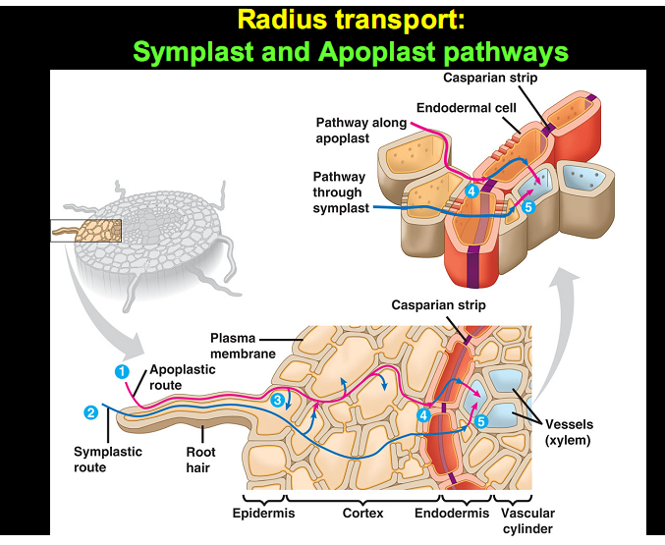

Slide 6
Circulation of salts
Salts delivered to the xylem ducts of the root are translocated upward to the shoot and, once there, are distributed and redistributed throughout the plant.
Salts deposited in the leaves are withdrawn prior to abscission and translocated to the reproductive organs or younger leaves.
Circulation takes place in the vascular tissues.

Slide 7
By the use of radioactive tracers several pathways for the translocation of salts were discovered:
1- in the xylem,
2- in the phloem,
3- laterally between the two tissues and
4- outward from the leaves.

Slide 8
Translocation of salts in xylem
Experimental evidence
1- Ringing experiment: The upward translocation of salts is unimpeded by removal of a ring of phloem near the stem base.
2- Large amounts of salts occur in the xylem sap.
3- ³²P travels upward to plant tip faster under high transpiration (bright sunlight) than under low transpiration.
4- If transpiration by a leaf is diminished by covering the leaf with a polyethylene bag, translocation of minerals to that particular leaf is reduced considerably.

Slide 9
5- Dissection experiment with radioactive tracers:
A: Procedure
i- The bark and xylem along a 9-inch length of a willow stem were separated and a strip of impervious waxed paper was inserted between them.
iii- The continuity of bark and xylem was undisturbed, and the plant was left intact.
iv- The plant was allowed to absorb ⁴²K for 5 hours.
v- Sections of the treated and intact areas of the stem were analyzed for ⁴²K.

Slide 10
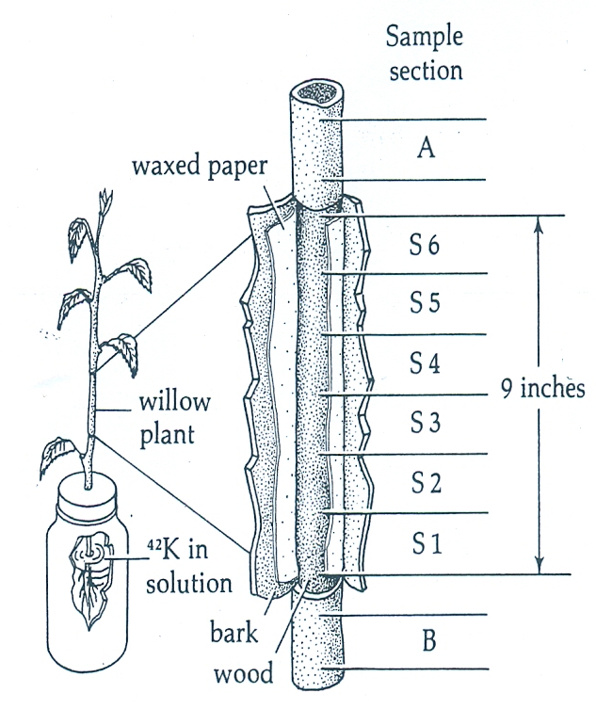

Slide 11
Section | Stripped branch |  | Unstripped branch
 | ⁴²K in bark (ppm) | ⁴²K in wood (ppm) | ⁴²K in bark (ppm) | ⁴²K in wood (ppm)
SA | 53.0 | 47 | 64 | 56
S6 | 11.6 | 119
S5 | 0.9 | 122
S4 | 0.7 | 112 | 87 | 69
S3 | 0.3 | 98
S2 | 0.3 | 108
S1 | 20.0 | 113
SB | 84.0 | 58 | 74 | 67

Slide 12
B: Results and conclusion
1- ⁴²K translocates upward in the xylem.
2- Lateral interchange of ⁴²K between phloem and xylem (through cambium) occurs within the intact region but further translocation either upward or downward in the phloem is slow.
3- The small amounts of ⁴²K in the bark along the stripped area suggests that little translocation takes place in the phloem tissue.

Slide 13
Lateral translocation of salts
The above experiment revealed:
1- upward translocation of salts in xylem and
2- lateral movement between xylem and phloem through cambium.
Cambium regulates the amount of salts carried up in the transpiration stream.
If the upward movement of salts were not regulated, certain areas of the plant (shoot and root tips) would not be accommodated.
The cambium position allows - both metabolically and physically - regulation of the upward, lateral and downward movement of salt.

Slide 14
The active accumulation of salt by the cambial cells acts as a deterrent against an indiscriminate sweep of salts upward in the transpiration stream.
The lateral movement from xylem to phloem correlates inversely with element content in the phloem
high concentration of an element in the phloem, slows down the lateral translocation into the phloem and low concentration enhances lateral movement.

Slide 15
Translocation of salts in the phloem
The initial upward movement of salts occurs in the xylem.
But upward movement may occur also in the phloem.
Evidence on upward movement:
1- Ringing bark high up in the stem retarded stem tip growth.
But ringing at stem base has no effect on salt nutrition of the whole plant including stem tip.
Thus, the influence on stem tip growth was because of the blockage of salts moving out of the lower leaves and transported upward in the phloem and not because of the root-absorbed salts.

Slide 16
Evidence on downward movement:
2- Dissection experiment with Radioactive tracers.
Procedure:
A- The bark was separated from wood by waxed paper immediately below leaf petiole of a cotton plant.
B- Bark and wood were left intact.
C- ³²P was injected into leaf blade just above the separated area.
D- One hour later, sections of stem were analyzed for ³²P.

Slide 17
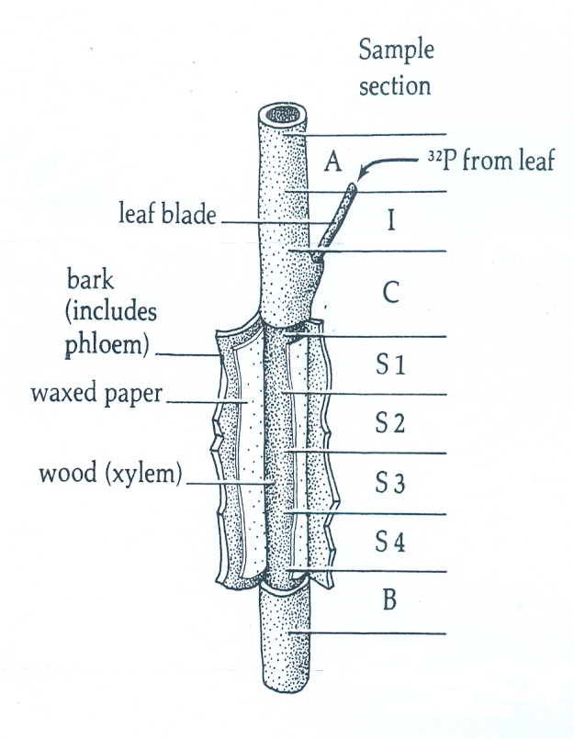

Slide 18
Section | Stripped plant |  |  | Unstripped plant
 | ³²P in bark (mg) |  | ³²P in wood (mg) | ³²P in bark (mg) |  | ³²P in wood (mg)
A |  | 1.11
I | 0.485 |  | 0.100 |  | 0.444
C |  | 0.610
S1 | 0.554 |  | 0.064 | 0.160 |  | 0.055
S2 | 0.332 |  | 0.004 | 0.103 |  | 0.063
S3 | 0.592 |  | 000 | 0.055 |  | 0.018
S4 | 0.228 |  | 0.004 | 0.026 |  | 0.007
B |  | 0.653 |  |  | 0.152

Slide 19
Results and conclusion
1- Salts entering the main vascular stream from leaf move primarily in a downward as well as upward direction in the phloem.
2- Lateral transport between the vascular tissues takes place where the phloem and xylem are not separated.
4- Both tissues may thus be involved with the upward translocation of mineral salts moving out from leaves.

Slide 20
The movement of salts in the phloem is bidirectional.
This bidirectional movement might occur:
1- Simultaneously in the same sieve elements.
Or
2- In two different phloem channels, one toward the tip and the other toward the base of the plant.

Slide 21
Outward movement of salts from leaves
In the leaves of deciduous plants, mineral salts move out of the leaf just prior to abscission.
The mineral nutrients moving out of leaves are N, K, P, S, Cl and (Mg and Fe).
Those remaining include Ca, B, Mn and Si.
Mineral nutrients move out of leaves primarily in the phloem.
When ³²P was introduced to leaves at different levels on the plant: P from base leaves moves downward toward the root while P from top leaves moves upward to tip.

Slide 22
Circulation and reutilization
Minerals are taken up in the transpiration stream.
Move primarily in the xylem vessels to the leaves.
Excess quantities are withdrawn from leaves and re-translocated downward in the phloem.
Then they could be laterally transported into the xylem where upward translocation could take place again.
Elements such as N, K and P move readily in this circuit.
Calcium ascends the stem but does not relocate in the phloem.

Slide 23
Phosphorus
P is highly mobile in the plant and it is in continuous circulation.
P mobility is an essential feature of plant growth.
P is needed in such metabolic schemes as photosynthesis, starch synthesis, glycolysis, and the synthesis of fats and proteins.
P is thus needed at various points in the plant.
A pool of P in a useable form is maintained throughout the plant in a relatively uniform concentration.

Slide 24
Sulfur
Sulfur is mobile in plants but to a lower extent than P.
This is because of its rapid incorporation into metabolic compounds.
Absorbed *S rapidly ascends in the xylem to the leaves.
Within 24 h most of the *S was found in the younger leaves.
The older leaves having lost their S to the young actively growing leaves.
S is a constituent of protein and protein synthesis occurs heavily in the younger leaves.
S, then, is freely mobile in the plant but is rendered immobile rather quickly in metabolic reactions.

Slide 25
Iron
Mobility of iron in the plant depends on :
1- Fe concentration of the plant tissues.
Being highest at low Fe concentration in the plant and decreases at high concentration.
2- P availability.
High P concentrations in the plant tissues render iron immobile in the veins of the leaf.
3- pH of the rooting medium.
A pH of 4 gives high iron mobility and mobility decreases at pH of 7.

Slide 26
Calcium
Absorbed *Ca ascends in the transpiration stream to the different areas of the plant.
Ca is immobile in the phloem, and once delivered by the transpiration stream, it remains stationary.

Slide 27
In conclusion:
1- There are four general directions of ion movement in the plant: upward, downward, lateral and outward.
3- The upward translocation of salts takes place primarily in the xylem, but also in the phloem.
4- Downward movement takes place in the phloem where upward movement also occurs.
5- Movement of salts in the phloem is, thus, bidirectional.
6- Lateral movement occurs between xylem and phloem through the cambium.
7- Movement of salts out of leaves is common, especially prior to abscission, and occurs in the phloem.

