Slide 1
Course: Plant Physiology
Code: 308 Bot
Students: Third year Botany
Lecture 2 (Water relationships)
Dr. Taha Mohamed El-Katony

Slide 2
Absorption of water
Water absorption takes place by the root system, particularly the root hair zone through osmosis.
Water diffuses into the root hair and into other epidermal cells as a result of Ψ_{w} gradient.
Ψ_{w} of the root cell sap is more -ve than Ψ_{w} of the soil solution.
The cell Ψ_{w} can be made more -ve and hence water absorption will increase by:
* increase in solute concentration of the cell (more -ve Ψ_{s})
* or decrease in its turgor pressure (Ψ_{p}).

Slide 3
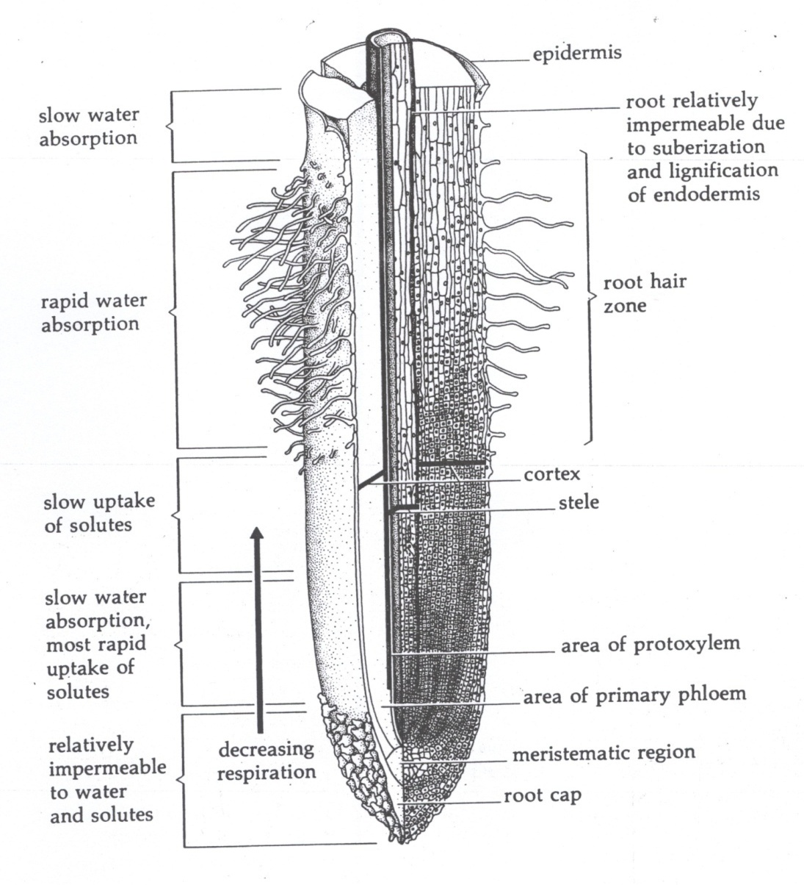

Slide 4
The root system varies a great deal in appearance and extent of soil penetration and hence in water absorbing capacity.
Root system of some plants penetrates deep into the soil.
Other plants form a dense shallow network of branch roots that cover a large area of soil.
Root hairs are very delicate structures and last for a short period of time (less than two days).
Rarely, root hairs may persist in some species. These root hairs become lignified and suberized with age, which limit their ability to absorb water.

Slide 5
Most of the plant's root system does not absorb water efficiently. Why?
The root hair zone lies between the root tip zone and the older naked zone.
The root tips represent the growing area of the root and is not involved in absorption.
In the older tissues of the root, several mm back from the tip, secondary thickening takes place and a periderm layer of highly suberized cells develops.
This embed the permeability of the root to water.

Slide 6
Although efficient water absorption takes place at the unsuberized root hair zone, water may also be taken up by suberized areas of the root.
Only a very small percentage of the root system of certain trees is unsuberized, making it necessary for suberized tissues to take up water.
The suberized roots of some trees can absorb a dye solution.
This can be done through three ports of entry: *lenticels, *breaks around branch roots and *wounds.

Slide 7
Path of water movement through root
Water taken up into the root hairs moves through the cortex to the endodermis, the pericycle and finally into the xylem.
This can be done easily along the walls of the cortical cells.
But the movement along the endodermal cell walls is impeded by the presence of the casparian strip.
Water is diverted into the endodermal cell and follows a Ψ_{w} gradient into the pericycle and into the xylem, which connects directly with the xylem of the stem.
Water thus moves out of the root and into the stem.

Slide 8
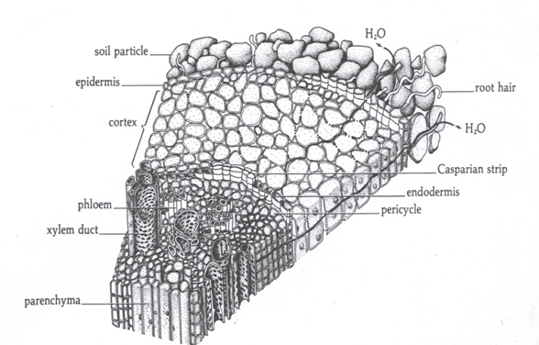

Slide 9
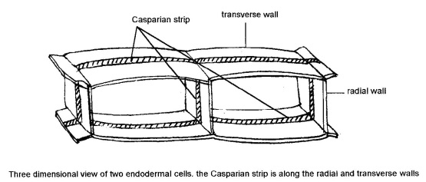

Slide 10
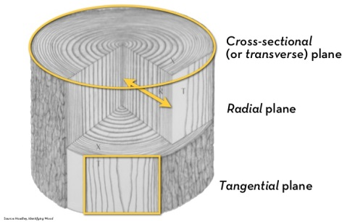
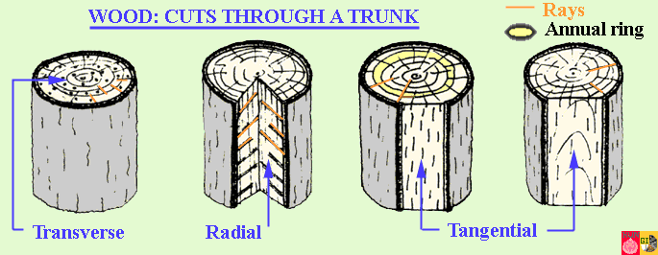
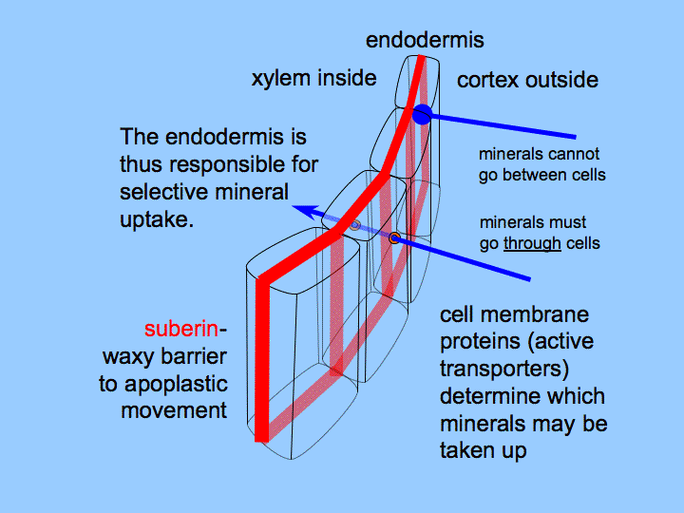

Slide 11
Path of water movement in the leaf
The xylem of stem is divided and subdivided into a complex network of vessels, which finally ends in the fine veins of the leaf.
Dicot. and monocot. leaves differ in mesophyll structure.
Water moves from the tracheids of leaf veins into the mesophyll cells, where a small portion is used by the cells and a large amount evaporates from the surface of cells into intercellular spaces.
Water vapor escapes from the substomatal chamber through the stomata into the atmosphere as a result of a very steep water vapor gradient.

Slide 12
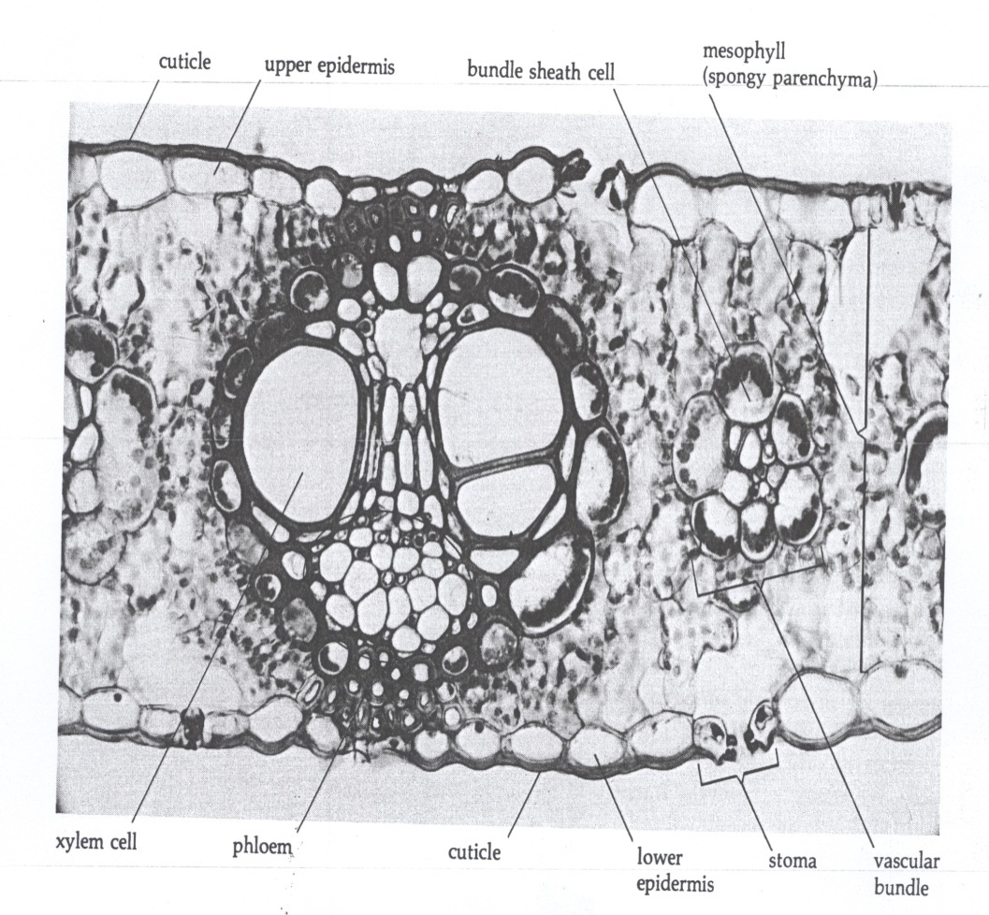

Slide 13
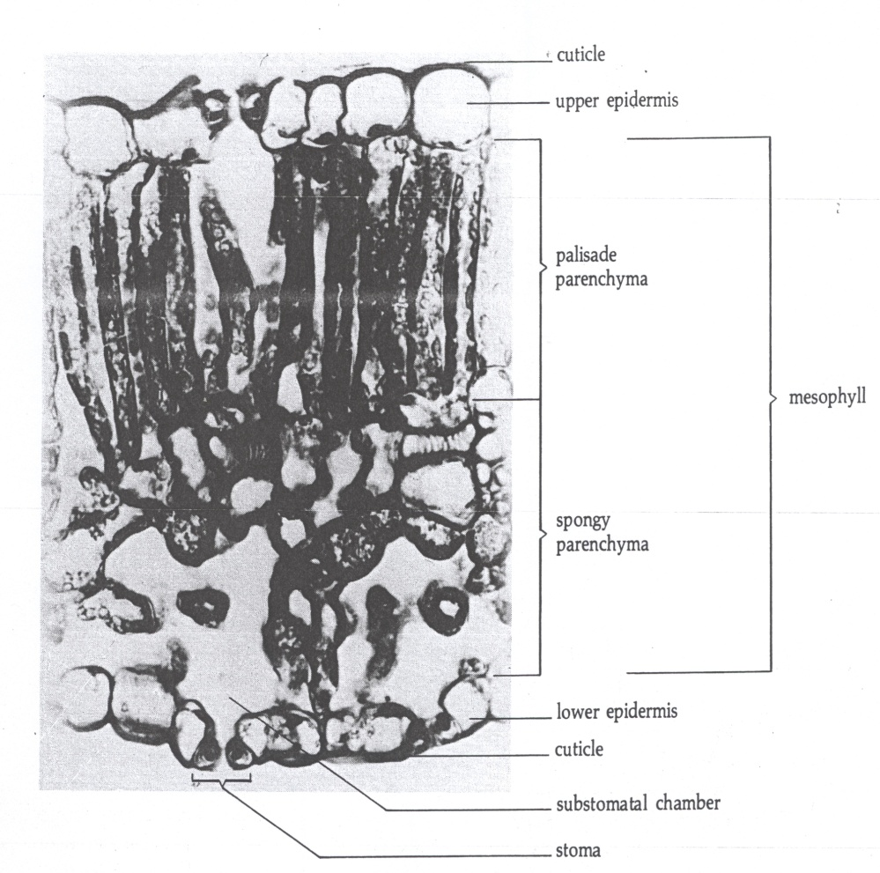

Slide 14
In a rapidly transpiring plant, the xylem vessels and tracheids are in a state of negative pressure or tension.
The rate of transpiration is often similar to the rate of absorption, but sometimes transpiration can exceed absorption.
The tension in the leaf is transmitted to the stem and then to the root, and water is literally pulled into the root from the soil.
The Ψ_{w} of the cell sap becomes more negative as it is subjected to increasing negative pressure (tension): Ψ_{w} = Ψ_{s} +(-Ψ_{p}).
The more negative Ψ_{w} leads to increased water uptake.

Slide 15
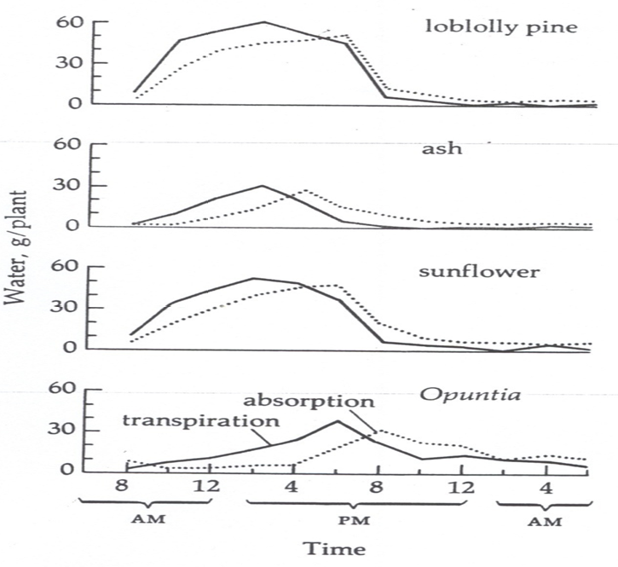

Slide 16
Water uptake, thus, occurs as a result of activity (transpiration) in the shoot.
The root merely acts as an adsorbing and absorbing surface.
This phenomenon is clearly supported by the fact that the shoot can absorb water through dead roots and may, in fact, take it up at a faster rate.
The resistance to water uptake by living roots may be due to the living cells of the root.

Slide 17
Absorption of water by aerial parts of the plant
Plant foliage can absorb water (both liquid and vapor).
The extent of foliar absorption depends on:
a) the Ψ_{w} of leaf cells and
b) permeability of the cutin layer.
The cutin layer on the leaves of McIntosh apple is not continuous but occurs in lamellae parallel to epidermal cells, interspersed with parallel layers of pectinaceous materials of good water absorbing capacity.

Slide 18
This pectinaceous material extends vertically to the vein extensions within the interior of the leaf forming a continuous path for water from the surface to the vascular tissue.
Water absorbed by the leaves can travel in a negative direction through the plant and diffuse through the roots into the soil.
This could occur along (down) Ψ_{w} gradient favoring movement in this direction.

Slide 19
Apoplast and symplast
The Apoplast is the non-living continuum of cell walls and intercellular spaces.
Since living cells are not included, translocation within this system is not due to osmosis but to capillary action (water) and free diffusion (solutes).
Symplast is the living continuum of plasmodesmata and cytoplasm.
Movement of water and solutes into symplast is due to osmosis (water), free diffusion or active uptake (solutes).

Slide 20
Water moves from the soil into the root along a decreasing Ψ_{w} gradient established by solute concentration.
Why the salt content of the interior cells of the root (the stele) is higher than that in the exterior cells.
Absorption and accumulation of salt by root cells requires metabolic energy.
Crafts and Broyer suggests that there is a decreasing O₂ and energy gradient and an increasing CO₂ gradient from the cortex to the stele.
Metabolic activity is thus at a minimum in the interior cells adjacent to xylem ducts.

Slide 21
Thus the stele cells in contrast to the cortex cells favor the loss of solutes.
Because diffusion back through the impervious Casparian strip is not allowed, there will be a unidirectional loss of salt into the lumina of the xylem vessels.
Water will follow this unidirectional path and diffuses from the less negative Ψ_{w} of the soil solution to the more negative Ψ_{w} of the interior of the root.

