Slide 1
The nucleus

Slide 2
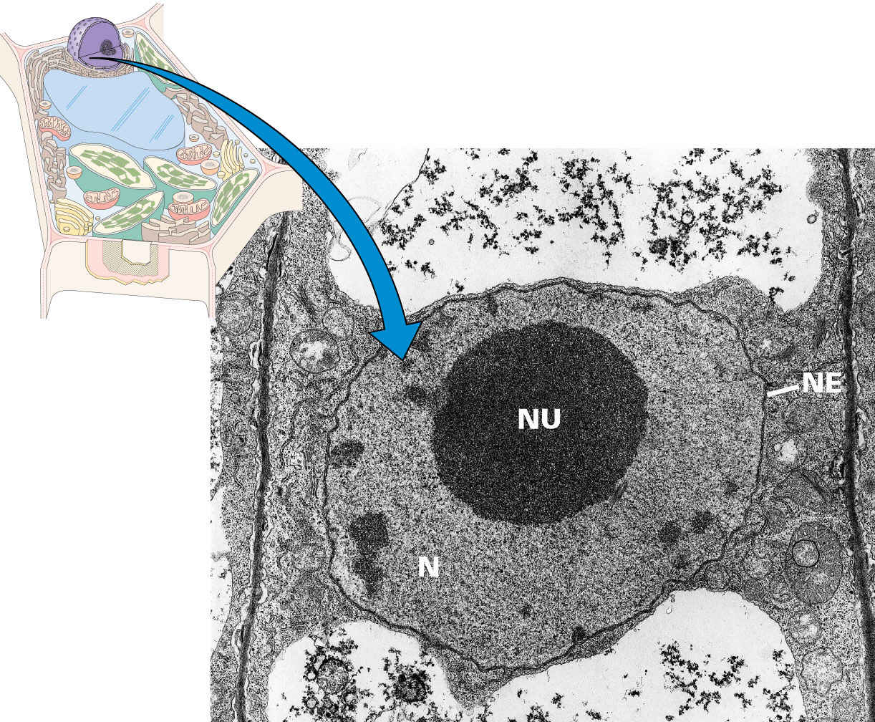
The nucleus contains most of the cell's genetic
information and serves as the center of regulatory activity

Slide 3
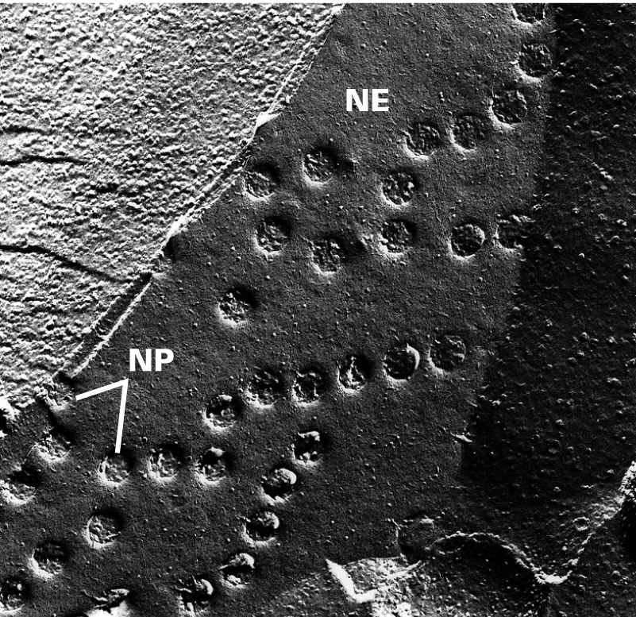
The nucleus is enclosed in a nuclear envelop

Slide 4
A typical interphase plant cell nucleus contains one to
several nucleoli lying free in the nuclear matrix
The nuclear envelope is a dynamic structure
with many functions
The nucleus is bounded by an envelope consisting
of two bilayer membranes separated by a lumen,
the perinuclear space

Slide 5
The envelope separates the genetic material in the nucleus
from protein synthesis in the cytoplasm and controls
nucleocytoplasmic exchange by means of highly complex
nuclear pores
The outer membrane of the nuclear envelope is continuous
with membranes of the ER through narrow connections
and resembles the ER in having functional ribosomes
on its cytoplasmic face

Slide 6
Nuclear pore complexes function both as molecular
sieves and as active transporters
In plant cells pores occupy 8-20% of the envelope surface
at a pore density of 6 to 25/μm²
Each pore consists of an elaborate macromolecular
assemblage known as the nuclear pore complex
Nuclear pore complexes appear generally similar in size
and architecture throughout the plant and animal kingdoms

Slide 7
A nuclear pore complex measures 120 nm in depth,
with a pore diameter of 50 nm
The complex has a total protein mass of 124 MDa and
contains approximately 120 different kinds of proteins,
called nucleoporins
A nuclear pore complex has octagonal symmetry
about a central axis

Slide 8
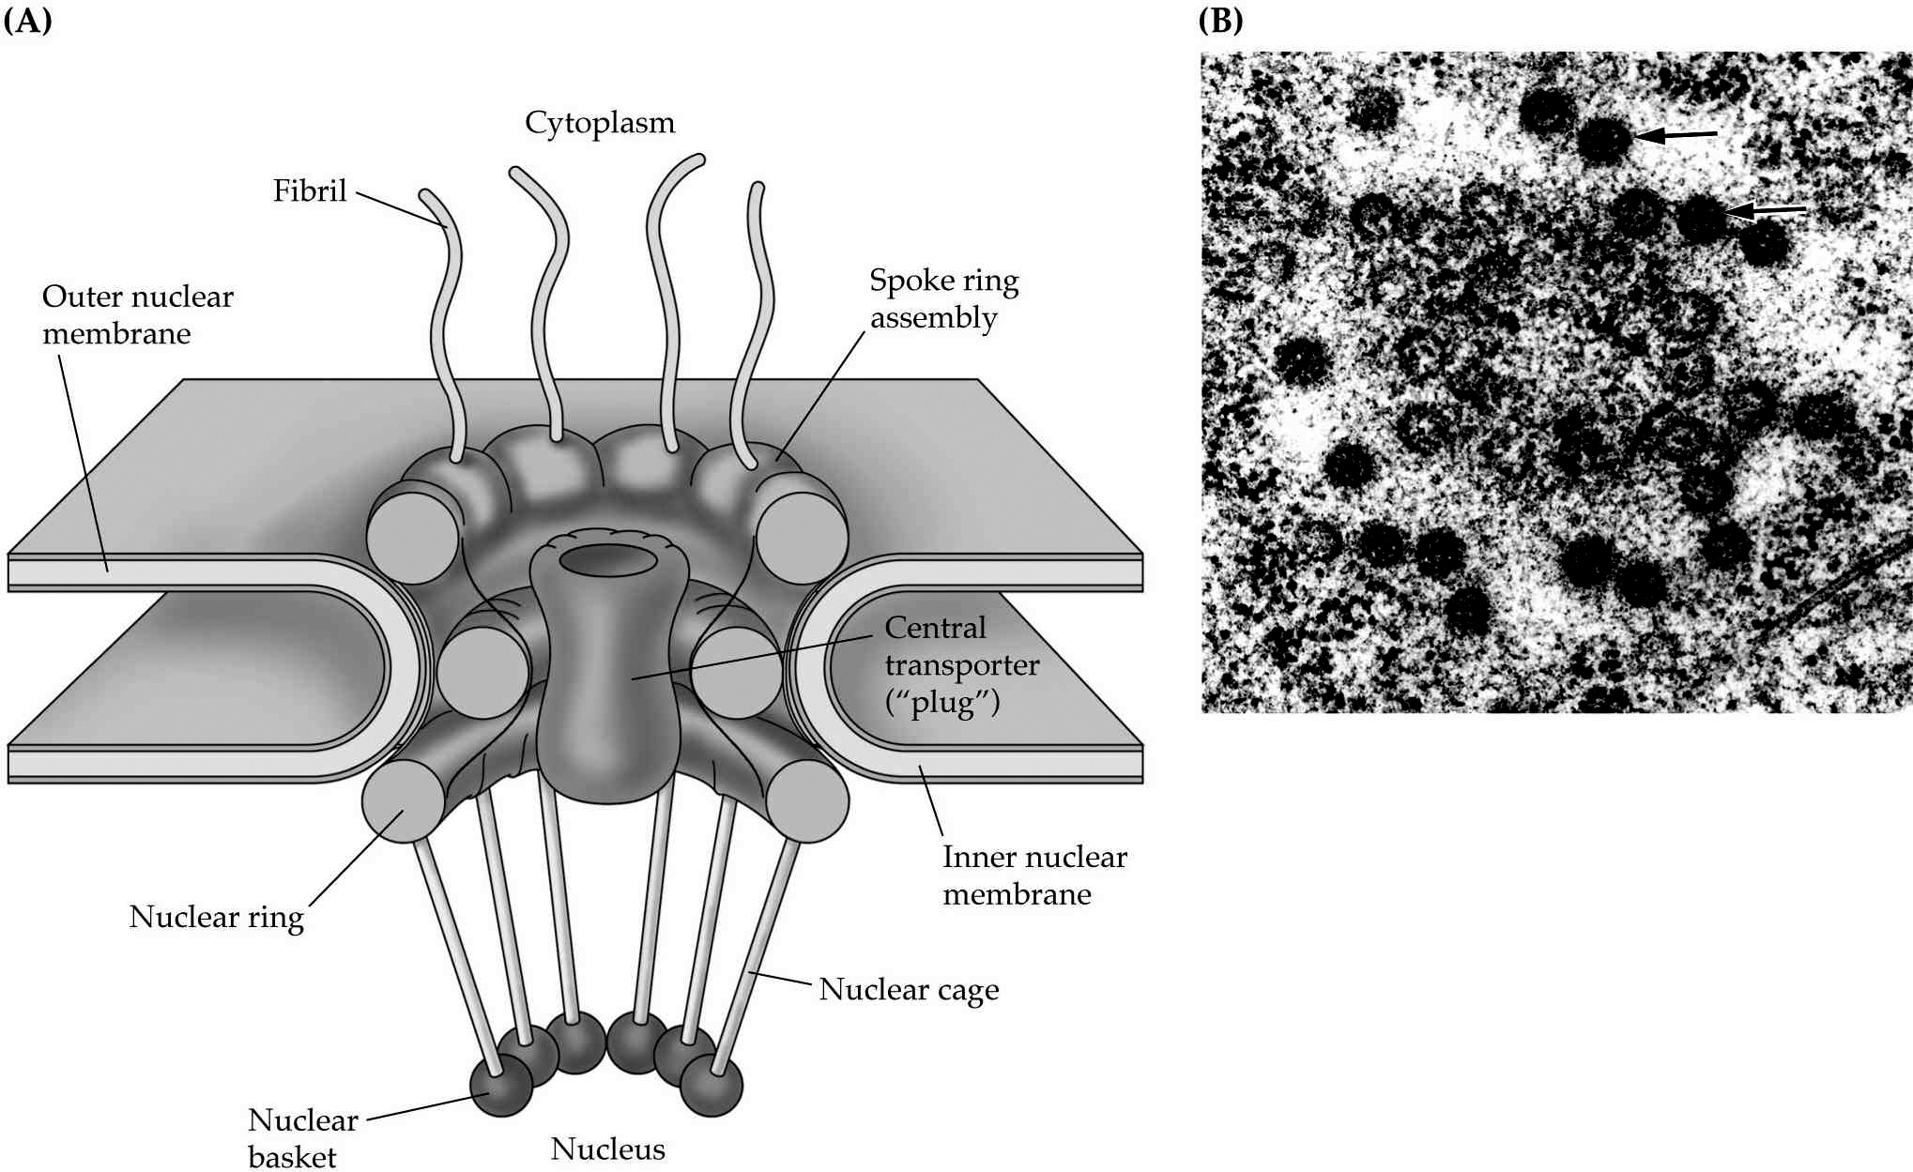
Organization of the nuclear envelop

Slide 9
Eight peripheral, aqueous channels, each 9 nm in diameter,
permit free diffusion of small molecules
A larger, regulated, central channel functions in the active
transport of proteins and RNA molecules
This central channel contains a particle 35 nm in diameter
called the "plug"
Proteins in the cytoplasm can gain access to the nucleus
only if they contain a
nuclear localization signal
sequence of ammo acids

Slide 10
An additional signal is apparently needed for exit from the nucleus
Energy in the form of ATP is required to transport most
proteins or particles through the central channel in either direction

Slide 11
The nucleolus, a prominent organelle in the
interphase nucleus, is the ribosome factory of the cell
Although the nucleolus is not membrane-bounded, it is a distinct
organelle forming a highly specialized region of the nucleus
A product of active ribosomal genes, the nucleolus that
contains more than 100 different proteins and nucleic acids

Slide 12
It is responsible for transcribing ribosomal DNA
Processing ribosomal RNA transcripts
And assembling ribosomal RNA and imported ribosomal
proteins into ribonucleoprotein subunits for transport
to the cytoplasm

Slide 13
The nucleolus

Slide 14
The nucleolus contains three sub-structures
1-One or more fibrillar centers, in which ribosomal transcription
is believed to take place
2- Dense fibrillar components surrounding the centers,
where the ribosomal RNA transcripts are processed
3- Granular component that surrounds the entire fibrillar region

Slide 15
During mitosis, the nuclear envelope disassembles
into vesicles that participate in the formation of
new envelopes around the daughter nuclei.
Read this

