Slide 1
The nucleus continued

Slide 2
The DNA of a eukaryotic nucleus does not exist in the form of naked molecules simply lying free in the nucleoplasm
The DNA is always associated with a range of proteins, and this complex is the chromatin of the nucleus
The proteins fall into two groups. The histones are basic proteins, whilst the non-histone proteins are more diverse

Slide 3
The histones may be classified into five major fractions. These are called
HI, H2A, H2B, H3 and H4
Sequence determinations of histones from different sources have shown that they are characterized by great stability in terms of their chemical composition throughout the plant and animal kingdoms
Thus H4 from peas and from calf differ by only two amino acids

Slide 4
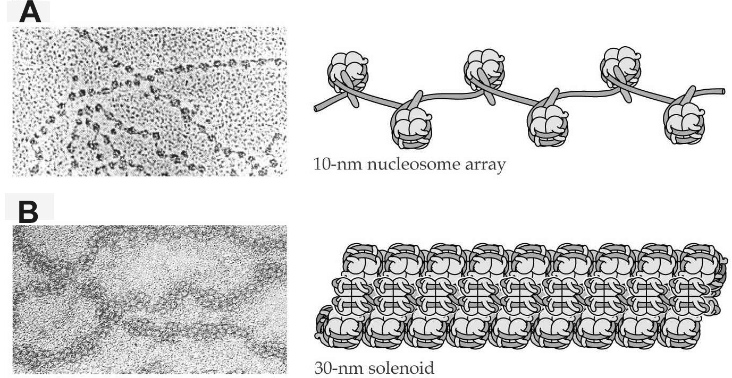
Organization of eukaryotic genetic material

Slide 5
The nucleosome consists of a complex of eight histone molecules (two of each, except HI) acting as a core for the winding of 1.75 turns of DNA
Each nucleosome therefore consists of a nucleoprotein particle joined to its neighbors by a short link
The DNA associated with the particle is about 146 base pairs long, and the linker region is variable in length, up to 100 or so base pairs
Histone HI is thought to be associated with the linker region

Slide 6
Higher degrees of organization of chromatin are necessary to account for the ability of the DNA, up to 10 m in length, to be accommodated in a functional state within the space of the nucleoplasm
The fundamental 10 nm fibril (the beads on a string structure of nucleosomes and linker regions) is thought to be wound into a 'solenoid' structure with a diameter of about 30 nm
These single coils are then themselves wound into supercoils

Slide 7
Cell division

Slide 8
The visible events of cell division are mitosis and cytokinesis
Mitosis involves the condensation and ordered movement of chromosomes, and has been well studied both at the light microscope level and using the electron microscope.
Cytokinesis is the partitioning of the cytoplasm, which takes place by the formation of a new cell wall

Slide 9
The cell cycle

Slide 10
The process of cell division is cyclic; that is, after a certain period of time, the cell is returned to a starting point
Most of the time cells are at the stage of interphase
Interphase is the stage in the cycle when the chromosomes are not condensed, and when most of the net synthesis required for the formation of new cells takes place
Interphase itself consists of three stages, G1 (a gap, during which no DNA synthesis occurs), S (the replication phase of DNA) and G2 (a second gap)

Slide 11
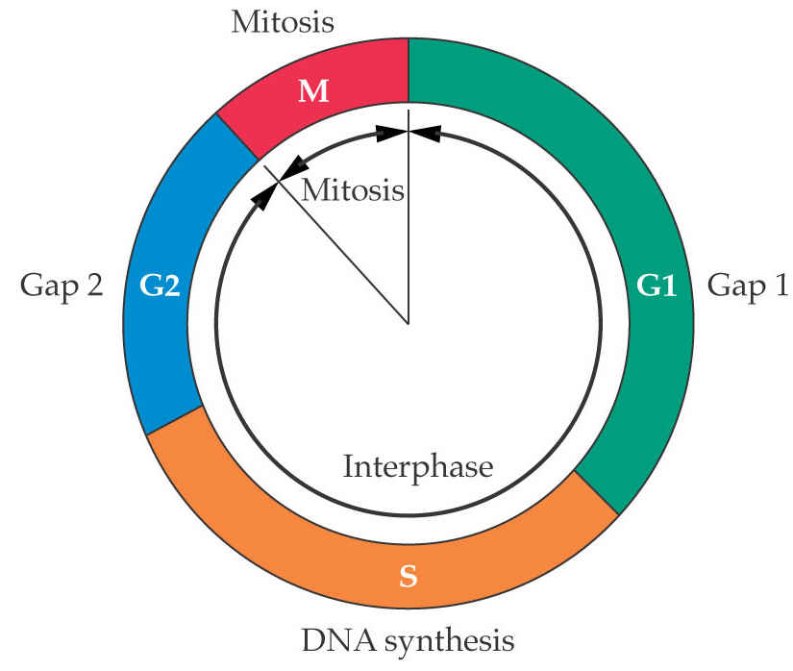
Stages of the cell cycle

Slide 12
Commonly interphase accounts for about 90% of the total cycle time, with S taking up half of the interphase period.
Why ?

Slide 13
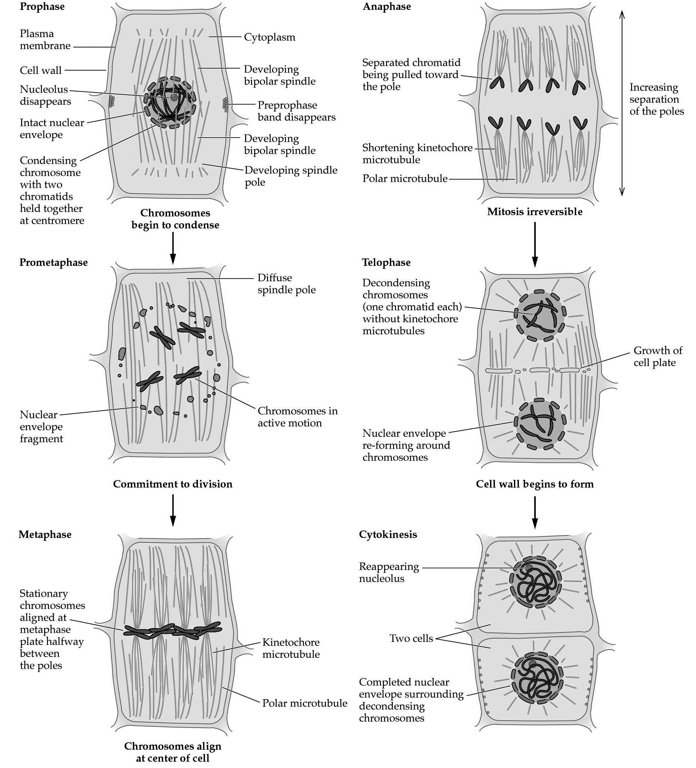

Slide 14
Meisosis occurs in two steps. The first is reduction division while the second in a normal mitotic division
It occurs in reproductive tissues leading to production of gametes with half the chromosome number of the organism.

Slide 15
Mitosis
Meiosis
Comparison of mitosis and meiosis

Slide 16
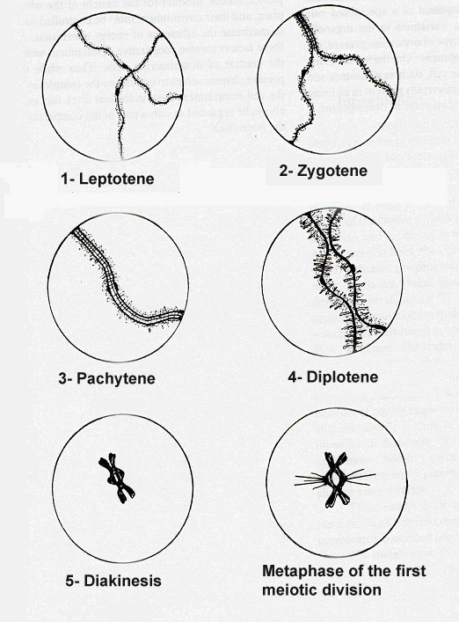

Slide 17
