Slide 1
Dr. Rasha Abou Samra
A geographic information system (GIS)

Slide 2
PROJECTED COORDINATE SYSTEMS
Although Earth images and map data that you use are typically rendered onto flat surfaces (such as your computer screen or a sheet of paper), the Earth’s surface obviously is not flat.
Because Earth has a curving, not-quite sphericial shape, planar maps of all but the smallest areas contain significant geometric distortions of shapes, areas, distances, or angles.

Slide 3
In order to produce two-dimensional maps that preserve geographic relationships and minimize particular types of distortion, several steps are required.
We must choose a geometric model (known as a geodetic datum) that closely approximates the shape of the Earth, yet can be described in simple mathematical terms.
We must also adopt a coordinate system for referencing geographic locations in the mapping plane.
Finally we must choose an appropriate mathematical method of transferring locations from the idealized Earth model to the chosen planar coordinate system: a map projection.

Slide 4
A coordinate system, datum, and map projection are all components of the coordinate reference system for a spatial object.
Map projection is 3D surface is transformed to create a flat surface.
This transformation, usually by a mathematical conversion, is commonly referred to as map projection
A 2D surface is imagined around the Earth and is referred as projection surface

Slide 5
A projected coordinate system is defined on a flat, two-dimensional surface.
A projected coordinate system, unlike a geographic one, has the advantage that lengths, angles, and areas are constant across the two dimensions.
A projected coordinate system is always based on a geographic coordinate system that can use a sphere or spheroid.

Slide 6
In a projected coordinate system, locations are identified by x,y coordinates on a grid, with the origin at the center of the grid.
Each position has two values referencing it to that central location. One specifies its horizontal position and the other its vertical position.
The two values are called the x-coordinate and y-coordinate. Using this notation, the coordinates at the origin are x = 0 and y = 0.

Slide 7
On a gridded network of equally spaced horizontal and vertical lines, the horizontal line in the center is called the x-axis and the central vertical line is called the y-axis.
Horizontal lines above the origin and vertical lines to the right of the origin have positive values; those below or to the left are negative.
The four quadrants represent the four possible combinations of positive and negative x and y-coordinates.

Slide 8
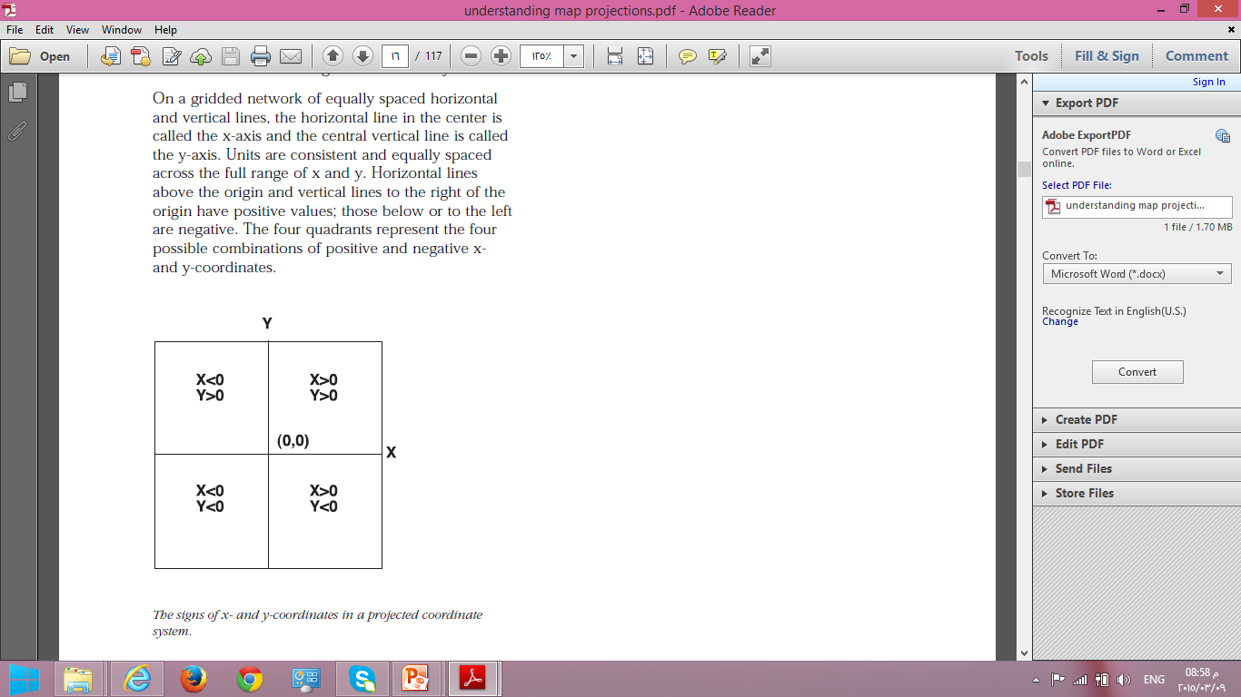

Slide 9
Whether you treat the earth as a sphere or as a spheroid, you must transform its three-dimensional surface to create a flat map sheet. This mathematical transformation is commonly referred to as a map projection.
A spheroid can’t be flattened to a plane any easier than flattening a piece of orange peel—it will rip.
Representing the earth’s surface in two dimensions causes distortion in the shape, area, distance, or direction of the data.

Slide 10
Different projections cause different types of distortions.
Some projections are designed to minimize the distortion of one or two of the data’s characteristics.
A projection could maintain the area of a feature but alter its shape.
The diagram on the next page shows how three-dimensional features are compressed to fit onto a flat surface.

Slide 11
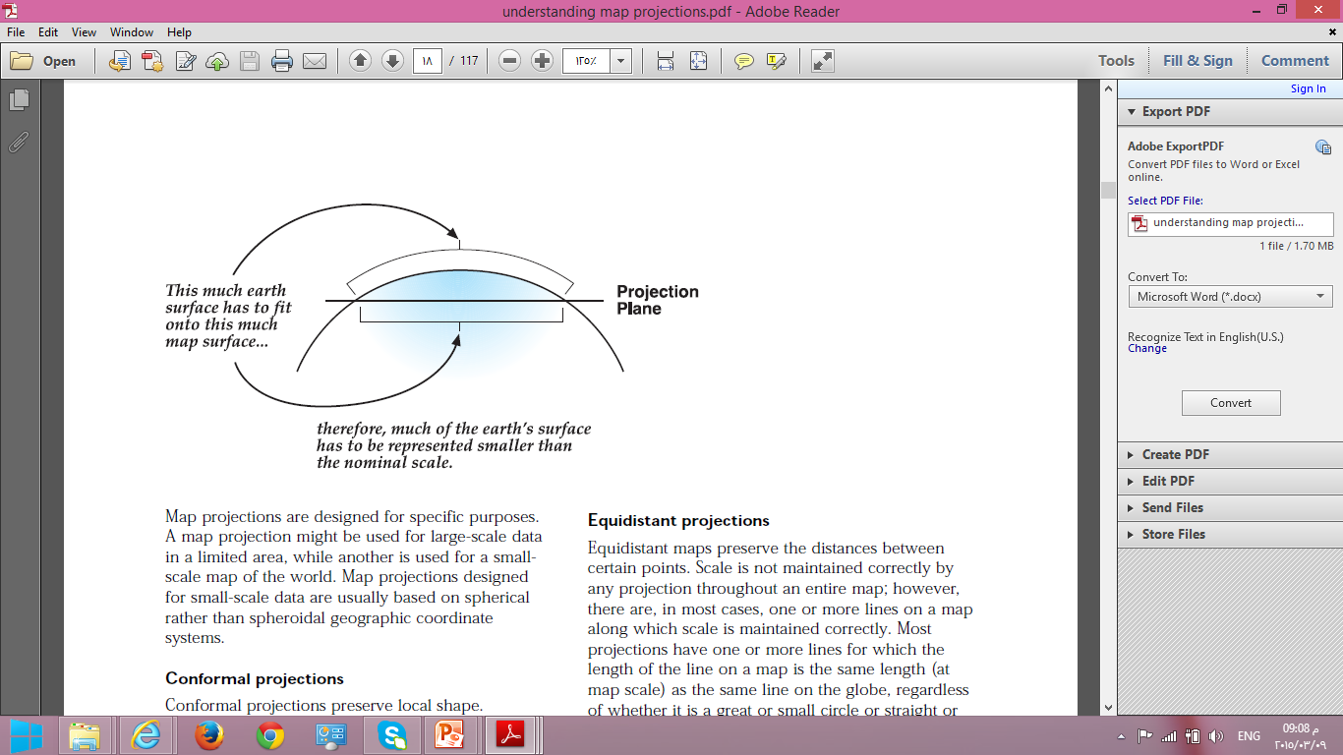

Slide 12
Conformal projections
preserve local shape. Graticule lines on the globe are perpendicular. To preserve individual angles describing the spatial relationships, a conformal projection must show graticule lines intersecting at 90-degree angles on the map.
This is accomplished by maintaining all angles. The drawback is that the area enclosed by a series of arcs may be greatly distorted in the process. No map projection can preserve shapes of larger regions.

Slide 13
Equal area projections
preserve the area of displayed features. To do this, the other properties of shape, angle, and scale are distorted.
In equal area projections, the meridians and parallels may not intersect at right angles.
In some instances, especially maps of smaller regions, shapes are not obviously distorted, and distinguishing an equal area projection from a conformal projection may prove difficult unless documented or measured.

Slide 14
Equidistant projections
Equidistant maps preserve the distances between certain points.
Scale is not maintained correctly by any projection throughout an entire map; however, there are, in most cases, one or more lines on a map along which scale is maintained correctly.

Slide 15
True- direction
or azimuthal projections maintain some of the great circle arcs, giving the directions or azimuths of all points on the map correctly with respect to the center.
Some true-direction projections are also conformal, equal area, or equidistant.

Slide 16
PROJECTION TYPES
Because maps are flat, some of the simplest projections are made onto geometric shapes that can be flattened without stretching their surfaces.
Common examples are cones, cylinders, and planes.
The first step in projecting from one surface to another is to create one or more points of contact. Each contact is called a point (or line) of tangency. the contact point or lines are significant because they define locations of zero distortion.
Lines of true scale are often referred to as standard lines. In general, distortion increases with the distance from the point of contact.

Slide 17
Conic projections
Projects a globe onto a cone
In simplest case, globe touches cone along a single latitude line, or tangent, called standard parallel.
Other latitude lines are projected onto cone .
To flatten the cone, it must be cut along a line of longitude
the opposite line of longitude is called the central meridian

Slide 18
Projection is most accurate where globe and cone meet—at the standard parallel.
Distortion generally increases north or south of it, so poles are often not included.
Conic projections are typically used for mid- latitude zones with east-to-west orientation. They are normally applied only to portions of a hemisphere (e.g. North America)

Slide 19
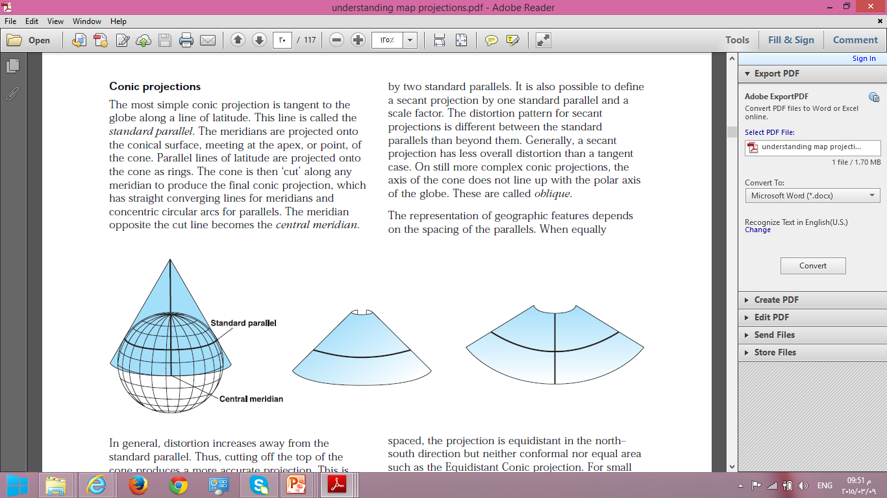

Slide 20
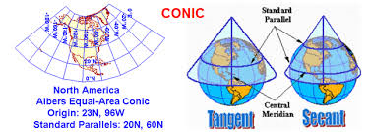

Slide 21
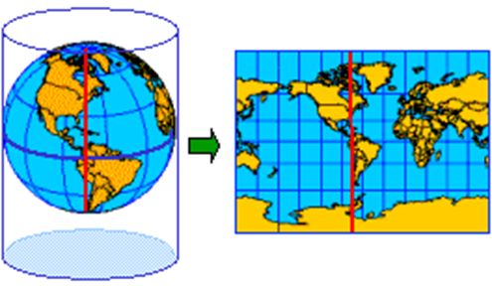
Cylindrical projections
Created by wrapping a cylinder around a globe
The meridians in cylindrical projections are equally spaced, while the spacing between parallel lines of latitude increases toward the poles,

Slide 22
Cylindrical Map Types
Tangent to great circle: in the simplest case, the cylinder is North-South, so it is tangent (touching) at the equator; this is called the standard parallel and represents where the projection is most accurate.
If the cylinder is smaller than the circumference of the earth, then it intersects as a secant in two places.
Secant projections are more accurate because projection is more accurate the closer the projection surface is to the globe and when the projection surface touches twice, that means it is on average closer to the globe

Slide 23
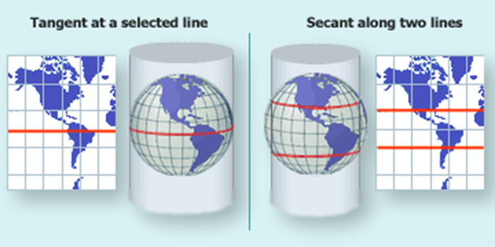

Slide 24
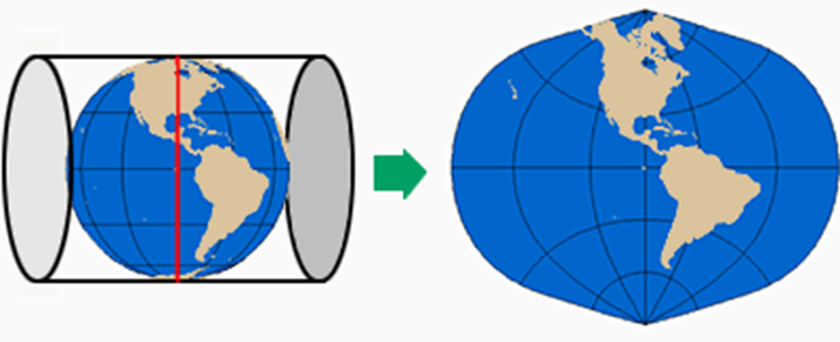
Transverse cylindrical projections: in this type the cylinder is turned on its side so it touches a line of longitude; these can also be tangent

Slide 25
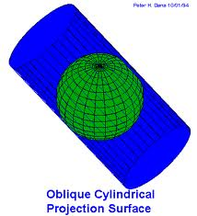
Oblique cylinders are rotated around a great circle line located anywhere between the equator and the meridians.

Slide 26
North-south cylindrical Projections cause major distortions in higher latitudes because those points on the cylinder are further away from the corresponding point on the globe.

Slide 27
Planar projections
Planar projections project map data onto a flat surface touching the globe.
A planar projection is also known as an azimuthal projection or a zenithal projection.
This type of projection is usually tangent to the globe at one point but may be secant.
The point of contact may be the North Pole, the South Pole, a point on the equator, or any point in between.
This point specifies the aspect and is the focus of the projection. The focus is identified by a central longitude and a central latitude.
Possible aspects are polar, equatorial, and oblique.

Slide 28
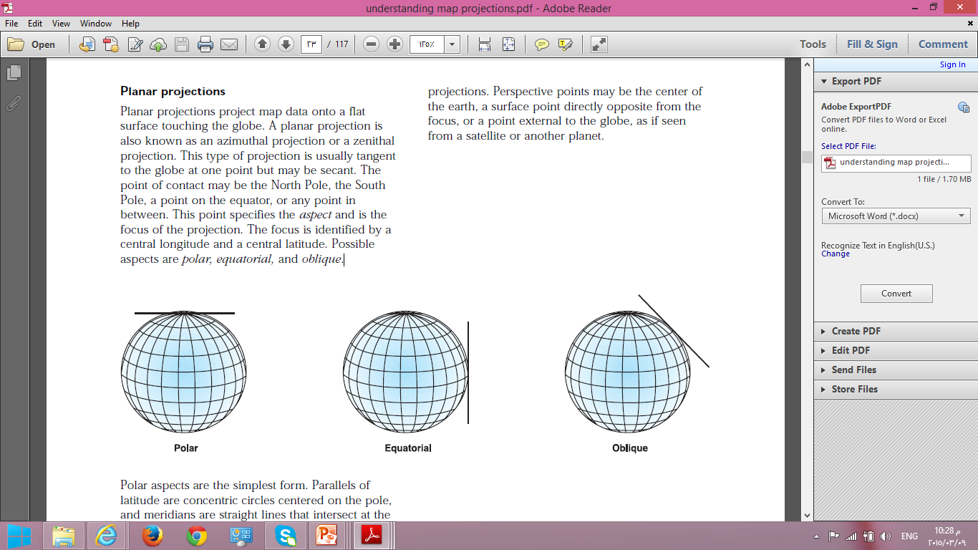

Slide 29
project a globe onto a flat plane
The simplest form is only tangent at one point
Any point of contact may be used but the poles are most commonly used
When another location is used, it is generally to make a small map of a specific area
Because the area of distortion is circular around the point of contact, they are best for mapping roughly circular regions, and hence the poles

Slide 30
UTM coordinate system
The Universal Transverse Mercator coordinate system is an international locational reference system that depicts the Earth's three-dimensional surface in a relatively-accurate, two-dimensional manner.
Universal Transverse Mercator is a global coordinate system that is defined in meters rather than degrees-minutes-seconds.

Slide 31
A Mercator projection is a ‘cylindrical’ conformal projection (it preserves shape).
It relies on the meter unit of measure, and allows users to accurately and unambiguously identify geographical locations anywhere on the Earth's surface between the northern limits of North America (84 degrees north latitude) and the southern limits of continent of Antarctica (80 degrees south latitude).

Slide 32
The remaining north and south polar regions are not included in the UTM coordinate system due to extreme projection distortions in the UTM grid.

Slide 33
The UTM zones and grid
The UTM system depicts the Earth's three-dimensional surface as a flat, two-dimensional plane by dividing its surface into 60 equally-spaced vertical planes known as zones, or world zones. Sequentially-numbered 1 through 60, from west to east.
The first zone begins at the International Date Line (180°, using the geographic coordinate system). The zones are numbered from west to east, so zone 2 begins at 174°W and extends to 168°W. The last zone (zone 60) begins at 174°E and extends to the International Date Line (180°E) .

Slide 35
The world-wide grid for the UTM coordinate system consists of parallel-running vertical (easting) lines and parallel-running horizontal (northing) lines, each of which is spaced exactly 1,000 meters (1 kilometer) apart, to form 1,000-meter squares.
The UTM grid divides the world into 60 north-south zones; the zones are numbered 1-60 . Each zone is 6 degrees wide in longitude.

Slide 36
The zones are then further subdivided into an eastern and western half by drawing a line, representing a transverse Mercator projection, down the middle of the zone. This line is known as the ‘central meridian’ and is the only line within the zone that can be drawn between the poles and be perpendicular to the equator.
UTM uses two coordinates – easting and northing – to determine a location. Locations within a zone are measured in meters east and west from the central meridian, and north and south from the equator .

Slide 38
Easting coordinate
The central meridian is an arbitrary line drawn down the center of each zone, and given a false easting value of 500,000 meters.
By definition the Central Meridian is assigned a false easting of 500,000 meters. Any easting value greater than 500,000 meters indicates a point east of the central meridian. Any easting value less than 500,000 meters indicates a point west of the central meridian.

Slide 39
Each zone at its widest point cannot exceed 999,999 meters.
Northing coordinate
Northing is the distance in meters north and south of the equator (measured along a zone line).
If the point lies north of the equator, coordinates always increase from south to north (bottom of map to the top) of the equator, with the equator given a value of 0 meters. For locations south of the equator, the equator is given a false value of 10,000,000 meters and values decrease from north to south.

Slide 40
Example: This coordinate – 19 0297480E 4834360N – describes a location in New Hampshire.

Slide 41
The coordinate 0297480E represents an east-west measurement and is the easting. This coordinate is located 202520 meters west of the 19th zone’s central meridian line. This number – 202520 meters – was calculated by subtracting the value of 297480 from the false value for the central meridian, which is designated as 500000.
The location of this coordinate is 202 thousand, 520 meters west of the 19th zones central meridian line and 4 million, 834 thousand, 360 meters north of the equator.

Slide 42
The coordinate 4834360N represents a north-south measurement and is the northing. The location of this coordinate is 4,834,360 meters north of the equator in zone 19.

Slide 43
ESRI vector formats:
Shapefiles -- The shapefile format is a popular geospatial vector data format for geographic information system (GIS) software. It is developed and regulated by Esri as a (mostly) open specification for data interoperability among Esri and other GIS software products.
.shx, .shp .dbf

Slide 44
shp — shape format; the feature geometry itself
.shx — shape index format; a positional index of the feature geometry to allow seeking forwards and backwards quickly
.dbf — attribute format; columnar attributes for each shape, in dBase IV format
ArcInfo Coverage -- store all attribute in an “info” folder, and all spatial features, e.g. points, arc, label , points, polygons, routes, regions, and annotation in the space called coverage.
Geodatabase – contains features class, feature datasets, tables, annotation, relationships.

Slide 45
ESRI Raster formats:
• ArcInfo Grid
• ERDAS Imagine -- .img files
• .jpeg, .tiff
• MrSid -- .sid
• TIN (3D data model)
•Import files –DEM
•remotely sensed images (Landsat) , aerial photographs

Slide 46
ArcCatalog
is part of a GIS software package manufactured by ESRI. ArcCatalog allows you to examine and organize different types of geographic data. Using ArcMap you can incorporate information from ArcCatalog into a map.

