Slide 1

CIRAMICS

Slide 2
Factors that Determine Crystal Structure
1. Relative sizes of ions – Formation of stable structures:
--maximize the # of oppositely charged ion neighbors.
-
-
-
-
-
-
+
+
+
-
-
-
-
-
-
unstable
stable
stable
2. Maintenance of
Charge Neutrality :
--Net charge in ceramic
should be zero.
--Reflected in chemical
formula:
F
-
Ca
2+
CaF
2
:
+
anions
cation
F
-
A
m
X
p
m, p values to achieve charge neutrality

Slide 3
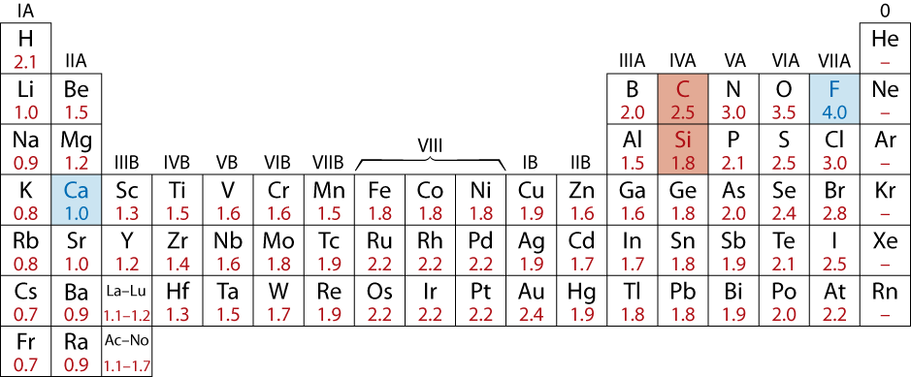
Atomic Bonding in Ceramics
• Bonding:
-- Can be ionic and/or covalent in character.
-- % ionic character increases with difference in
electronegativity of atoms.
• Degree of ionic character may be large or small:
CaF₂: large
SiC: small

Slide 4
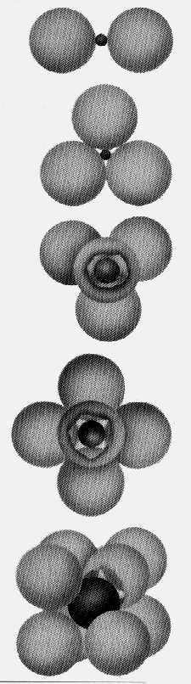
Coordination # and Ionic Radii
r
• Coordination number increases with
cation
r
anion
To form a stable structure, how many anions can surround a cation?
r
cation
Coord
#
ZnS
r
anion
(zinc blende)
< 0.155
2
linear
0.155 - 0.225
3
triangular
NaCl
(sodium
0.225 - 0.414
4
tetrahedral
chloride)
0.414 - 0.732
6
octahedral
CsCl
(cesium
chloride)
0.732 - 1.0
8
cubic

Slide 5
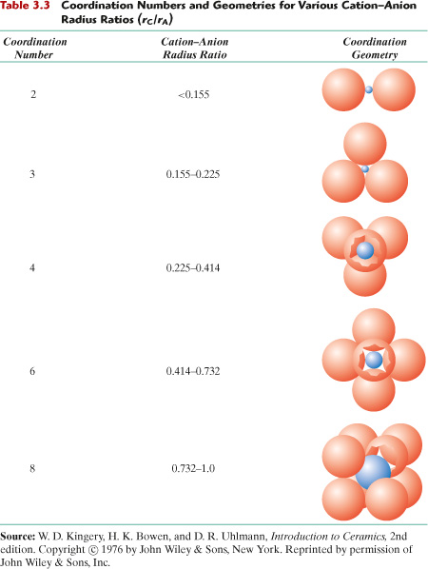
c03tf03

Slide 6
Computation of Minimum Cation-Anion Radius Ratio
Determine minimum r_{cation}/r_{anion} for an octahedral site (C.N. = 6)
a
Measure the radii (blue and yellow spheres)
a = 2r_{anion}
Substitute for “a” in the above equation

Slide 7
Example Problem: Predicting the Crystal Structure of FeO
• On the basis of ionic radii, what crystal structure would you predict for FeO?
Cation
Ionic radius (nm)
• Answer:
Al
3+
0.053
Fe
2
+
0.077
Fe
3+
0.069
Ca
2+
0.100
based on this ratio,
-- coord # = 6 because
0.414 < 0.550 < 0.732
-- crystal structure is similar to NaCl
Anion
O
2-
0.140
Cl
-
0.181
F
-
0.133

Slide 8
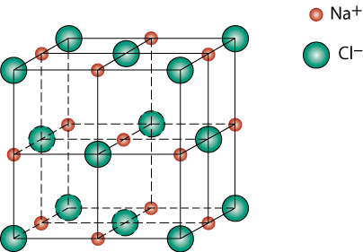
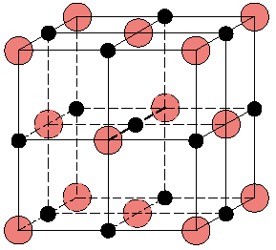
Rock Salt Structure
Same concepts can be applied to ionic solids in general.
Example: NaCl (rock salt) structure
r_{Na} = 0.102 nm
r_{Cl} = 0.181 nm
r_{Na}/r_{Cl} = 0.564
cations (Na⁺) prefer octahedral sites

Slide 9

MgO and FeO
MgO and FeO also have the NaCl structure
O²⁻ r_{O} = 0.140 nm
Mg²⁺ r_{Mg} = 0.072 nm
r_{Mg}/r_{O} = 0.514
cations prefer octahedral sites
So each Mg²⁺ (or Fe²⁺) has 6 neighbor oxygen atoms

Slide 10
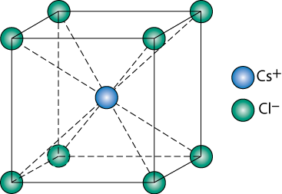
AX Crystal Structures
AX–Type Crystal Structures include NaCl, CsCl, and zinc blende
Cesium Chloride structure:
∴ Since 0.732 < 0.939 < 1.0,
cubic sites preferred
So each Cs⁺ has 8 neighbor Cl⁻

Slide 11
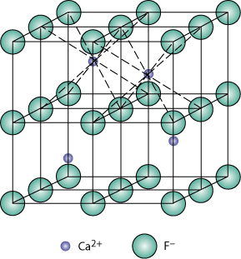
AX₂ Crystal Structures
Fluorite structure
Calcium Fluorite (CaF₂)
Cations in cubic sites
UO_{2,} ThO₂, ZrO₂, CeO₂
Antifluorite structure –
positions of cations and
anions reversed

Slide 12
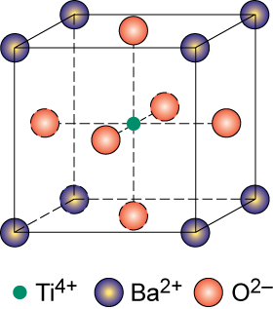
ABX₃ Crystal Structures
Perovskite structure
Ex: complex oxide
BaTiO₃

Slide 13
SUMMARY
• Atoms may assemble into crystalline or amorphous structures.
• Common metallic crystal structures are FCC, BCC and HCP.
Coordination number and atomic packing factor are the same
for both FCC and HCP crystal structures.
• We can predict the density of a material, provided we know the
atomic weight, atomic radius, and crystal geometry (e.g., FCC,
BCC, HCP).
• Interatomic bonding in ceramics is ionic and/or covalent.
• Ceramic crystal structures are based on:
-- maintaining charge neutrality
-- cation-anion radii ratios.

