Slide 1
Rectifiers

Slide 2
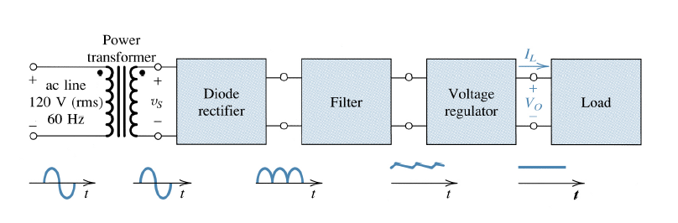
Diodes and Diodes Circuits
Rectifier Circuits
One of the most important applications of diodes is in the design of rectifier circuits. Used to convert an AC signal into a DC voltage used by most electronics.
The Basic DC Power Supply

Slide 3
The Basic DC Power Supply
Transformers changes ac voltages based on the turns ratio between the primary and secondary.
The rectifier converts the ac input voltage to a pulsating dc voltage.
The filter eliminates the fluctuations in the rectified voltage and produces a relatively smooth dc voltage.
The regulator is a circuit that maintains a constant dc voltage for variations in the input line voltage or in the load.

Slide 4
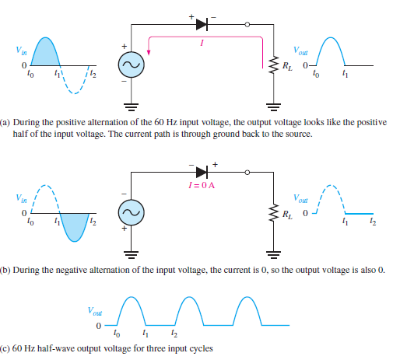
Half wave rectifier operation

Slide 5
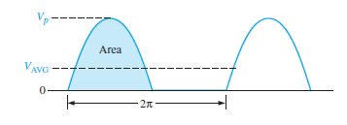

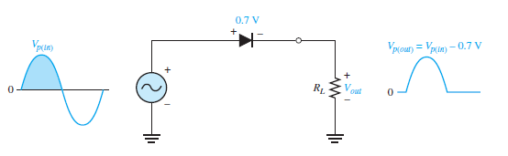

Average Value of the Half-Wave Output Voltage
The average value of the half-wave rectified output voltage is the value you would measure on a dc voltmeter. Mathematically, it is determined by finding the area under the curve over a full cycle,
Effect of the Barrier Potential on the Half-Wave Rectifier Output
The effect of the barrier potential on the half-wave rectified output voltage is to reduce the peak value of the input by about 0.7 V.

Slide 6
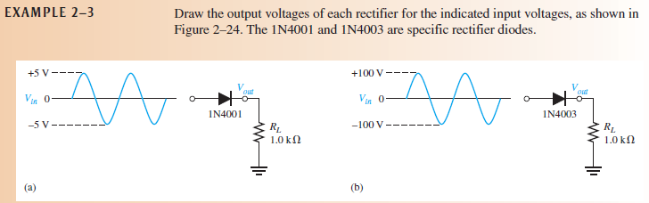
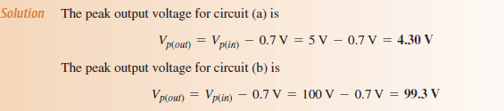


Slide 7

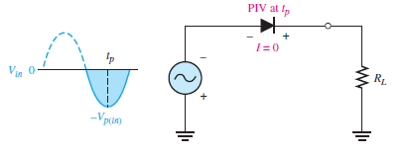
The peak inverse voltage (PIV) equals the peak value of the input voltage,
The PIV occurs at the peak of each half-cycle of the input voltage when the diode is reverse-biased. In this circuit, the PIV occurs at the peak of each negative half-cycle.

Slide 8
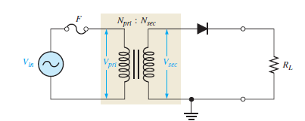

Transformer Coupling
The secondary voltage of a transformer equals the turns ratio, n, times the primary
voltage.
n is “the number of turns in the secondary (N_{sec}) divided by the number of turns in the primary (N_{pri}).
The peak secondary voltage, Vp(sec), in a transformer-coupled half-wave rectifier is written in terms of Vp(sec) as

Slide 9
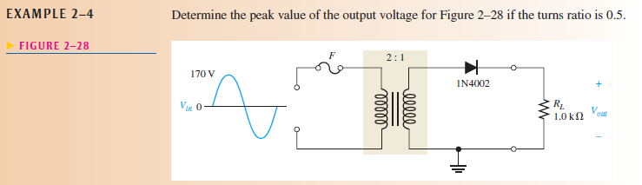
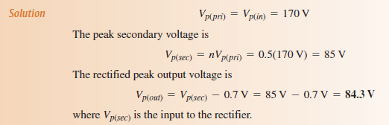

Slide 10
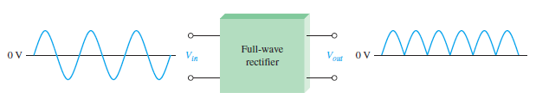
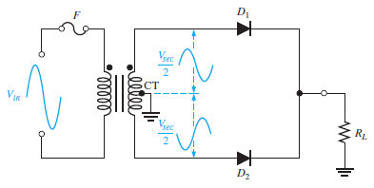
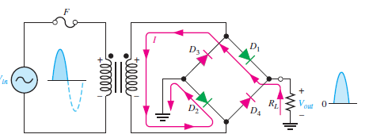
Full wave rectifiers

Slide 11
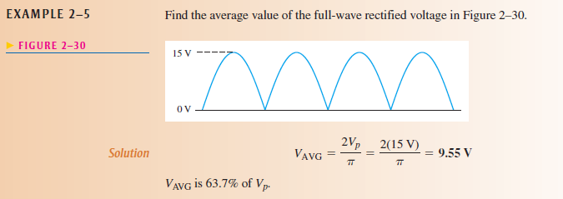

Slide 12
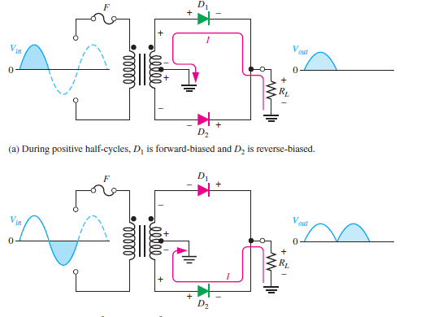
Center-Tapped Full-Wave Rectifier Operation

Slide 13
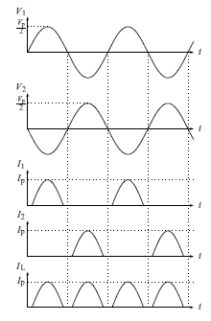
Center-Tapped Full-Wave Rectifier Operation

Slide 14
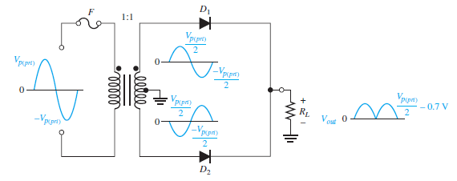


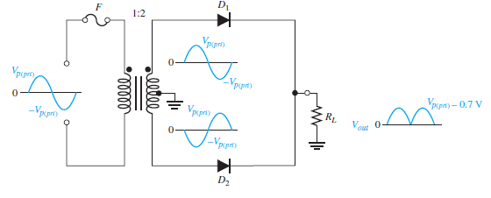


Effect of the Turns Ratio on the Output Voltage

Slide 15
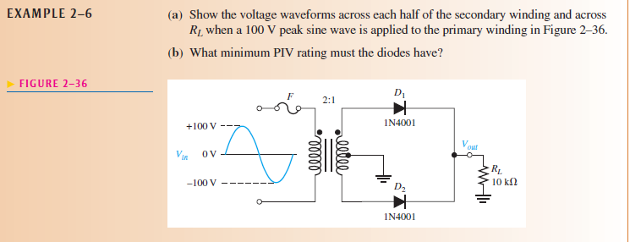
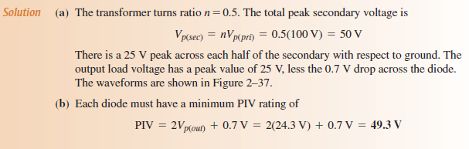
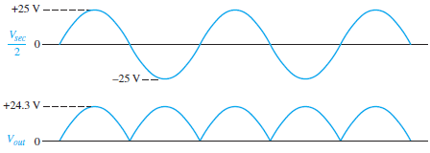

Slide 16
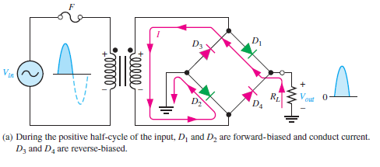
Bridge Full-Wave Rectifier Operation
The bridge rectifier uses four diodes connected as shown in Figure
When the input cycle is positive as in part (a), diodes D1 and D2 are forward-biased and conduct current in the direction shown. A voltage is developed across RL that looks like the positive half of the input cycle. During this time, diodes D3 and D4 are reverse-biased.

Slide 17
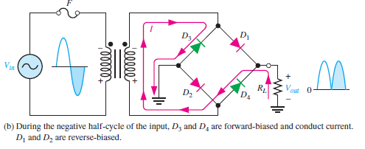
Bridge Full-Wave Rectifier Operation
When the input cycle is negative as in Figure 2–38(b), diodes D3 and D4 are forward biased and conduct current in the same direction through RL as during the positive half-cycle. During the negative half-cycle, D1 and D2 are reverse-biased.
A full-wave rectified output voltage appears across R_{L} as a result of this action.

Slide 18
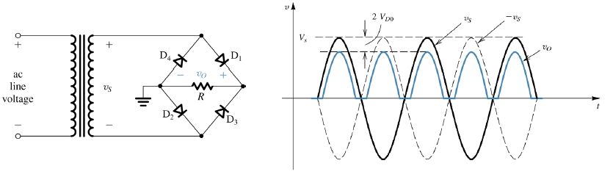
Bridge Rectifier
Looks like a Wheatstone bridge. Does not require a enter tappedtransformer.
Requires 2 additional diodes and voltage drop is double.
Neglecting the diode drops, the secondary voltage appears across the load resistor.
If these diode drops are taken into account, the output voltage is

Slide 19
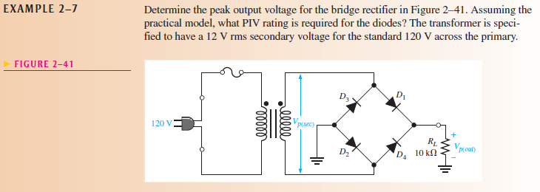
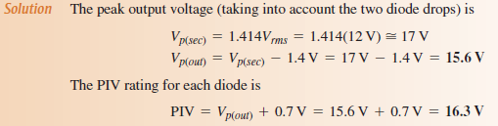

Slide 20
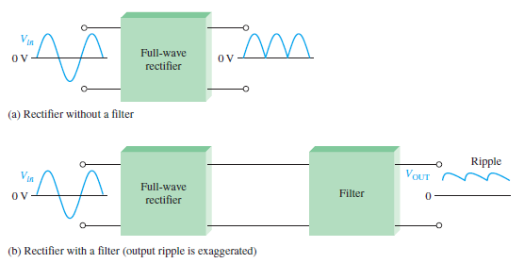
POWER SUPPLY FILTERS AND REGULATORS
The small amount of fluctuation in the filter output voltage is called ripple.

Slide 21
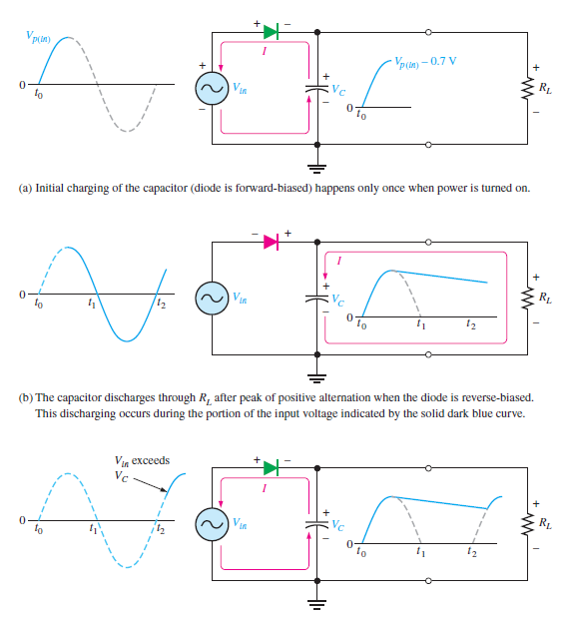
Capacitor-Input Filter

Slide 22
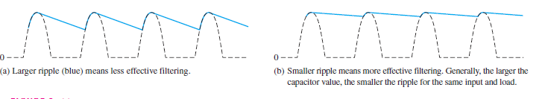
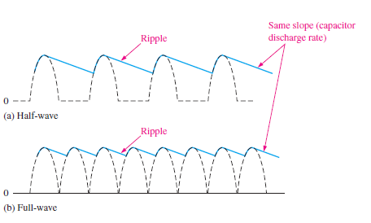
Ripple Voltage
The variation in the capacitor voltage due to the charging and discharging is called the ripple voltage. Generally, ripple is undesirable; thus, the smaller the ripple, the better the filtering action
For a given input frequency, the output frequency of a full-wave rectifier is twice that of a half-wave rectifier, as illustrated in Figure. This makes a full-wave rectifier easier
to filter because of the shorter time between peaks.

Slide 23
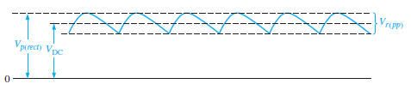

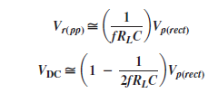
Ripple Factor
The ripple factor (r) is an indication of the effectiveness of the filter and
is defined as
For a full-wave rectifier with a capacitor-input filter, approximations for the peak-to-peak
ripple voltage, V_{r(pp)}, and the dc value of the filter output voltage, V_{DC}, are given in
the following equations. The variable V_{p(rect)} is the unfiltered peak rectified voltage.
Notice that if R_{L} or C increases, the ripple voltage decreases and the dc voltage increases.

