Slide 1
Chapter 12
Amines

Slide 2
Amines
Amines may be considered as derivatives of ammonia, NH₃, in which an alkyl or aryl group has replaced one or more of the hydrogen.
Those amines that carry only alkyl groups are classified as aliphatic amines. Amines that have one or more aryl groups directly attached to the nitrogen are classified as aromatic amines.
Amines are further classified as 1°, 2°, and 3° depending on the number of carbon atoms directly attached to nitrogen.

Slide 3
Nomenclature of Amines:-
In naming amines, the following rules apply:
The simple aliphatic amines are named as alkyl derivatives of ammonia, except that the word ammonia is changed to amine. The name of the alkyl group attached to the nitrogen atom is written first, followed by the ending amine.
        2) When two or three identical alkyl groups are attached to the nitrogen atom, the prefix di- or tri- is added to the name of the amine.
3-When the attached alkyl groups are not identical they are named in order of increasing complexity.

Slide 4
4. If the amine is too complex, the IUPAC system of nomenclature is used. In this system the amino group (-NH₂) is considered the substituent, and its position on the chain is indicated by the lowest possible number

Slide 5
5-Amine salts are named as derivatives of the ammonium ion (NH4+). The alkyl substituents are named first, in increasing order of complexity and are followed by the ending –ammonium. The name of the anion associated with the ammonium ion is then written as a second word.

Slide 6
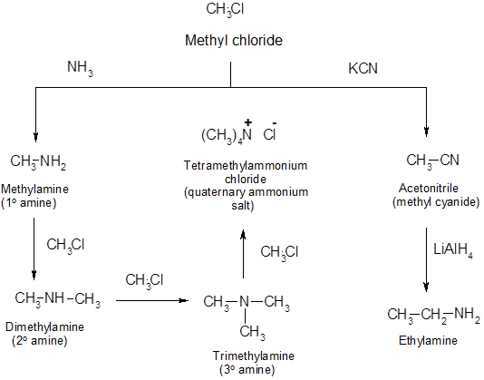
Preparation of Amines:-
1. from alkyl halides:-

Slide 7
2- from the reduction of amides:

Slide 8
Reactions of Amines:-
Because they are bases, amines react with strong mineral acids to form water-soluble alkyl or aryl ammonium salts.
Primary amines react with primary and secondary alkyl halides to give a mixture of secondary amines, tertiary amines, and quaternary ammonium salts.
Amines react with esters, acid anhydrides, or acid chlorides to form amides.

Slide 10
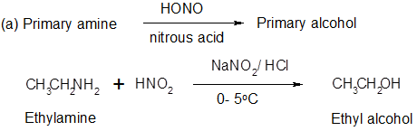
Reaction with Nitrous Acid:
Reaction of nitrous acid with primary aliphatic amines yields nitrogen gas and primary alcohol.

Slide 11
Secondary aliphatic amines react more slowly with nitrous acid than do primary amines.Upon reaction they are converted into water- insoluble, oily, yellow derivatives called nitosoamines

Slide 12
Tertiary aliphatic amines form water soluble amine nitrite salts when treated with nitrous acid. Because of the solubility of the nitrite salt in aqueous solution there is no visible sigin of reaction.

