Slide 1

Seismic Method
Introduction
Lec. I & II
Prof M A OMRAN,
Prof. Of Geophysics,
Faculty of Science,
Damietta University

Slide 2
LECTURE I

Slide 3
Expectations after today’s lecture
Know types of seismic waves
Know the definition of stress & strain and their relationship
Know how to create a seismic wave
Be able to compare between the different types of seismic waves
Have a clue about the generation and recording of seismic wave
Have concepts about the nature of seismic waves
Understand the seismic characters of each type of the seismic wave

Slide 4
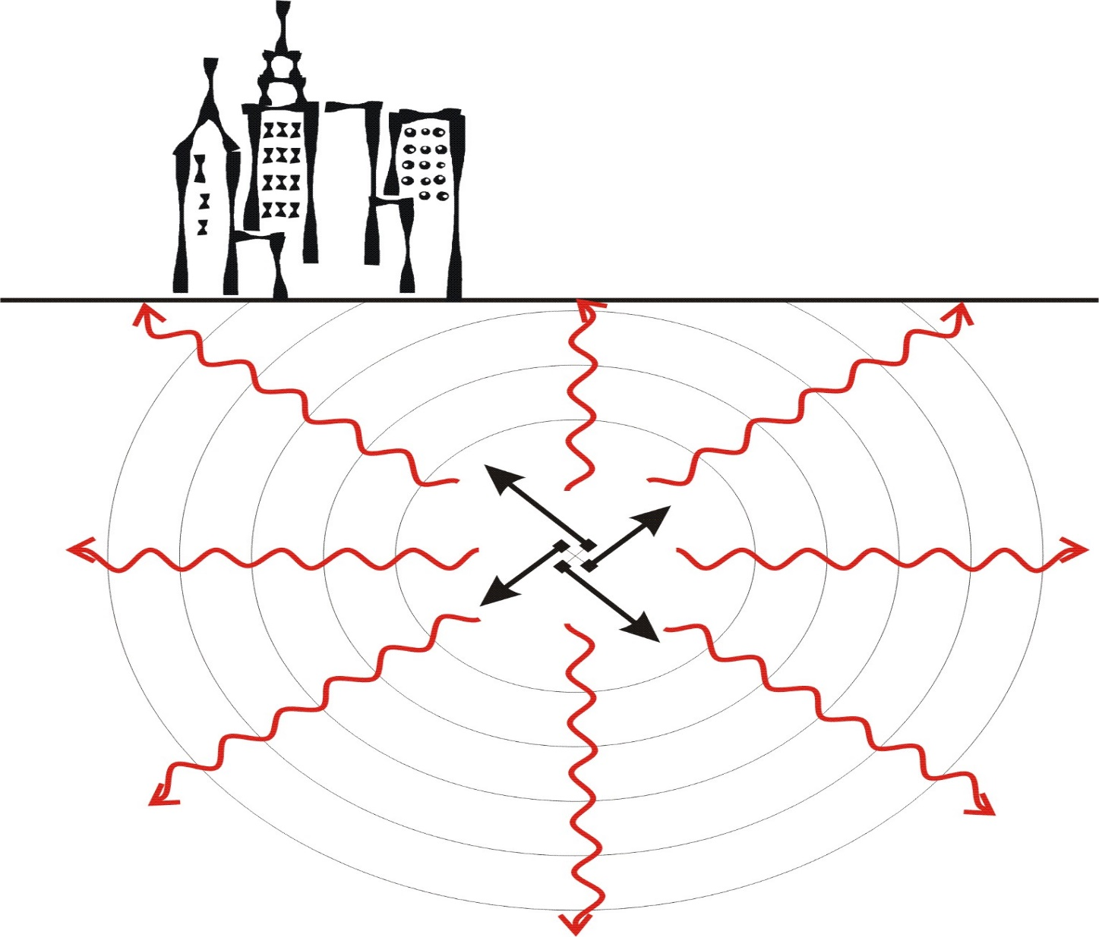
Seismic method

Slide 5
It all starts with a bang; explosion, (OR EARTHQAKE) to produce an expanding compressional wave front, seismic pulse called the source wavelet.
The seismic pulse is transmitted through the rock as elastic wave
The seismic pulse transfer energy by the movement of rock particles.
In seismic surveying, ground movement caused by some source is measured at a variety of distances from the source.

Slide 6
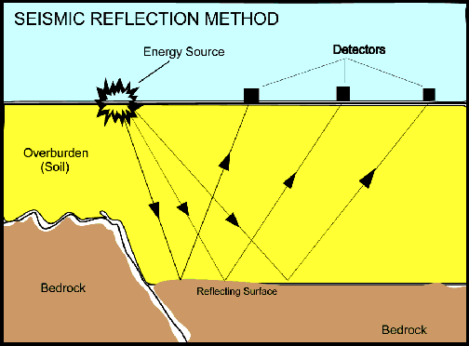

Slide 7
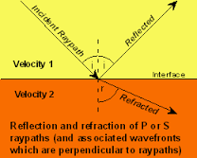
In seismic surveying, seismic waves are created by controlled sources and propagate through the subsurface.
These waves will return to the surface after reflection or refraction at geological boundaries.

Slide 8
Seismic waves are messengers that give us information about the earth interior.
These waves cause the particles of materials to vibrate which means that theses particles are temporarily stretched out of position as they move back and forth.

Slide 9
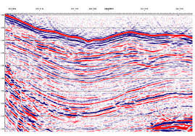
The Seismic method is used in search for oil and gas.
The method is also used for the mapping of near surface sedimentary layers, the location of the water table, engineering application, determination of the depth to bedrock.
Seismic surveying can be carried out at land or at sea.

Slide 10
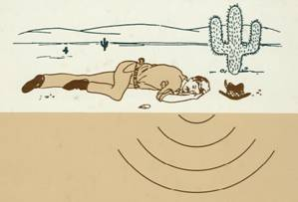
Prof OMRAN

Slide 11
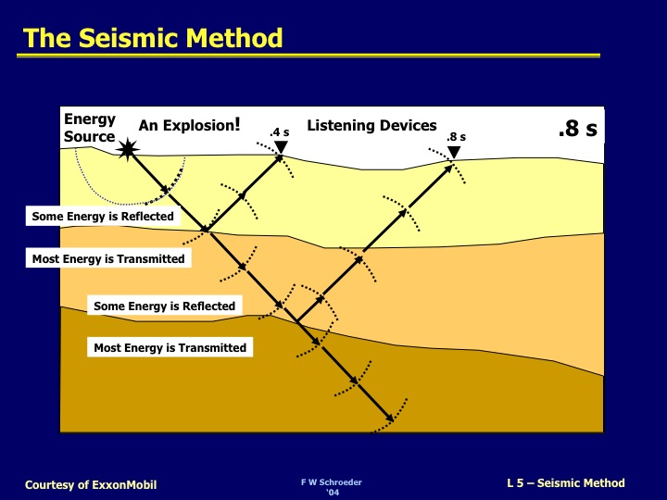

Slide 12
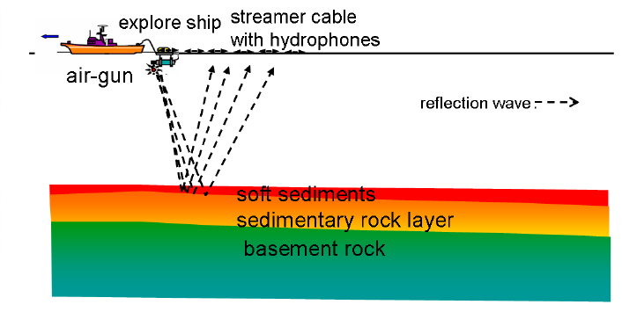

Slide 13
Seismic waves test the extent of the earth by which its materials can be stretched or squeezed.
The capacity of a material to be temporarily deformed by passing seismic waves can be described by its ability to Elasticity.

Slide 14
ELASTICITY
The object can be deformed by different ways;
Stretching
Squeezing
Twisting
Any object can be deformed by applied the force on the side of the object.

Slide 15
STRESS
Any application of the force on the surface of an object is called Stress.
Stress is the force per unit area.
The SI unit of stress is called a Pascal.
Pascal = 1 N/ m2

Slide 16
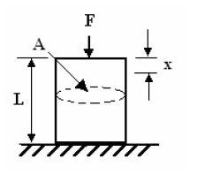
TYPES OF STRESS
There are two different types of stress;
Directed stress in limited direction.
Ex. of directed stress is similar to the force of a hammer striking the head of a nail.

Slide 17
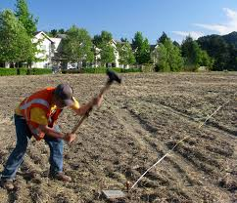

Slide 18
Non-directed stress in all direction (hydrostatic pressure).
Ex. of non-directed stress is similar to an object placed at some depths in a lake, where the water presses against its sides from all directions.

Slide 19
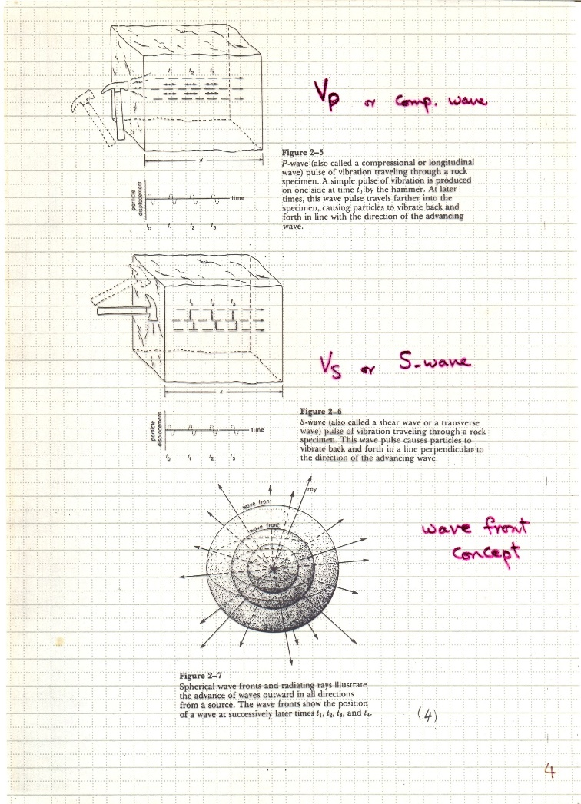

Slide 20
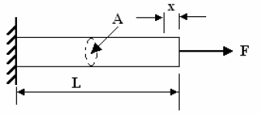
Strain is the deformation of an object by changing its shape and size

Slide 21
KINDS OF STRAIN
There are two different types of strain depend on;
1. Directed stress
2. Non directed stress

Slide 22
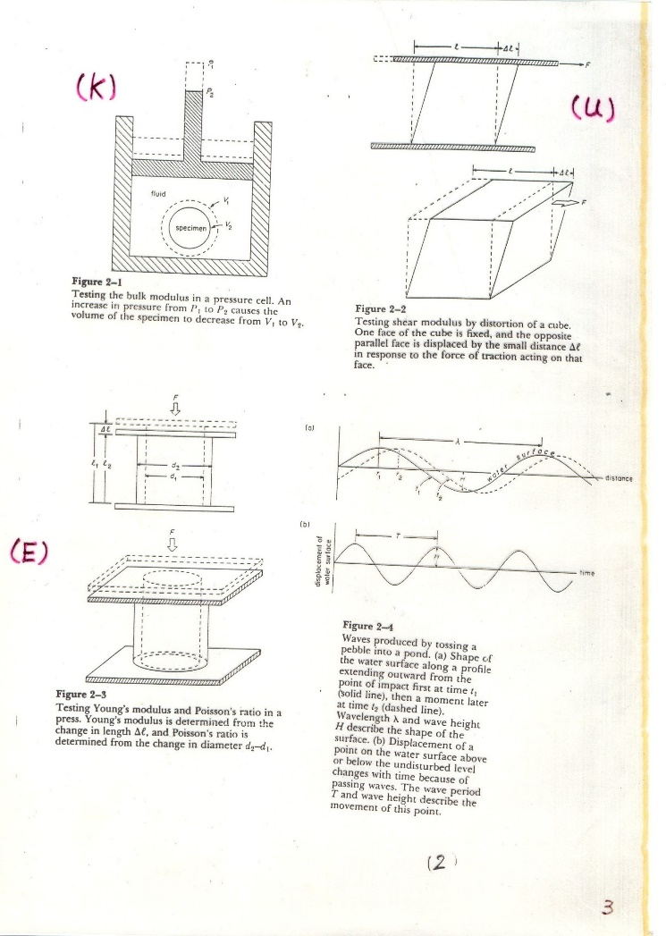

Slide 23
Elastic Strain
Elastic strain is proportional to the applied stress and it disappears when this stress ceases.
Ex. When we pulling a rubber band, its length is stretched and when we stop the effect of stress it retains to its normal position.

Slide 24
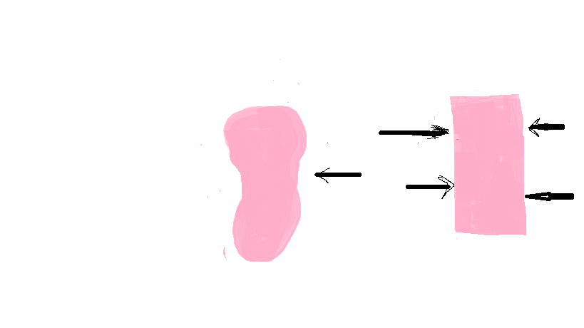
Plastic Strain
Plastic strain produce permanent deformation .
Ex. When we stretch a lump of soft clay, it remains stretched after we release it.

Slide 25
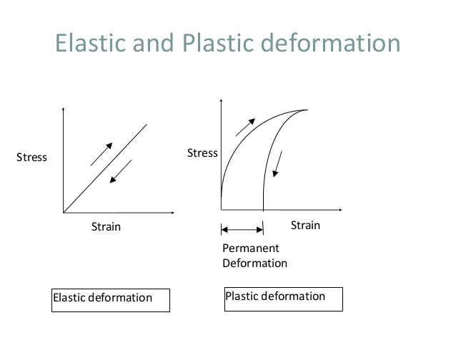

Slide 26
According to Hook's Law the relationship between stress and strain is linear for the elastic deformation.
When the strain reaches the yielding strain or Yielding Point.
After the yielding point the materials behave as ductile or brittle material and the plastic deformation occurs until the rupture took place.

Slide 29
If the stress exceeds the strength of the material, rupture occur.
By pulling very hard, we can break the rubber band or the lump of clay to produce plastic strain.

Slide 30
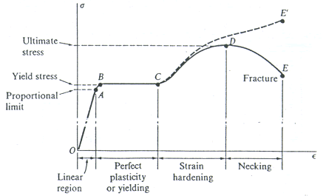
STRESS STRAIN DIAGRAM

Slide 31
Exploration seismologists are concerned principally with Elastic Strain, this is due to;
plastic deformation and rupture are caused by explosions or movements along faults that generates seismic waves.

Slide 32
But this sever deformation is confined to a small zone close to the point of energy release.
As the seismic waves travel a way from this small sources zone, they produce only Elastic Strain.
Therefore, it is important for us to examine the formal ways of describing Elastic Strain.

Slide 33
The relationship between stress and strain in the elastic field is specified by its various elastic moduli.
Bulk Modulus (K).
Shear Modulus (μ).
Young's Modulus (E) and
Poisson's Ratio (σ)

Slide 34
Bulk Modulus (K) Change in volume
The bulk modulus (K) of a substance essentially measures the substance's resistance to uniform compression.
It is defined as the pressure increase needed to effect a given relative decrease in volume.

Slide 35
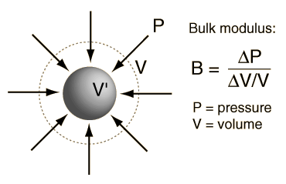
Bulk modulus

Slide 36
If K is very large, then the material is very stiff, meaning that it doesn't compress very much even under large pressures.
If K is small, then a small pressure can compress the material by large amounts.

Slide 37
For example, gases have very small incompressibility's.
Solids and liquids have large incompressibilities so
Bulk modulus can be measured for any kind of solids, liquids and gases

Slide 38
Shear Modulus (μ)
The shear modulus takes place when a force is applied parallel to one face of the object while the opposite face is held fixed by another equal force.
The shear modulus S is defined as the ratio of the stress to the strain.
S= Shear Stress /Shear Strain

Slide 40
The bigger the shear modulus the more rigid is the material since for the same change in horizontal distance (strain) you will need a bigger force (stress).
Gases and fluids can not support shear forces.
That is, they have shear moduli of zero.

Slide 41
Young's Modulus (E) and Poisson's Ratio (σ)
The ratio of the stress to the strain is called Young's Modulus

Slide 42
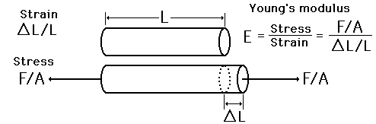

Slide 43
Poisson's Ratio (σ)
Poisson's Ratio (σ) is another constant where defined as the change in diameter is proportional to the change in length.
σ = (∆d/d1)/ (∆L/L1).
Young's modulus and Poisson's modulus are used for describing the elastic properties of solids.

Slide 44
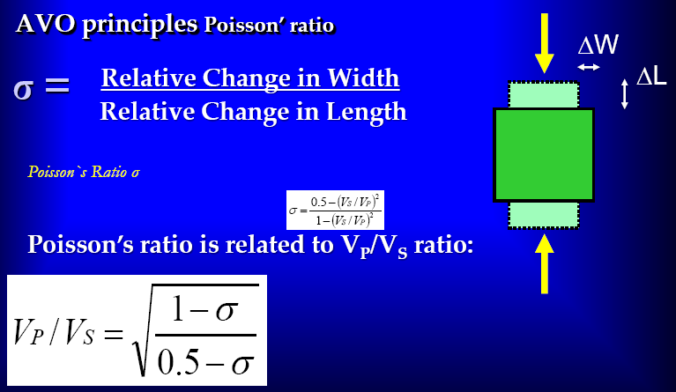

Slide 45
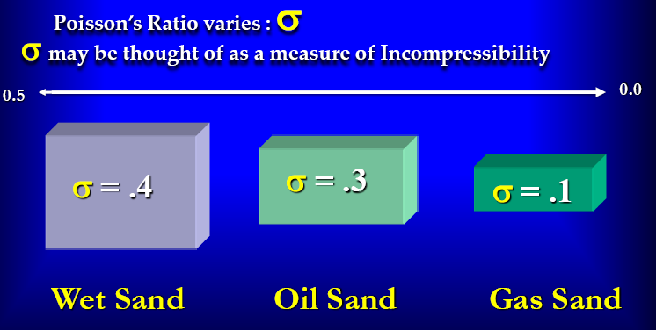

Slide 46
You can observe that the velocity of the seismic waves is related to the physical properties of the substance it passes through it.
The change in the shear or bulk modulus & density causes the velocity change in certain medium.

Slide 47
Suppose a seismic wave is transmitted from non saturated sand to saturated sand the velocity will change.
This because the change of physical parameters of the sand i. e. density, saturation by water, since the bulk modulus of water is larger than that of air.
In fact the bulk modulus is controlling the change of velocity
The change in the P- wave velocity is greater than the S- wave

Slide 48
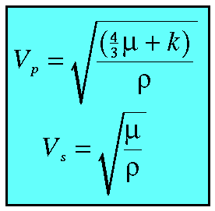
In case of homogenous isotropic medium the relation between P-wave & S-wave can be demonstrated by:
حيث أن
Vp سرعة الموجات الأولية .
Vs سرعة الموجات الثانوية
ρ كثافة الوسط density of the medium
μ : عامل القص Shear Modulus
κ : المعامل الحجمي Bulk Modulus

Slide 49
Some other factors changes the seismic wave velocities in rocks including ;
Rock type & cemented materials
Rock content of fluid
Change in stress on rocks.
So, seismic velocity is the key stone in the identification of rock types and subsurface structures, gas water contact, water oil contact in oil traps.

Slide 50
Material | P wave Velocity (m/s) | S wave Velocity (m/s)
Air | 332
Water | 1400-1500
Petroleum | 1300 - 1400
Steel | 6100 | 3500
Concrete | 3600 | 2000
Granite | 5500 – 5900 | 2800 - 3000
Basalt | 6400 | 3200
Sandstone | 1400 – 4300 | 700 - 2800
Limestone | 5900 – 6100 | 2800 – 3000
Sand (Unsaturated) | 200 – 1000 | 80 - 400
Sand (saturated) | 800 – 2200 | 320 - 880
Clay | 1000 – 2500 | 400 - 1000
Glacial Till (Saturated) | 1500 – 2500 | 600 - 1000

Slide 51
LECTURE II

Slide 52
ELASTIC WAVES
When the is Earth rapidly displaced or distorted at some point, the energy imparted into the Earth by the source of the distortion can be transmitted in the form of Elastic waves.

Slide 53
A wave is a disturbance that propagates through, or on the surface of a medium
Waves transfer energy from one place to another.
They do this by vibrating something up and down, or back and forth.
There are two types of wave motion.
Transverse and longitudinal.

Slide 54
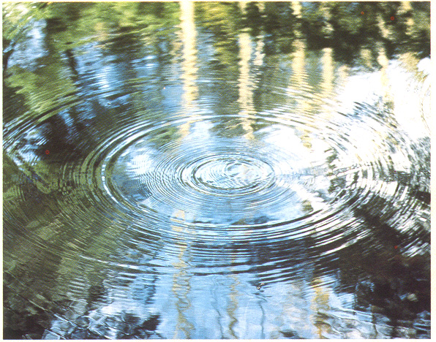
Seismic Wave Propagation

Slide 55
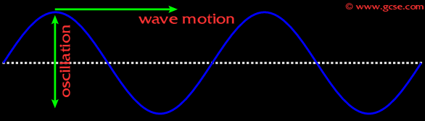
Transverse Wave

Slide 56
Transverse waves are those with vibrations perpendicular to the direction of the propagation of the wave
Longitudinal waves are those with vibrations parallel to the direction of the propagation of the wave; examples include most sound waves
Wave Properties:.
Amplitude is the peak to trough height of the wave divided by two.
Amplitude is the amount of movement from equilibrium displacement.
Amplitude is defined as the maximum displacement from the rest position.

Slide 57
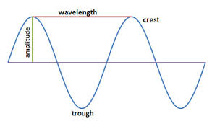
Wavelength
Wavelength is the distance over which the wave goes through one complete cycle (transverse waves).
e.g. from one peak to the next, or from one trough to the next).

Slide 58
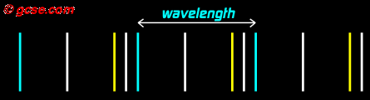
As with transverse waves, wavelength is the distance between parts of the wave that are doing the same thing (longitudinal waves ).

Slide 59
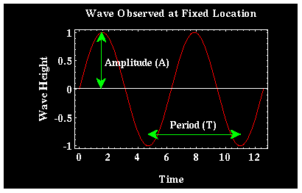
Period (T) and Frequency (f)
Period (T): is the time over which the wave is observed to complete a single cycle.

Slide 60
Frequency (f) means how frequent.
In other words, how often something happens.
how many times something happens per second.
For a wave, frequency means: how many waves per second.
Frequency is the reciprocal of the period.
F = 1/T

Slide 61
Period and Wavelength are related.
They are related by the speed at which the wave propagates across the surface of the pond V, where V equals the wavelength divided by the period of the wave
V = λ/T so
Velocity = frequency x wavelength

Slide 62
Problem and Solution
Bill counts 5 waves on a pond in 10 s. The distance between them is 80 cm. What is their speed?
Frequency = 5/10 = 0·5 Hz.
Speed = frequency × wavelength
= 0·5 × 80 = 40 cm/s

Slide 63
SEISMIC WAVES
Analysis of the Earth's internal structure is made possible because earthquakes produce vibrations called seismic waves.
These waves travel through the interior of the Earth and can be measured with sensitive detectors called seismographs.

Slide 64
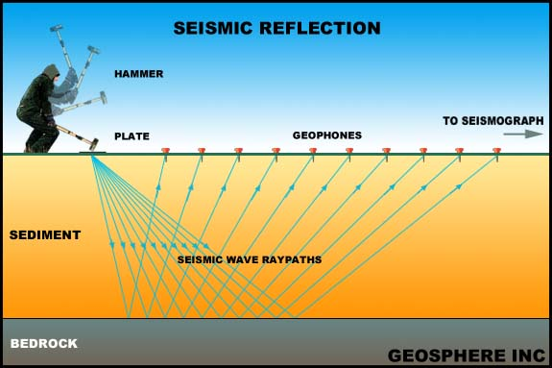

Slide 65
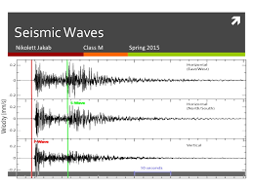

Slide 66
How seismic waves happen
Vibrations through the specimen could be produced by striking one side with the hummer.
This striking led to the moving of particles inside the specimen and can be detect by a device called a transducer

Slide 67
Types of seismic waves
There are two broad categories of seismic waves;
Body waves
Surface waves.

Slide 68
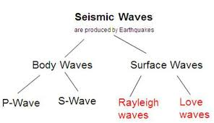

Slide 69
Body waves
Body waves - These are elastic waves that propagate through the Earth's interior.
Body waves propagate away from the source in all directions

Slide 70
body waves can be further subdivided into two classes of waves P waves and S waves.

Slide 71
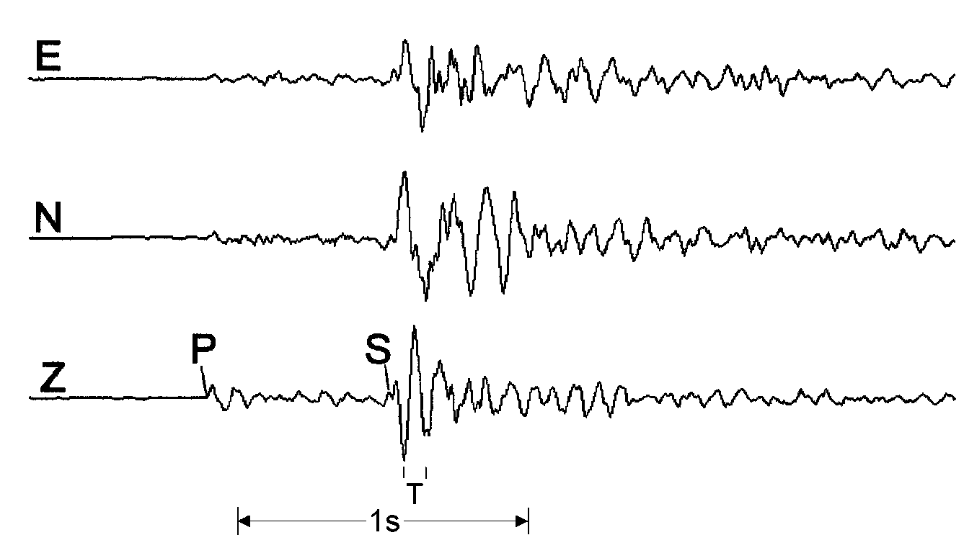

Types of Seismic Wave
Three-components of a seismometer record proportional to ground velocity of the P and S waves from a local aftershock of the Killari-Latur EQ, India (1993), at a hypocentral distance of 5.3 km
P. Bormann. 2002. New Manual of Seismological Observatory Practice (NMSOP)
Notes:
Two categories of seismic wave exist – body waves (which travel through the entire volume of the Earth) and surface waves (which are restricted to the near-surface). Each category consists of several types of seismic wave which all propagate through the earth with different velocity, amplitude, and particle motion.

Slide 72
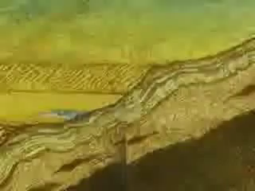

Slide 73
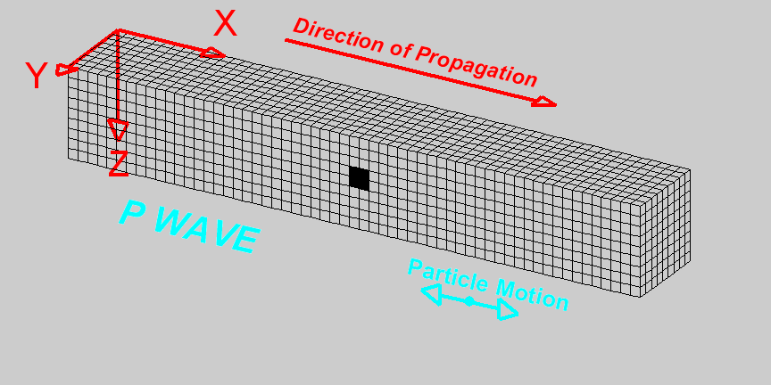
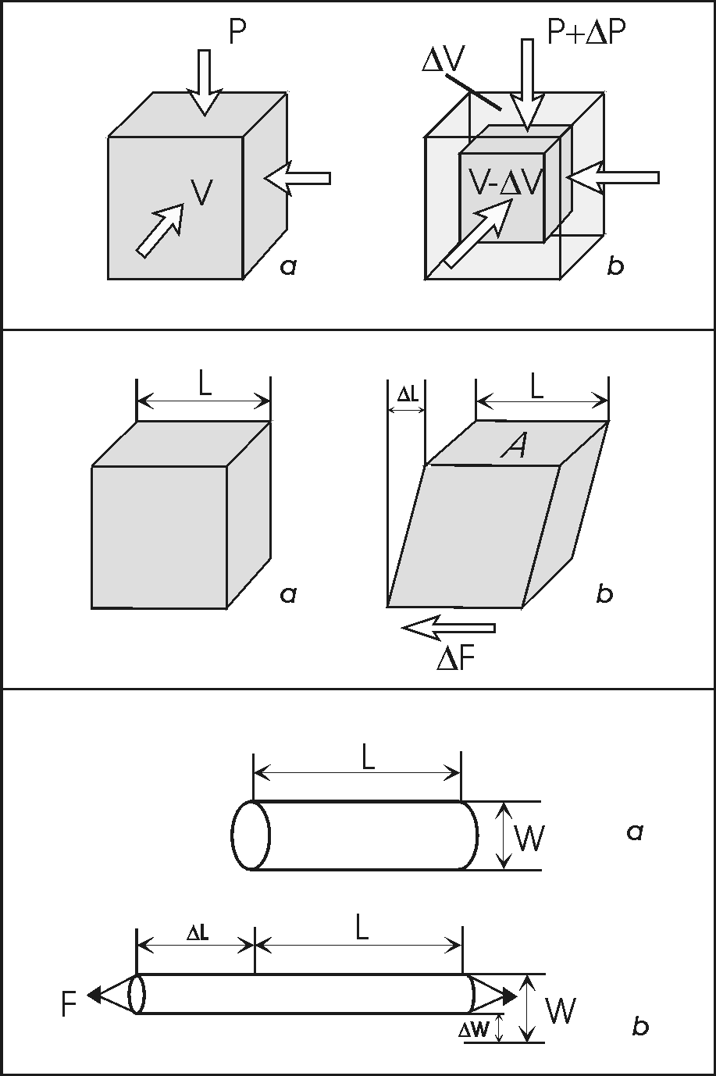
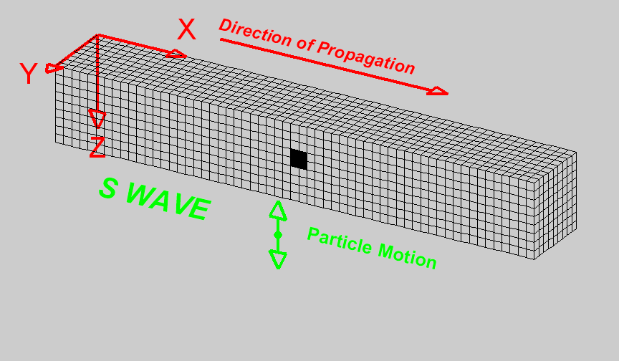
Body Waves
P. Bormann, NMSOP
Bulk modulus
κ = ΔP / (ΔV/ V) ⇒
Shear modulus
or „rigidity“
μ = (ΔF/A) / (ΔL/L) ⇒
Young´s or „stretch“
modulus E = (F/A)/ (ΔL/L)
and Poisson ratio
σ = (ΔW/W) / (ΔL/L) ⇒
Deformation of material samples for determining elastic moduli
© Copyright 2004. L. Braile.
Notes:
Body waves are those which travel through the entire volume of the Earth. There are two types: P-waves (Primary, or first arriving) are the quickest and have a compressional particle motion parallel to the direction of travel. S-waves (Shear) are quicker than surface waves, and have a shearing particle motion perpendicular to the direction of travel. The velocity of a P or S wave is related to the bulk or shear moduli (respectively) of the material through which they travel.

Slide 74
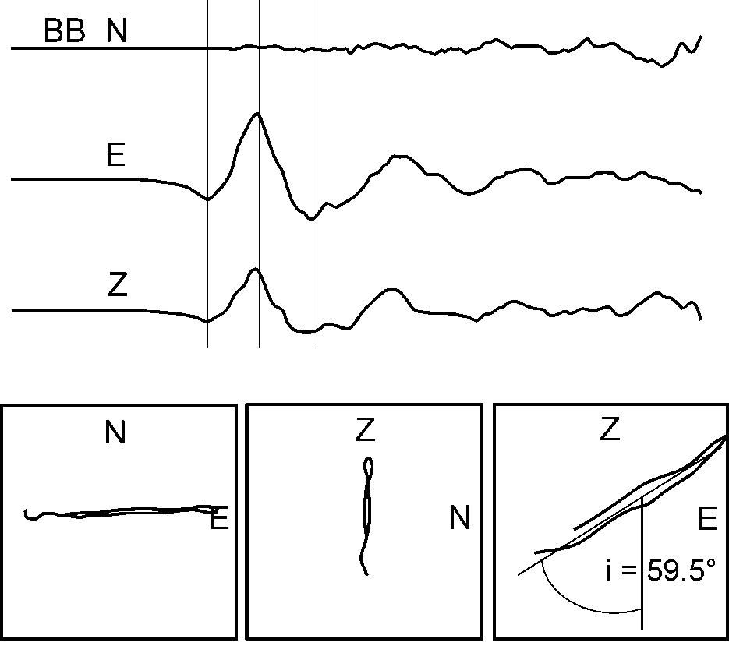
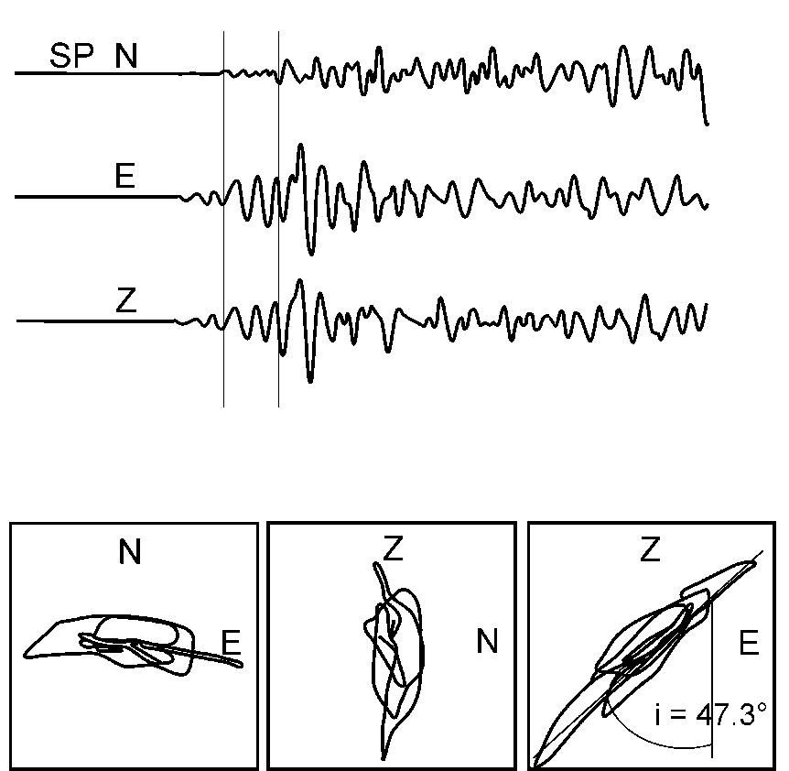
Particle motion of body waves
< 4.5 s >
1s
3-component records at station MOX (top traces) and related plots of particle motion in the horizontal (N - E) plane and two vertical planes (Z - N and Z – E, respectively) of the P- wave onset from seismic event (mining collapse) in Germany (1989; Ml = 5.5; epicentral distance D = 112 km, back-azimuth BAZ = 273°). Left: broadband recording (0.1 – 5 Hz); right: filtered short-period recording (1 – 5 Hz).
Note: The incidence angle is 59.5° for the long-period P- wave oscillation
and 47.3° for the high-frequency P-wave group.
P. Bormann (NMSOP)
Notes:
Different arrivals in a seismic wave-train can usually be identified by considering the particle motion of each seismic wave.

Slide 75
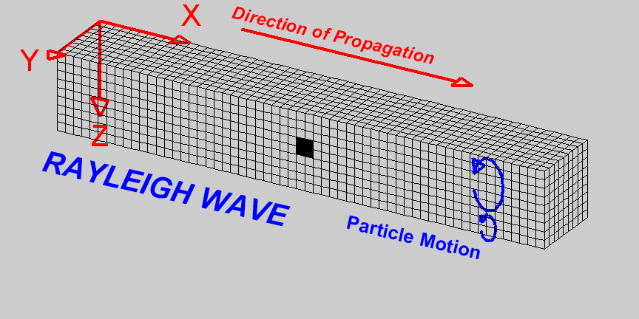
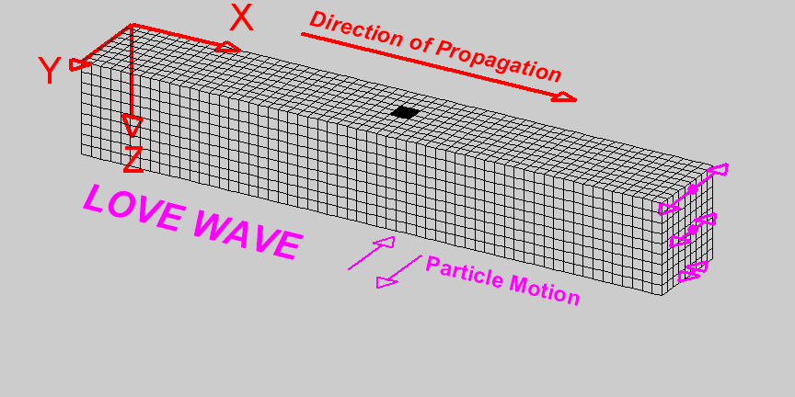
Surface Waves
  Form at the free surface
  Amplitude decays exponentially with depth.
© Copyright 2004. L. Braile.
Notes:
Surface waves are those which are restricted to propagation close to the free surface. There are two main types: Love waves have a shearing particle motion but only in the horizontal plane (parallel to the ground surface). Rayleigh waves have a reverse retrograde ellipse particle motion parallel to the direction of propagation.

Slide 76
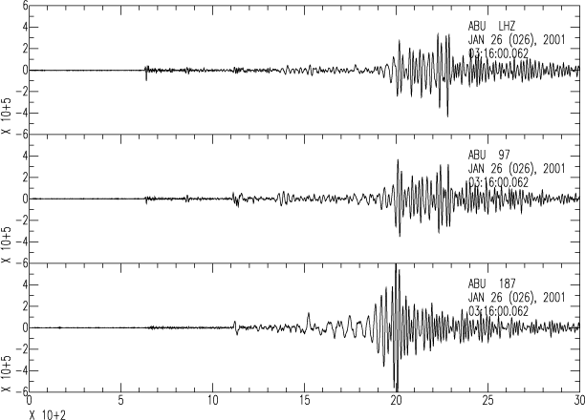
January 26, 2001 Gujarat, India Earthquake (Mw7.7)
vertical
Rayleigh Waves
radial
transverse
Love Waves
Recorded in Japan at a distance of 57º (6300 km)
Courtesy J. Mori
Notes:
On a 3-component seismometer we can separate out the Love and Rayleigh waves as a result of their different particle motion. The Love waves arrive earlier. A seismometer records the ground motion caused by the different seismic waves as they arrive and pass by. Different records are made in 3 orthogonal directions – N, E, and Z. Depending on the distance to the source, different ‘phases’ (the recorded waveforms corresponding to different seismic arrivals) could appear close together in a complicated wave-train (if the earthquake was close), or separated out into distinct arrivals depending on the propagation velocity of each seismic wave. If the earthquake was very far away (Teleseismic) then surface waves will not be recorded.

Slide 77
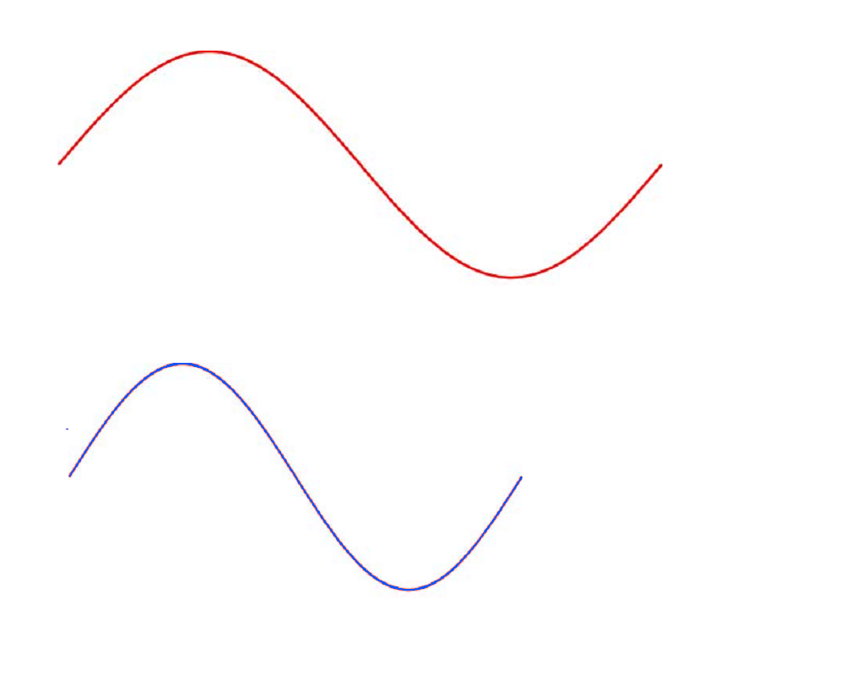
Wave Period and Wavelength
Velocity 6 km/s
Space
x
wavelength 300 km
wavelength
Time
t
period 50 s
frequency = 1/period= 0.02 Hz
period
Velocity = Wavelength / Period
Courtesy J. Mori
Notes:
In the spatial domain, one wavelength describes the distance for one complete cycle of the seismic wave (e.g. peak to peak, or trough to trough). In the time domain, the period describes the time taken for one whole cycle to pass a certain point/ The velocity of the wave is related to both the wavelength and the period.

Slide 78
Period
Wavelength
Body waves | 0.01 to 50 sec | 50 m to 500 km
Surface waves | 10 to 350 sec | 30 to 1000 km
Free Oscillations | 350 to 3600 sec | 1000 to 10000 km
Static Displacements |  | -
Courtesy J. Mori
Notes:
The different phases have different wavelengths and periods, this is important when we try to use the seismic waves to investigate the earthquake source – see earthquake sources lecture.

Slide 79
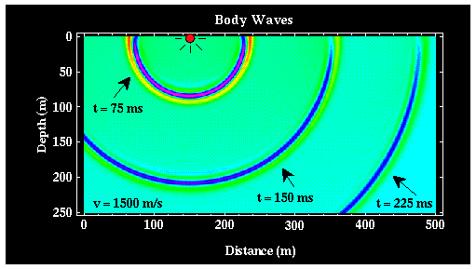

Slide 80
P waves are analogous to sound waves propagating through the air.
Primary waves are longitudinal waves that push and pull the earth.
They are the fastest body wave, averaging speeds of about 6 km/s, so arrive first.

Slide 81
Compressional Wave (P-Wave) Animation
Deformation propagates. Particle motion consists of alternating
compression and dilation. Particle motion is parallel to the
direction of propagation (longitudinal). Material returns to its
original shape after wave passes.

Slide 82
S Waves are called secondary waves, because they propagate through the medium slower than P waves.
In S-waves, particles constituting the medium are displaced in a direction that is perpendicular to the direction that the wave is propagating and have average velocity about 4 km/s.

Slide 83
Types of Seismic Wave
Notes:
Two categories of seismic wave exist – body waves (which travel through the entire volume of the Earth) and surface waves (which are restricted to the near-surface). Each category consists of several types of seismic wave which all propagate through the earth with different velocity, amplitude, and particle motion.

Slide 84
Shear Wave (S-Wave) Animation
Deformation propagates. Particle motion consists of alternating
transverse motion. Particle motion is perpendicular to the
direction of propagation (transverse). Transverse particle motion
shown here is vertical but can be in any direction. Material returns
to its original shape after wave passes.

Slide 85
S- wave, does not travel in liquids, discuss!!
μ for liquids = zero
So, Vs = Zero

Slide 86
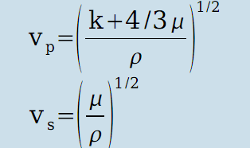

Why P-wave faster than S- Wave
الإجابة : تذكر أيضا أن
إذا بقسمة المعادلتين يتبين التالى:
و بما أن قيمة µ K and دائما موجبة إذا النسبة بين سرعة P-wave و S-wave دائما أكبر من الواحد إذا تنتشر P-wave دائما بسرعة أكبر من S-wave

Slide 87
Surface Waves
Surface Waves are waves that propagate along the Earth's surface.
Surface waves propagate at speeds that are slower than S waves.
There are two classes of surface waves, Love and Rayleigh waves,

Slide 88
Love Waves
Love waves are transverse horizontal motion, perpendicular to the direction of propagation and generally parallel to the Earth’s surface .
VL ~ 2.0 - 4.4 km/s

Slide 89
Love Wave (L-Wave) Animation
Deformation propagates. Particle motion consists of alternating transverse motions. Particle motion is horizontal and perpendicular to the direction of propagation (transverse). To aid in seeing that the particle motion is purely horizontal, focus on the Y axis (red line) as the wave propagates through it. Material returns to its original shape after wave passes.

Slide 90
Rayleigh waves
Rayleigh waves, Particle motion consists of elliptical motions (generally retrograde elliptical) in the vertical plane and parallel to the direction of propagation.

Slide 91
Rayleigh Wave (R-Wave) Animation
Deformation propagates. Particle motion consists of elliptical motions (generally retrograde elliptical) in the vertical plane and parallel to the direction of propagation. Material returns to its original shape after wave passes.

Slide 92
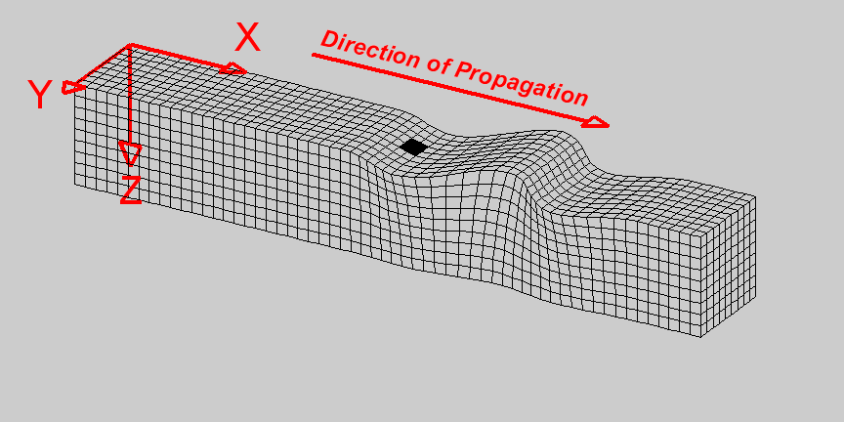
1. What seismic wave type is shown here?

Slide 93
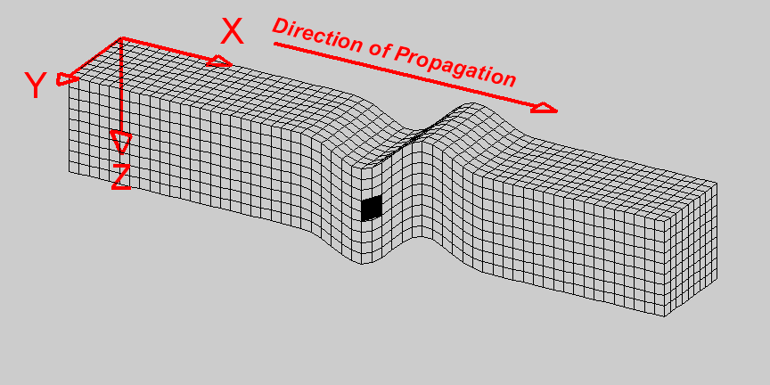
2. What seismic wave type is shown here?

Slide 94
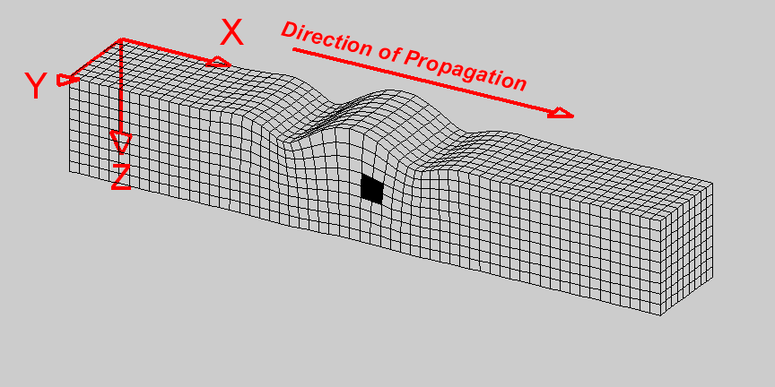
3. What seismic wave type is shown here?

Slide 95
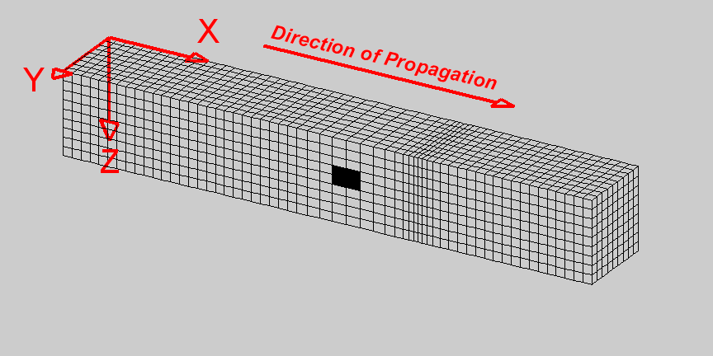
4. What seismic wave type is shown here?

Slide 96
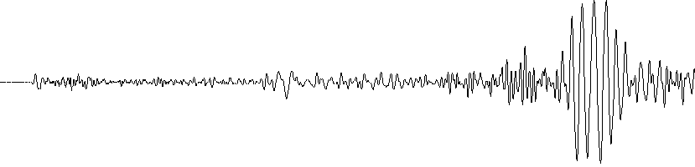
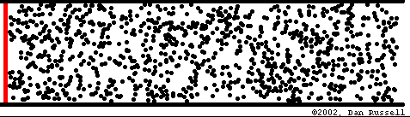
Wave animations
Animation courtesy of Dr. Dan Russell, Kettering University
http://www.kettering.edu/~drussell/demos.html
Seismic Wave
animations
(Developed by L. Braile)
http://web.ics.purdue.edu/~braile/edumod/waves/WaveDemo.htm

Slide 97
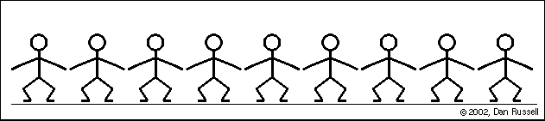
Dan Russell animations – The people wave
Animation courtesy of Dr. Dan Russell, Kettering University
http://www.kettering.edu/~drussell/demos.html

Slide 98
Dan Russell animations – A wave pulse
Animation courtesy of Dr. Dan Russell, Kettering University
http://www.kettering.edu/~drussell/demos.html

Slide 99
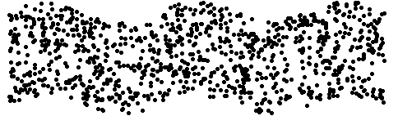
Dan Russell animations – Transverse wave
Animation courtesy of Dr. Dan Russell, Kettering University
http://www.kettering.edu/~drussell/demos.html

Slide 100
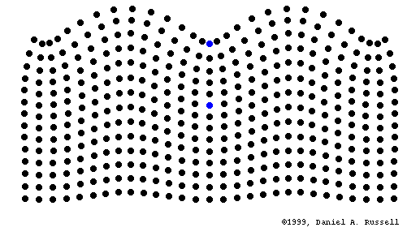
Dan Russell animations – Rayleigh wave
Animation courtesy of Dr. Dan Russell, Kettering University
http://www.kettering.edu/~drussell/demos.html

Slide 101
Compressional Wave (P-Wave) Animation
Deformation propagates. Particle motion consists of alternating
compression and dilation. Particle motion is parallel to the
direction of propagation (longitudinal). Material returns to its
original shape after wave passes.

Slide 102
Shear Wave (S-Wave) Animation
Deformation propagates. Particle motion consists of alternating transverse motion. Particle motion is perpendicular to the direction of propagation (transverse). Transverse particle motion shown here is vertical but can be in any direction. However, Earth’s layers tend to cause mostly vertical (SV; in the vertical plane) or horizontal (SH) shear motions. Material returns to its original shape after wave passes.

Slide 103
Rayleigh Wave (R-Wave) Animation
Deformation propagates. Particle motion consists of elliptical motions (generally retrograde elliptical) in the vertical plane and parallel to the direction of propagation. Amplitude decreases with depth. Material returns to its original shape after wave passes.

Slide 104
Love Wave (L-Wave) Animation
Deformation propagates. Particle motion consists of alternating transverse motions. Particle motion is horizontal and perpendicular to the direction of propagation (transverse). To aid in seeing that the particle motion is purely horizontal, focus on the Y axis (red line) as the wave propagates through it. Amplitude decreases with depth. Material returns to its original shape after wave passes.

Slide 105

Schematic diagram illustrating students performing wave simulations. Student holds a poster board or cardboard circle in front of his or her body and walks forward (like the seismic waves propagating in the Earth). While walking, the student moves their circle forward and backward (“push and pull”, for the P wave), or up and down (transverse motion for the shear wave), or in a retrograde ellipse (for the Rayleigh wave), or side to side horizontally (for the Love wave), as shown above.

Slide 106
Characteristics of Seismic Waves
Table 2: Seismic Waves
Type (and names) | Particle Motion | Typical Velocity | Other Characteristics
P,Compressional, Primary, Longitudinal | Alternating compressions (“pushes”) and dilations (“pulls”) which are directed in the same direction as the wave is propagating (along the raypath); and therefore, perpendicular to the wavefront | V_{P} ~ 5 – 7 km/s in typical Earth’s crust; >~ 8 km/s in Earth’s mantle and core; 1.5 km/s in water; 0.3 km/s in air | P motion travels fastest in materials, so the P-wave is the first-arriving energy on a seismogram. Generally smaller and higher frequency than the S and Surface-waves. P waves in a liquid or gas are pressure waves, including sound waves.
S, Shear, Secondary, Transverse | Alternating transverse motions (perpendicular to the direction of propagation, and the raypath); commonly polarized such that particle motion is in vertical or horizontal planes | V_{S} ~ 3 – 4 km/s in typical Earth’s crust; >~ 4.5 km/s in Earth’s mantle; ~ 2.5-3.0 km/s in (solid) inner core | S-waves do not travel through fluids, so do not exist in Earth’s outer core (inferred to be primarily liquid iron) or in air or water or molten rock (magma). S waves travel slower than P waves in a solid and, therefore, arrive after the P wave.

Slide 107
Characteristics of Seismic Waves
L, Love, Surface waves, Long waves | Transverse horizontal motion, perpendicular to the direction of propagation and generally parallel to the Earth’s surface | V_{L} ~ 2.0 - 4.5 km/s in the Earth depending on frequency of the propagating wave | Love waves exist because of the Earth’s surface. They are largest at the surface and decrease in amplitude with depth. Love waves are dispersive, that is, the wave velocity is dependent on frequency, with low frequencies normally propagating at higher velocity. Depth of penetration of the Love waves is also dependent on frequency, with lower frequencies penetrating to greater depth.
R, Rayleigh, Surface waves, Long waves, Ground roll | Motion is both in the direction of propagation and perpendicular (in a vertical plane), and “phased” so that the motion is generally elliptical – either prograde or retrograde | V_{R} ~ 2.0 - 4.5 km/s in the Earth depending on frequency of the propagating wave | Rayleigh waves are also dispersive and the amplitudes generally decrease with depth in the Earth. Appearance and particle motion are similar to water waves.

Slide 109


Slide 110
THANK YOU

