Slide 1
Oogenesis
Lecture 4
Prof Dr. Hekmat El-Gammal
2018

Slide 2
Lecture Objectives
On completion of this lecture, students will be able to:
Describe the organization of the vertebrate ovary.
List the stages of oogenesis.
Understand the events of oocyte maturation.
Discuss oocyte and granulosa cells symbiosis.
Define and summarize folliculogenesis.
Describe the types of ovarian follicles.
Describe the structure of the egg and how this is suited to its role of being fertilized and eventually giving rise to the embryo and
Deduce the similarities and differences between the male and female gametes, including lifespans, replenishment, relative number of gametes, and structure (i.e., size, motility, and reserve food).

Slide 3
Definition of Oogenesis
Oogenesis is the creation of an ovum (egg cell) in the ovarian follicle of the ovary.
Oogenesis differs from spermatogenesis in several ways.
Whereas the gamete formed by spermatogenesis is essentially a motile nucleus, the gamete formed by oogenesis contains all the materials needed to initiate and maintain metabolism and development.
Therefore, in addition to forming a haploid nucleus, oogenesis also builds up a store of cytoplasmic enzymes, mRNAs, organelles, and metabolic substrates.
While the sperm becomes differentiated for motility, the egg develops a remarkably complex cytoplasm.

Slide 4
Organization of the Vertebrate Ovary
The primary female reproductive organs, or gonads, are the two ovaries.
The ovary is usually, but not always, paired.
In birds, for example, only a single ovary is active; the other remains undeveloped.
The ovaries are covered on the outside by a layer of simple cuboidal epithelium called germinal (ovarian) epithelium. This is actually the visceral peritoneum that envelops the ovaries.
Underneath this layer there is a dense connective tissue capsule, the tunica albuginea.

Slide 5
The substance of the ovaries is distinctly divided into an outer cortex and an inner medulla.
The cortex appears more dense and granular due to the presence of numerous ovarian follicles in various stages of development (Fig. 23).
Each of the follicles contains an oocyte, a female germ cell, surrounded by follicular cells.
The medulla is loose connective tissue with abundant blood vessels, lymphatic vessels, and nerve fibers.

Slide 7
Oogenesis Processes
Oogenesis consists of several processes: oocytogenesis, ootidogenesis and the final maturity to form an ovum (Fig. 24).
Multiplication (Oocytogenesis)
Oogonia, the female descendants of the primordial germ cells, proliferate by mitosis in either a discontinuous or a continuous pattern.

Slide 8
Stages | Cell type | Ploidy | Process | Process Completion
Multiplication | Oogonium | Diploid | Oocytogenesis | third (trimester) forming oocyte
Growth | Primary Oocyte | Diploid | Ootidogenesis (meiosis 1) (Folliculogenesis | Dictyate in prophase I until ovulation
Maturation | Secondary | Haploid | Ootidogenesis meiosis 11 | Halted in metaphase II until fertilization
 | Ootide | Haploid |  | Minutes after fertilization
 | Ovum | Haploid

Slide 9
The discontinuous pattern, which is practiced by cyclostomes, elasmobranchs, birds, and mammals, results in a single, large population of oogonia, the only source of all the oocytes a female will have during her lifetime.
In the continuous pattern, which is practiced by almost all bony fishes, amphibians, and most (or all?) reptiles, oogonial stem cells persist throughout the female’s life and produce a batch of new oogonia during each breeding season from which the oocytes come.
Each oogonium becomes an oocyte when it begins the first of the two meiotic divisions.

Slide 10
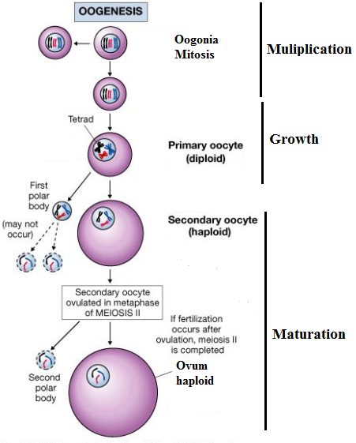
Growth (Ootidogenesis)
Oogenesis starts with transformation into primary oocytes
In mammals oocytogenesis is completed either before or shortly after birth.

Slide 11
Maturation (Ootidogenesis)
The succeeding ootidogenesis is the step in which the primary oocyte turns into an ootid.
It is achieved by meiosis .The primary oocyte is even defined from its role to undergo meiosis.
However, although this process begins at prenatal age, it stops at prophase I.
In late fetal life, all oocytes, still primary oocytes, have taken this halt in development, called dictyate (diplotene).
First after menarche they continue to develop, although only a few does so every menstrual cycle.

Slide 12
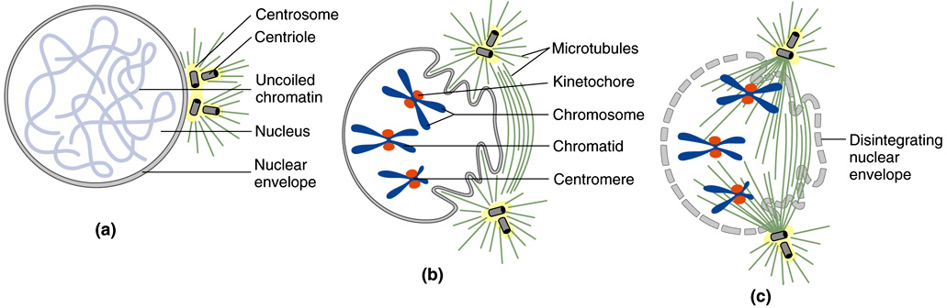
Events of Oocyte Maturation
The oocyte becomes fully mature only after a series of developmental changes.
Breakdown of the germinal vesicle (GVB) (dissolution of the nuclear membrane) and
Resumption and completion of meiosis I;
Release of 1st polar body,
The next is progression to metaphase of meiosis II (Fig. 25).

Slide 13
These primarily nuclear events are followed by cytoplasmic changes that lead to the ability to be ovulated (Fig. 26), to be fertilized, and to form a viable zygote.

Slide 14
In the nonmammalian vertebrates, full maturity also includes the accumulation of yolk (Fig. 27) and maternal mRNAs, proteins, and other substances on which at least the early stages of embryogenesis depend.

Slide 15
The follicle is an essential element of the processes that allow the oocyte to become mature.
Until the beginning of growth of the vesicular follicle in mammals and of vitellogenesis in nonmammalians, the steps to maturity are largely—or entirely—independent of the internal environment of the organism.
Folliculogenesis
In biology, folliculogenesis refers to the maturation of the ovarian follicle, a densely-packed shell of somatic cells that contains an immature oocyte.
In mammals folliculogenesis describes the progression of a number of small primordial follicles into large preovulatory follicles.

Slide 16
Types of Ovarian Follicles
  The growing follicle passes through the following distinct stages that are defined by certain structural characteristics, primordial follicle, primary follicle, secondary follicle and Graafian follicle.
Up until the preovulatory stage, the follicle contains a primary oocyte that is arrested in diplotene of prophase of meiosis I.
During the late preovulatory stage, the oocyte continues meiosis and becomes a secondary oocyte, arrested in metaphase II.

Slide 17
The Primordial Follicle
Primordial follicles are considered the fundamental reproductive units of the ovary because they give rise to all dominant follicles.
Histologically, a primordial follicle contains a small primary oocyte arrested in the diplotene stage of meiosis, a single layer of flattened or squamous (Fig. 28) follicular cells (arise from a population of stromal cells only when an oogonium becomes an oocyte and in response to the latter) and a basal lamina.
By virtue of the basal lamina, the follicular and oocyte exist within a microenvironment in which direct contact with other cells does not occur.

Slide 18
Primordial follicles do not have an independent blood supply and thus have limited access to the endocrine system.
  The primordial follicle does not grow until it is transformed into a primary follicle. Once this happens, the follicle is committed to one of three fates:
death through atresia,
ovulation, or
death through luteolysis if the postovulatory follicle (POF) becomes a corpus luteum (CL).
  Once meiosis begins, the oocyte’s chromosomes proceed through the leptotene, zygotene, and pachytene to the diplotene stage of prophase, where they remain (meiotic arrest) until ovulation occurs.

Slide 19
The Primary and Vesicular Follicle Growth in Mammals
A primary follicle is defined by the presence of one or more cuboidal follicular cells that are arranged in a single layer surrounding the oocyte.
The major developmental events that occur in the primary follicle include FSH receptor expression and oocyte growth and differentiation.
This enormous growth occurs as a consequence of the reactivation of the oocyte genome.
Some of the oocyte mRNAs are translated and the resulting proteins contribute to oocyte growth and differentiation.

Slide 20
For example, the genes encoding the zona pellucida (ZP) proteins, ZP-1, ZP-2, and ZP-3 are transcribed and translated.
The secreted ZP proteins begin to polymerize near the oocyte surface, forming the zona pellucida which eventually encapsulates the egg.
The importance of the zona pellucida is emphasized by the fact that ZP-3 is the species-specific sperm-binding molecule and therefore is responsible for initiating the acrosome reaction in capacitated sperm.

Slide 21
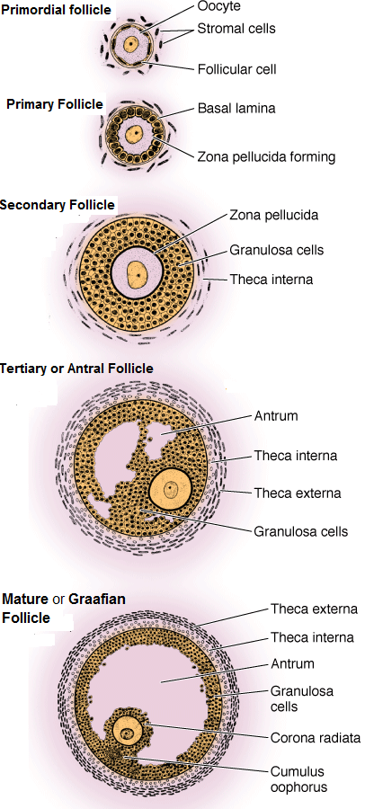

Slide 22
An important event in primary follicle development is the development of gap junctions between the oocyte and granulosa cells.
When the oocyte completes its growth during the preantral folliculogenesis, it acquires the capacity to resume meiosis.
One of the primary oocytes seems to outgrow the others and it resumes meiosis I. The other cells degenerate.
The large cell undergoes an unequal division so that nearly all the cytoplasm, organelles, and half the chromosomes go to one cell, which becomes a secondary oocyte.
The remaining half of the chromosomes go to a smaller cell called the first polar body.

Slide 23
The secondary oocyte begins the second meiotic division, but the process stops in metaphase II. At this point ovulation occurs.
If fertilization occurs, meiosis II continues
The smaller cell from this division is a second polar body.
The first polar body also usually divides in meiosis I to produce two even smaller polar bodies.
If fertilization does not occur, the second meiotic division is never completed and the secondary oocyte degenerates.

Slide 24
Here again there are obvious differences between the male and female.
  In spermatogenesis, four functional sperm develop from each primary spermatocyte.
  In oogenesis, only one functional fertilizable cell develops from a primary oocyte. The other three cells are polar bodies and they degenerate.
The Secondary Follicle
As preantral folliculogenesis continues, the structure of the follicle begins to change. The major changes occur during secondary follicle development include:
The accumulation of increased numbers of granulosa cells.
The acquisition of a theca.

Slide 25
The development of a primary to a full-grown secondary follicle results from an active autocrine/paracrine regulatory process that involves growth factors produced by the oocyte.
Secondary follicle development begins with the acquisition of a second layer of granulosa cells.
This step is termed the primary-to-secondary follicle transition.
It involves a change in the arrangement of the granulosa cells from a simple cuboidal epithelium to a stratified or pseudostratified columnar epithelium.

Slide 26
Theca Development
Secondary follicle development is also characterized by thecal development.
  At or about the time of the primary/secondary transition, several layers of stromal-like cells appear around the basal lamina.
  As secondary follicle development proceeds, two primary layers of theca appear:
An inner theca interna that differentiates in the theca interstitial cells and
An outer theca externa that differentiates into smooth muscle cells.

Slide 27
At the completion of the preantral phase of folliculogenesis, a full-grown secondary follicle contains five distinct structural units:
a fully grown oocyte surrounded by a zona pellucida, approximately 9 layers of granulosa cells,
a basal lamina,
a theca interna,
a theca externa and
a capillary net in the theca tissue.

Slide 28
The Graafian Follicle
A Graafian follicle is characterized by a cavity or antrum containing a fluid termed follicular fluid or liquor folliculi.
Accordingly, the term antral follicle is used correctly as a synonym for Graafian follicle.
Follicular fluid is an exudate of plasma and is conditioned by secretory products from the oocyte and granulosa cells.
It is the medium in which the granulosa cells and oocyte reside and through which regulatory molecules must pass on their way to and from this microenvironment.

Slide 29
Cavitation
The onset of Graafian follicle development is characterized by the appearance of a fluid filled cavity at one pole of the oocyte.
This process is termed cavitation or beginning antrum formation.
In laboratory animals, two proteins expressed by the follicle itself are essential for cavitation, namely granulosa-derived kit ligand and oocyte Cx 37.
If either of these proteins is absent, then no Graafian follicles develop and the female is infertile.

Slide 30
Classification of Graafian follicle
Graafian follicle growth and development can be arbitrarily divided into four stages based on size.
Each dominant follicle has a destiny to complete the transition from the small (1-6 mm), medium (7-11 mm), large (12-17 mm), to the preovulatory state (18-23 mm) in women.
An atretic follicle usually fails to develop beyond the small to the medium stage (1-10 mm).
The relative abundance of Graafian follicles and their sizes vary as a function of age and the menstrual cycle.

Slide 31
Architecture of Graafian follicle
The size of a Graafian follicle is determined largely by the size of the antrum, which in turn is determined by the volume of follicular fluid.
The proliferation of the follicle cells also contributes to follicle size.
In a dominant follicle, the granulosa and theca cells proliferate extensively (as much as 100-fold) concomitant with the antrum becoming filled with follicular fluid.
Thus, increased follicular fluid accumulation and cell proliferation are responsible for the tremendous growth of the dominant follicle during the follicular phase of the cycle.
The theca externa consists of concentrically arranged smooth muscle cells, which are innervated by autonomic nerves.

Slide 32
The theca interna contains a population of large epithelioid cells termed the theca interstitial cells.
They have the ultrastructural characteristics typical of active steroid producing cells, i.e., the cytoplasm is filled with lipid droplets, smooth endoplasmic reticulum and mitochondria with tubular cristae.
The theca interstitial cells possess cell receptors for LH and insulin.

Slide 33
The theca interna is richly vascularized by a loose capillary network that surrounds the Graafian follicle during its growth.
This spatial organization gives rise to four subtypes of granulosa cells:
the membrana,
the periantral area,
the cumulus oophorus, and
the corona radiata granulosa cells.

Slide 34
The Types of Eggs
The type of eggs (Fig. 29) can determined by the amount or distribution of the yolk.
On the basis of amount of yolk the eggs are classified into:
1-Alecithal egg, is completely or almost completely yolkless as in Eutherian mammals.
2-Microlecithal egg, or yolk poor as in some Eutherian eggs; rhesus monkey contain fine yolk granules; sheep contain nonfat yolk granules; armadillo contain granular yolk; bat have yolk in vesicles. Metatherian eggs contain masses of yolk in the cytoplasm.
3-Medialecithal or oligolecithal eggs have relatively little yolk as in amphioxus.
4-Mesolecithal eggs contain relatively more yolk as in amphibian.
5-Megalecithal eggs contain large amount of yolk as in some sharks, reptiles, birds and Prototherian mammals.

Slide 35
On the basis of distribution of yolk the eggs are classified into:
Isolecithal / Homolecithal - There is even distrubtion of the yolk in the ooplasm. eg. Alecithal and microlecithal yolk.
Telolecithal - The yolk is found in the one pole which called as vegetal pole.
The yolk free pole is called as an animal pole. eg fishes, amphibians, reptiles and birds.
Yolk unequally distributed in the ooplasm.
Centrolecithal - The yolk is present in the center and surrounded by ooplasm. eg. Insect and hydrozoa.

Slide 36
