Slide 1
Fertilization
Lecture 5
Prof Dr. Hekmat El-Gammal
2018

Slide 2
Lecture Objectives
This lecture contains information that should enable you to do the following:
Define fertilization and state its functions and events.
State recognition of egg and sperm.
Outline sperm attraction and describe the acrosomal reaction.
Explain the role of the zona pellucida in fertilization.
List the requirement for capacitation.
Depict how fusion of the sperm plasma membrane with the plasma membrane of the egg.
Recognize two mechanisms to avoid polyspermy.
Trace the series of the activation of egg metabolism.

Slide 3
Definition of Fertilization
Fertilization is the fusion of two nuclei of sperm and egg, to produces a single diploid cell, the zygote. The fusion is called syngamy.
Functions of Fertilization
Fertilization restores the full genetic complement of the animal, but the events and processes of fertilization do even more:
They help eggs and sperm get together.
They determine the sex.
They prevent the union of sperm and eggs of different species.
They restore the diploid number of chromosomes.
They guarantee that only one sperm will enter the egg and activate it metabolically.

Slide 4
Events of Fertilization
The recognition of egg and sperm
The sperm is activated so that it is capable of gaining access to the plasma membrane of the egg.
The plasma membranes of the sperm and egg fuse.
The egg blocks entry by additional sperm.
The egg is metabolically activated and stimulated to start development.
The egg and sperm nuclei fuse to create the diploid nucleus of the zygote.
Preparation for Cleavage.

Slide 5
1. The Recognition of Egg and Sperm
The aquatic organisms are faced with two problems:
How can sperm and eggs meet in such a dilute concentration?
How can sperm be prevented from trying to fertilize eggs of another species?
Two major mechanisms have evolved to solve these problems:
species specific attraction of sperm and
species-specific sperm activation.

Slide 6
2. Sperm Attraction: Action at a distance
Species-specific sperm attraction has been documented in numerous species, including cnidarians, molluscs, echinoderms, and urochordates.
In many species, sperm are attracted toward eggs of their species by chemotaxis, that is, by following a gradient of a chemical secreted by the egg.
The oocytes control not only the type of sperm they attract, but also the time at which they attract them.

Slide 7
Gamete Binding and Recognition in Mammals
A second interaction between sperm and egg is the acrosomal reaction.
ZP3: the sperm-binding protein of the mouse zona pellucida.
The zona pellucida in mammals plays a role analogous to that of the vitelline envelope in invertebrates.
This glycoprotein matrix, which is synthesized and secreted by the growing oocyte, plays two major roles during fertilization: it binds the sperm, and it initiates the acrosomal reaction after the sperm is bound.

Slide 8
The binding of sperm to the zona is relatively, but not absolutely, species-specific.
ZP3 is the specific glycoprotein in the mouse zona pellucida to which the sperm bind.
ZP3 also initiates the acrosomal reaction after sperm have bound to it.
The mouse sperm can thereby concentrate its proteolytic enzymes directly at the point of attachment at the zona pellucida.

Slide 9
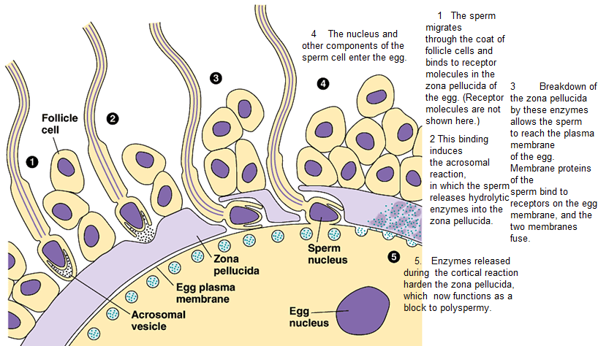

Slide 10
Induction of the mammalian acrosomal reaction by ZP3.
The acrosomal reaction in mammals occurs only after the sperm has bound to the zona pellucida.
The mouse sperm acrosomal reaction is induced by the crosslinking of ZP3 with the receptors for it on the sperm membrane.
This crosslinking opens calcium channels to increase the concentration of calcium in the sperm.

Slide 11
The mechanism by which ZP3 induces the opening of the calcium channels and the subsequent exocytosis of the acrosome remains controversial, but it may involve the receptor's activating a cation channel (for sodium, potassium, or calcium), which would change the resting potential of the sperm plasma membrane.
The calcium channels in the membrane would be sensitive to this change in membrane potential, allowing calcium to enter the sperm.

Slide 12
Secondary binding of sperm to the zona pellucida.
During the acrosomal reaction, the anterior portion of the sperm plasma membrane is shed from the sperm.
This region is where the ZP3-binding proteins are located, and yet the sperm must still remain bound to the zona in order to lyse a path through it.
In mice, it appears that secondary binding to the zona is accomplished by proteins in the inner acrosomal membrane that bind specifically to ZP2.
Whereas acrosome-intact sperm will not bind to ZP2, acrosome-reacted sperm will.

Slide 13
Moreover, antibodies against the ZP2 glycoprotein will not prevent the binding of acrosome-intact sperm to the zona, but will inhibit the attachment of acrosome-reacted sperm.
The structure of the zona consists of repeating units of ZP3 and ZP2, occasionally crosslinked by ZP1.
It appears that the acrosome-reacted sperm transfer their binding from ZP3 to the adjacent ZP2 molecules.
After a mouse sperm has entered the egg, the egg cortical granules release their contents.
One of the proteins released by these granules is a protease that specifically alters ZP2. This inhibits other acrosome-reacted sperm from moving closer toward the egg.

Slide 14
Action at a Distance: Mammalian Gametes
It is very difficult to study the interactions that might be occurring between mammalian gametes prior to sperm-egg contact.
One obvious reason for this is that mammalian fertilization occurs inside the oviducts of the female.
A second reason for this difficulty is that the sperm population ejaculated into the female is probably very heterogeneous, containing spermatozoa at different stages of maturation. Of the 280 × 10⁶ human sperm normally ejaculated into the vagina, only about 200 10⁶ reach the ampullary region of the oviduct, where fertilization takes place.
Since fewer than 1 in 10,000 sperm get close to the egg, it is difficult to assay those molecules that might enable the sperm to swim toward the egg and become activated.

Slide 15
Activation, Translocation and Capacitation
The reproductive tract of female mammals plays a very active role in the mammalian fertilization process.
While sperm motility is required for mouse sperm to encounter the egg once it is in the oviduct, sperm motility is probably a minor factor in getting the sperm into the oviduct in the first place.
Sperm are found in the oviducts of mice, hamsters, guinea pigs, cows, and humans within 30 minutes of sperm deposition in the vagina, a time "too short to have been attained by even the most Olympian sperm relying on their own flagellar power".

Slide 16
Rather, the sperm appear to be transported to the oviduct by the muscular activity of the uterus.
By whatever means, mammalian sperm pass through the uterus and oviduct, interacting with the cells and secretions of the female reproductive tract as they do so.
These interactions are critical for their ability to interact with the egg.
Newly ejaculated mammalian sperm are unable to undergo the acrosomal reaction without residing for some time in the female reproductive tract.
The set of physiological changes that allow the sperm to be competent to fertilize the egg is called capacitation.

Slide 17
The requirement for capacitation varies from species to species.
Capacitation can be mimicked in vitro by incubating sperm in tissue culture media (containing calcium ions, bicarbonate, and serum albumin) or in fluid from the oviducts.
Sperm that are not capacitated are "held up" in the cumulus and so do not reach the egg.
Although some human sperm reach the ampullary region of the oviduct within a half hour after intercourse, those sperm may have little chance of fertilizing the egg.

Slide 18
Nearly all human pregnancies result from sexual intercourse during a 6-day period ending on the day of ovulation.
This means that the fertilizing sperm could have taken as long as 6 days to make the journey.
As the sperm reach the ampulla, they acquire competence, but if they stay around too long, they lose it.
Sperm may also have different survival rates depending on their location within the reproductive tract, and this may allow some sperm to arrive late but with better chance of success than those that have arrived days earlier.

Slide 19
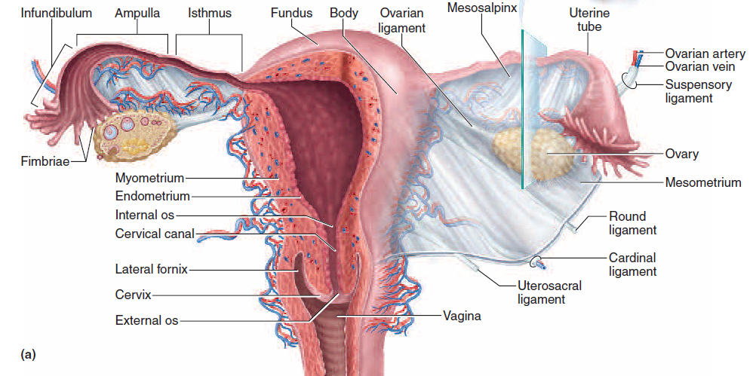

Slide 20
3. Fusion of the Egg and Sperm Plasma Membranes
Recognition of sperm by the zona pellucida is followed by the lysis of that portion of the envelope or zona in the region of the sperm head by the acrosomal enzymes.
This lysis is followed by the fusion of the sperm plasma membrane with the plasma membrane of the egg.
In mammals, the fertilin proteins in the sperm plasma membrane are essential for sperm membrane-egg membrane fusion.
Mouse fertilin is localized to the posterior plasma membrane of the sperm head.
It adheres the sperm to the egg by binding to the integrin protein on the egg plasma membrane.

Slide 21
Moreover, like sea urchin bindin (to which it is not structurally related), fertilin has a hydrophobic region that could potentially mediate the union of the two membranes.
Thus, fertilin appears to bind the sperm plasma membrane to the egg plasma membrane and then to fuse the two of them together.
Mice homozygous for mutant fertilin have sperm with several defects, one of them being the inability to fuse with the egg plasma membrane.
When the membranes are fused, the sperm nucleus, mitochondria, centriole, and flagellum can enter the egg.

Slide 22
4. Blocks to Polyspermy
The entrance of multiple sperm polyspermy leads to disastrous consequences in most organisms.
Species have evolved ways to prevent the union of more than two haploid nuclei.
The sea urchin egg has two mechanisms to avoid polyspermy:
a fast reaction, accomplished by an electric change in the egg plasma membrane, and
a slower reaction, caused by the exocytosis of the cortical granules.

Slide 23
Blocks to Polyspermy in Sea Urchin Eggs
• The fast block to polyspermy.
The fast block to polyspermy is achieved by changing the electric potential of the egg plasma membrane.
This membrane provides a selective barrier between the egg cytoplasm and the outside environment, and the ionic concentration of the egg differs greatly from that of its surroundings.
This concentration difference is especially significant for sodium and potassium ions.
Seawater has a particularly high sodium ion concentration, whereas the egg cytoplasm contains relatively little sodium.

Slide 24
The reverse is the case with potassium ions.
This condition is maintained by the plasma membrane, which steadfastly inhibits the entry of sodium ions into the oocyte and prevents potassium ions from leaking out into the environment.
If we insert an electrode into an egg and place a second electrode outside it, we can measure the constant difference in charge across the egg plasma membrane.
This resting membrane potential is generally about 70 mV, usually expressed as -70 mV (Fig. 31) because the inside of the cell is negatively charged with respect to the exterior.

Slide 25
Within 1- 3 seconds after the binding of the first sperm, the membrane potential shifts to a positive level, about +20 mV.
This change is caused by a small influx of sodium ions into the egg.
Although sperm can fuse with membranes having a resting potential of -70 mV, they cannot fuse with membranes having a positive resting potential, so no more sperm can fuse to the egg.

Slide 27
The slow block to polyspermy.
The eggs of sea urchins (and many other animals) have a second mechanism to ensure that multiple sperm do not enter the egg cytoplasm.
This brief potential shift is not sufficient to prevent polyspermy, which can still occur if the sperm bound to the vitelline envelope are not somehow removed.
This removal is accomplished by the cortical granule reaction, a slower, mechanical block to polyspermy that becomes active about a minute after the first successful sperm-egg attachment.
Directly beneath the sea urchin egg plasma membrane are about 15,000 cortical granules.

Slide 28
Upon sperm entry, these cortical granules fuse with the egg plasma membrane and release their contents into the space between the plasma membrane and the fibrous mat of vitelline envelope proteins.
Several proteins are released by this cortical granule exocytosis.
The first are proteases.
These enzymes dissolve the protein posts that connect the vitelline envelope proteins to the cell membrane, and they clip off the bindin receptor and any sperm attached to it.

Slide 29
Mucopolysaccharides released by the cortical granules produce an osmotic gradient that causes water to rush into the space between the plasma membrane and the vitelline envelope, causing the envelope to expand and become the fertilization envelope (Fig. 32).
A third protein released by the cortical granules, a peroxidase enzyme, hardens the fertilization envelope by crosslinking tyrosine residues on adjacent proteins.
This process starts about 20 seconds after sperm attachment and is complete by the end of the first minute of fertilization.
Finally, a fourth cortical granule protein, hyalin, forms a coating around the egg.
The egg extends elongated microvilli whose tips attach to this hyaline layer. This layer provides support for the blastomeres during cleavage.

Slide 31
Blocks to Polyspermy in Mammals
In mammals, the cortical granule reaction does not create a fertilization envelope, but its ultimate effect is the same.
Released enzymes modify the zona pellucida sperm receptors such that they can no longer bind sperm.
During this process, called the zona reaction, both ZP3 and ZP2 are modified.
It has been proposed that the cortical granules of mouse eggs contain an enzyme that clips off the terminal sugar residues of ZP3, thereby releasing bound sperm from the zona and preventing the attachment of other sperm.

Slide 32
Cortical granules of mouse eggs have been found to contain N-acetylglucosaminidase enzymes capable of cleaving N-acetylglucosamine from ZP3 carbohydrate chains.
N-acetylglucosamine is one of the carbohydrate groups that sperm can bind to, and Miller and co-workers (1992, 1993) have demonstrated that when the N acetylglucosamine residues are removed at fertilization, ZP3 will no longer serve as a substrate for the binding of other sperm. ZP2 is clipped by the cortical granule proteases and loses its ability to bind sperm as well.
Thus, once a sperm has entered the egg, other sperm can no longer initiate or maintain their binding to the zona pellucida and are rapidly shed.

Slide 33
Calcium as the initiator of the cortical granule reaction.
In sea urchins and mammals, the rise in calcium concentration responsible for the cortical granule reaction is not due to an influx of calcium into the egg, but rather comes from within the egg itself.
The calcium ions do not merely diffuse across the egg from the point of sperm entry.
Rather, the release of calcium ions starts at one end of the cell and proceeds actively to the other end.

Slide 34
The entire release of calcium ions is complete in roughly 30 seconds in sea urchin eggs, and the free calcium ions are resequestered shortly after they are released.
If two sperm enter the egg cytoplasm, calcium ion release can be seen starting at the two separate points of entry on the cell surface.
The calcium ions responsible for the cortical granule reaction are stored in the endoplasmic reticulum of the egg.

Slide 35
5. The Activation of Egg Metabolism
Early Responses
The activation of all eggs appears to depend on an increase in the concentration of free calcium ions within the egg.
Such an increase can occur in two ways:
calcium ions can enter the egg from outside, or
calcium ions can be released from the endoplasmic reticulum within the egg.

Slide 36
The presence of calcium ions is essential for activating the development of the embryo.
The elevation of the fertilization envelope, a rise of intracellular pH, a burst of oxygen utilization, and increases in protein and DNA synthesis are all generated in their proper order.
In most of these cases, development ceases before the first mitosis because the egg is still haploid and lacks the sperm centriole needed for division.

Slide 37
Late Responses
Shortly after the calcium ion levels rise in a sea urchin egg, its intracellular pH also increases.
The rise in intracellular pH begins with a second influx of sodium ions, which causes a 1:1 exchange between sodium ions from the seawater and hydrogen ions from the egg.
This loss of hydrogen ions causes the pH to rise.
It is thought that the pH increase and the calcium ion elevation act together to stimulate new protein synthesis and DNA synthesis .

Slide 38
The late responses of fertilization brought about by these ionic changes include the activation of DNA synthesis and protein synthesis.
In sea urchins, a burst of protein synthesis usually occurs within several minutes after sperm entry.
This protein synthesis does not depend on the synthesis of new messenger RNA; rather, it utilizes mRNAs already present in the oocyte cytoplasm.
These messages include mRNAs encoding proteins such as histones, tubulins, actins, and morphogenetic factors that are utilized during early development.

Slide 39
6. Fusion of the Genetic Material
I. Fusion of genetic material in sea urchins
In sea urchins, the sperm nucleus enters the egg perpendicular to the egg surface.
After fusion of the sperm and egg plasma membranes, the sperm nucleus and its centriole separate from the mitochondria and the flagellum.
The mitochondria and the flagellum disintegrate inside the egg, so very few, if any, sperm-derived mitochondria are found in developing or adult organisms.
In mice, it is estimated that only 1 out of every 10,000 mitochondria is sperm-derived.

Slide 40
Thus, although each gamete contributes a haploid genome to the zygote, the mitochondrial genome is transmitted primarily by the maternal parent.
Conversely, in almost all animals studied (the mouse being the major exception), the centrosome needed to produce the mitotic spindle of the subsequent divisions is derived from the sperm centriole.
The egg nucleus, once it is haploid, is called the female pronucleus. Once inside the egg, the sperm nucleus decondenses to form the male pronucleus (Fig. 33).
The sperm nucleus undergoes a dramatic transformation.

Slide 41
The nuclear envelope vesiculates into small packets, thereby exposing the compact sperm chromatin to the egg cytoplasm.
The proteins holding the sperm chromatin in its condensed, inactive state are exchanged for other proteins derived from the egg cytoplasm. This exchange permits the decondensation of the sperm chromatin.
In sea urchins, decondensation appears to be initiated by the phosphorylation of two sperm-specific histones that bind tightly to the DNA.
This process begins when the sperm comes into contact with a glycoprotein in the egg jelly that elevates the level of cAMP-dependent protein kinase activity.

Slide 42
These protein kinases phosphorylate several of the basic residues of the sperm-specific histones and thereby interfere with their binding to DNA.
This loosening is thought to facilitate the replacement of the sperm-specific histones with other histones that have been stored in the oocyte cytoplasm.
Once decondensed, the DNA can begin transcription and replication.
After the sea urchin sperm enters the egg cytoplasm, the male pronucleus rotates 180° so that the sperm centriole is between the sperm pronucleus and the egg pronucleus.

Slide 43
The sperm centriole then acts as a microtubule organizing center, extending its own microtubules and integrating them with egg microtubules to form an aster.
These microtubules extend throughout the egg and contact the female pronucleus, and the two pronuclei migrate toward each other.
Their fusion forms the diploid zygote nucleus.
The initiation of DNA synthesis can occur either in the pronuclear stage (during migration) or after the formation of the zygote nucleus.

Slide 45
II- Fusion of genetic material in mammals
In mammals, the process of pronuclear migration takes about 12 hours, compared with less than 1 hour in the sea urchin.
The mammalian sperm enters almost tangentially to the surface of the egg rather than approaching it perpendicularly, and it fuses with numerous microvilli.
The mammalian sperm nucleus also breaks down as its chromatin decondenses and is then reconstructed by coalescing vesicles.
The DNA of the sperm nucleus is bound by basic proteins called protamines, and these nuclear proteins are tightly compacted through disulfide bonds.

Slide 46
In the egg cytoplasm, glutathione reduces these disulfide bonds and allows the uncoiling of the sperm chromatin.
The mammalian male pronucleus enlarges while the oocyte nucleus completes its second meiotic division.
The centrosome (new centriole) accompanying the male pronucleus produces its asters (largely from proteins stored in the oocyte) and contacts the female pronucleus.

Slide 47
Then each pronucleus migrates toward the other, replicating its DNA as it travels.
Upon meeting, the two nuclear envelopes break down.
However, instead of producing a common zygote nucleus (as happens in sea urchin fertilization), the chromatin condenses into chromosomes that orient themselves on a common mitotic spindle.
Thus, a true diploid nucleus in mammals is first seen not in the zygote, but at the 2-cell stage.

Slide 48
7. Preparation for Cleavage
The increase in intracellular free calcium ions that activates DNA and protein synthesis also sets in motion the apparatus for cell division.
The mechanisms by which cleavage is initiated probably differ among species, depending on the stage of meiosis at which fertilization occurs.
However, in all species studied, the rhythm of cell divisions is regulated by the synthesis and degradation of a protein called cyclin.
Cyclin keeps cells in metaphase, and the breakdown of cyclin enables the cells to return to interphase.
In addition to their other activities, calcium ions appear to initiate the degradation of cyclin.
Once the cyclin is degraded, the cycles of cell division can begin anew.

