Slide 1
Microbial Enzymes
2nd Year Students
Microbiology/Chemistry
Prof. Dr. Mamdouh Nemat Alla

Slide 2
Microbial Enzymes
Lecture 6

Slide 3
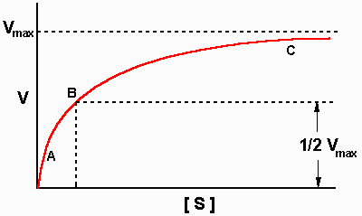
Determination of
kinetic constants
(Vmax and Km)
Inaccurate
Michaelis-Menten equation
Michaelis-Menten plot

Slide 4
Accurate
1- Lineweaver-Burk equation
v = Vmax [S] / (Km + [S])
1/v = (Km / Vmax [S]) + ([S] / Vmax [S])
= (Km / Vmax [S]) + (1 / Vmax)
1/v =(Km / Vmax)(1/[S]) + (1 / Vmax)
y= ax+b

Slide 5
Lineweaver-Burk plot
1/v
Slop = Km/Vmax
1/Vmax
-1/Km
1/ [S]

Slide 6
2- Eadie-Hofstee equation
v = Vmax [S] / (Km + [S])
v[S]+vkm= Vmax[S]
v+vkm/[S]=Vmax
v=Vmax- vkm/[S]
v= - km (v/[S]) + Vmax
y= ax+b

Slide 7
Eadie-Hofstee plot
Vmax
Slop = Km
v
v / [S]
Vmax/Km

Slide 8
3- Hanes equation
1/v =(Km / Vmax)(1/[S]) + (1 / Vmax)
[S]/v = (Km / Vmax) + [S]/Vmax
[S]/v = [S]/Vmax + (Km / Vmax)
[S]/v= (1/Vmax)[S] + (Km/Vmax)
y= ax+b

Slide 9
Hanes plot
[S]/v
Slop = 1/Vmax
Km/Vmax
-Km
[S]

Slide 10
The direct linear plot
Every pair of data points
Cornish-Bowden plot
v
Vmax
Km
[S]

