Slide 1
Microbial Enzymes
2nd Year Students
Microbiology/Chemistry
Prof. Dr. Mamdouh Nemat Alla

Slide 2
Microbial Enzymes
Lecture 8

Slide 3
Classification of Enzymes
depends on the reaction nature that catalyzes
6 groups
Hydrolases
Oxidoreductases
Lyases
Isomerases
Transferases
Ligases (Synthetases)

Slide 4
A- Carbohydrases
B- Esterases
1- Hydrolases
C- Amidases
D- Proteolytic enzymes
AB + H₂O AH + BOH

Slide 5
Glycosidases
Hydrolyze oligosaccharides
α-glucosidase (Maltase)
β-glucosidase
β-fructosidase (Invertase)
A- Carbohydrases
Polysaccharases
Hydrolyze polysaccharides
Amylase
Cellulase

Slide 6
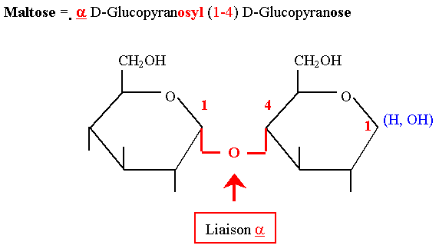
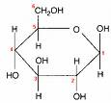
= α-glucosidase (Maltase)
Maltase
Maltose 2 glucose units
H₂O

Slide 7
= β-glucosidase
Emulsin (Amigdalase + Pronase + Mandilonitrilase)
Amigdalase
Amigdaline glucose + pronasine
H₂O
Pronase
pronasine glucose + mandilonitile
H₂O
Mandilonitrilase
mandilonitile benzaldehyde + HCN
H₂O

Slide 8
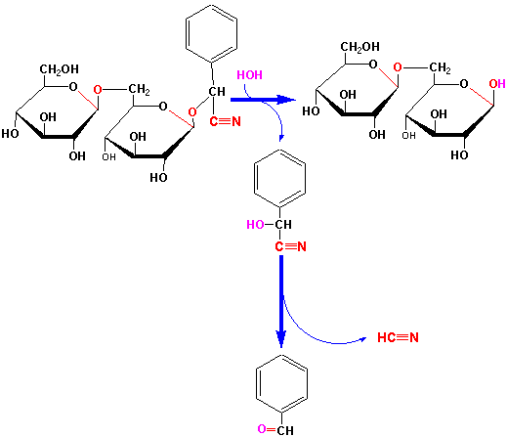

Slide 9
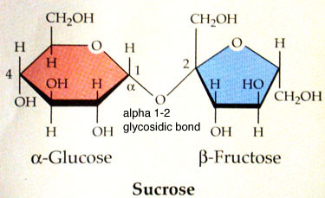

iii- β-fructosidase (Invertase)
Invertase
Sucrose glucose + fructose
H₂O

Slide 10
2- Polysaccharases
Hydrolyze polysaccharides into simple sugars
i.e. amylase, Cellulase, Cellobiase
Amylase hydrolyzes starch into maltose

Slide 11
2- Polysaccharases
Amylase hydrolyzes starch into maltose
amylose amylopectin

Slide 12
2- Polysaccharases
Amylase hydrolyzes starch into maltose
amylose amylopectin
α-amylase
(dextrinogenic amylase
endoamylase)
Q enzyme
α-amylase
Starch
α-dextrins
R enzyme
β-amylase
maltogenic amylase
saccharogenic amylase
exoamylase)
β-amylase
Starch
β-dextrins+ maltose
β-amylase
α-dextrins
maltose
R- and Q
Abnormal dextrins
α-dextrins

Slide 13
α-amylase
Starch α-dextrins
β-amylase
Starch β-dextrins + maltose
β-amylase
α-dextrins maltose
R- and Q
Abnormal dextrins α-dextrins

Slide 14
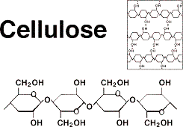
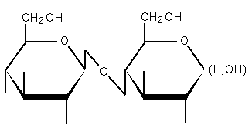
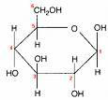
Cellulase and Cellobiase:
They hydrolyze Cellulose to simple Sugars.
Cellulose is composed of sugar units held together by β-1,4-Glucosidic Linkage.
Cellulase
n (C₁₂H₂₂O₁₁)
H₂O
Cellobiose
Cellobiase
H₂O

Slide 15
B- Esterases
(Lipases
Esterase
R–O-CO–R” + HOH ROH + HO–OC–R”
Ester Alcohol Acid
Triacyl Glycerol
Lipases
CH₂OOCR₁ CH₂OH
CHOOCR₂ CHOOCR₂ + R₁COOH
CH₂OOCR₃ CH₂OOCR₃
CH₂OH CH₂OH
CHOH +R₃COOH CHOH + R₂COOH
CH₂OH CH₂OOCR₃
H₂O
H₂O
Glycerol + 3 Fatty Acids
H₂O
H₂O

Slide 16
C- Amidases
(asparaginase, glutaminase, urease)
Asparaginase
Asparagine Aspartic Acid + NH₃
H₂O
Glutaminase
Glutamine Glutamic Acid + NH₃
H₂O
Urease
Urea CO₂+ NH₃
H₂O

Slide 17
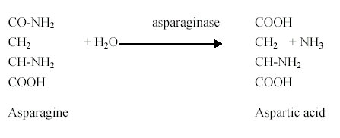
asparaginase

Slide 18
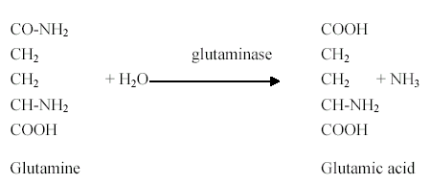
glutaminase

Slide 19

urease

Slide 20
D- Proteolytic enzymes
COOH–CH–NH---AAAAAAAAAAAAAAAAA---CO–CH–NH₂ R R
H₂O
Protease
peptidase
COOH–CH–NH–CO–CH–NH₂
R R
2 COOH–CH–NH₂
R
H₂O

Slide 21

2. Oxidoreductases
a- Oxidation state, electron
(Reductases)
b- Oxygen addition
(Oxidases,
Peroxidases,
Oxygenases)
c- Hydrogen transfer
(Dehydrogenases)

Slide 22
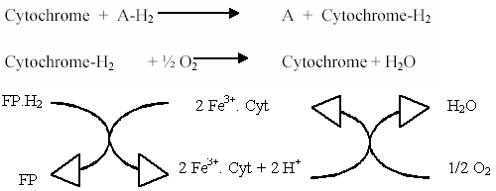
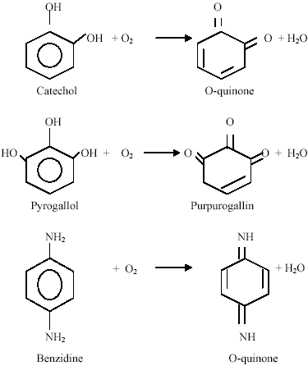
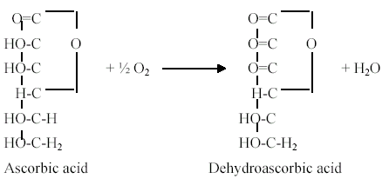
Oxidases

Slide 23
Peroxidases

Slide 24
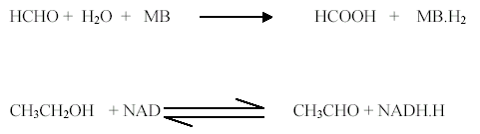
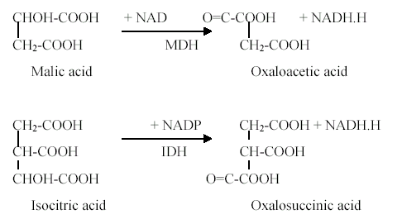
Dehydrogenases

Slide 25
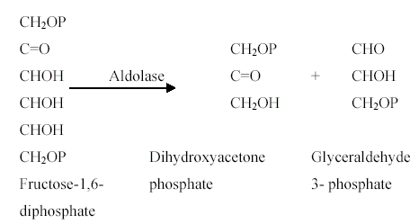
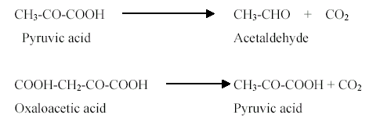
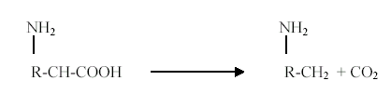
3. Lyases
A + B
A + B
Aldolase,
Carboxylase,
AA carboxylase
Ammonia lyase , Aspartase
Carbonic anhydrase,
Hydratase, aconitase, fumarase
C
C + D

Slide 26



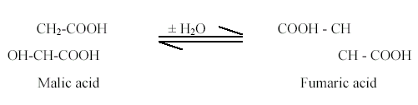
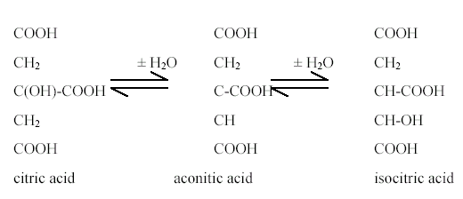
3. Lyases
A + B
A + B
Aldolase,
Carboxylase,
AA carboxylase
Ammonia lyase , Aspartase
Carbonic anhydrase,
Hydratase, aconitase, fumarase
C
C + D

