Slide 1
Microbial Enzymes
2nd Year Students
Microbiology/Chemistry
Prof. Dr. Mamdouh Nemat Alla

Slide 2
Microbial Enzymes
Lecture 9

Slide 3
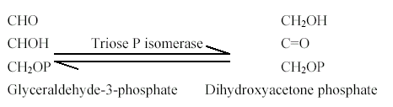
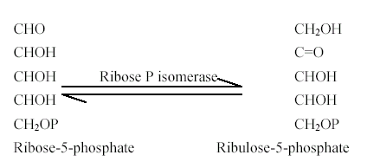
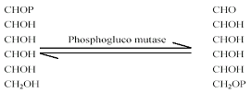
4. Isomerases
Rearrangement
a- Isomerization
(Isomerases)
b- Epimerization
(Epimerases)
c- mutation
(Mutases)

Slide 4

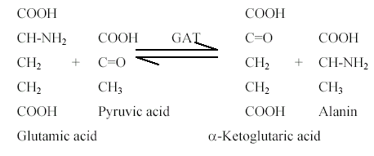
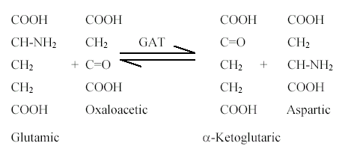
5. Transferases
transfer a group
Transaminases,
Adenylate Kinase,
Sucrose transglucosylase,
Starch transglucosylase
Methyl transferase
Acetyl transferase

Slide 5
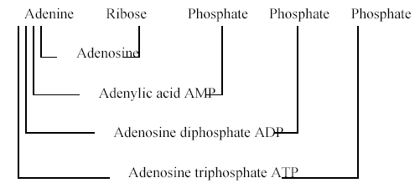
5. Transferases
transfer a group
Transaminases,
Adenylate Kinase,
Sucrose transglucosylase,
Starch transglucosylase
Methyl transferase
Acetyl transferase

Slide 6
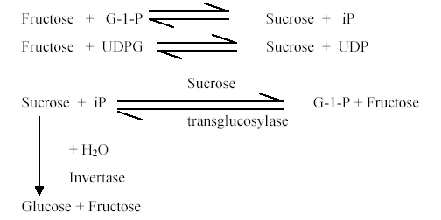

5. Transferases
transfer a group
Transaminases,
Adenylate Kinase,
Sucrose transglucosylase,
Starch transglucosylase
Methyl transferase
Acetyl transferase

Slide 7

5. Transferases
transfer a group
Transaminases,
Adenylate Kinase,
Sucrose transglucosylase,
Starch transglucosylase
Methyl transferase
Acetyl transferase

Slide 8

6. Ligases (Synthetases)
Activate synthesis on the expense of ATP consumption.
Glutamine synthetase, GS
Asparagine synthetase, AS
Acetyl Coenzyme A synthetase (Acetothiokinase)

Slide 9
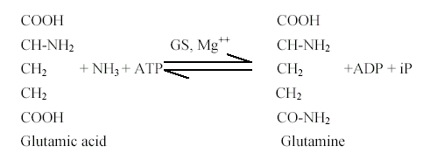
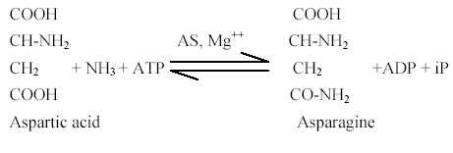

6. Ligases (Synthetases)

Slide 10
Extracellular microbial enzymes
Microorganisms have the ability to produce the extracellular enzymes that are needed for the bioremediation of organic waste, known as heterotrophic organisms.
The decomposition process of the organic material consists of various types of microorganisms such as proteolytic, cellulolytic, amylolytic, nitrification and denitrification.

Slide 11
Extracellular microbial enzymes
Heterotrophic microorganisms utilize ammonia as an energy source for cell regeneration and use organic compounds such as acetate, pyruvate and oxaloacetate as a carbon source in pond water.
Proteins, carbohydrates, and fats are the main components of the feed and have a large percentage of feed formulation.

Slide 12
Extracellular microbial enzymes
Remover microorganisms of organic material are a biological activator that grows naturally or is intentionally given to accelerate the transformation of organic matter. Heterotrophic bacteria participate in energy transformation which can be utilized by cultivated organisms. Heterotrophic microorganisms can be obtained by a series of nutrient hydrolysis tests using media mixed with protein, starch, and cellulose.

Slide 13
Extracellular microbial enzymes
Heterotrophic microorganisms had the ability to produce proteolytic, amylolytic and cellulolytic extracellular enzymes
Biologically active enzymes may be extracted from any living organism. A very wide range of sources are used for commercial enzyme production from Actinoplanes to Zymomonas, from spinach to snake venom.

Slide 14
Extracellular microbial enzymes
Of the hundred or so enzymes being used industrially, over a half are from fungi and yeast and over a third are from bacteria with the remainder divided between animal (8%) and plant (4%) sources
A very much larger number of enzymes find use in chemical analysis and clinical diagnosis. Non-microbial sources provide a larger proportion of these, at the present time.

Slide 15
Extracellular microbial enzymes
Microbes are preferred to plants and animals as sources of enzymes because:
1. they are generally cheaper to produce.
2. their enzyme contents are more predictable and controllable,
3. reliable supplies of raw material of constant composition are more easily arranged, and

Slide 16
Extracellular microbial enzymes
4. plant and animal tissues contain more potentially harmful materials than microbes, including phenolic compounds (from plants), endogenous enzyme inhibitors and proteases.
In practice, the great majority of microbial enzymes come from a very limited number of genera, of which Aspergillus species, Bacillus species and Kluyveromyces (also called Saccharomyces) species predominate.

Slide 17
Extracellular microbial enzymes
Most of the strains used have either been employed by the food industry for many years or have been derived from such strains by mutation and selection.
There are very few examples of the industrial use of enzymes having been developed for one task.
Shining examples of such developments are the production of high fructose syrup using glucose isomerase and the use of pullulanase in starch hydrolysis.

Slide 18
Extracellular microbial enzymes
Producers will aim to use strains of microbe that are known to be generally safe.
Users will pay little regard to the way in which the enzyme is produced but will insist on having preparations that have a known activity and keep that activity for extended periods, stored at room temperature or with routine refrigeration.

Slide 19
Extracellular microbial enzymes
They will pay little attention to the purity of the enzyme preparation provided that it does not contain materials (enzymes or not) that interfere with their process.
Both producers and users will wish to have the enzymes in forms that present minimal hazard to those handling them or consuming their product.

Slide 20
Extracellular microbial enzymes
The development of commercial enzymes is a specialized business which is usually undertaken by a handful of companies which have high skills in
1. screening for new and improved enzymes,
2. fermentation for enzyme production,
3. large scale enzyme purifications,
4. formulation of enzymes for sale,
5. customer liaison, and
6. dealing with the regulatory authorities.

