Slide 1
Damietta Faculty of science Fourth Year English 1st lecture- March 2020
Dr. Engy Salah

Slide 2
What’s meant by a high frequency wave and a low frequency wave? What are the parts of guitar? How does a guitar work?
Music to Your Ears

Slide 3
Chord(kord) noun. A combination of musical notes played at the same time. Frequency(free-kwuhn-see) noun. The number of sound waves created in one second. Fret(fret) noun. A ridge on the neck of a guitar. Interpret(in-tur-prit) verb. To understand or fi gure out. Melody(mel-uh-dee) noun. A series of notes. Sound wave(sound WAVE) noun. A series of vibrations that can be heard. Vibrate (vye-brate) verb. To move back and forth quickly.
Vocabulary

Slide 4
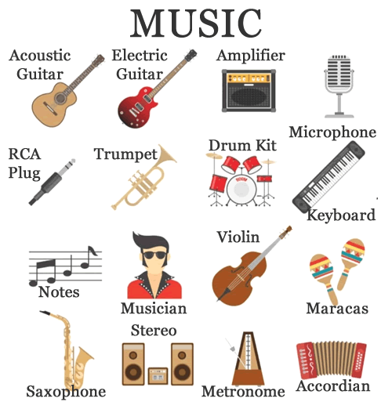
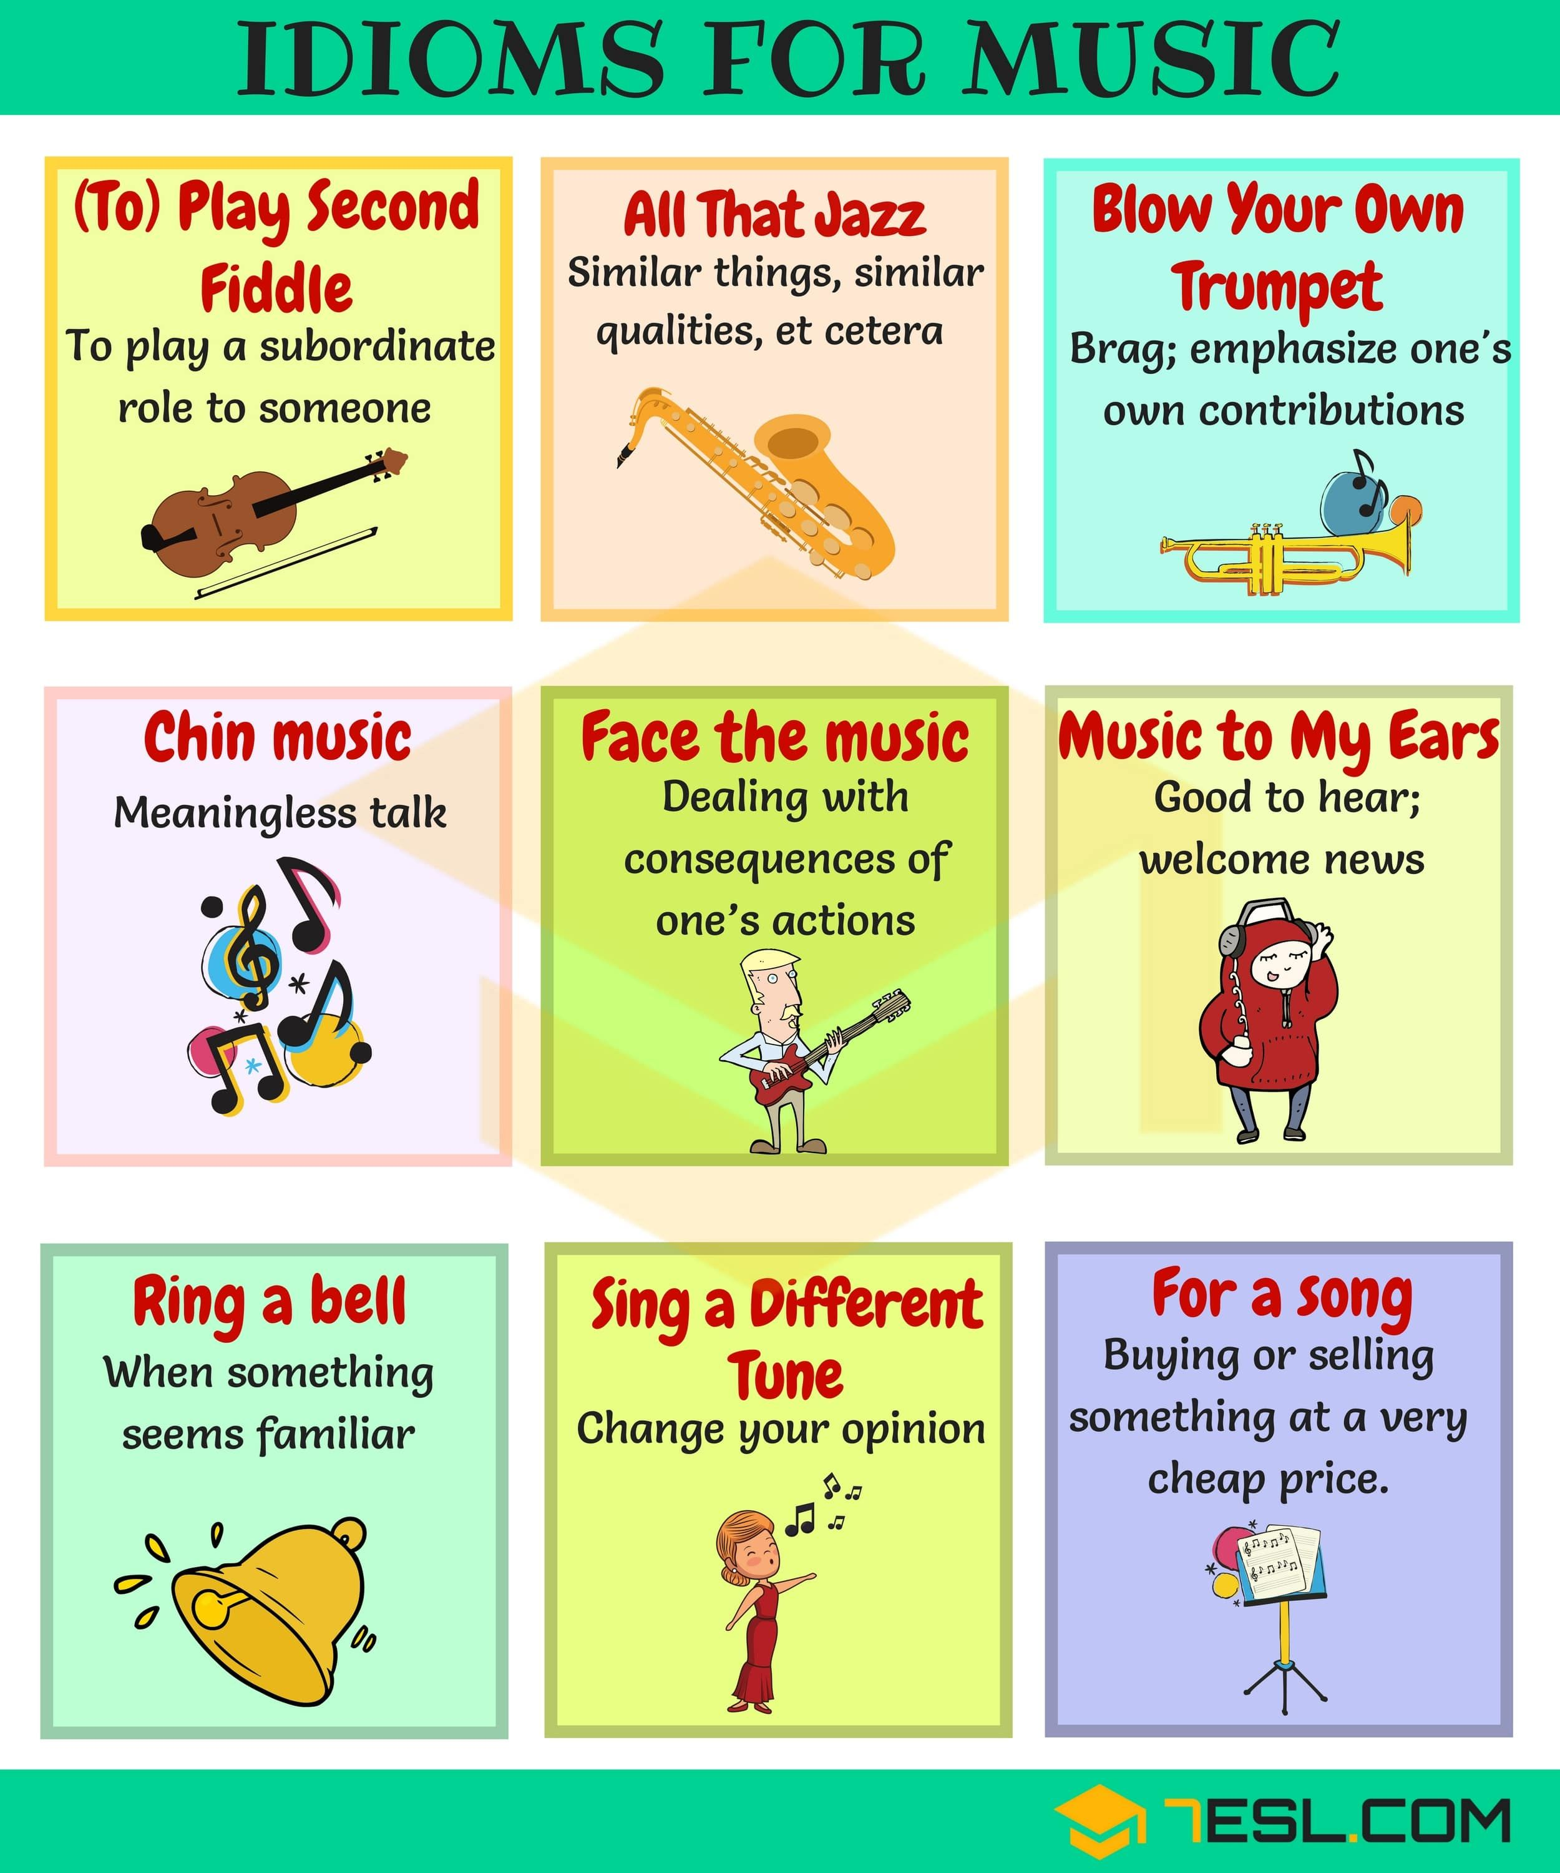
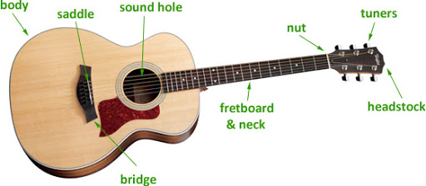
Vocabulary and Idioms:

Slide 5
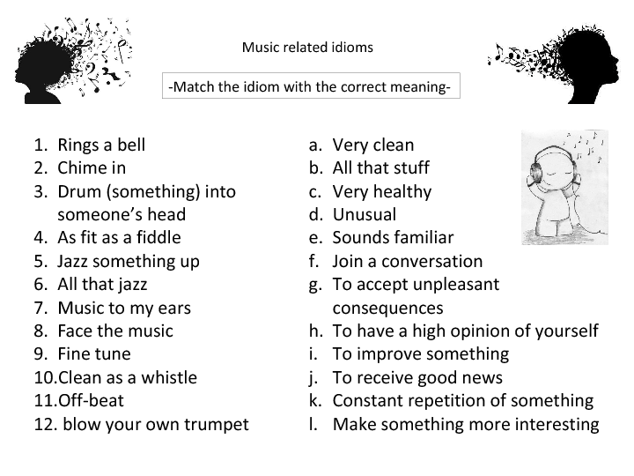
Quizz

Slide 6
If Conditionals

Slide 7
1- What creates a sound? 2- what is the frequency of a sound? 3-what kind of pitch does a sound with a low frequency creates? 4-what does a sound box do?
Questions:

Slide 8
1- What is the passage about? 2- What is the relation between the picture and the topic?
II- Not Just a Dirt

Slide 9
Language Functions and Vocabulary

Slide 10
1. Small pieces 2. Soil that can hold a lot of water 3. To get smaller 4. Wearing away 5. Rich, productive 6. Soil that can hold little water 7. The “hotness” or “coldness” of something 8. To get bigger 9. To dig a hole in the ground
QUIZZ
Write words that mean:

Slide 11
Write a paragraph on
Earthworms

Slide 12
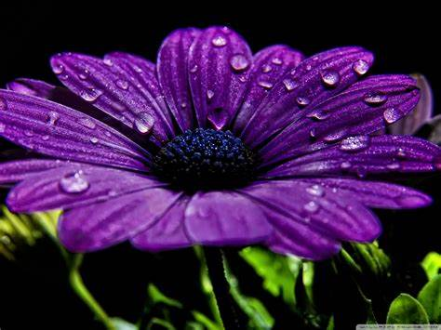
Thank You … Stay Safe
Dr. Engy Salah

