Slide 1
Damietta Faculty of science Fourth Year English 2nd lecture- March 2020
Dr. Engy Salah

Slide 2
Make Your Backyard a Better Habitat for Birds
Describe the picture.
Is there any relation between the topic and the picture?

Slide 3
Vocabulary
Cedar: A cedar is an evergreen tree with a particularly fragrant wood. ... Cedars are probably best known for the strong, appealing scent of their wood, which is often used to line storage chests or closets, both for the smell and its tendency to repel moths. The Greek root of cedar is kedros.
Shrub: A shrub is a short, tree-like plant with many stems or branches. ... Shrubs are similar to trees with two exceptions: they are shorter and have more individual stems, rather than a wide, thick trunk. Some plants, like a hazelnut, can grow into either a shrub or a tree. You can also call a shrub a bush.
Patio: is an outdoor space generally used for dining or recreation that adjoins a residence and is typically paved.
Birdbath: is an artificial puddle or small shallow pond, created with a water-filled basin, in which birds may drink, bathe, and cool themselves. ... Bird baths that provide a reliable source of water year round add to the popularity and "micro-habitat" support.
Foliage: refers to leaves — either individual leaves or the collective leafy canopy of many trees or plants.

Slide 4
Some trees and their names

Slide 5
Some birds and their names

Slide 6
Language Functions- Types of sentences:

Slide 7
Questions:
1.What is a habitat?
2. What are the four important things that a good habitat must supply?
3. What do hummingbirds eat?
4. Why shouldn’t birdbaths and bird feeders be placed on the ground?
5. Why is it important to keep hummingbird feeders clean?

Slide 8
James B. Eads and His Famous Bridge
Describe the picture.
Is there any relation between the topic and the picture?

Slide 9
Vocabulary:
steel
vessel
cargo
foremost
arches
Hose
To name… after
Figure out:

Slide 10
Vocabulary: Means of transport

Slide 11
Vocabulary: Engineer

Slide 12
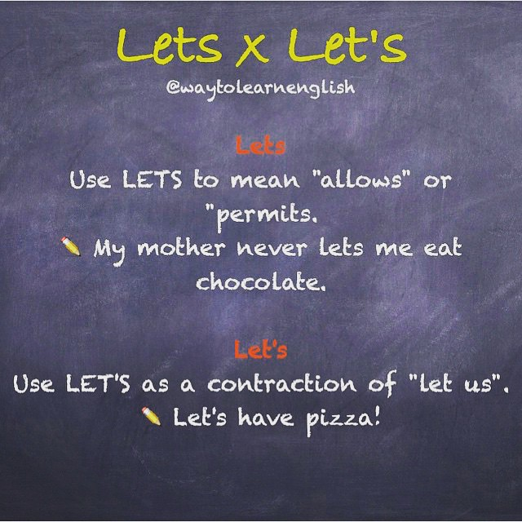
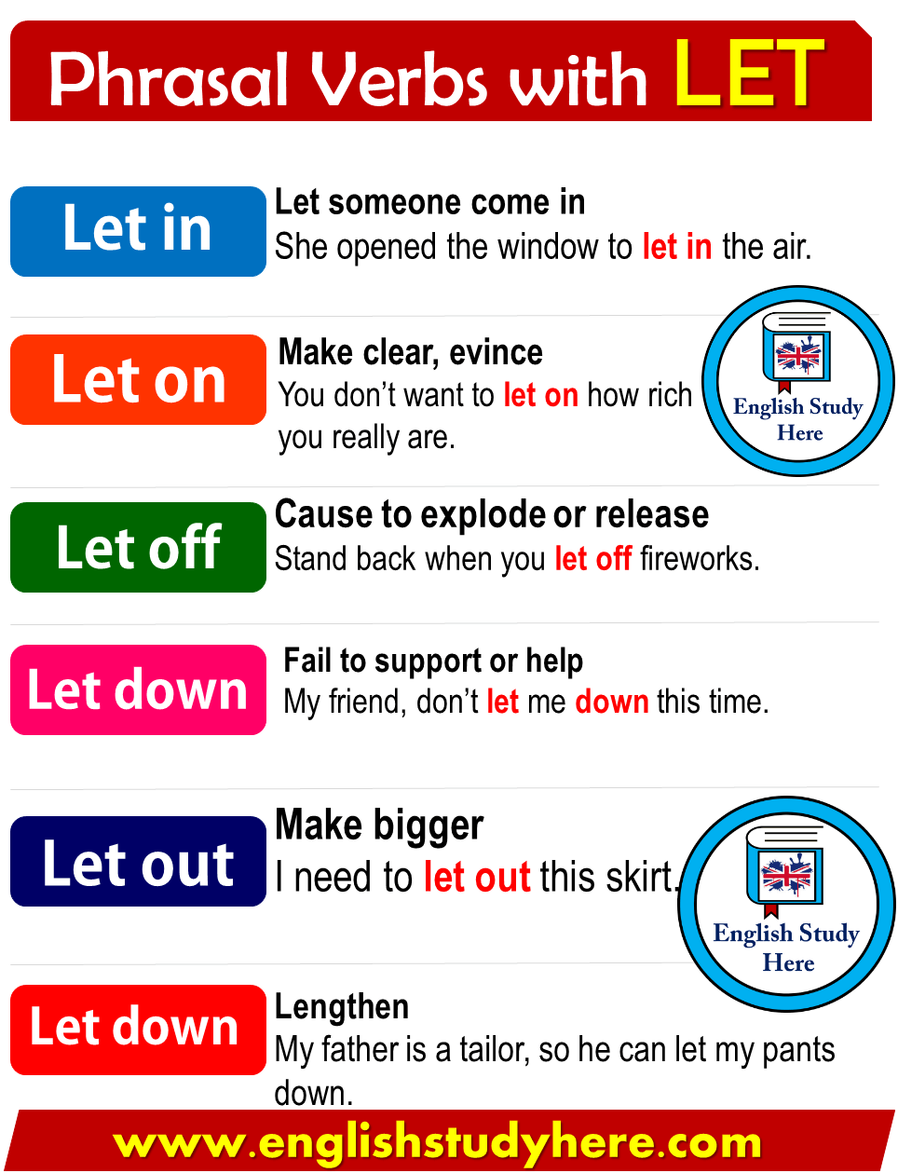
Language Functions: Let

Slide 13
Questions on the passage:
Complete:
1. When James was young, he got a job working in a …
2. James realized that there were valuable things …
3. James invented ironclad boats to help the United States win …
4. In 1867 the people decided to build a bridge across the Mississippi River …
5. The bridge was made of steel because steel is …

Slide 14
Writing:
Write a paragraph on :
Bridges

Slide 15
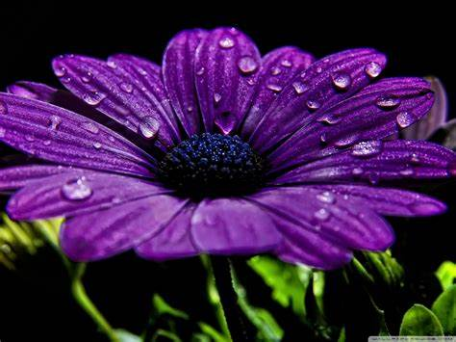
Thank You … Keep Safe
Dr. Engy Salah

