Slide 1
Soil Microorganisms in Cycling of Elements or Plant Nutrient
Soil microorganisms are the most important agents in the transformation of various elements (N, P, K, S, Iron etc.)
in the biosphere; where the essential elements undergo cyclic alterations between the inorganic state as free elements in nature and the combined state in living organisms.
Life on earth is dependent on the cycling of nutrient elements from their elemental states to inorganic compounds to organic compounds and back into their elemental states

Slide 2
The microbes through the process of biochemical reactions convert complex organic compounds into simple inorganic compounds and finally into their constituent elements. This process is known as "Mineralization".
Mineralization of organic carbon, nitrogen, phosphorus, sulphur and iron by soil microorganisms makes these elements available for reuse by plants.
In the following paragraphs the cycling of some of the important elements are discussed.

Slide 3
Nitrogen Cycle
Although molecular nitrogen (N₂) is abundant (i.e. 78-80 % by volume) in the earth's atmosphere, but it is chemically inert and therefore, can not be utilized by most living organisms and plants.
Plants, animals and most microorganisms, depend - on a source of combined or fixed nitrogen (e.g. ammonia, nitrate) or organic nitrogen compounds for their nutrition and growth.

Slide 4
Plants require fixed nitrogen (ammonia, nitrate) provided by microorganisms, but about 95 to 98 % soil nitrogen is in organic form (unavailable) which restrict the development of living organisms including plants and microorganisms.
Therefore, transformation of nitrogen and nitrogenous compounds mediated by soil microorganisms is of paramount importance in supplying required forms of nitrogen to the plants and various nutritional classes of organisms in the biosphere
In nature, nitrogen exists in three different forms viz. gaseous / gas (78 to 80 % in atmosphere), organic (proteins and amino acids, chitins, nucleic acids and amino sugars) and inorganic (ammonia and nitrates).

Slide 5
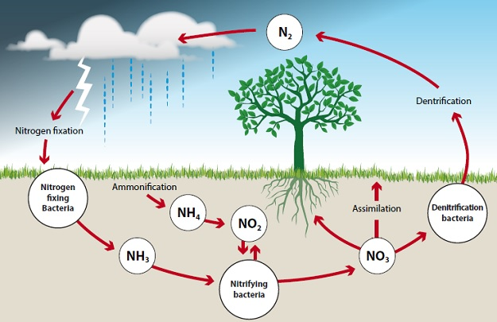

Slide 6
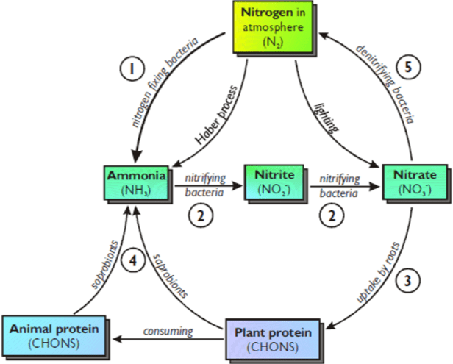

Slide 7
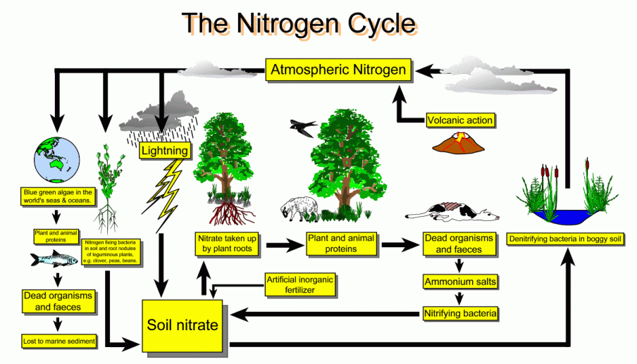

Slide 8
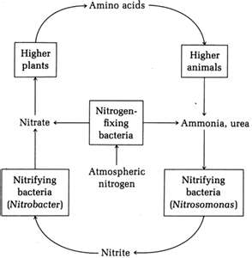
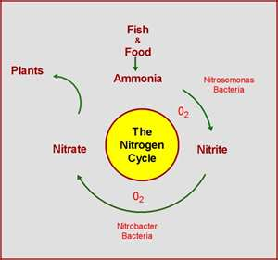
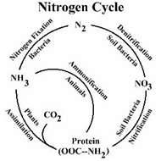

Slide 9
Biological N₂ Fixation
Symbiotic
B. Non Symbiotic
e.g. Rhizobium (Eubacteria) legumes, Frankia (Actinomycete) and Anabaena (cyanobacteria) non - legumes
Free Living: e.g. Azotobacter, Derxia, Beijerinckia, Rhodospirillum and BGA.
Associative: e.g. Azospirillum, Acetobacter, Herbaspirillim.
Nutritional categories of N₂ fixing Bacteria
A- Heterotrophs / B- Photoautotrophs

Slide 10
Nitrogen cycle is the sequence of biochemical changes form free atmospheric N₂ to complex organic compounds in plant and animal tissues and further to simple inorganic compounds (ammonia, nitrate) and eventual release of molecular nitrogen (N₂) back to the atmosphere is called "nitrogen cycle".
In this cycle a part of atmospheric nitrogen (N₂) is converted into ammonia and then to amino acids (by soil microorganisms and plant-microbe associations) which are used for the biosynthesis of complex nitrogen-containing organic compound such as proteins, nucleic acids, amino sugars etc.
The proteins are then degraded to simpler organic compounds viz. peptones and peptides into amino acids which are further degraded to inorganic nitrogen compounds like ammonia, nitrites and nitrates.

Slide 11
The nitrate form of nitrogen is mostly used by plants or may be lost through leaching or reduced to gaseous nitrogen and subsequently goes into the atmosphere, thus completing the nitrogen cycle.
Thus, the process of mineralization (conversion of organic form of nutrients to its mineral /inorganic form) and immobilization (process of conversion of mineral / inorganic form of nutrient elements into organic form) are continuously and simultaneously going on in the soil.

Slide 12
Nitrogen Cycle: Proteolysis & Ammonification
Several biochemical steps involved in the nitrogen cycle
1. Proteolysis
2. Ammonification
3. Nitrification
4. Nitrate reduction
and 5. Denitrification.

Slide 13
1. Proteolysis
Plants use the ammonia produced by symbiotic and non-symbiotic nitrogen fixation to make their amino acids & eventually plant proteins. Animals eat the plants and convert plant proteins into animal proteins.
Upon death, plant and animals undergo microbial decay in the soil and the nitrogen contained in their proteins is released. Thus, the process of enzymatic breakdown of proteins by the microorganisms with the help of proteolysis enzymes is known as “proteolysis"

Slide 14
The breakdown of proteins is completed in two stages
Proteins Peptides Amino Acids Proteinases Peptidases
The amino acids produced may be utilized by other microorganisms for the synthesis of cellular components, absorbed by the plants through mycorrhiza or may be de animated to yield ammonia

Slide 15
The most active microorganisms responsible for elaborating the proteolytic enzymes (Proteinases and Peptidases) are Pseudomonas, Bacillus, Proteus, Clostridium, Micrococcus, Alternaria, Penicillium etc
2. Ammonification (Amino acid degradation)
Amino acids released during proteolysis undergo deamination in which nitrogen containing amino (-NH₂) group is removed. Thus, process of deamination which leads to the production of ammonia is termed as "ammonification".

Slide 16
ammonification is mediated by several soil microorganisms.
Ammonification usually occurs under aerobic conditions (known as oxidative deamination) with the liberation of ammonia (NH₃) or ammonium ions (NH₄) which are either released to the atmosphere or utilized by plants ( paddy) and microorganisms or still under favorable soil conditions oxidized to form nitrites and then to nitrates.
The processes of ammonification are commonly brought about by Clostridium sp., Micrococcus sp., Proteus sp. etc. and it is represented as follows
CH₃ CHNH₂ COOH + 1/2 O₂ C H₃COCOOH + NH₃ Alanine deaminase Pyruvic acid ammonia

Slide 17
