Slide 1
Kinds of Epistatic Interactions
In epistasis less than four phenotypes appear in F2.
(і) Dominant Epistasis. (12:3:1)
(ii) Recessive epistasis.(9:3:4)(Supplementary interaction)
(iii) Duplicate Recessive Genes (9:7) (Complementary Genes)
(iv) Duplicate Dominant Genes. (15:1)
(v) Duplicate Genes with Cumulative Effect (9:6:1)
(vi) Dominant Recessive Interaction (13:3)

Slide 2
Dominant Epistasis. (12:3:1)
 Dominant allele (eg.,A) of one gene hides the effect of allele of another gene (eg., B) and expresses itself phenotypically.
 The B allele (hypostatic) will be expressed only when gene locus A contains two recessive (aa) alleles.
 Thus, the genotype AA BB or Aa Bb and AA bb or Aa bb produce the same phenotype
 genotype aa BB or aa Bb and aa bb produce two additional phenotype.
 This type of dominant epistasis modifies the classical ratio of 9:3:3:1 into 12:3:1

Slide 3
Epistatic alleles | Hypostatic alleles | Phenotypic Expression
aa | bb | b
aa | BB, Bb | B
AA, Aa | Bb, Bb, bb | A

Slide 4
Example:
Studied in summer squash (Cucurbita pepo)
Common fruit colors- white,yellow and green, White (W) is dominant over colored squash. Yellow (Y) is dominant over green squash
Pure breeding white fruited variety is crossed with the double recessive green variety,F1 hybrids are all white
When the hybrids are selfed, white, yellow and green fruited plants arise in the ratio of 12:3:1

Slide 5
The effect of dominant gene ’Y’ is masked by the dominant gene ’W’ (epistatic gene)
❖ P WWYY X wwyy
(white) ↓ (green)
❖ F1 WwYy
P (white) (selfed)
❖ F2
White:Yellow:Green
❖ 12 : 3 : 1
♂/♀ | WY | Wy | wY | wy
WY | WWYY | WWYy | WwYY | WwYy
Wy | WWYy | WWyy | WwYy | Wwyy
wY | WwYY | WwYy | wwYY | wwYy
wy | WwYy | Wwyy | wwYy | wwyy

Slide 6
Recessive epistasis. (9:3:4)
(Supplementary interaction
Recessive allele (aa) of one gene locus hides the
effect of another gene locus (BB, Bb or bb) and
expresses itself phenotypically.
The alleles of B locus express themselves only
when epistatic locus has dominant alleles (eg., AA
or Aa).
This will modify the ratio 9:3:3:1 to ratio 9:3:4

Slide 7
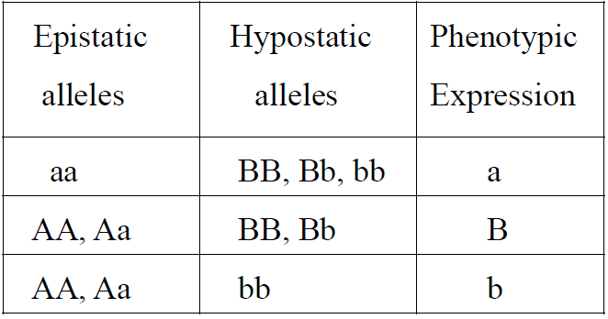

Slide 8
Example
 In horses, brown coat color (B) is dominant over
tan (b).
 However, how that gene is expressed in the
phenotype is dependent on a second gene that
controls the deposition of pigment in hair.
 The dominant gene (C) codes for the presence of pigment in hair, whereas the recessive gene (c)
codes for the absence of pigment.

Slide 9
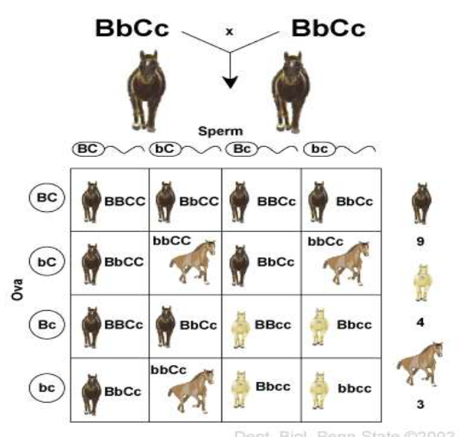

Slide 10
Duplicate Recessive Genes (9:7)
(Complementary Genes)
 Both the genes loci have homozygous recessive alleles and both of them produce identical phenotype.
 Both dominant alleles are necessary to produce a different phenotype. e.g.: AABB, AaBB, AaBb, in all these combinations.
 Both the dominant alleles (A and B) are present and they will produce a different phenotype.
 Whereas aaBB or bbAA, in which the other dominant allele is absent, produces the normal phenotype.

Slide 11
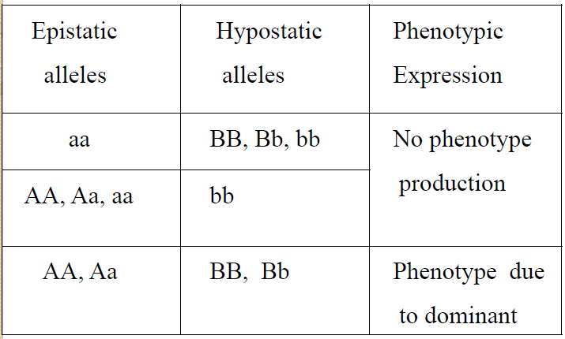

Slide 12
 Bateson and Punnett observed that when two white flowered varieties of sweet pea, Lathyrus odoratus were crossed, F1 progeny had coloured flowers. When F1 was selfed, the F2 ratio showed the presence of both coloured and white flowered varieties in the ratio 9:7.
 In man, deaf mutism is complementary gene dependent, depending upon two dominant genes A and B, the presence of both of them is responsible for normal hearing and speech.

Slide 13
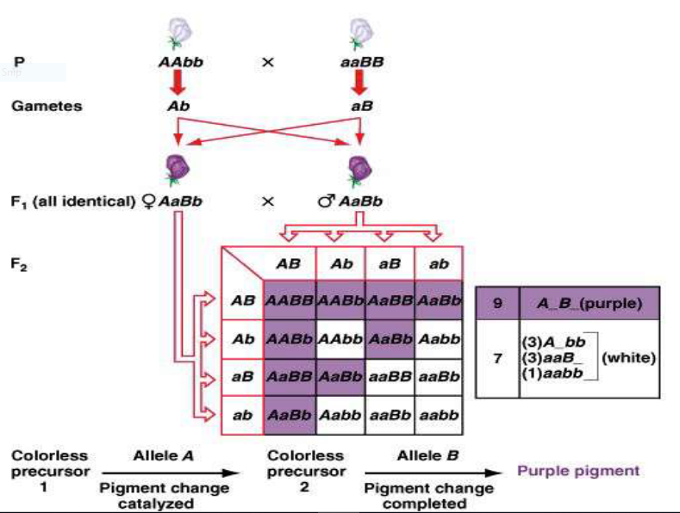

Slide 14
 In this case dominant alleles on both locus are required hence wherever A and B both are present they result into purple effect masking the white.
 This is because A and B alleles modified the colorless precursor by showing their effects

Slide 15
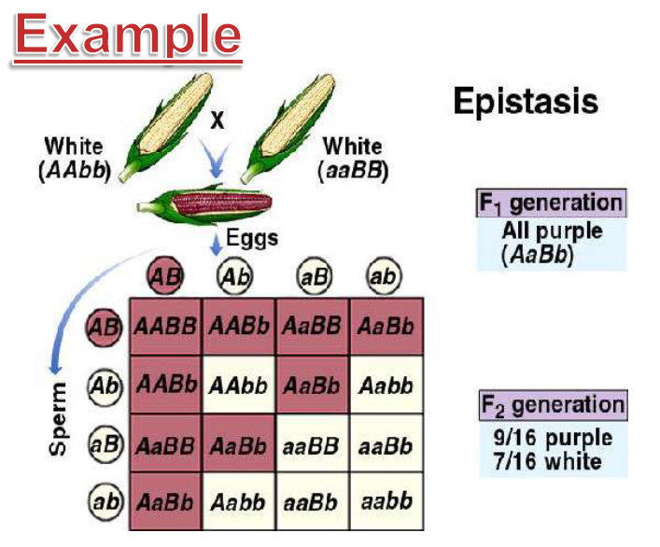

Slide 16
 The purple pigment in corn requires that two enzymes (controlled by two dominant alleles) must be active for the pigment to form.
 Two white varieties of corn showing the genotypes AAbb and aaBB, will produce a ratio of 9/16 purple and 7/16 white ears, depending upon the nine different possible arrangements of the chromosomes (and alleles) for these characteristics.

Slide 17
Duplicate Dominant Genes. (15:1)
 The dominant alleles of both the genes produce the same
phenotypic effect giving the ratio 15:1.
 At least one of the dominant allele is necessary for the
phenotypic effect. e.g. AABB, AaBb, Aabb, aaBB, aaBbgive one phenotype.
 In the absence of all the dominant genes (only in case of aabb), the recessive phenotype will be expressed.
 The duplicate genes are also called pseudoalleles

Slide 18
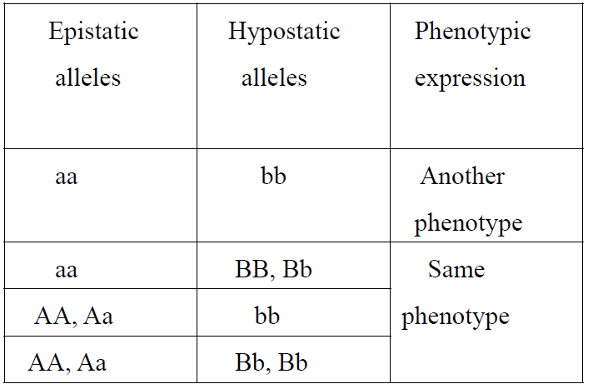

Slide 19
 As observed by G.H.Shull, the seed capsules of Shepherd’s purse (genus Capsella) occur in two different shapes,
➢ i.e. triangular and top shaped.
➢ When F1 individuals were self crossed, the F2 generation showed plants with triangular and top shaped capsules in the ratio 15:1
➢ (A and B) would produce plants with triangular-shaped
capsules.
➢ aabb would produce plants with top shaped capsules.F2
phenotypic ratio 15(triangular) 1(Top shaped).

Slide 20
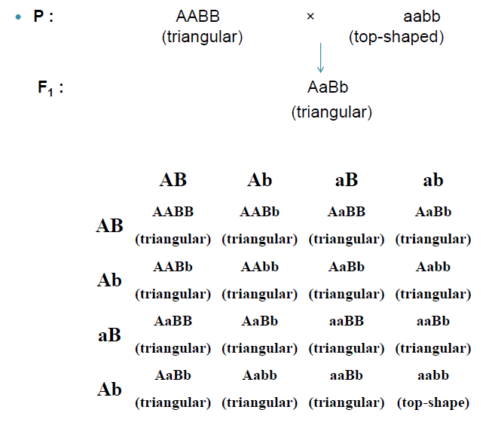

Slide 21
Duplicate Genes with
Cumulative Effect. (9:6:1)
 Both the dominant non allelic alleles, when present together, give a new phenotype, but when allowed to express independently, they give their own phenotypic expression separately.
 In the absence of any dominant allele, the recessive allele is expressed.

Slide 22
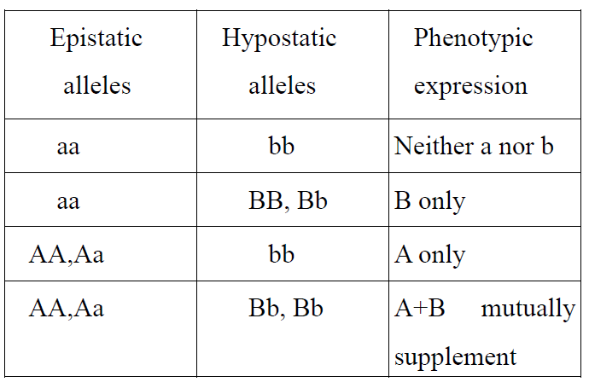

Slide 23
Example
 In pigs S and s are allelic genes;
➢ S giving sandy colour
➢ ss giving white colour.
➢ A non-allelic gene R also gives sandy colour (same as S) but when both the dominant genes interact together, they give red colour.
➢ Non-allelic gene does not interact with ss

Slide 24
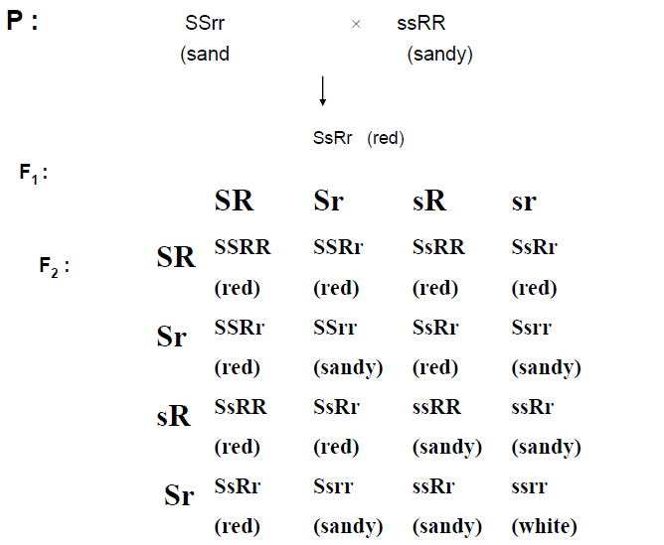

Slide 25
Dominant Recessive Interaction (13:3)
 The dominant allele (A), either in homozygous or heterozygous condition, of one gene and the homozygous recessive allele (bb) of other gene produces the same phenotype.
 In F2 generation, progenies having A (homozygous or heterozygous) or bb (homozygous) will not allow the C gene to be expressed.
 Genotype AABB, AABb, AaBb and Aabb produce same phenotype and the genotype aaBB, aaBb and aabb produce another but same phenotype.

Slide 26
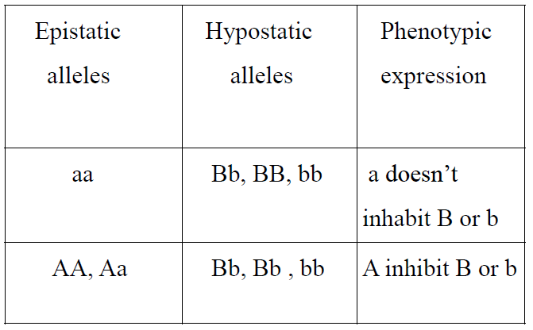

Slide 27
 In Leghorn fowl, the white colour of feather is formed by CCII (due to the presence of epistatic gene I).
 Similarly in Plymouth Rock fowl the white colour of feather is formed by ccii (due to the absence of dominant C gene).
 Therefore C is suppressed by inhibitor gene both in dominant (I) and recessive (ii) condition.

Slide 28
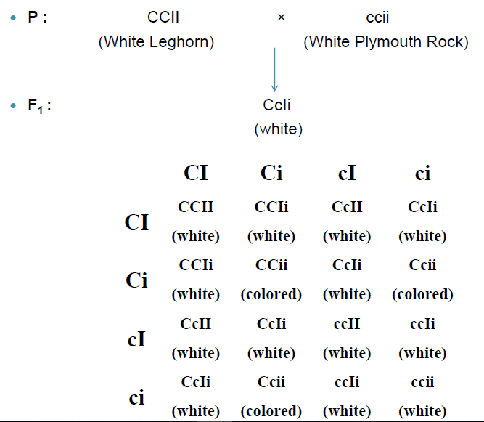

Slide 29
Example
❑ Interaction involves an inhibitory factor which by itself has no phenotypic effect
❑ But, when present in the dominant form prevents or inhibits the expression of another dominant gene
❑ eg :.Malvidin in primula flowers
Malvidin is a O-Methylated anthocyanin responsible for the blue pigments in Primula polyanthus plant
Synthesis of malvidin (blue) is controlled by gene K

Slide 30
In recessive state(k), malvidin is not synthesized
Production is suppressed by gene D, found at completely different locus
D allele is dominant to K allele

Slide 31
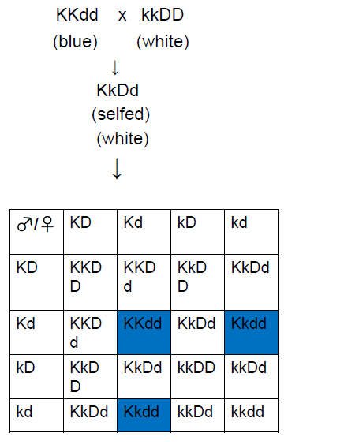

Slide 32
KkDd genotype will not produce malvidin due to the presence of D allele
Thus, white & blue colored flowers producing plants are obtained in the ratio of 13:3
Also known as dominant

Slide 33
